Slide 1
冒險故事
(Vtube Studio)

Slide 2
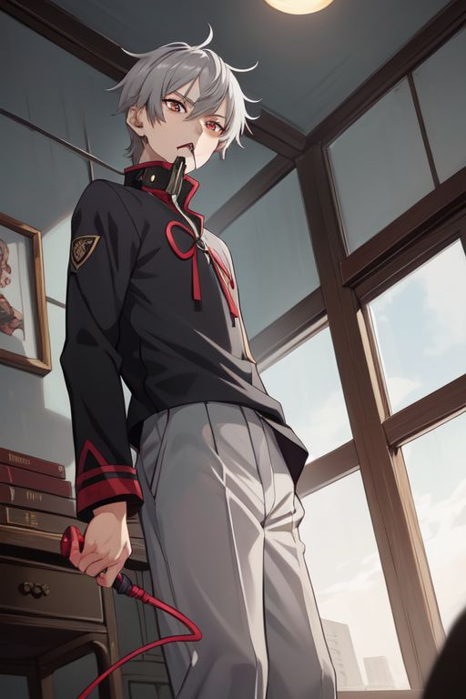
Notes:
Description: a boy, gray hair, red eyes, gray men's student uniform, high collar, whip, mouth, angry
Anti-Description: tie, bow tie, red clothing

Slide 3
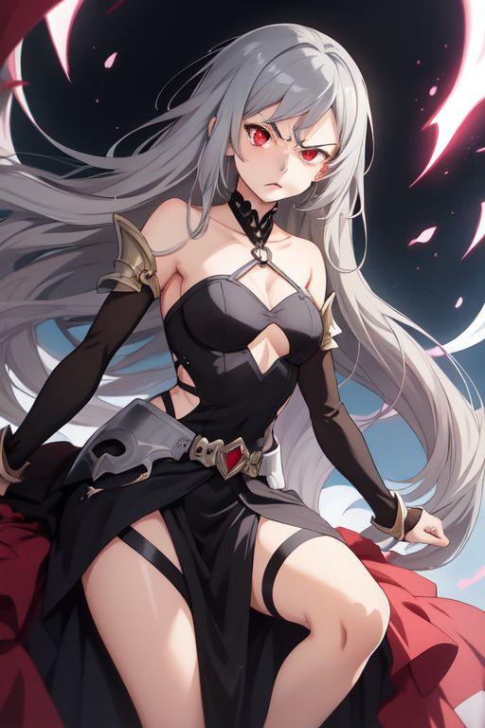
Notes:
Description: a girl, gray hair, red eyes, black dress, despise
Anti-Description: tie, bow tie, red clothing

Slide 4
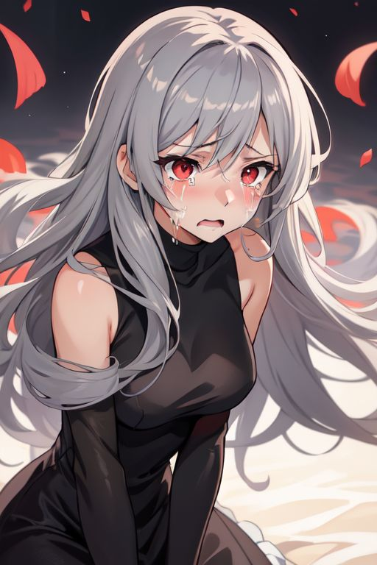
Notes:
Description: a girl, gray hair, red eyes, crying
Anti-Description: tie, bow tie, red clothing

Slide 5
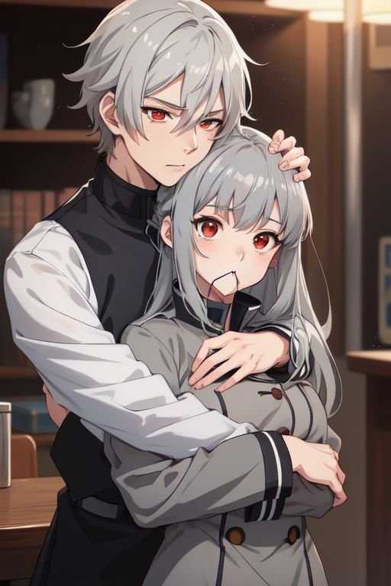
Notes:
Description: a boy, gray hair, red eyes, gray men's student uniform, high collar, hug a girl, mouth
Anti-Description: tie, bow tie, red clothing

Slide 6
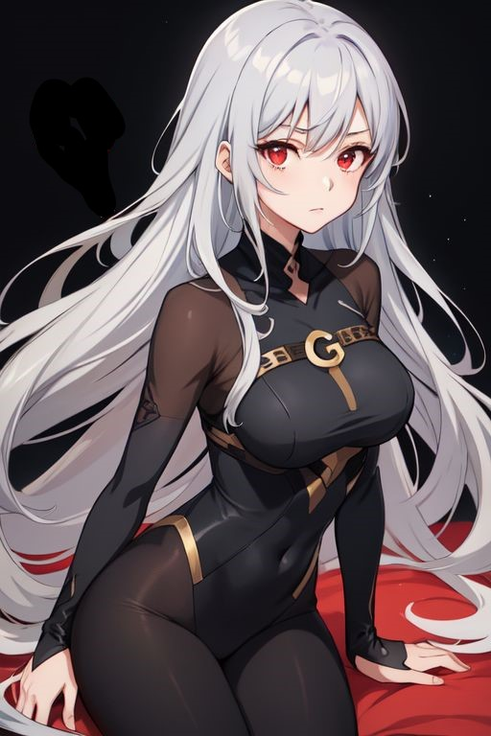

Slide 7


Slide 9
Notes:
Description: a girl, gray hair, red eyes, question mark
Anti-Description: tie, bow tie, red clothing

Slide 10
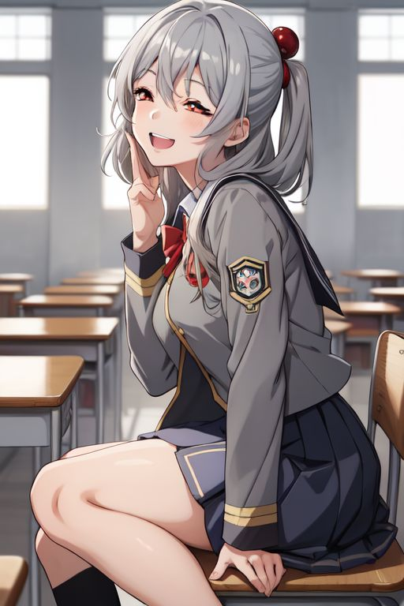
Notes:
Description: a girl, gray hair, red eyes, gray student uniform
Anti-Description: tie, bow tie, red clothing

Slide 11
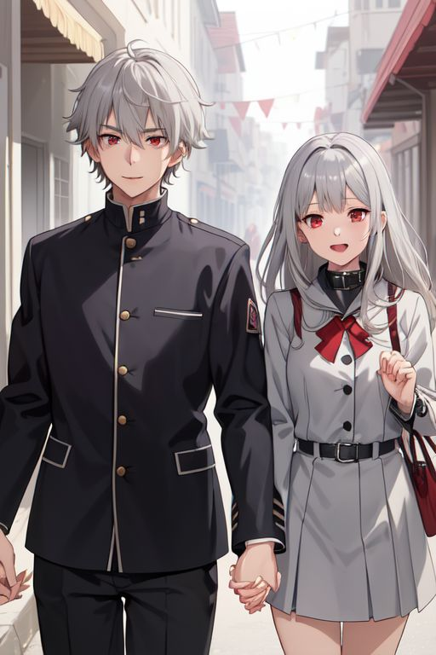
Notes:
Description: a boy, gray hair, red eyes, gray men's student uniform, high collar, a girl, hold the hand
Anti-Description: tie, bow tie, red clothing

Slide 12

Notes:
Description: a boy, gray hair, red eyes, gray men's student uniform, high collar, happy, jump
Anti-Description: tie, bow tie, red clothing

Slide 13
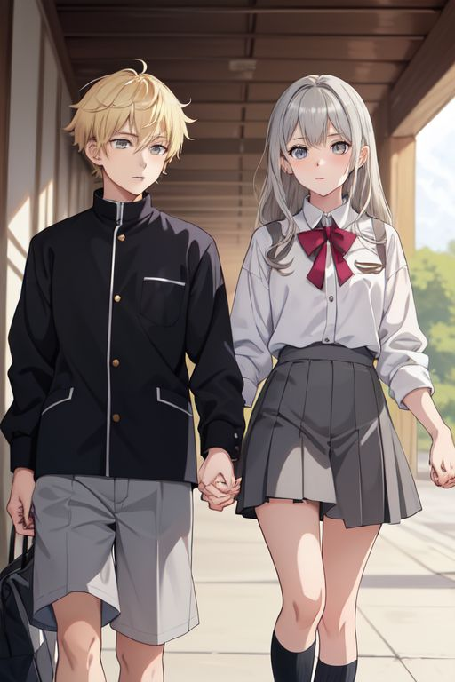
Notes:
Description: a boy, blond, student uniform, (a girl, hold the hand)
Anti-Description: tie, bow tie, red clothing

Slide 14
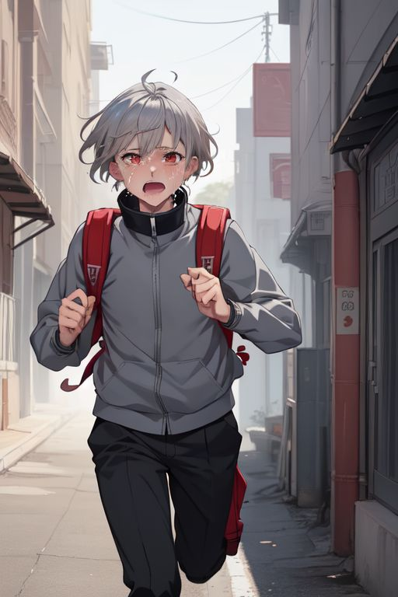
Notes:
Description: a boy, gray hair, red eyes, gray men's student uniform, high collar, crying, running
Anti-Description: tie, bow tie, red clothing

Slide 15
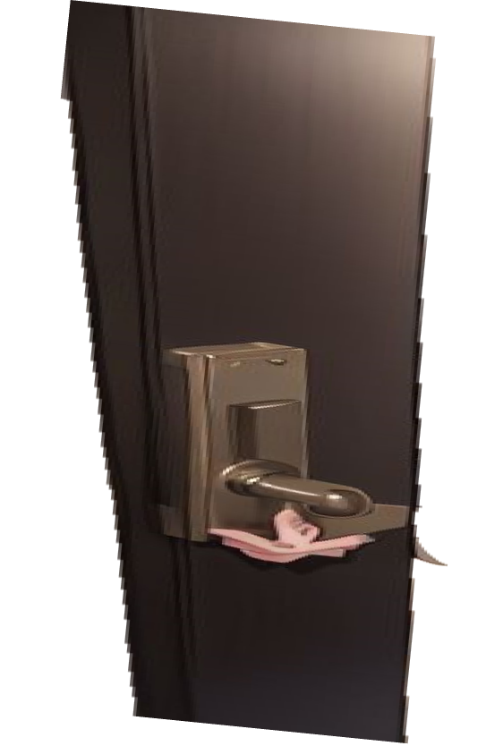
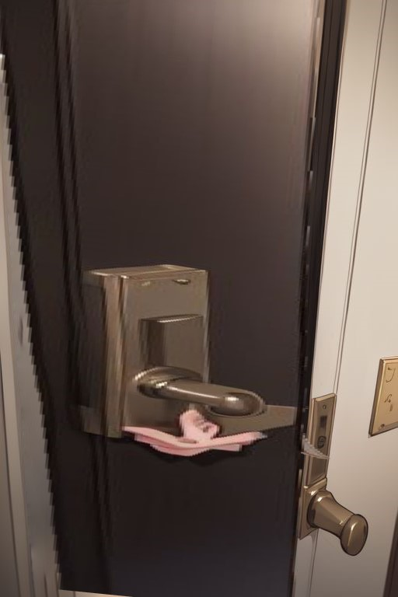

Slide 16
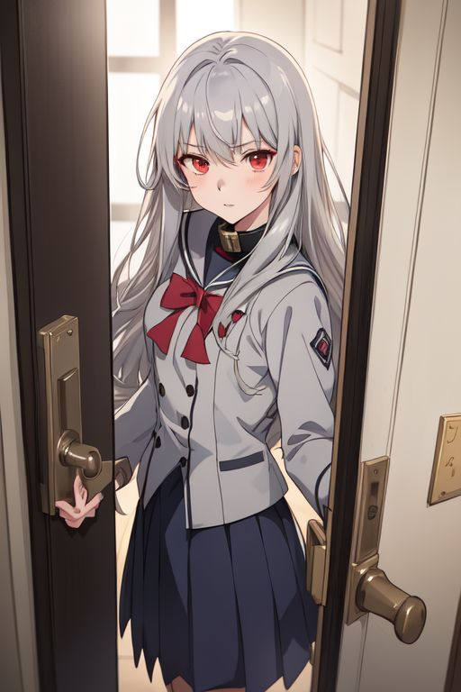
Notes:
Description: a girl, gray hair, red eyes, gray student uniform, open the door
Anti-Description: tie, bow tie, red clothing

Slide 17
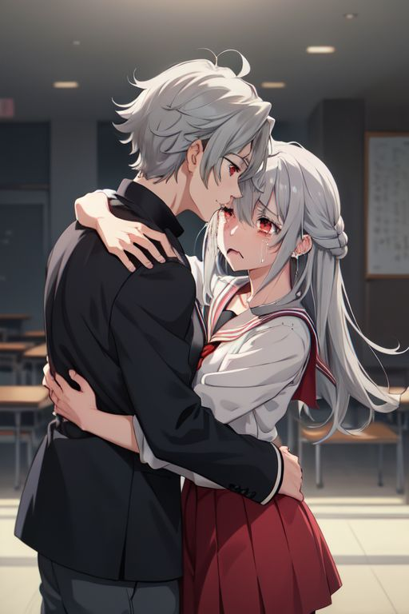
Notes:
Description: a boy, gray hair, red eyes, gray men's student uniform, high collar, hug a crying girl
Anti-Description: tie, bow tie, red clothing

Slide 18

Notes:
Description: a boy, gray hair, red eyes, gray men's student uniform, high collar, knife, blood
Anti-Description: tie, bow tie, red clothing

Slide 19
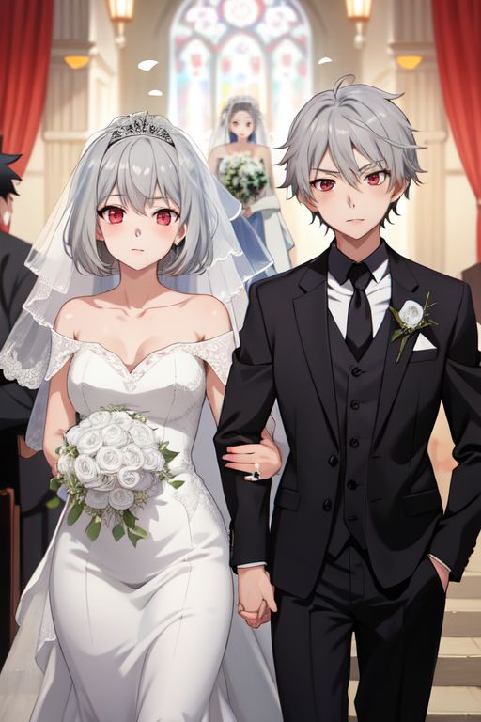
Notes:
Description: a boy, gray hair, red eyes, (a girl, wedding)
Anti-Description: tie, bow tie, red clothing

