Slide 1

Melo
MENTAL WELLNESS APP
停一停。呼吸。好好說。
為難以開口的訊息提供停頓與改寫流程。
HKIIT × Temasek Polytechnic · Team A
Linus Chong · 2505098J · P05
Notes:
Timing: 0:00–0:30
繁中講稿
這是 Melo，一個專門處理很具體時刻的虛擬 wellness 夥伴：就是我們準備發出情緒化訊息之前。Melo 不取代朋友、輔導員或真正的人際溝通；它只是創造一個小小的停頓，讓這段關係多一點被保護的機會。
English reference
Meet Melo, a virtual wellness companion designed for one very specific moment: the moment before someone sends an emotional message. Melo does not replace a friend, counsellor or real conversation. It creates a small pause that can help protect that conversation.
[Sources]
- Melo repository: https://github.com/miku233333/mobile-Team-A
- Project evidence verified locally on 2026-08-05.

Slide 2
問題是真的，但這句話仍會傷人
「你從來都不做事。我不想再做這個小組項目了。」
問題是真的，但這種寫法可能令問題更難解決。
真實問題
表達問題
工作量令人感到不公平。
指責會令對話停止。
MELO / TEAM A / 2
Notes:
Timing: 0:30–1:20
繁中講稿
想像一位正在做小組項目的學生。他覺得工作量不公平，截止時間又很接近，於是打出這段訊息。問題本身可能完全真實，但這種寫法攻擊了組員，卻沒有清楚說明問題。如果在情緒最高點直接發出去，本來可以解決的分工問題，就可能變成人際衝突。Melo 專注的，就是有情緒與按下發送之間的空隙。
English reference
Imagine a student working on a group project. The workload feels unfair, the deadline is close, and this is the message they type. The concern may be completely real. But the wording attacks the teammate rather than explaining the problem. If it is sent at the emotional peak, a solvable workload issue can become a relationship conflict. Melo focuses on this narrow gap between feeling and sending.
[Sources]
- Melo repository: https://github.com/miku233333/mobile-Team-A
- Project evidence verified locally on 2026-08-05.

Slide 3
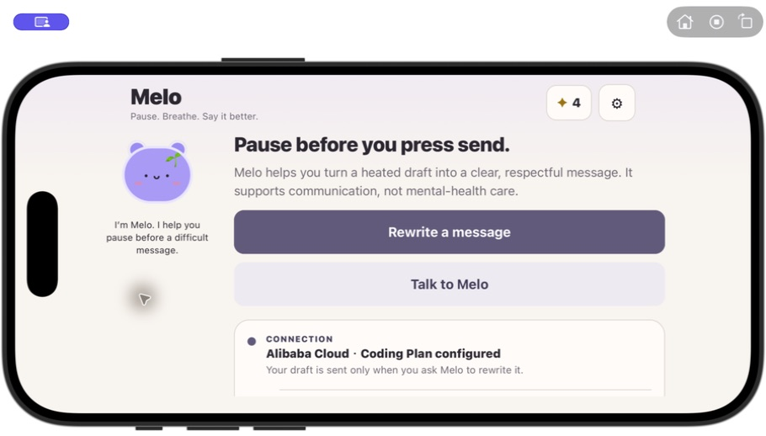
主頁只給一個清楚的下一步
主頁入口
1
Rewrite a message
核心引導式流程
2
Talk to Melo
另一條有界線的聊天路徑
3
觸控 Melo · Settings
表情、語言及自備模型控制
連線狀態在主頁可見；用戶先知道內容是否會離開裝置。
MELO / TEAM A / 3
Notes:
Timing: 1:20–2:00
繁中講稿
[舞台提示：先展示 Home 投影片，然後切換到 App，按 Rewrite a message。] 主頁讓用戶在輸入任何內容之前，就能明白產品的入口。最主要的按鈕是「Rewrite a message」，會進入 Guided Rewrite；「Talk to Melo」則是另一條有界線的聊天路徑。用戶可以觸控 Melo 看見表情回應，Calm Stars 顯示進度但不製造斷簽壓力，Settings 則放置語言及自備模型設定。同一頁亦會顯示目前連線狀態，讓用戶知道內容會留在本機，還是傳送到所選服務。
English reference
[Stage cue: show the Home slide, then switch to the live App and tap Rewrite a message.] The home page keeps the product understandable before the user types anything. The main action is Rewrite a message, which opens Guided Rewrite. Talk to Melo is a separate, bounded chat path. The Melo character reacts when tapped, Calm Stars show progress without streak pressure, and Settings contains language plus bring-your-own-provider controls. The provider state is visible on the same screen, so users know whether a rewrite will stay offline or contact their selected service.
[Sources]
- Melo repository: https://github.com/miku233333/mobile-Team-A
- Project evidence verified locally on 2026-08-05.
- App screenshots captured locally with Computer Use on 2026-08-05.

Slide 4
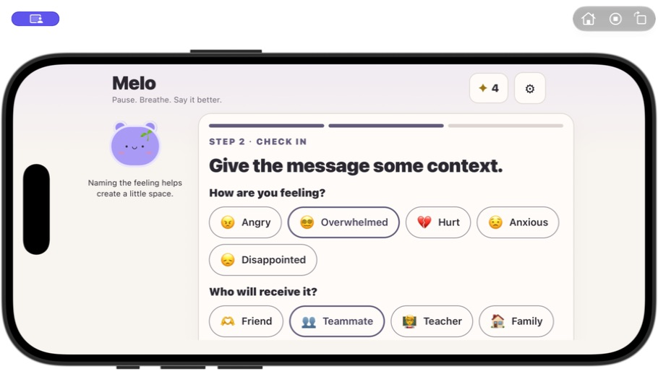
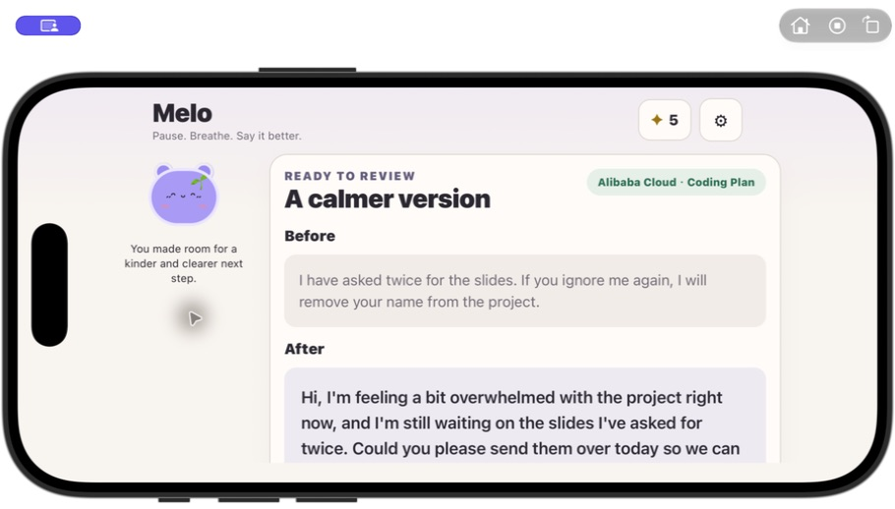
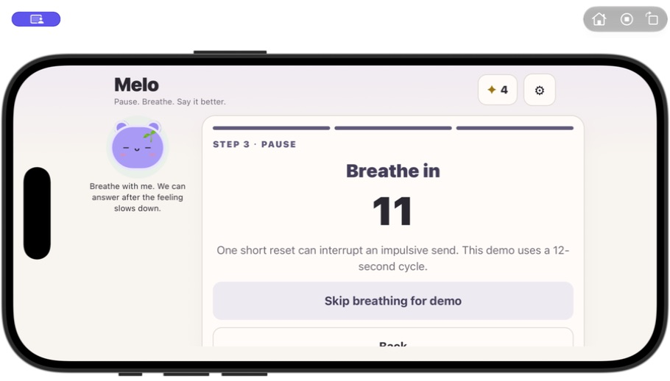
現場示範：Guided Rewrite
步驟 1 / 補充情境
步驟 3 / 檢視改寫
步驟 2 / 和 Melo 停一停
MELO / TEAM A / 4
Notes:
Timing: 2:00–4:00
繁中講稿
[舞台提示：留在 App 完成 Context → Pause → Review；只有現場失敗時才返回此頁使用真實截圖。] Guided Rewrite 有三個清楚可見的階段。第一，補充感受、溝通對象、語氣和輸出語言。第二，Melo 帶領十二秒呼吸停頓，避免在情緒最高點立即生成。第三，同時顯示原訊息與改寫結果；使用真實服務時亦會標示確切供應商及模型。最後決定權仍在用戶手上：可以檢視、複製或分享，而 Melo 永遠不會自動發送。
English reference
[Stage cue: stay in the live App for Context → Pause → Review. Return to this slide only as the screenshot fallback.] Guided Rewrite has three visible stages. First, the user adds context such as feeling, recipient, tone and output language. Second, Melo leads a twelve-second breathing pause so the response is not generated at the emotional peak. Third, Melo shows the original and rewritten message together, including the exact provider and model when a real service was used. The user keeps control: they review, copy or share the result, and Melo never sends it automatically.
[Sources]
- Melo repository: https://github.com/miku233333/mobile-Team-A
- Project evidence verified locally on 2026-08-05.
- App screenshots captured locally with Computer Use on 2026-08-05.

Slide 5
Melo 保留問題，改變表達方式
改寫前
改寫後
我已經問過兩次投影片。如果你再不理我，我會把你的名字從項目中移除。
你好，我現在對這個項目有點不知所措，而且仍在等待我已經問過兩次的投影片。你今天可以傳給我嗎？這樣我們就能繼續完成項目。
→
感受 · 具體情況 · 可行要求
MELO / TEAM A / 5
Notes:
Timing: 4:00–4:50
繁中講稿
Melo 並不是單純把句子變得客氣。它的改寫規則會保留原本意圖和已有事實，移除敵意、威脅或操控式語氣，再加入一個實際可行的下一步。離線模式會使用固定的多語言本機模板，而且明確標示為 Offline fallback，不會把本機模板冒充成模型答案。
English reference
Melo is not simply making a sentence sound polite. The rewrite keeps the original intent and facts, removes hostile or manipulative wording, and asks for one realistic next step. In offline mode, the app uses a deterministic multilingual template and labels it Offline fallback. It never presents that local template as an AI answer.
[Sources]
- Melo repository: https://github.com/miku233333/mobile-Team-A
- Project evidence verified locally on 2026-08-05.

Slide 6
Calm Stars 鼓勵進步，不製造壓力
完成一次 Pause → 獲得 1 顆 Calm Star
3 ✦ 嫩芽 7 ✦ 圍巾 15 ✦ 皇冠
離開 App 不會失去任何東西。
不扣除連續紀錄 · 沒有飢餓或疾病 · 不因離開而內疚
陪伴，而不是壓力。
MELO / TEAM A / 6
Notes:
Timing: 4:50–5:40
繁中講稿
這個角色不只是裝飾。輸入訊息時 Melo 會聆聽，pause 時會一起呼吸，完成後會一起慶祝。Calm Stars 在三、七和十五顆時解鎖簡單配件。我們刻意沒有加入斷簽懲罰、飢餓、疾病，或責怪用戶離開的文案。這個獎勵肯定一次健康行動，但不把暫停使用變成失敗。
English reference
The mascot is part of the interaction, not just decoration. Melo listens during the draft, breathes during the pause and celebrates after completion. Calm Stars unlock simple accessories at three, seven and fifteen stars. We deliberately left out streak loss, hunger, illness and messages that blame the user for leaving. The reward acknowledges a constructive action without turning absence into failure.
[Sources]
- Melo repository: https://github.com/miku233333/mobile-Team-A
- Project evidence verified locally on 2026-08-05.

Slide 7
用戶選擇模型，Melo 清楚標示
供應商可以使用
沒有 Key、逾時或輸出不安全
使用用戶輸入的確切 Model ID
改用固定的本機改寫規則
↓
↓
顯示「Provider · Model」
清楚標示「Offline fallback」
Melo 不附帶模型、API key、額度或預設 Model ID。
MELO / TEAM A / 7
Notes:
Timing: 5:40–6:50
繁中講稿
Melo 使用 React Native、Expo 和 TypeScript 開發。改寫流程先以本機關鍵字規則檢查明顯高風險內容。若用戶已設定兼容服務，Melo 才會用用戶輸入的確切 Model ID 發出請求。如果沒有 key、請求失敗、逾時，或模型輸出未通過檢查，Guided Rewrite 就使用固定的本機 fallback。只有成功而且可讀的模型回覆才會顯示供應商名稱。
English reference
Melo is built with React Native, Expo and TypeScript. The rewrite pipeline starts with a local keyword guard for obvious high-risk phrases. If the user has configured a compatible provider, Melo makes an OpenAI-compatible request using the exact model they entered. If a key is missing, the request fails, times out, or the response does not pass the output guard, Guided Rewrite uses its deterministic fallback. Only a readable successful provider response receives an AI provider label.
[Sources]
- Melo repository: https://github.com/miku233333/mobile-Team-A
- Project evidence verified locally on 2026-08-05.

Slide 8
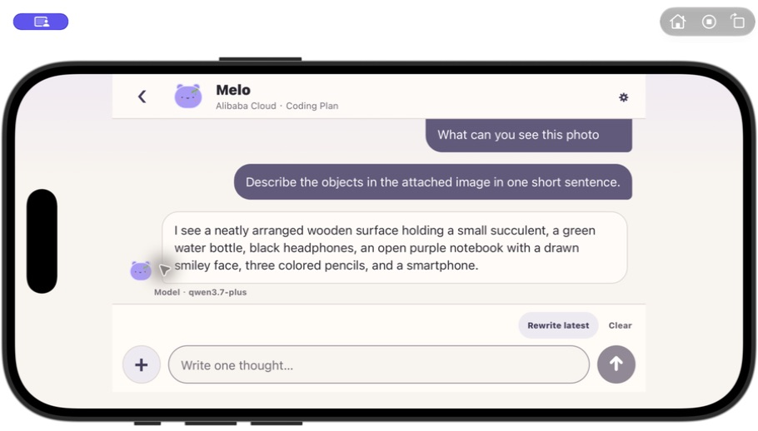
Melo Chat 只保留需要的對話
Melo 會記得什麼
✓ 近期訊息留在裝置本機
✓ 只有指定模型啟用後才可附圖
✓ 供應商失敗時會清楚說明，不加入假回覆
MELO / TEAM A / 8
Notes:
Timing: 6:50–7:50
繁中講稿
Melo Chat 使用同一套模型連接，但對對話設有更明確的界線。Melo 不提供模型、key 或額度。本機只保留最新二十四則訊息，每次最多把最近八則上下文傳送到用戶選擇的供應商。圖片功能必須針對確切模型手動開啟。模型只能選擇五種白名單內的 Melo 表情。請求失敗時，Chat 會誠實顯示失敗，不會加入虛構回覆。
English reference
Melo Chat uses the same provider connection but has stricter conversation boundaries. Melo supplies no model, key or credits. The newest twenty-four messages are retained locally, and at most eight recent messages are sent per turn. Image input is opt-in for the exact model. The model can select only five whitelisted Melo expressions. If a request fails, Chat reports the failure and appends no fake assistant answer.
[Sources]
- Melo repository: https://github.com/miku233333/mobile-Team-A
- Project evidence verified locally on 2026-08-05.
- App screenshots captured locally with Computer Use on 2026-08-05.

Slide 9
展示之前，我們做了這些測試
59 / 59
18 / 18 Expo Doctor
Web · iOS · Android export
固定式自動化測試全部通過
Alibaba 真實改寫通過
我們測試了成功改寫，也測試了三十秒逾時。
仍在組員實體手機確認：Expo Go ＋ 模型 ＋ 圖片流程
MELO / TEAM A / 9
Notes:
Timing: 7:50–8:50
繁中講稿
在目前 checkout 中，五十九項固定式自動化測試全部通過，Expo Doctor 十八項全部通過，而且 Web、iOS、Android bundle 均成功 export。一次新的 Alibaba Coding Plan Guided Rewrite 亦返回不同於本機模板、並有正確來源標示的結果。另一個 Chat 請求在三十秒後逾時，App 正確沒有加入假回覆。不過它仍然是比賽原型：安全 guard 只是關鍵字規則、尚未建立可信任 backend，而組員實體手機上的 Expo Go 及相簿權限流程仍需最後確認。
English reference
In the current checkout, all sixty-two deterministic automated tests pass, Expo Doctor passes eighteen out of eighteen checks, and Web, iOS and Android bundles export successfully. A fresh Alibaba Coding Plan Guided Rewrite also returned a distinct provider-attributed result. A separate Chat request reached the configured time limit and correctly added no fake reply. This is still a competition prototype: the safety guard is keyword-based, there is no trusted backend, and the final Expo Go and image-permission run still needs confirmation on a teammate's physical device.
[Sources]
- Melo repository: https://github.com/miku233333/mobile-Team-A
- Project evidence verified locally on 2026-08-05.
- App screenshots captured locally with Computer Use on 2026-08-05.

Slide 10
發送之前，先停一停
THANK YOU · Q&A
保留問題，拿走攻擊。
先檢視訊息，再決定是否發送。
以 Expo 製作並完成測試的功能原型。
MELO / TEAM A / 10
Notes:
Timing: 8:50–9:40
繁中講稿
Melo 的創新並不是單純把 AI 加進 wellness。它把一項界線清楚的溝通任務、可見的 pause、誠實的模型來源標示，以及不製造內疚感的虛擬夥伴結合起來。最後產生的不是抽象建議，而是一個用戶可以立即檢視、複製，並在準備好時發出的訊息。Melo 不取代人與人的連結；它創造一個小小的停頓，去保護這段連結。謝謝。
English reference
Melo's innovation is not simply adding AI to wellness. It combines a bounded communication task, a visible pause, honest provider attribution and a companion that rewards progress without guilt. The result is a functional action the user can take immediately: a message they can review, copy and send when they are ready. Melo does not replace human connection. It creates one small pause that can protect that connection. Thank you.
[Sources]
- Melo repository: https://github.com/miku233333/mobile-Team-A
- Project evidence verified locally on 2026-08-05.

Slide 11
參考資料 · 附錄
1. Melo 原始碼 · miku233333/mobile-Team-A
2. React Native · Expo SDK 54 · TypeScript
3. 本機 Simulator／響應式截圖 · 2026 年 8 月 5 日
4. 所有產品主張均以實作為依據；不宣稱臨床成效。
github.com/miku233333/mobile-Team-A
Notes:
Timing: Appendix
繁中講稿
這個附錄列出實作來源，以及簡報內測試證據的來源。每一頁 speaker notes 亦保存相應引用。
English reference
This appendix lists the implementation sources and the provenance of the evidence shown in the deck. Detailed citations are also stored in each slide's speaker notes.
[Sources]
- Melo repository: https://github.com/miku233333/mobile-Team-A
- Project evidence verified locally on 2026-08-05.

