Slide 1

Melo
MENTAL WELLNESS APP
Pause. Breathe. Say it better.
A virtual wellness companion for healthier communication.
HKIIT × Temasek Polytechnic · Team A
Notes:
Timing: 0:00–0:30
English talk track
Meet Melo, a virtual wellness companion designed for one very specific moment: the moment before someone sends an emotional message. Melo does not replace a friend, counsellor or real conversation. It creates a small pause that can help protect that conversation.
繁中參考
這是 Melo，一個專門處理很具體時刻的虛擬 wellness 夥伴：就是我們準備發出情緒化訊息之前。Melo 不取代朋友、輔導員或真正的人際溝通；它只是創造一個小小的停頓，讓這段關係多一點被保護的機會。
[Sources]
- Melo repository: https://github.com/miku233333/mobile-Team-A
- Project evidence verified locally on 2026-08-05.

Slide 2
A real concern can still become a harmful message
“You never do any work. I am done with this group project.”
The concern may be real. The emotional peak changes how it lands.
FEELING → WORDING → RELATIONSHIP
MELO · FUNCTIONAL PROTOTYPE 2
Notes:
Timing: 0:30–1:20
English talk track
Imagine a student working on a group project. The workload feels unfair, the deadline is close, and this is the message they type. The concern may be completely real. But the wording attacks the teammate rather than explaining the problem. If it is sent at the emotional peak, a solvable workload issue can become a relationship conflict. Melo focuses on this narrow gap between feeling and sending.
繁中參考
想像一位正在做小組項目的學生。他覺得工作量不公平，截止時間又很接近，於是打出這段訊息。問題本身可能完全真實，但這種寫法攻擊了組員，卻沒有清楚說明問題。如果在情緒最高點直接發出去，本來可以解決的分工問題，就可能變成人際衝突。Melo 專注的，就是有情緒與按下發送之間的空隙。
[Sources]
- Melo repository: https://github.com/miku233333/mobile-Team-A
- Project evidence verified locally on 2026-08-05.

Slide 3
Four small steps before Send
1
2
3
4
Draft
Context
Pause
Review
→
→
→
Write what you were about to send.
Feeling · recipient · tone · language
A short breathing reset with Melo.
Compare · copy · share · retry
One bounded communication task
MELO · FUNCTIONAL PROTOTYPE 3
Notes:
Timing: 1:20–2:00
English talk track
Instead of opening an unlimited chatbot first, Melo gives the user one task at a time. They enter the message, select how they feel, who they are speaking to, the tone and language, then complete a short breathing pause. Only after that does Melo show the original and revised message together. The user can copy it, share it, change the tone or begin again.
繁中參考
Melo 不會一開始就把用戶丟進一個無限制的聊天機器人。它一次只給一個任務：輸入訊息、選擇感受、溝通對象、語氣和語言，再完成一個短暫的呼吸停頓。之後，Melo 才會把原訊息和改寫結果並排呈現。用戶可以複製、分享、改變語氣，或者重新開始。
[Sources]
- Melo repository: https://github.com/miku233333/mobile-Team-A
- Project evidence verified locally on 2026-08-05.

Slide 4
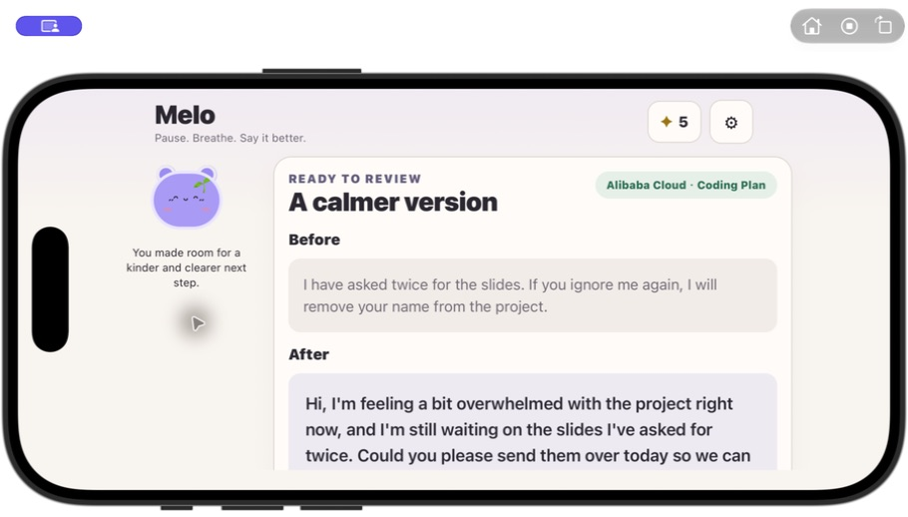
Live demo: one pause changes the next action
LIVE PATH
1
Start a calm rewrite
2
Choose context and language
3
Pause with Melo
4
Compare, copy or share
Alibaba Cloud · Coding Plan
MELO · FUNCTIONAL PROTOTYPE 4
Notes:
Timing: 2:00–4:00
English talk track
Let me show the complete flow. I start a calm rewrite and use our group-project example. I select Overwhelmed, Teammate, Gentle and English. Melo tells me whether this run is offline or will contact my selected provider, so the data movement is visible before generation. Next, Melo pauses with me. The normal breathing cycle lasts twelve seconds; for today's demo I will show the interaction and then use the skip button. Now we can compare the two messages. The original attacks the teammate. The new version says what I feel, explains the situation and asks for a practical next step. I can copy or share it immediately, and completing the pause earns one Calm Star.
繁中參考
現在示範完整流程。我先按開始冷靜改寫，使用小組項目的示例，再選擇不知所措、組員、溫和及英文。Melo 會在生成前清楚告訴我，這次是本機離線模式，還是會把內容傳送到我選擇的模型供應商。接著，Melo 會陪我停一停。正常呼吸流程是十二秒；為了節省示範時間，我先讓大家看到互動，再按跳過。現在可以直接比較前後。新版本會說明我的感受、具體情況和下一步要求。我可以立即複製或分享，完成 pause 亦會獲得一顆 Calm Star。
[Sources]
- Melo repository: https://github.com/miku233333/mobile-Team-A
- Project evidence verified locally on 2026-08-05.
- App screenshots captured locally with Computer Use on 2026-08-05.

Slide 5
Change the structure, not the concern
ATTACK
ACCUSATION
DEAD END
↓
↓
↓
First-person feeling
Observable situation
Practical request
Keep intent and facts · remove hostility · add one realistic next step
MELO · FUNCTIONAL PROTOTYPE 5
Notes:
Timing: 4:00–4:50
English talk track
Melo is not simply making a sentence sound polite. The rewrite keeps the original intent and facts, removes hostile or manipulative wording, and asks for one realistic next step. In offline mode, the app uses a deterministic multilingual template and labels it Offline fallback. It never presents that local template as an AI answer.
繁中參考
Melo 並不是單純把句子變得客氣。它的改寫規則會保留原本意圖和已有事實，移除敵意、威脅或操控式語氣，再加入一個實際可行的下一步。離線模式會使用固定的多語言本機模板，而且明確標示為 Offline fallback，不會把本機模板冒充成模型答案。
[Sources]
- Melo repository: https://github.com/miku233333/mobile-Team-A
- Project evidence verified locally on 2026-08-05.

Slide 6
Reward progress without streak pressure
3 ✦ Sprout
DELIBERATELY OMITTED
7 ✦ Scarf
— No streak loss
15 ✦ Crown
— No hunger or illness
— No guilt for leaving
COMPANION, NOT PRESSURE
MELO · FUNCTIONAL PROTOTYPE 6
Notes:
Timing: 4:50–5:40
English talk track
The mascot is part of the interaction, not just decoration. Melo listens during the draft, breathes during the pause and celebrates after completion. Calm Stars unlock simple accessories at three, seven and fifteen stars. We deliberately left out streak loss, hunger, illness and messages that blame the user for leaving. The reward acknowledges a constructive action without turning absence into failure.
繁中參考
這個角色不只是裝飾。輸入訊息時 Melo 會聆聽，pause 時會一起呼吸，完成後會一起慶祝。Calm Stars 在三、七和十五顆時解鎖簡單配件。我們刻意沒有加入斷簽懲罰、飢餓、疾病，或責怪用戶離開的文案。這個獎勵肯定一次健康行動，但不把暫停使用變成失敗。
[Sources]
- Melo repository: https://github.com/miku233333/mobile-Team-A
- Project evidence verified locally on 2026-08-05.

Slide 7
AI is optional; attribution is not
1
2
3
4
Local risk check
→
Selected BYOK provider
→
Deterministic fallback
→
Clearly attributed result
React Native · Expo SDK 54 · TypeScript · iOS / Android / Web
Melo bundles no model, API key, credits or default Model ID.
MELO · FUNCTIONAL PROTOTYPE 7
Notes:
Timing: 5:40–6:50
English talk track
Melo is built with React Native, Expo and TypeScript. The rewrite pipeline starts with a local keyword guard for obvious high-risk phrases. If the user has configured a compatible provider, Melo makes an OpenAI-compatible request using the exact model they entered. If a key is missing, the request fails, times out, or the response does not pass the output guard, Guided Rewrite uses its deterministic fallback. Only a readable successful provider response receives an AI provider label.
繁中參考
Melo 使用 React Native、Expo 和 TypeScript 開發。改寫流程先以本機關鍵字規則檢查明顯高風險內容。若用戶已設定兼容服務，Melo 才會用用戶輸入的確切 Model ID 發出請求。如果沒有 key、請求失敗、逾時，或模型輸出未通過檢查，Guided Rewrite 就使用固定的本機 fallback。只有成功而且可讀的模型回覆才會顯示供應商名稱。
[Sources]
- Melo repository: https://github.com/miku233333/mobile-Team-A
- Project evidence verified locally on 2026-08-05.

Slide 8
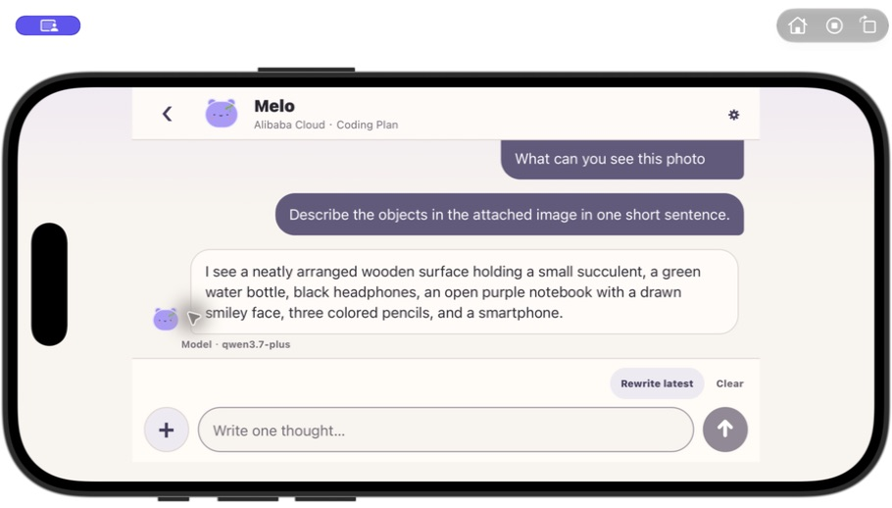
Melo Chat stays bounded
BOUNDED BY DESIGN
✓ 24 newest messages kept locally
✓ Up to 8 recent messages sent per turn
✓ Images only for an enabled exact model
✓ 5 validated Melo expressions
✓ Failure = no invented reply
MELO · FUNCTIONAL PROTOTYPE 8
Notes:
Timing: 6:50–7:50
English talk track
Melo Chat uses the same provider connection but has stricter conversation boundaries. Melo supplies no model, key or credits. The newest twenty-four messages are retained locally, and at most eight recent messages are sent per turn. Image input is opt-in for the exact model. The model can select only five whitelisted Melo expressions. If a request fails, Chat reports the failure and appends no fake assistant answer.
繁中參考
Melo Chat 使用同一套模型連接，但對對話設有更明確的界線。Melo 不提供模型、key 或額度。本機只保留最新二十四則訊息，每次最多把最近八則上下文傳送到用戶選擇的供應商。圖片功能必須針對確切模型手動開啟。模型只能選擇五種白名單內的 Melo 表情。請求失敗時，Chat 會誠實顯示失敗，不會加入虛構回覆。
[Sources]
- Melo repository: https://github.com/miku233333/mobile-Team-A
- Project evidence verified locally on 2026-08-05.
- App screenshots captured locally with Computer Use on 2026-08-05.

Slide 9
Tested limits
18 / 18 Expo Doctor
59 / 59
Web · iOS · Android export
AUTOMATED CHECKS
Fresh Alibaba rewrite passed
Visible evidence for success + timeout protection
OPEN GATE · Teammate physical-device Expo Go + provider + photo flow
MELO · FUNCTIONAL PROTOTYPE 9
Notes:
Timing: 7:50–8:50
English talk track
In the current checkout, all sixty-two deterministic automated tests pass, Expo Doctor passes eighteen out of eighteen checks, and Web, iOS and Android bundles export successfully. A fresh Alibaba Coding Plan Guided Rewrite also returned a distinct provider-attributed result. A separate Chat request reached the configured time limit and correctly added no fake reply. This is still a competition prototype: the safety guard is keyword-based, there is no trusted backend, and the final Expo Go and image-permission run still needs confirmation on a teammate's physical device.
繁中參考
在目前 checkout 中，五十九項固定式自動化測試全部通過，Expo Doctor 十八項全部通過，而且 Web、iOS、Android bundle 均成功 export。一次新的 Alibaba Coding Plan Guided Rewrite 亦返回不同於本機模板、並有正確來源標示的結果。另一個 Chat 請求在三十秒後逾時，App 正確沒有加入假回覆。不過它仍然是比賽原型：安全 guard 只是關鍵字規則、尚未建立可信任 backend，而組員實體手機上的 Expo Go 及相簿權限流程仍需最後確認。
[Sources]
- Melo repository: https://github.com/miku233333/mobile-Team-A
- Project evidence verified locally on 2026-08-05.
- App screenshots captured locally with Computer Use on 2026-08-05.

Slide 10
One small pause can protect a relationship
THANK YOU · Q&A
Melo does not replace human connection.
It creates a small pause that can protect it.
MELO · FUNCTIONAL PROTOTYPE 10
Notes:
Timing: 8:50–9:40
English talk track
Melo's innovation is not simply adding AI to wellness. It combines a bounded communication task, a visible pause, honest provider attribution and a companion that rewards progress without guilt. The result is a functional action the user can take immediately: a message they can review, copy and send when they are ready. Melo does not replace human connection. It creates one small pause that can protect that connection. Thank you.
繁中參考
Melo 的創新並不是單純把 AI 加進 wellness。它把一項界線清楚的溝通任務、可見的 pause、誠實的模型來源標示，以及不製造內疚感的虛擬夥伴結合起來。最後產生的不是抽象建議，而是一個用戶可以立即檢視、複製，並在準備好時發出的訊息。Melo 不取代人與人的連結；它創造一個小小的停頓，去保護這段連結。謝謝。
[Sources]
- Melo repository: https://github.com/miku233333/mobile-Team-A
- Project evidence verified locally on 2026-08-05.

Slide 11
References · Appendix
1. Melo source repository · miku233333/mobile-Team-A
2. React Native · Expo SDK 54 · TypeScript
3. Local Simulator / responsive screenshots · 5 Aug 2026
4. All product claims are implementation-backed; no clinical-effect claim.
github.com/miku233333/mobile-Team-A
Notes:
Timing: Appendix
English talk track
This appendix lists the implementation sources and the provenance of the evidence shown in the deck. Detailed citations are also stored in each slide's speaker notes.
繁中參考
這個附錄列出實作來源，以及簡報內測試證據的來源。每一頁 speaker notes 亦保存相應引用。
[Sources]
- Melo repository: https://github.com/miku233333/mobile-Team-A
- Project evidence verified locally on 2026-08-05.

