Slide 1
The Method of Moving Asymptotes
MTH 5007/ORP 5001
Justin Blackman & Alexis Miller

Slide 2

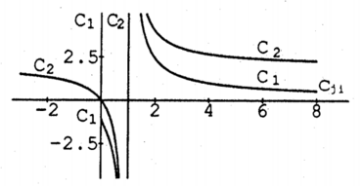
What is MMA?
Mixed Martial Arts- full contact combat sport that allows opponents to legally employ a wide range of fighting techniques including striking, kicking, and grappling
Method of Moving Asymptotes- a method of nonlinear programming in (structural) optimization characterized by an iterative process where a new strictly convex subproblem is generated and solved per each iteration; see also, “impossible to find on Wikipedia”
(Svanberg, K.)
Notes:
Each generated convex subproblem is an approximation of the original problem with a set of parameters that sets the curvature of the approximation and act as asymptotes for the associated subproblem. The convergence of the overall process is stabilized by moving these asymptotes between each iteration.

Slide 3

Consider a structural optimization problem...
P: minimize
f₀(x) (xєR^{n})
subject to
f_{i}(x)≤ , for i = 1 , … , m
and
x_{j} ≤ x_{j}≤ x_{j} for j = 1 , … , n
where x = (x₁ , … , x_{n})^{T} is the vector of design variables,
f₀(x) is the objective function (structural weight),
f_{i}(x)≤ are behaviour constraints (stress and displacement limitations),
x_{j} & x_{j} are given lower/upper bounds or “technological constraints” on the design variables
(Svanberg, K.)

Slide 4
The Process
Choose a starting point x⁽⁰⁾ and let the iteration index k = 0
Given an iteration point x^{(k)}, calculate f_{i}(x^{(k)}) and the gradients ∇f_{i}(x^{(k)}) for i = 1,2,...,m
Generate a subproblem P^{(k)} by replacing, in P, the (usu. implicit) functions f_{i} by approximating explicit functions f_{i}^{(k)}, based on the calculations from Step 2.
Solve P^{(k)} and let the optimal solution of this subproblem be the next iteration point x^{(k +1)}. Let k = k + 1 and go back to Step 2.
The process is interrupted either when a convergence criteria is met or you are satisfied with the solution...
(Svanberg, K.)

Slide 5
How the Function Should Be Defined
The function f_{i}^{(k)} should be obtained by the a linearization (i.e a first order Taylor Expansion) in the reciprocal elemental sizes (1/x_{j}) of f_{i} at the current iteration point x^{(k)} while f₀^{(k)} should be chosen identical to f₀.
In addition, f_{i}^{(k)} is obtained by a linearization of f_{i} in variables of the type 1/(x_{j} - L_{j}) or 1/(U_{j}- x_{j}) dependent on the signs of the derivatives of f_{i,}at x^{(k)}.
L and U are the lower and upper bounds of the design variables and will sometimes be referred to as moving asymptotes.

Slide 6
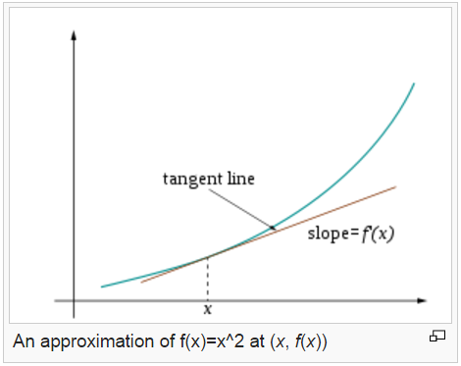
Concept (Oversimplified)
cc
The linearization at specific points is being used to approximate the function in order to find an optimal solution at subproblems in order to find the optimal solution of the entire problem.

Slide 7
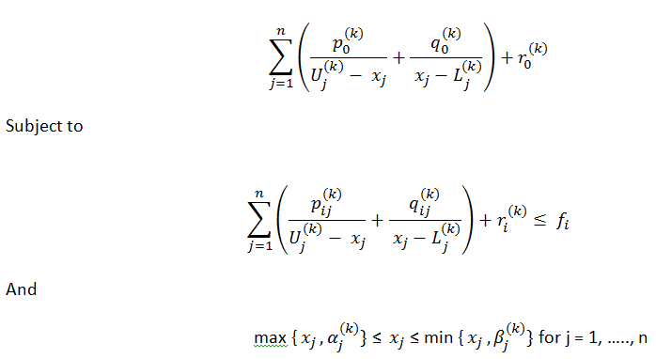
Taylor Expansion of the Function
P^{k}: minimize
Notes:
The parameter alpha and beta are used to ensure that their is never an unexpected division by zero when trying to solve a subproblem.
They are chosen in the manner:
L < alpha < x < beta < U

Slide 8
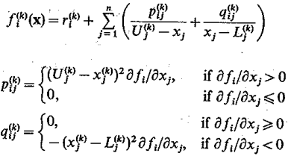
Taylor Series Expansion Cont.
Notes:
Since p and q are greater than 0, then the function is convex. This is because functions with linear constraints are convex.

Slide 9
How to Choose Values for L and U
Let L_{j}^{k} = x_{j} - s₀(x_{j} - x_{j}) and U_{j}^{(k)} = x_{j} - s₀(x_{j} - x_{j})
where S₀ is a real fixed number. L and U do not depend on k, i.e. they are fixed asymptotes rather than moving.

Slide 10
How to Change the Values of L and U
If the process tends to oscillate, then it needs to be stabilized. This stabilization may be accomplished by moving the asymptotes towards the current iteration point.
If, instead, the process is monotone and slow, it needs to be relaxed. This may be accomplished by moving the asymptotes away from the current iteration point.
Notes:
Example to be used…sine graph as an oscillating function and a increasing monotonic function.

Slide 11

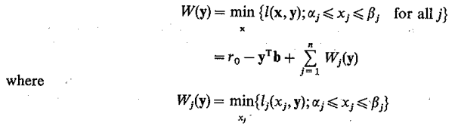

Dual Problem Corresponding to Initial Problem
D: Maximize
subject to
y ≥ 0
Notes:
D is a concave function, it is smooth ( since x depends continuously on uy) and easier to solve by an arbitrary gradient method.

Slide 12

The Solution
The unique solution of the dual problem is found by:
Since D is x_{i}(y) depends continuously on y, it follows that W(y) is a smooth function. It is also easy to prove it is a concave function. Therefore, once the dual problem has been solved, the optimal solution of the primal subproblem is directly obtained by plugging ‘y’ into the above equation.

Slide 13
Why Convert to a Dual Problem?
Optimization problems may be viewed as either primal or dual problems.
The solution to dual problems provide a lower bound to the solution of the corresponding primal (minimization) problem.
These optimal values are not necessarily the same since there may exist a duality gap.
However, for convex optimization problems, the duality gap is zero under Karush-Kuhn-Tucker (KKT) conditions.
Therefore, a solution to the dual problem provides a bound on the value to the primal problem, then the value of an optimal solution of the primal problem is given by the dual problem!
Notes:
KKT conditions are first order necessary conditions for a solution in nonlinear programming to be optimal provided some conditions are satisfied.

Slide 14
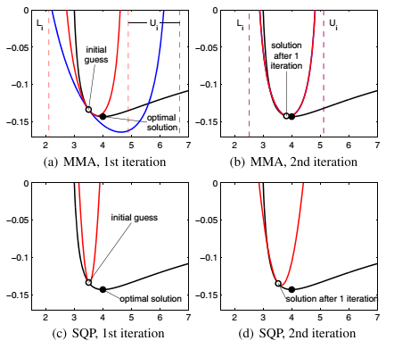
Example Asymptotes
(a) and (b) illustrate the adjustment of asymptotes in MMA. The first two iterations of MMA are compared with a trust region method (SQP) in (c) and (d). All figures show the objective function (black line), and the convex approximation before (thick blue line) and after (thick red line) adjustment used by the optimizer. In (a), MMA asymptotes before (vertical blue dashed lines) and after (vertical red dashed lines) adjustment are shown. in (b), neither the convex approximation nor the asymptote requires adjustment.
(Bukshtynov, Volkov, Durlofsky, Aziz)

Slide 15
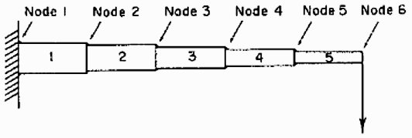
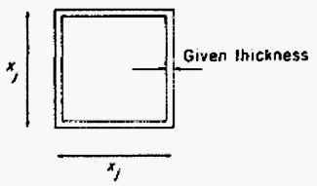
The Cantilever Beam
P1: minimize
C₁(x₁+x₂+x₃+x₄+x₅), x_{j}>0
subject to
61/x₁³ + 37/x₂³ + 19/x₃³ + 7/x₄³ + 1/x₅³ ≤ C₂
Go on to find C_{1,2}, solve for x_{j} and get an optimal solution
Demonstrate how moving asymptotes affects the method’s behavior:
L_{j}^{(k)}=tx_{j}^{(k)} , U_{j}^{(k)}=x_{j}^{(k)}/t , where 0 < t < 1
(Svanberg, K.)
Notes:
In this problem, the weight of the beam shown is being minimized given a constraint on the vertical displacement of node 6, at which point a downward force is also applied.
Beam is 5 parts with quadratic cross-sections
Downward force acting on node 6
Design variables = x_{j}
Objective function = beam weight, to be minimized, unit weight
Behaviour constraint = given limit on vertical displacement allowed on node 6 (how much can the end of the beam dip?)
C₁ and C₂ are constants dependent on material properties, magnitude of given load, etc

Slide 16
The Cantilever Beam
Traditional Method
didn’t converge (Svanberg)
Sequential quadratic programming (SQP)
10 iterations (Jiang, Papalambros)
Method of moving asymptotes (MMA)
3 iterations (Jiang, Papalambros)
Notes:
These other (“traditional”) methods implemented “inscribed hyperspheres… temporary deletion of non-critical constraints, design variable linking, and taylor series expansions of response variables in terms of design variables.“
Which is all about as much fun as it sounds.
To save time and energy, we will just compare the number of iterations using different methods. One of the pieces of literature we reviewed compared first order, second order MMA, MMA and SQP as methods of convergence to solve the objective function.

Slide 17
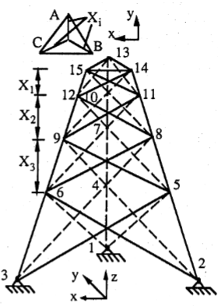
The 39-bar Tower
Case 1
single deflection constraint at node 14 or 15 + a total of 26 stress constraints
initial point is feasible
No. of Iterations
FOMMA: 17
SOMMA: 26
SQP: 233
Case 2
buckling constraints applied to all elements + 56 total stress constraints
initial point is the optimum of Case 1 + infeasible
No. of Iterations
FOMMA: 12
SOMMA: 21
SQP: 101

Slide 18
Applicability & Benefits
Tested against “traditional methods,” MMA converges faster
Easier to use and understand than other structural synthesis methods
MMA behavior is not sensitive to scaling or translating variables; variables do not need to be non-negative
Is mainly used to determine characteristics of a structure, which can include
structure self-weight
point or node displacement
member thickness
number of members
truss spacing
through-flow in turbo- machineries

Slide 19
Questions?
MTH 5007/ORP 5001
Justin Blackman & Alexis Miller

Slide 20
References
Bachar, M., Estebenet, T., & Guessab, A. (2014). A moving asymptotes algorithm using new local convex approximation methods with explicit solutions. Kent, OH: Kent State University.
Jiang, T., & Papalambros, P. Y. A first order method of moving asymptotes for structural optimization. Ann Arbor, MI: Design Laboratory, Department of Mechanical Engineering and Applied Mechanics, The University of Michigan.
Shmit, L. A., Jr., & Farshi, B. (1974). Some approximation concepts for structural synthesis. A1AA, 12(5), 692-699.
Svanberg, K. (1987). Method of moving asymptotes- a new method for structural optimization. International Journal for Numerical Methods in Engineering, 24, 359-373.
Notes:
Additional References
https://en.wikipedia.org/wiki/Duality_(optimization)
https://en.wikipedia.org/wiki/Linearization

