Slide 1
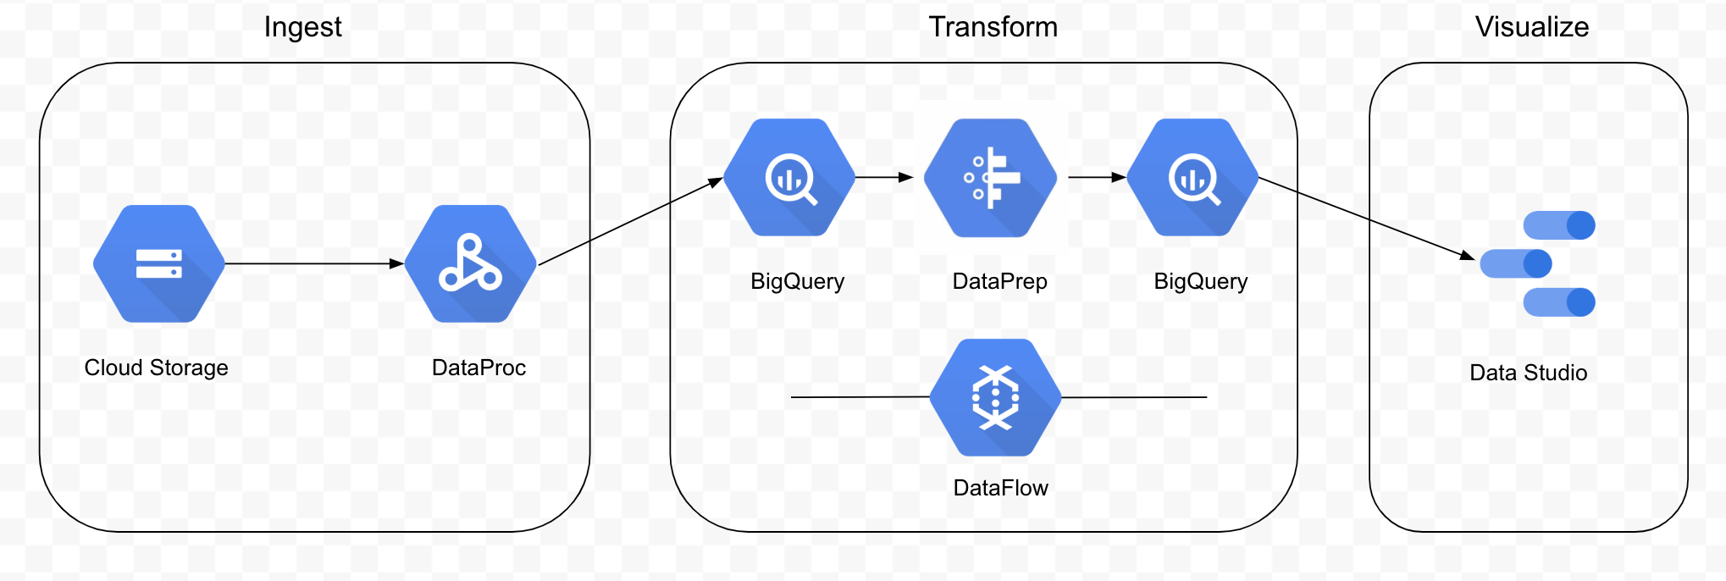
Proposed Workshop Demo Flow Draft

Slide 2
Flow Description Draft
Ingest
Upload file to cloud storage
Use Data Proc to load data with potential initial processing into Big Query
Convert JSON to tabular format
Transform
From Big Query, pull data into Data Prep
Use Data Prep to apply business logic / transformations and send back to Big Query
Data Prep jobs will be run by Data Flow behind the scenes
Visualize
Connect Data Studio to Big Query and visualize reports

