Slide 1
FAILURE-MODE STUDY
Why Balanced Token Pruning
Fails on Text Tasks
An empirical study on Qwen2.5-VL-7B
P. S. Kedar
Research Intern
Prof. Divya Saxena
Aditya Sharma, PhD Scholar
SAIDE, IIT Jodhpur · June 2026
Notes:
This is a follow-up to our BTP reproduction. While reproducing the paper, we hit something odd: on Qwen, text tasks fell apart under pruning. This study is our attempt to figure out why, through four small experiments.

Slide 2
THE OBSERVATION
The Result That Started This Study
Baseline
With BTP
82.7
23.6
BTP
Qwen2.5-VL-7B on TextVQA: accuracy fell by about 59 points. That is not a small dip; that is the model going blind to text. Why?
Notes:
Here is the result that kicked this off. On TextVQA, Qwen scored 82.7 normally, but 23.6 once we switched pruning on. A drop that large means the model basically stopped being able to read. That is the puzzle we set out to solve.

Slide 3
OBJECTIVE
Four Questions We Set Out to Answer
1
Does it spread?
2
Is it gradual?
Is the drop only on TextVQA, or on other text tasks too?
Does the score slide down slowly as we remove more tokens?
3
What gets cut?
4
Is text the target?
Which parts of the image does pruning actually throw away?
Does pruning hit text regions more than everything else?
1
Notes:
We broke the puzzle into four plain questions: does the failure spread to other tasks, does it come on gradually, what exactly gets removed, and is text being singled out. One experiment per question.

Slide 4
EXPERIMENT 1
Does the Failure Spread?
Dataset
Metric
Baseline
BTP
Drop
TextVQA
Accuracy
86.2
23.3
down 62.9
DocVQA
ANLS
94.7
19.2
down 75.5
ChartQA
Relaxed acc.
76.8
29.0
down 47.8
AI2D
Accuracy
86.4
79.6
down 6.8
All the text-heavy tasks we tested degrade sharply (down 48 to 76 points). AI2D, which leans on diagram layout, holds up. The contrast is consistent with the failure being about dense text, though AI2D alone does not prove it is the only cause.
2
Notes:
Yes, it spreads. TextVQA, DocVQA, and ChartQA all collapse, dropping anywhere from 48 to 76 points. The interesting exception is AI2D, which only drops about 7. AI2D leans on diagram structure and arrows rather than reading small text, so it survives. That single contrast tells us the failure is about dense text reading, not visual reasoning as a whole.

Slide 5
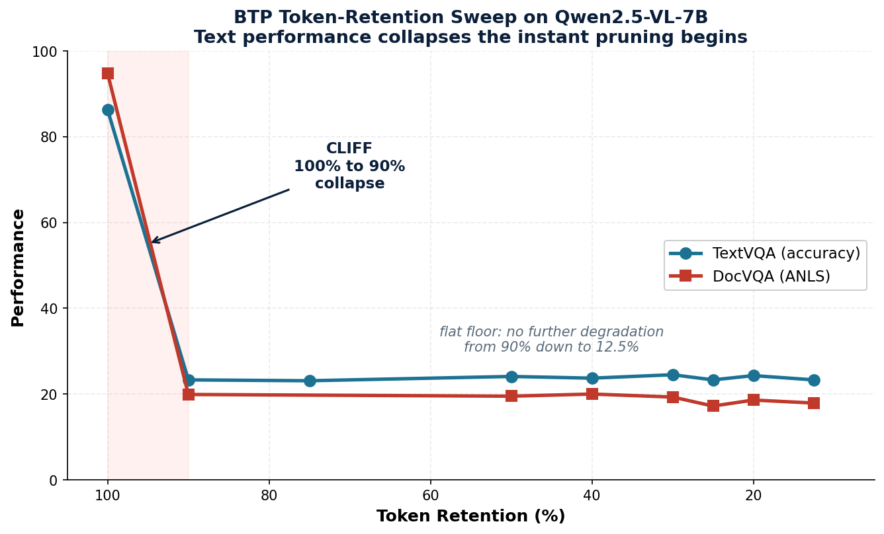
EXPERIMENT 2
It Breaks Instantly, Not Slowly
3
Notes:
We expected a gentle slope: keep fewer tokens, lose a little accuracy. Instead we got a cliff. The moment pruning starts, even keeping 90 percent of tokens, text is already gone, and it stays flat all the way down. There is simply no safe amount of pruning for text.

Slide 6
EXPERIMENT 2, TAKEAWAY
There Is No Safe Amount of Pruning
100% to 90%
The cliff. Trim just 10% of the tokens and text already collapses.
90% down to 12.5%
A flat floor. Nothing left to lose; the text was already gone.
The damage does not track how much you prune. The tokens that carry the text are lost right at the first cut.
Notes:
The takeaway is blunt: there is no graceful trade-off for text. The cliff is right at the start, and everything past it is a flat, collapsed floor. Whatever tokens hold the text, they go early.

Slide 7
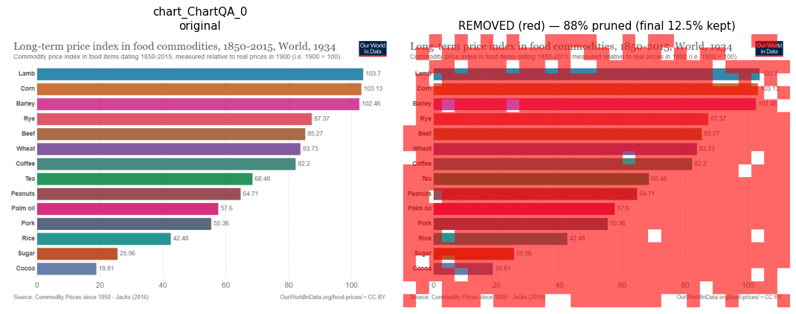
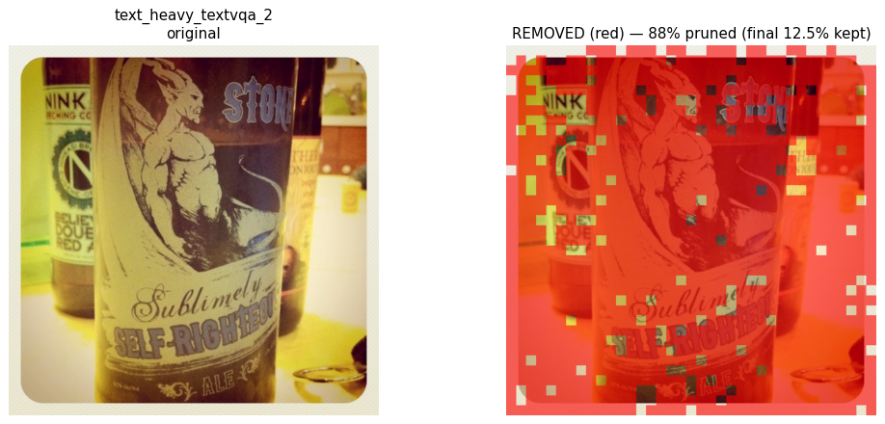
EXPERIMENT 3
What Actually Gets Thrown Away
ChartQA: the chart is almost entirely gone (about 88% removed)
Scene text, buried in red
At the setting BTP actually ships with, almost nothing readable is left on the page.
4
Notes:
Here we painted the removed patches red at the real operating point, where about 88 percent of the image is dropped. The chart is basically wiped out; the scene text is buried. Look closely and the few survivors do sit near text, a hint that BTP is trying to keep it, but there is nowhere near enough left to read.

Slide 8
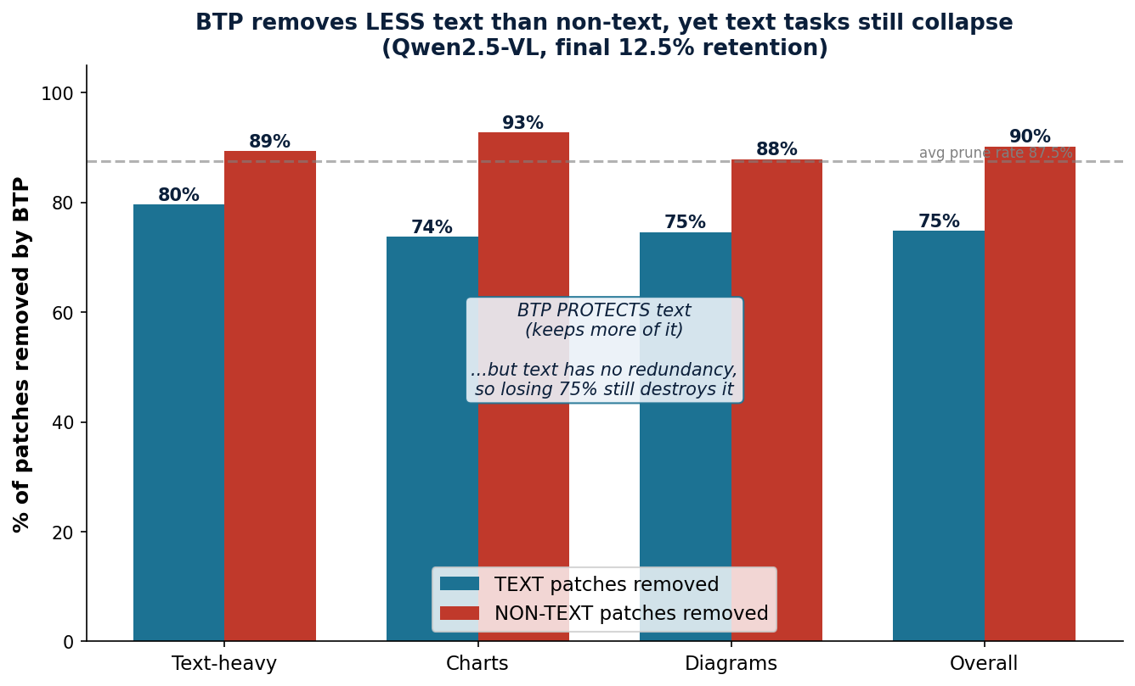
EXPERIMENT 4
Is Text the Target? Surprisingly, No.
BTP actually removes less text than non-text (75% vs 90%). It protects text, and text still fails.
5
Notes:
Here is the twist we did not expect. BTP is not picking on text at all. It removes text less often than everything else, 75 percent versus 90, and for charts it clearly shields the text. The selection is doing a sensible job. So if the method is keeping text on purpose, why does reading still break?

Slide 9
CAVEATS
Limitations
Single model (Qwen2.5-VL-7B); not yet tested on other vision-language models
Limited benchmark set, evaluated on reduced-size subsets
Token visualization is small-sample (12 images) and qualitative
No direct intervention yet to confirm the mechanism
Alternative causes remain open: pruning may disrupt spatial continuity or early text-feature formation
6
Notes:
Being upfront about the limits: one model, a few benchmarks on subsets, a small qualitative visualization, and no direct intervention yet. Besides low redundancy, the collapse could also come from the pruning operation disrupting spatial or positional structure. These stay open.

Slide 10
CONCLUSION
Likely Not the Pruning Itself, but the Text
In a photo, one patch of sky looks like the next, so tossing most of them out costs you nothing. But every letter on a page is its own thing. Keep only an eighth of the patches and the words simply fall apart, no matter how carefully you chose which ones to keep.
BTP is actually smart about it: it spots text and tries to hold on to it
But text has no spare copies; every stroke carries meaning you cannot get back
Photos and diagrams are full of repetition, so they survive the cut. That is why AI2D barely flinched
So our leading explanation is not a flaw in the selection, but the nature of squeezing content with little to spare (a hypothesis, not proof).
Notes:
Here is the whole story in plain terms. The failure is not bad token selection; BTP actually tries to keep text. The real issue is that text has no redundancy. A photo is full of repetition, so dropping most of it is fine, and that is exactly why AI2D held up. But writing is different: every character is unique, so losing three quarters of it destroys the words no matter which quarter you keep. This is not a bug you can patch out; it is the nature of aggressive pruning meeting content that cannot be compressed. The natural fix is to make pruning aware of where the text is.

Slide 11
WHERE THIS POINTS
What We Would Try Next
Content-aware retention
1
Spot the text-dense regions first, then leave them out of the pruning.
Task-adaptive pruning
2
Prune hard for photos, go easy for documents and charts.
Check other models
3
See whether the same thing happens beyond Qwen.
Thank You
Repository: github.com/milab-iitj-dev/btp-reproduction
7
Notes:
Where this points next. First, make pruning aware of text: find the text-dense regions and simply exclude them from the cut. Second, adapt the pruning strength to the task, hard for photos where there is lots of redundancy, gentle for documents and charts where there is not. And it is worth checking whether other vision-language models behave the same way. Everything is in the repository. Thank you.

