Slide 1
Visual Token Pruning and Text-Reading Performance
in Vision-Language Models
Phase 3 Investigation using Qwen2.5-VL-7B
P. S. Kedar
Supervised by Prof. Divya Saxena
Mentored by Aditya Sharma
IIT Jodhpur

Slide 2
Experimental Setup
An image is converted into many visual tokens before the language model processes it.
Baseline
→
→
Model
→
Answer
The original model without BTP. All visual tokens are kept.
Image
All visual tokens
Tells us how well the model performs when we do not interfere with its visual information.
Pruning (BTP)
→
→
Model
→
Answer
BTP removes some visual tokens so the model processes less visual information.
Image
BTP pruning
Some visual tokens remain, so the model can still use the image.
Complete deletion
→
→
→
Answer
Removes every visual token still remaining at a particular layer.
Image
Pruning: 12.5% remain
Complete deletion: 0 remain
After that layer, the model cannot receive any further visual information from the image.
Pruning = reducing visual information Complete deletion = cutting off visual information completely
This distinction is essential for every experiment that follows.

Slide 3
Initial Observation
We compared the original model (baseline) with BTP on Qwen2.5-VL-7B.
Task | Baseline | BTP
POPE | 87.6 | 86.2
MMBench | 83.7 | 79.3
GQA | 60.9 | 55.9
AI2D | 86.4 | 79.6
TextVQA * | 86.2 | 23.3
DocVQA * | 94.7 | 19.2
ChartQA * | 76.8 | 29.0
General visual tasks
POPE, MMBench, GQA, AI2D: performance decreases only moderately.
Reading tasks: performance collapses
Tasks where the model must identify and understand text physically present inside the image.
TextVQA questions answered from text in images
DocVQA understanding text in documents
ChartQA reading information from charts
Main observation
The degradation is not uniform. It is especially severe when the model must read text from the image.
* reading task

Slide 4
Possible Causes
Why does BTP make Qwen fail on reading tasks? We tested four explanations.
1. Are we keeping the wrong visual tokens?
2. Are text regions too similar or redundant?
Why: Perhaps BTP removes useful tokens and keeps unhelpful ones.
What: Replaced BTP's token selection with other methods, including random selection.
Result: All methods stayed around 17–19% on TextVQA.
So what: Changing which tokens are selected does not recover performance.
Why: If text patches look alike, BTP may treat them as duplicates and remove them.
What: Compared how similar text patches are to each other versus background patches.
Result: Text similarity 0.38, background similarity 0.44.
So what: Text was not more redundant than background. This explanation was not supported.
3. Are too many tokens being removed?
4. OCR-based text-token protection
Why: Removing a large share of tokens might destroy the information needed for reading.
What: Gradually changed token retention from 100% down to 12.5%.
Result: Even at 90% retention, TextVQA had already fallen to the same low level.
So what: The collapse happens even when almost all tokens are kept, so it is not the amount removed.
Why: If BTP accidentally removes text, protecting the text tokens should restore performance.
What: OCR gives the text locations in the image. We forced the visual tokens at those locations to survive pruning, a best-case test.
Result: 19.7% with OCR-based protection, 19.7% without.
So what: Even explicitly protecting the text tokens does not recover performance.
None of the four explanations can account for the collapse.

Slide 5
Control Experiment: 100% Token Retention
Is the pruning itself responsible for the collapse?
What does “BTP + 100% retention” mean?
We keep the BTP procedure active, but every pruning stage is set to retain 100% of the visual tokens. BTP runs, but nothing is removed by pruning.
Normal BTP
→
→
100% tokens
Pruning stage
Fewer tokens
100% retention
→
→
100% tokens
Pruning stage
100% remain
Why: if pruning causes the collapse, removing the pruning should restore the original performance.
Condition | TextVQA
Baseline | 87.6%
BTP + 100% retention | 17.8%
So what
The model still collapses even when no visual tokens are removed by pruning.
The major loss must be happening after the pruning stages.

Slide 6
Implementation Finding
What happens to the visual tokens after the pruning stages?
→
→
→
→
0 visual tokens
Image
All visual tokens
BTP pruning: 12.5% remain
Complete deletion
What we changed: kept the 12.5% pruning exactly the same, and switched off only the complete-deletion step.
Condition | TextVQA
No pruning | 85.65%
BTP as released | 17.25%
Complete deletion switched off | 78.60%
Intuition
If pruning were responsible, switching off deletion would leave the score low. Instead it rises from 17.25% to 78.60%, with the pruning still in place.
Conclusion
Most of the TextVQA collapse comes from completely removing the remaining tokens, not from the earlier pruning.
Note: the paper specifies retaining 12.5% of visual tokens for Qwen at the final stage, while the implementation tested here removes the remaining tokens.

Slide 7
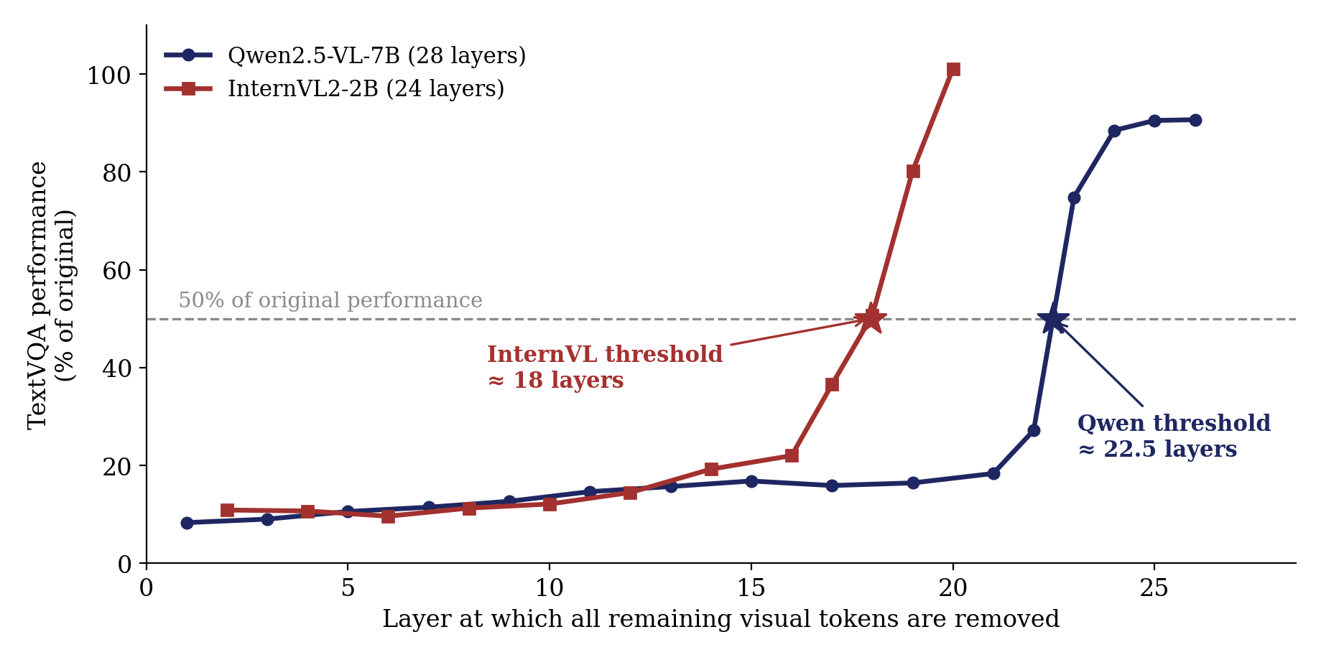
Visual Token Access Threshold
Complete deletion at one layer causes a large drop. Does the exact layer matter?
What: we moved the complete-deletion point from early layers to later ones, and measured TextVQA at each point.
Threshold
The point where the model still keeps at least 50% of its original TextVQA performance.
Qwen2.5-VL-7B
≈ 22.5 of 28 layers → ≈ 80%
InternVL2-2B
≈ 18 of 24 layers → ≈ 75%
Relative threshold position: the threshold as a share of the model's layers.
Remove visual information too early → reading collapses. Keep it available longer → performance recovers sharply.
Measured on TextVQA, so these are task-specific measurements, not a universal law.

Slide 8
Pruning and Deletion Costs
Which part of the loss comes from pruning, and which from complete deletion?
Corrected BTP = normal BTP pruning to 12.5%, but without the complete-deletion step.
Task | Pruning cost | Deletion cost | Dominant
TextVQA | 5.7 | 57.2 | Deletion
DocVQA | 17.9 | 57.6 | Deletion
ChartQA | 31.4 | 16.4 | Pruning
AI2D | 7.2 | 0.4 | Pruning
GQA | 2.1 | 2.9 | Both small
POPE | 1.3 | 0.1 | Both small
MMBench | 4.7 | 0.3 | Both small
Pruning cost
Baseline → Corrected BTP
This tells us the cost of removing some visual tokens.
Deletion cost
Corrected BTP → Released BTP
This tells us the additional cost of removing all remaining tokens.
Dominant effect
This tells us whichever causes the larger share of the total drop.
Points of performance lost, Qwen2.5-VL-7B.
There is no single dominant effect for every task.
TextVQA and DocVQA: deletion dominates. ChartQA: pruning dominates. General tasks: both effects relatively small.

Slide 9
Evaluation Results
Why did the standard evaluation not clearly reveal this problem?
Configuration | Standard benchmarks | Reading tasks
Qwen, BTP as released | 96.1% | 28.4%
Qwen, deletion switched off | 96.9% | 77.9%
InternVL, pruning only | 94.9% | 56.5%
Standard benchmarks
Around 95–97% retained, so pruning appears largely successful.
Reading tasks
Large losses become visible.
Share of each model's original performance retained.
Important comparison: InternVL does not have the complete-deletion issue, yet its reading performance still drops substantially. The blind spot is not only caused by the Qwen implementation.
A benchmark suite without a suitable text-reading task can miss substantial degradation in visual reading ability.

Slide 10
Conclusion and Next Steps
Finding 1: Implementation
In the Qwen configuration tested, complete removal of the remaining visual tokens causes most of the TextVQA collapse.
Finding 2: Model behaviour
The model needs visual information to remain accessible up to a measurable point in the network. TextVQA threshold: Qwen ≈ 80%, InternVL ≈ 75%.
Finding 3: Evaluation
Standard benchmarks can show healthy overall performance while visual text-reading ability has degraded substantially.
Next steps
1. Measure the threshold on DocVQA and ChartQA
2. Repeat on a third architecture
3. Consolidate the results into the manuscript

