Slide 1


State of art of generative models in robotics applications
Facoltà di Ingegneria dell'informazione, informatica e statistica
Master thesis in engineering in computer science
Supervisor: Prof. Daniele Nardi
Correlator: Ing. Francesco Riccio
Candidate:
Milad Kiwan
Academic year 2019-2020

Slide 2
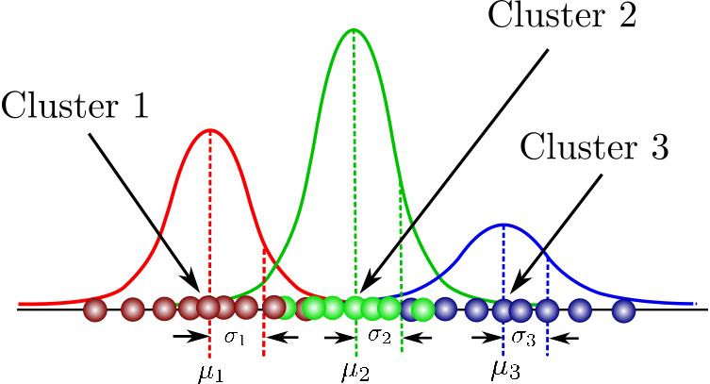
Gaussian Mixture Models GMMs

Slide 3
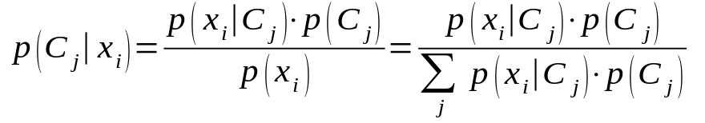
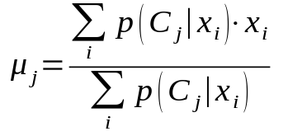
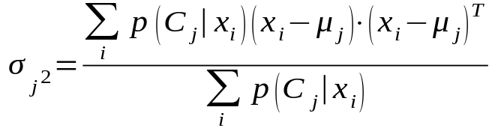
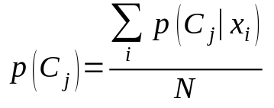
Gaussian Mixture Model GMM
K components probability distributions
Expectation maximization algorithm to update
E-step:
M-step:

Slide 4
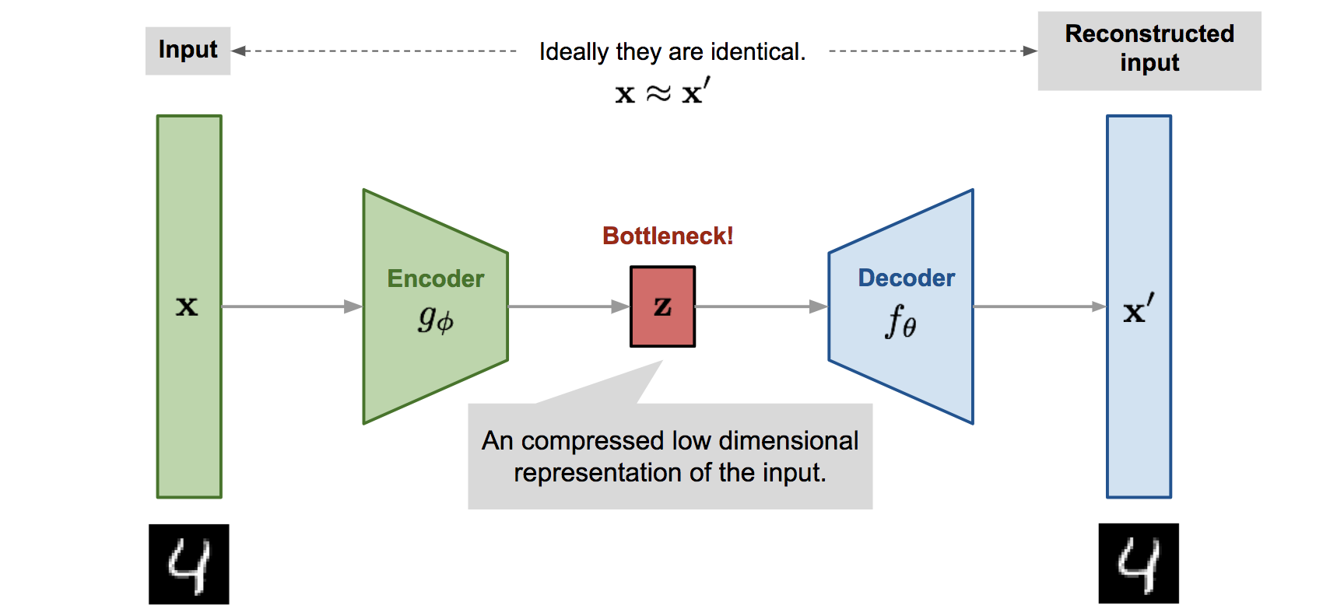
Variational Autoencoders VAEs

Slide 5
Variational Autoencoder VAE
Encoder:
Find latent space.
Low dimensional representation of the original data.
Decoder:
Given the latent or the data representation returned from the encoder, generates new data.
Reconstruct the original data.

Slide 6
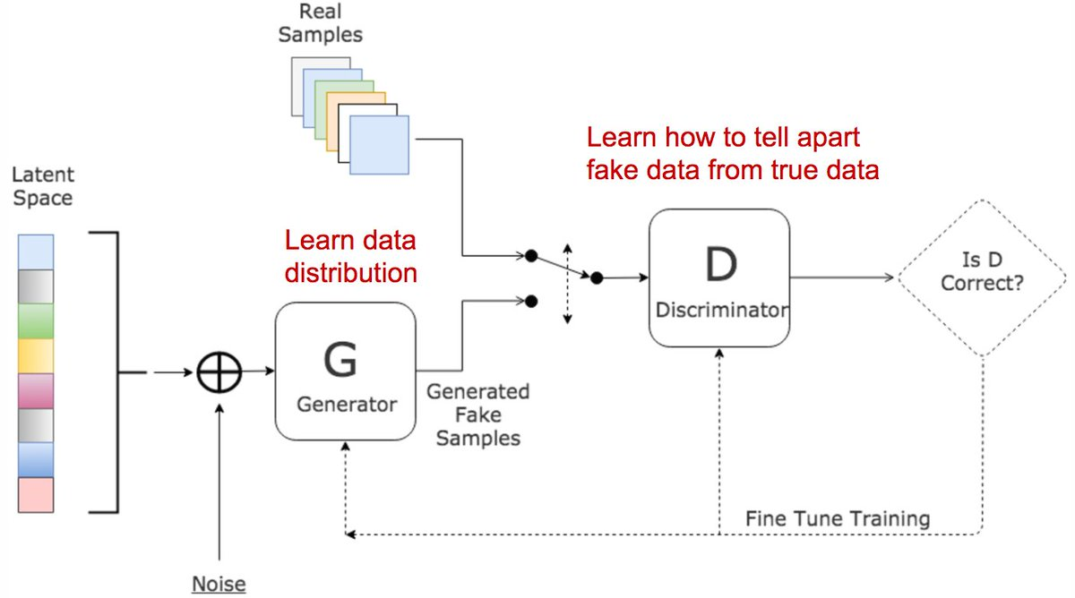
Generative Adversarial networks

Slide 7

Generative Adversarial Networks GANs
Distinguish between authentic and fake data.
Discriminator loss function:
Generate new data.
Generator loss function:

Slide 8
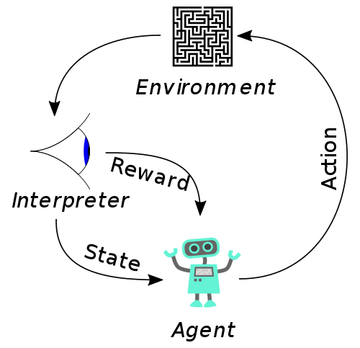
Reinforcement Learning

Slide 9

Reinforcement Learning RL
Basically is modeled as a Markov decision process:
  S is a set of environment a agent states.
  A is a set of actions the agent can perform.
  P is the transition probability between the states.
  R is is the immediate reward after transition from s to s' with action a.
  γ is a discount factor, to discount the future reward.

Slide 13
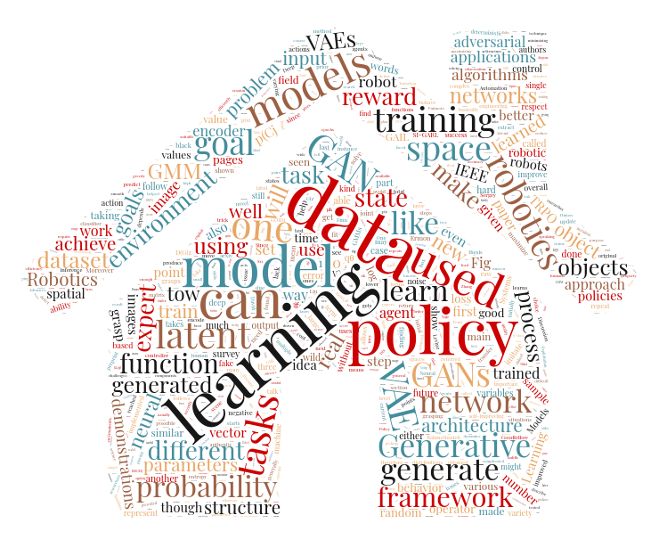
Thank you!

