Slide 1


State of art of generative models in robotics applications
Facoltà di Ingegneria dell'informazione, informatica e statistica
Master thesis in engineering in computer science
Supervisor: Prof. Daniele Nardi
Correlator: Ing. Francesco Riccio
Candidate:
Milad Kiwan
Academic year 2019-2020

Slide 2
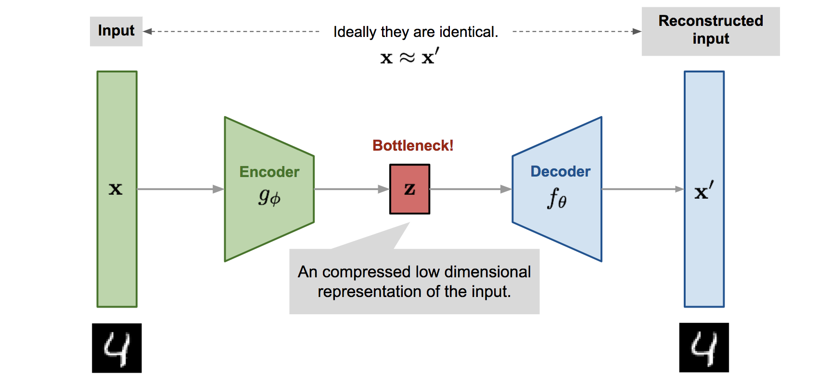
Variational Autoencoders VAEs

Slide 3
Variational Autoencoder VAE
Encoder:
Find latent space.
Low dimensional representation of the original data.
Decoder:
Given the latent or the data representation returned from the encoder, generates new data.
Reconstruct the original data.

Slide 4
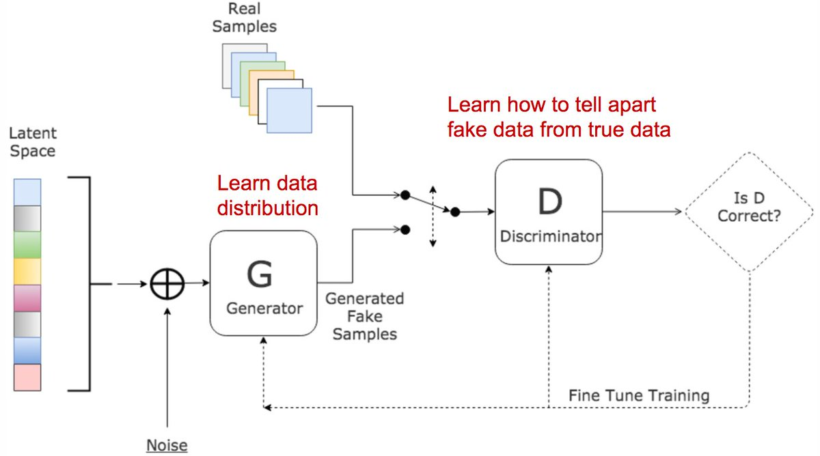
Generative Adversarial networks

Slide 5

Generative Adversarial Networks GANs
Distinguish between authentic and fake data.
Discriminator loss function:
Generate new data.
Generator loss function:
Find saddle point

Slide 6
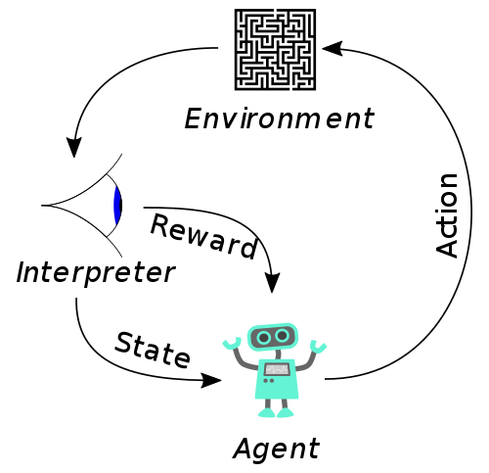
Reinforcement Learning

Slide 7

Reinforcement Learning RL
Basically is modeled as a Markov decision process:
S is a set of environment a agent states.
A is a set of actions the agent can perform.
P is the transition probability between the states.
R is the immediate reward after transition from s to s' with action a.
𝛾 is a discount factor, to discount the future reward.

Slide 8
Domain randomization and generative models for robotic grasping
Perform the grasp planning for randomized objects domain.
Objects generation was achieved by placing random meshes sequentially so that each mesh intersects with at least one of the preceding meshes.
The first part is the grasp planning module that outputs is a probability distribution over possible grasps.
The second part is grasp evaluation model that outputs a value corresponding to the likelihood of success of that grasp.

Slide 9
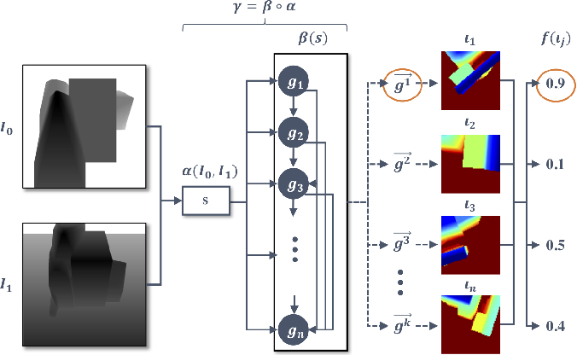
Domain randomization and generative models for robotic grasping

Slide 10
Vision-Based Multi-Task Manipulation for Inexpensive Robots Using
End-To-End Learning from Demonstration
The encoder finds the distribution of the data and then sample a latent representation.
The decoder is a GAN.
The policy controller that interact with the environment is an LSTM.
The output of the LSTM is a GMM.
The approach does not require a reward signal as RL.

Slide 11
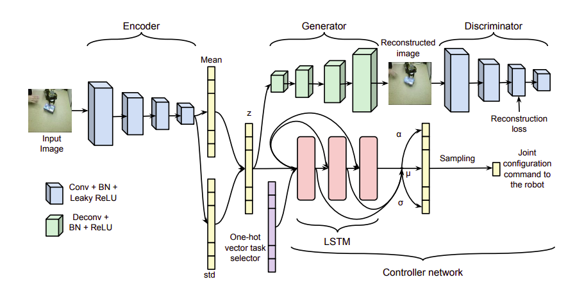
Vision-Based Multi-Task Manipulation for Inexpensive Robots Using
End-To-End Learning from Demonstration

Slide 12
Generative Adversarial Imitation Learning (GAIL)
GAIL is a combination between GAN and RL.
The generator is the policy to be learned, and follows TRPO algorithm.
discriminator distinguishes between the expert trajectories and those generated by the generator.
Again there is no need to design a reward function.

Slide 13
Self-Improving Generative Adversarial Reinforcement Learning
A network to generate initial policies.
A value function network to approximate how good is the current state.
Policy improvement black box (TRPO).
The improved policy interact with the environment.
A discriminator represents a classifier and assigns a low loss to the improved policies and a high loss to the initial ones.

Slide 14
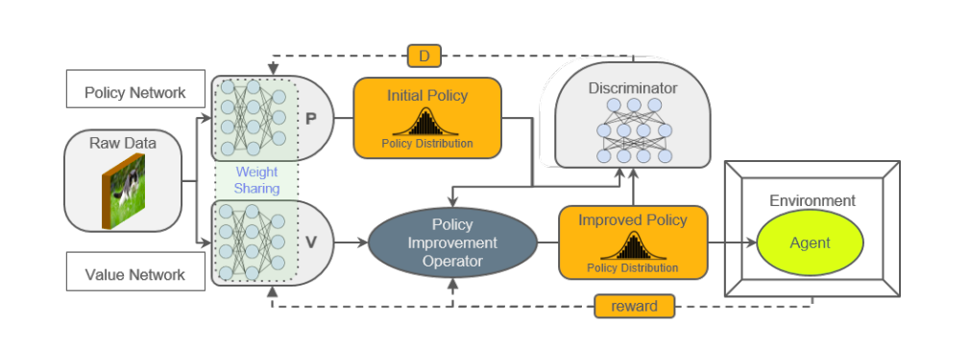
Self-Improving Generative Adversarial Reinforcement Learning

Slide 15
Discussion
Cons
Generative models are hard to train.
Generally requires a large amount of data.
VAEs explore places that does not always make sense.
Pros
Once the saddle point is found, GAN achieve a very good results.
VAEs are the best option to move to latent space.

Slide 16
Conclusion
Work in latent space using VAEs.
The introduction of GANs in RL transformed the actor-critic approach of reinforcement learning to generative adversarial network.
Avoiding reward function, led to achieve multi-task frameworks for robotics.
Private robots able to learn and perform multi-tasks.

Slide 17
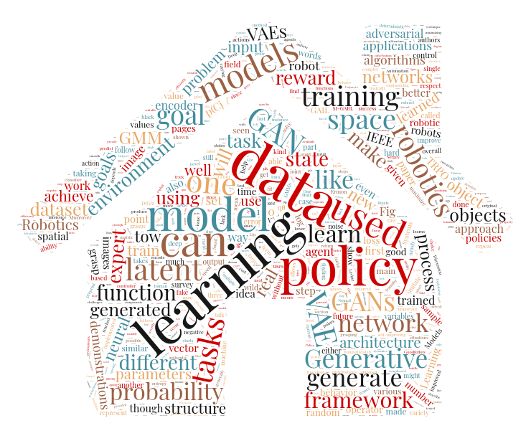
Thank you!

