Slide 2
Experiment Setup
Sample loop
V_{dead}²
*
V_{dead}³
Waste/collect
Benchtop NMR
15 sec/spectra
Online GPC
*
Dilution (HPLC) pump
Reaction Mixture
CVV
V_{dead}¹

Slide 3
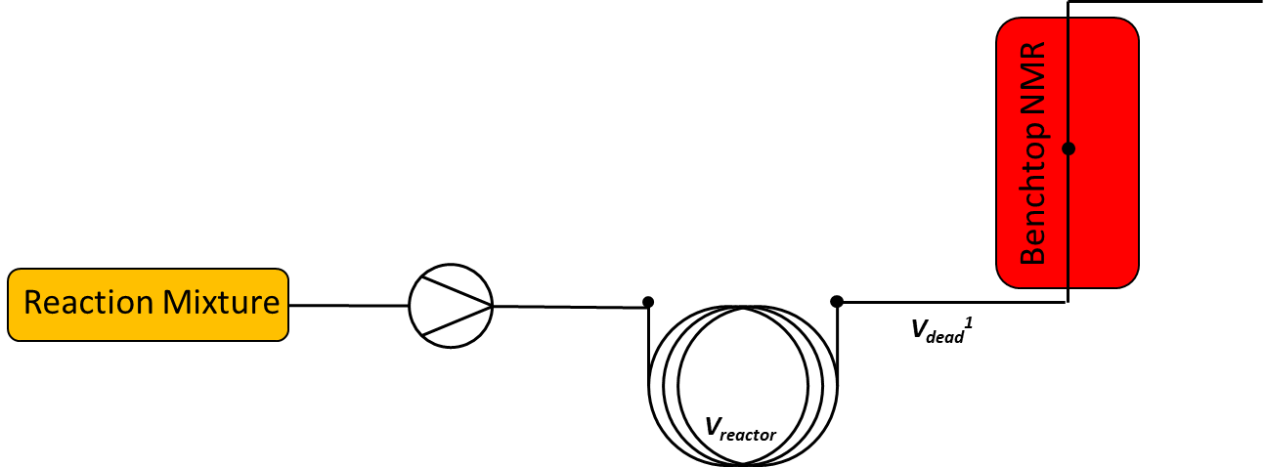
Benchtop NMR
Reaction Mixture
V_{dead}¹
V_{reactor}

Slide 4
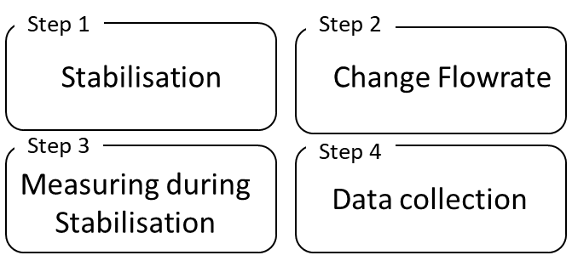
Step 1
Step 2
Stabilisation
Change Flowrate
Step 3
Step 4
Measuring during
Stabilisation
Data collection

Slide 5

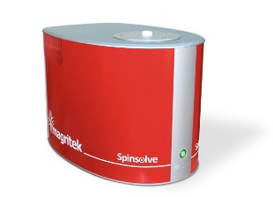



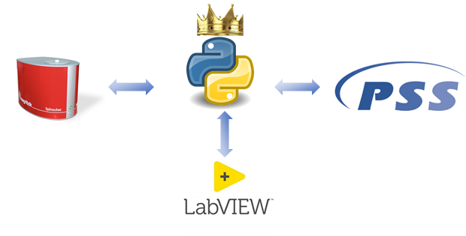
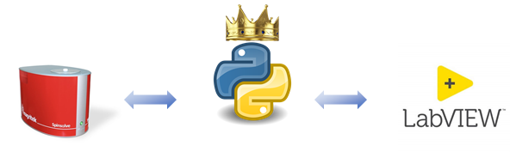

Slide 6


Slide 7
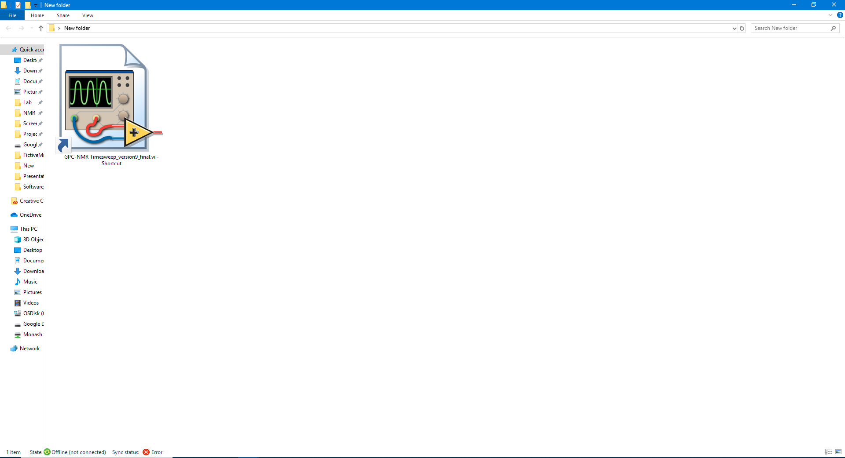
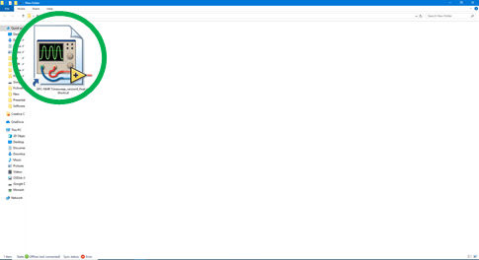
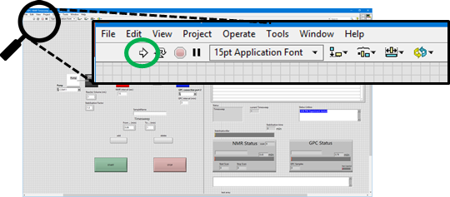

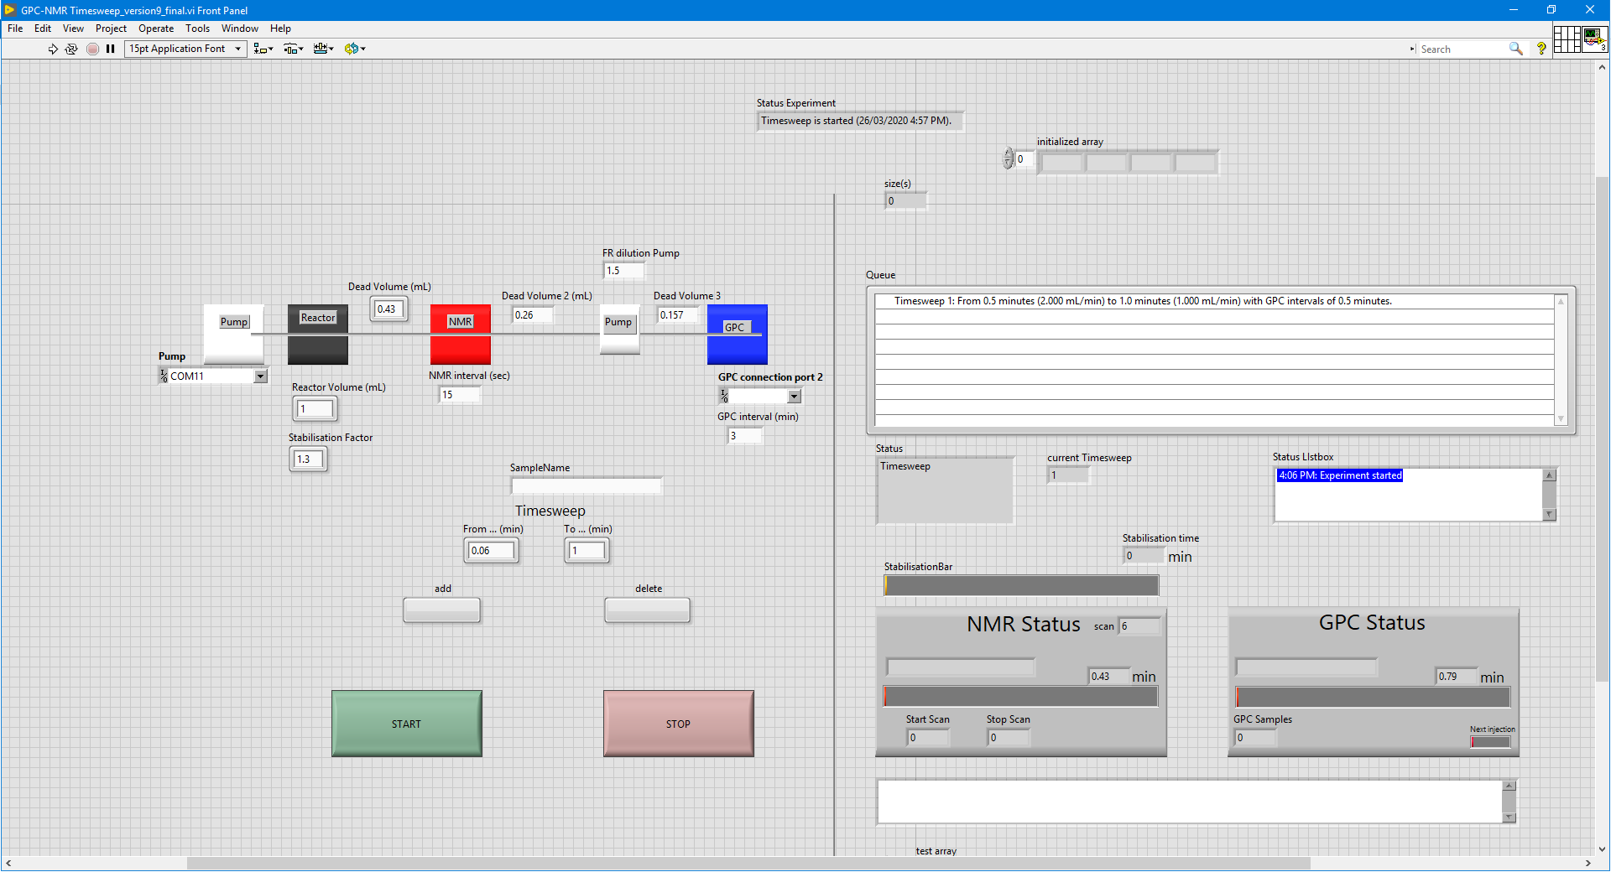


Slide 8
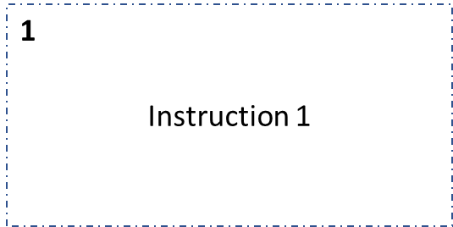
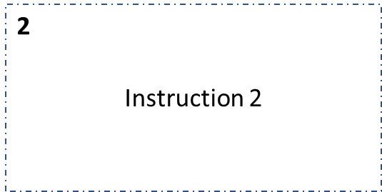


1
Instruction 1
2
Instruction 2
3
Instruction 3
4
Instruction 4

Slide 9
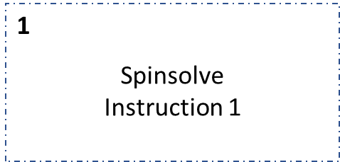
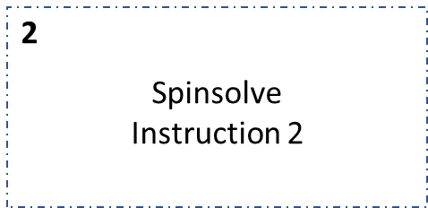
1
Spinsolve
Instruction 1
2
Spinsolve
Instruction 2
3
Instruction 3
4
Instruction 4

Slide 10
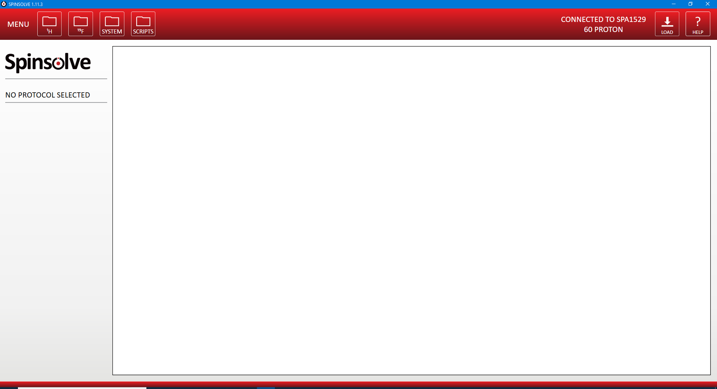
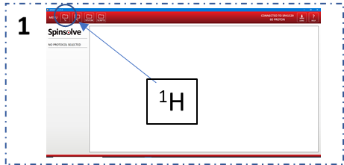
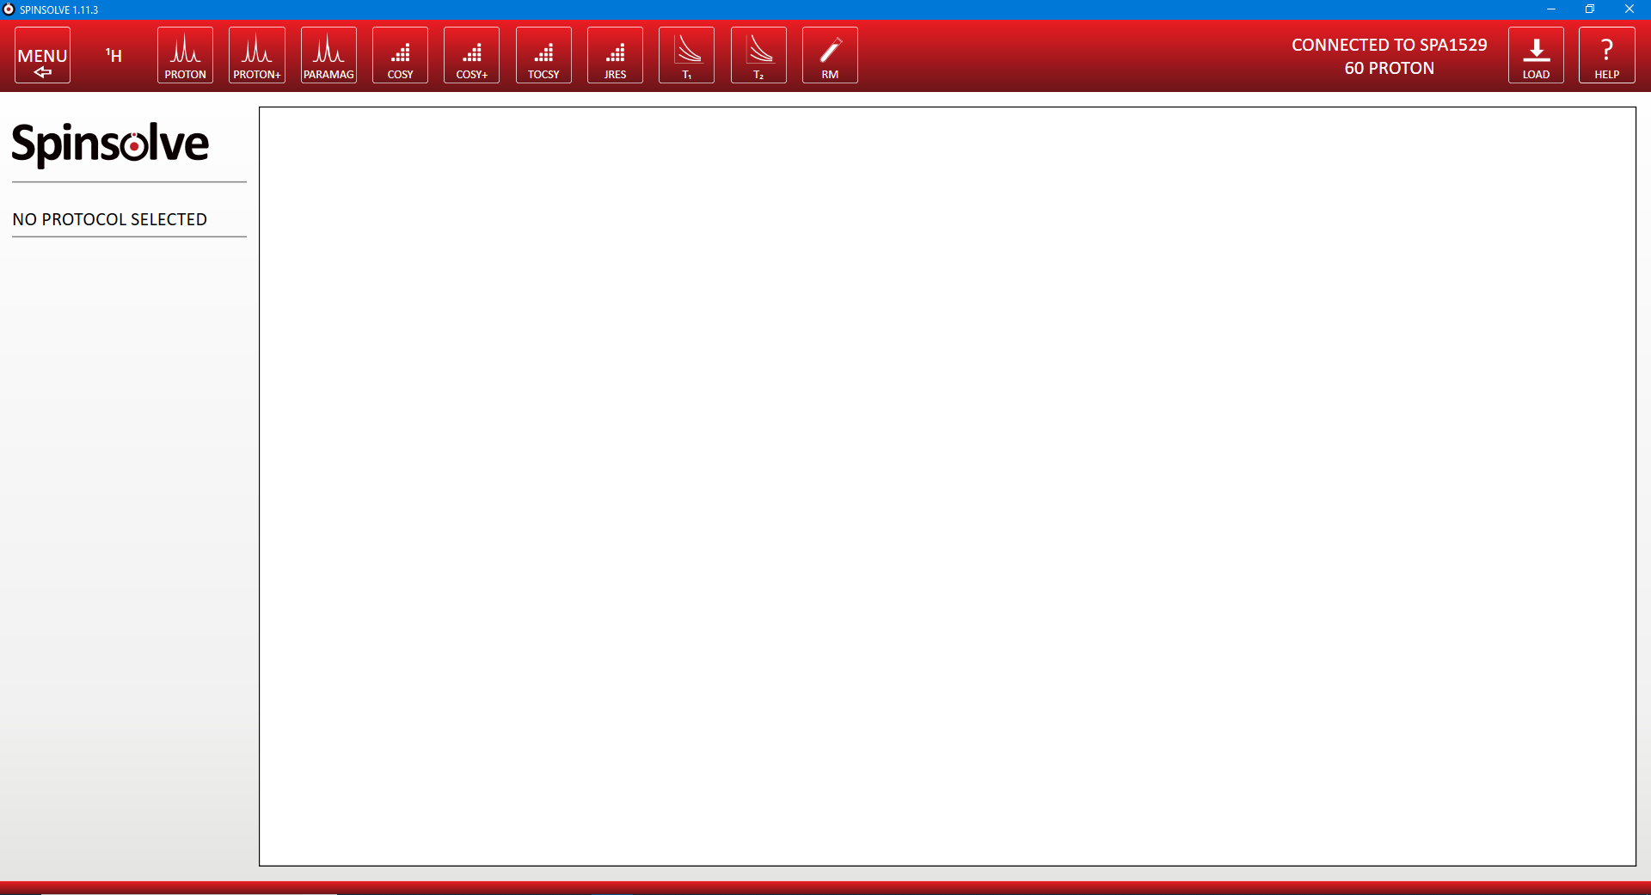
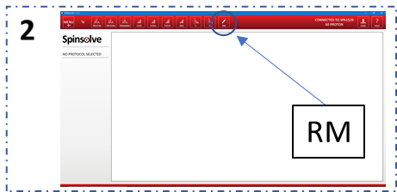
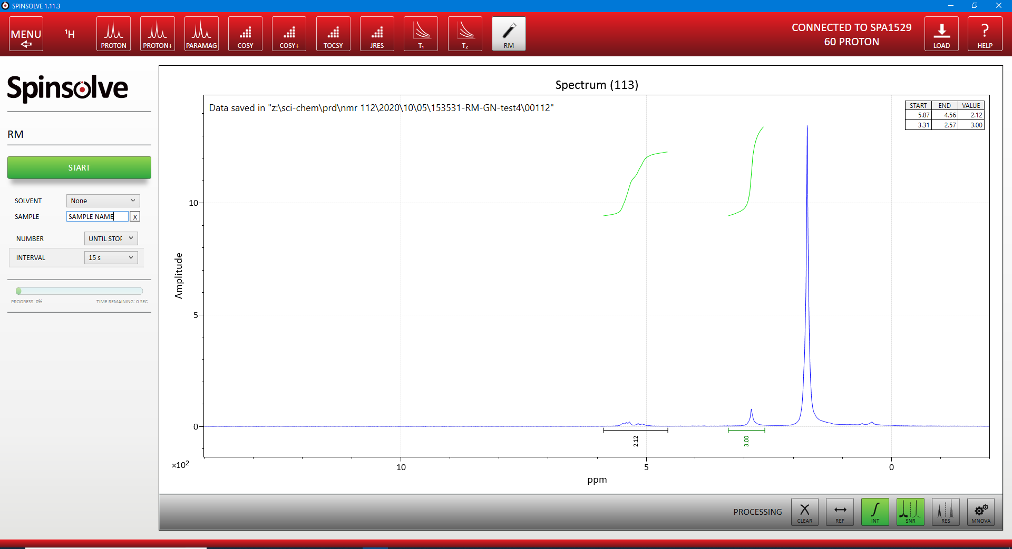
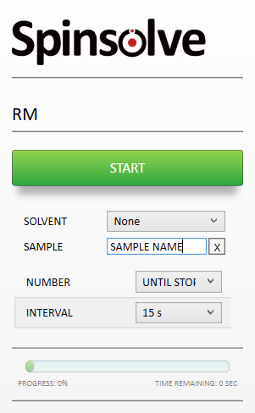
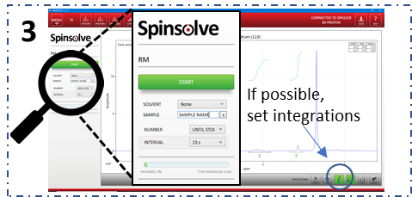

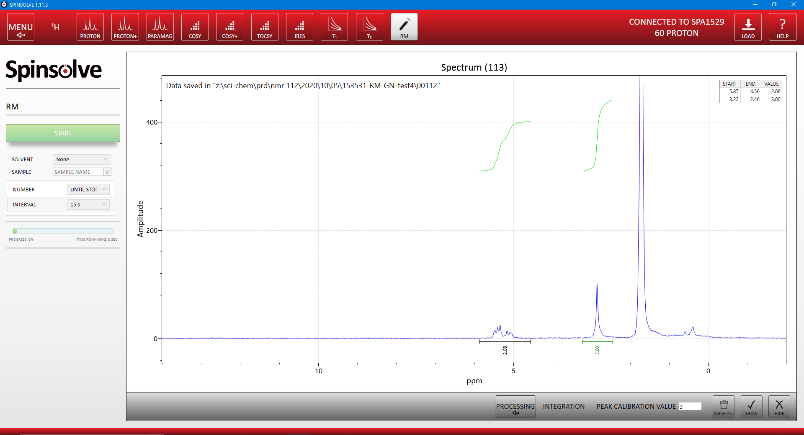
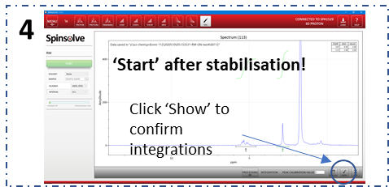
¹H
RM
3
If possible,
set integrations
4
‘Start’ after stabilisation!
Click ‘Show’ to confirm integrations

