Slide 1
Resource Allocation in Wireless Cellular Network
Amirkabir University of Technology

Slide 2
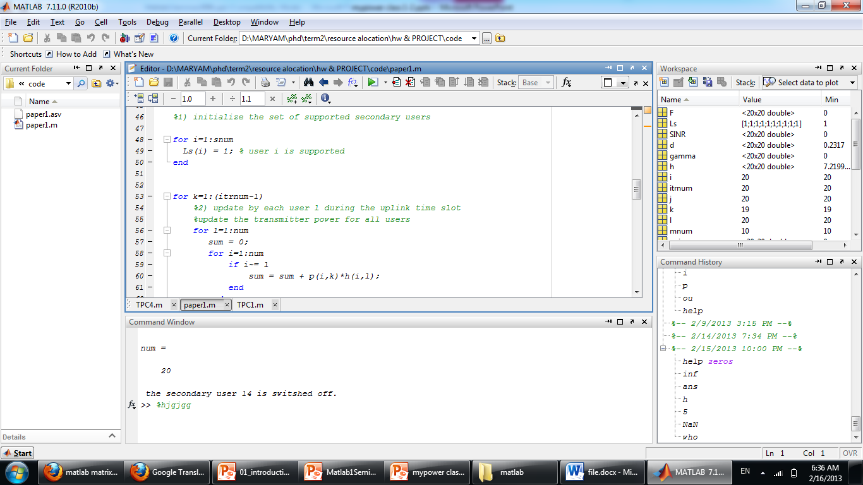
Matlab windows
Workspace
Editor
Arranging windows: Desktop -> layout -> default
Current folder
Command window
Command History

Slide 3
flow control constructs
MATLAB has five flow control constructs:
if statements
switch statements
for loops
while loops
break statements

Slide 4
if
if expression1
statements1
end
if expression1
statements1
elseif expression2
statements2
else
statements3
end

Slide 5
switch
switch switch_expr
case case_expr
statement, ..., statement
case {case_expr1, case_expr2, case_expr3, ...}
statement, ..., statement
otherwise
statement, ..., statement
End
Example:
switch interval < 1
case 1
xinc = interval /10;
case 0
xinc = 0.1;
end
Notes:
Discussion
The switch statement syntax is a means of conditionally executing code. In particular, switch executes one set of statements selected from an arbitrary number of alternatives. Each alternative is called a case, and consists of
The case statement
One or more case expressions
One or more statements
In its basic syntax, switch executes the statements associated with the first case where switch_expr == case_expr. When the case expression is a cell array (as in the second case above), switch executes the case where any of the elements of the cell array matches the switch expression. If no case expression matches the switch expression, then control passes to the otherwise case (if it exists). After the case is executed, program execution resumes with the statement after the end.
The switch_expr can be a scalar or a string. A scalar switch_expr matches a case_expr if switch_expr==case_expr. A string switch_expr matches a case_expr if strcmp(switch_expr,case-expr) returns logical 1 (true).
A case_expr can include arithmetic or logical operators, but not relational operators such as < or >. To test for inequality, use if-elseif statements

Slide 6
for
for index = values
program statements
:
end
for s = [1,5,8,17]
disp(s)
end
for s = 1.0: -0.1: 0.0
disp(s)
end

Slide 7
while
while expression
program statements
:
end
eps = 1;
while (1+eps) > 1
eps = eps/2;
end
eps = eps*2
1) while (A && B) 2) while (A || B)
the statement while (A < B) is true only if each element of matrix A is less than its corresponding element in matrix B.

Slide 8
break
break terminates the execution of a for or while loop.
fid = fopen('fft.m','r');
s = '';
while ~feof(fid)
line = fgetl(fid);
if isempty(line) || ~ischar(line), break, end
s = sprintf('%s%s\n', s, line);
end
disp(s);
fclose(fid);
Notes:
The example below shows a while loop that reads the contents of the file fft.m into a MATLAB character array. A break statement is used to exit the while loop when the first empty line is encountered. The resulting character array contains the command line help for the fft program.

Slide 9
M-Files
So far, we have executed the commands in the command window. But a more practical way is to create a M-file.
The M-file is a text file that consists a group of MATLAB commands.
MATLAB can open and execute the commands exactly as if they were entered at the MATLAB command window.
To run the M-files, just type the file name in the command window. (make sure the current working directory is set correctly)
All MATLAB commands are M-files.

Slide 10
Scripts and Functions
There are two kinds of M-files:
Scripts, which do not accept input arguments or return output arguments. They operate on data in the workspace
Functions, which can accept input arguments and return output arguments. Internal variables are local to the function

Slide 11
User-Defined Function
Add the following command in the beginning of your m-file:
function [output variables] = function_name (input variables);
NOTE: the function_name should be the same as your file name to avoid confusion.
calling your function:
-- a user-defined function is called by the name of the m-file, not the name given in the function definition.
-- type in the m-file name like other predefined commands.
Comments:
-- The first few lines should be comments, as they will be displayed if help is requested for the function name. the first comment line is reference by the lookfor command.
Notes:
lookfor
Search for keyword in all help entries

Slide 12
Function example
Example:
A file called STAT.M:
function [mean, stdev]=stat(x)
%STAT Interesting statistics.
n=length(x);
mean=sum(x)/n;
stdev=sqrt(sum((x-mean).^2)/n);
Defines a new function called STAT that calculates the mean and standard deviation of a vector

Slide 13
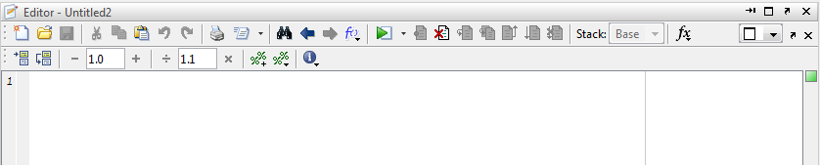
Creating Scripts and functions with MATLAB Editor/Debugger
Scripts in MATLAB has the ".m" suffix.
They are also called "M-files".
Open Matlab Editor:
File New M-file OR:
>> edit
Run scripts

Slide 14
Function m-files
flow.m
function [NRe, f] = flow(D,v,rho,mu)
% flow(Diamter, Velocity, Density,
% Viscosity)
% Outputs NRe and f
% Done on 22-Feb-2002
NRe = D*V*rho/mu;
f = 0.079*NRe^(-0.25);

Slide 15
Calling a Function
» [Re1, f1] = flow(3, 1.5, 900, 0.01)
Re1 =
405000
f1 =
0.0031
» help flow
?

Slide 16
Random matrix
a matrix whose elements are all random numbers.
The most commonly used random numbers are
Uniformly distributed random numbers
Normally distributed random numbers
Random matrices of integers

Slide 17
Uniformly distributed random numbers
Uniformly distributed random numbers in [0; 1) are generated by the rand function
>> r = rand % or rand(1)
>> R = rand(n) % or rand(m,n)
To generate uniformly distributed random numbers in
[a; b) use
>> R = a + (b - a)*rand(m, n)

Slide 18
Normally distributed random numbers
To generate normally distributed random numbers with mean 0 and standard deviation 1 use
>> R = randn(m, n)
To obtain mean “mu” and standard deviation “sig” use
>> R = mu + sig*randn(m, n)

Slide 19
Random matrices of integers
To generate one integer in the interval [1; k ]
>> r = randi(k)
To generate one integer in the interval [k1; k2]
>> r = randi([k1 k2])
To generate a matrix of integers in the interval [1; k ]
>>R = randi(k, n) % or randi(k, m, n)
To generate a matrix of integers in the interval [k1; k2]
>> R = randi([k1 k2], n) % or randi([k1 k2], m,n)

Slide 20
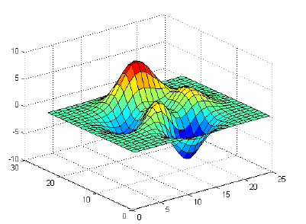
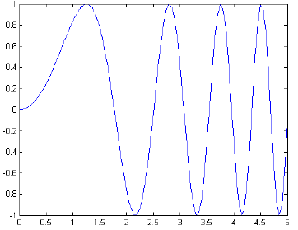
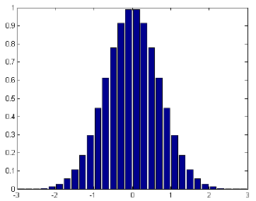
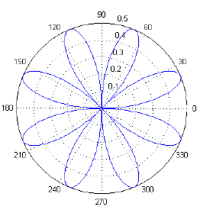
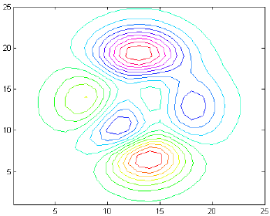
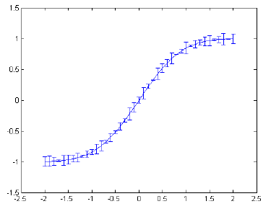
Basics
Matlab has a powerful plotting engine that can generate a wide variety of plots.

Slide 21
Generating Data
Matlab does not understand functions, it can only use arrays of numbers.
a=t²
b=sin(2*pi*t)
c=e^{-10*t} note: matlab command is exp()
d=cos(4*pi*t)
e=2t³-4t²+t
Generate it numerically over specific range
Try and generate a-e over the interval 0:0.01:2
t=0:0.01:10; %make x vector
y=t.^2; %now we have the appropriate y
% but only over the specified range

Slide 22
Plot
plot Linear plot.
plot(X,Y) plots vector Y versus vector X
plot(Y) plots the columns of Y versus their index
plot(X,Y,S) with plot symbols and colors

Slide 23
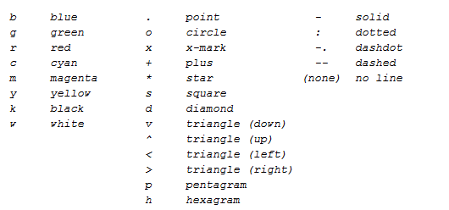
symbols and colors
plot(X,Y,S)
S is a character string made from one element from any or all the following 3 columns:

Slide 24
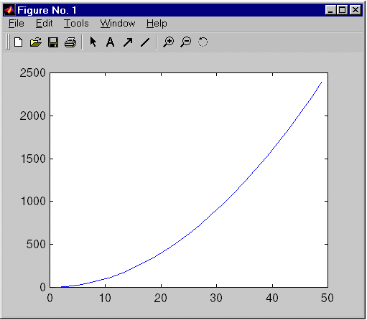
Plot example
» x = 1:2:50;
» y = x.^2;
» plot(x,y)
»

Slide 25
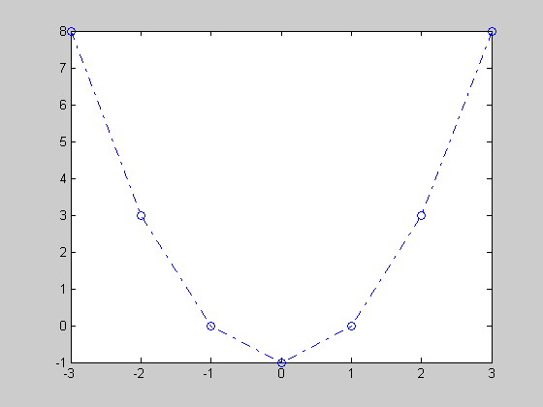
Plot example
>>x = [-3 -2 -1 0 1 2 3];
>>y1 = (x.^2) -1;
>>plot(x, y1,'bo-.');

Slide 26
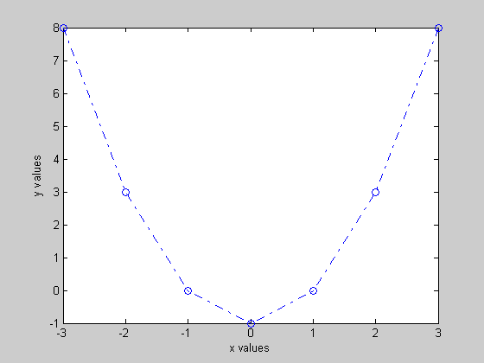
Plot Properties
Example
XLABEL X-axis label.
XLABEL('text') adds text beside the X-axis on the current axis.
YLABEL Y-axis label.
YLABEL('text') adds text beside the Y-axis on the current axis.
...
xlabel('x values');
ylabel('y values');

Slide 27
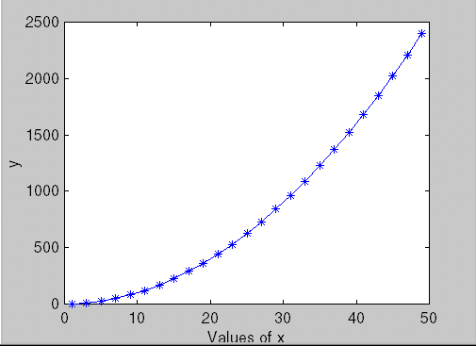
Plot example
» x = 1:2:50;
» y = x.^2;
» plot(x,y,'*-')
» xlabel('Values of x')
» ylabel('y')
»

Slide 28
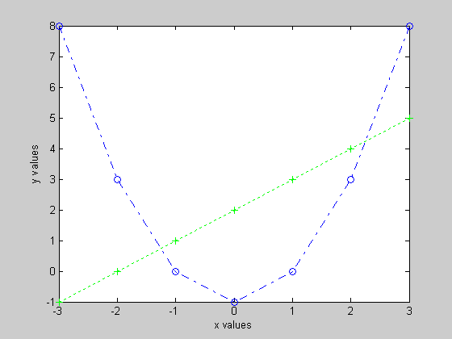
Hold
Example
HOLD Hold current graph.
HOLD ON holds the current plot and all axis properties so that subsequent graphing commands add to the existing graph.
HOLD OFF returns to the default mode
HOLD, by itself, toggles the hold state.
...
hold on;
y2 = x + 2;
plot(x, y2, 'g+:');

Slide 29
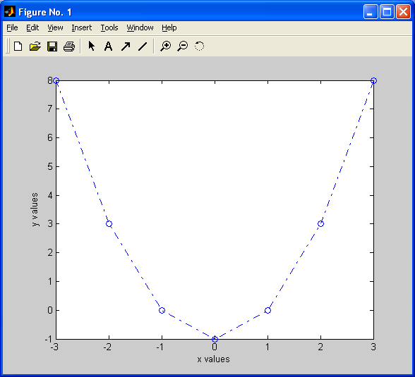
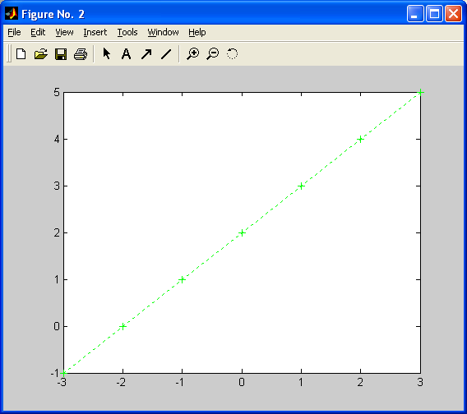
Figure
FIGURE Create figure window.
FIGURE, by itself, creates a new figure window, and returns its handle.
Example
x = [-3 -2 -1 0 1 2 3];
y1 = (x.^2) -1;
% Plot y1 in the 1st Figure
plot(x, y1,'bo-.');
xlabel('x values');
ylabel('y values');
% Plot y2 in the 2nd Figure
figure
y2 = x + 2;
plot(x, y2, 'g+:');

Slide 30
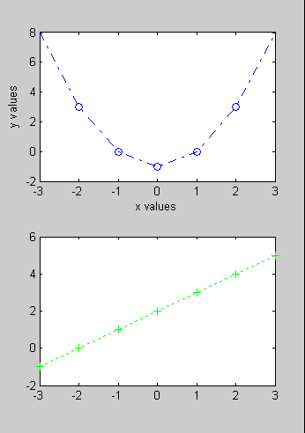
Subplot
SUBPLOT Create axes in tiled positions.
SUBPLOT(m,n,p), or SUBPLOT(mnp), breaks the Figure window into an m-by-n matrix of small axes
Example
x = [-3 -2 -1 0 1 2 3];
y1 = (x.^2) -1;
% Plot y1 on the top
subplot(2,1,1);
plot(x, y1,'bo-.');
xlabel('x values');
ylabel('y values');
% Plot y2 on the bottom
subplot(2,1,2);
y2 = x + 2;
plot(x, y2, 'g+:');

Slide 31
Exercise
Create the following:
x = (1, 1.05, 1.1, 1.15… 5)
Y=sin(x)
Z=log(x)
Put your name in the title

Slide 32
Solution
x=1:0.05:5;
y=sin(x);
z=log(x);
hold on
plot (x,y,'-.r*')
plot (x,z,'-.go')
hold off
title ('Merav''s graph');
xlabel ('x')
ylabel ('y')
legend ('sin(x)', 'log(x)');

