Slide 1
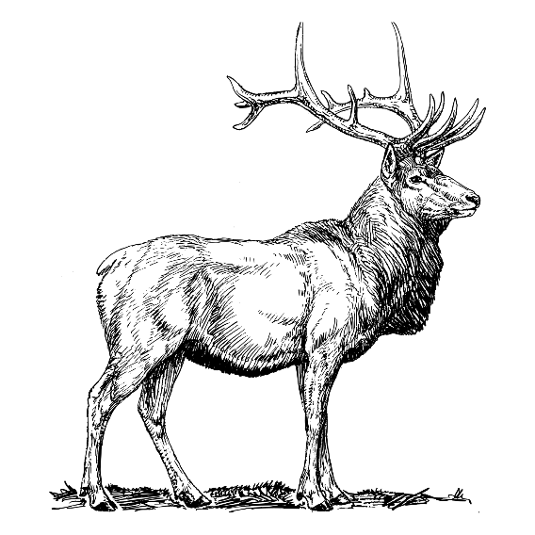
REINDEER SOFTWARE
PROTEIN-LIGAND FEATURE GENERATOR

