Slide 1
LEAD SCORING CASE STUDY
“Lead Scoring in Action: A Case Study in Precision Marketing"

Slide 2


Assisting XEducation in selecting high-potential leads that have the greatest chance of turning into customers.
Higher Lead Conversion Rate
Focused Marketing
Selection of Hot Leads

Slide 3
METHODOLOGY
Designing a Logistic Regression model to rank leads based on their likelihood of conversion, with the goal of achieving an approximate 80% lead conversion rate.

Slide 4




Importing and Observing the past data provided by the Company
Univariate and Bivariate analysis
Data Cleaning
Exploratory Data Analysis
Data Preparation
Missing value imputation
Removing duplicate data and other redundancies
Outlier treatment
Dropping unnecessary columns
Dummy variable creation
Feature standardization

Slide 5
Feature selection using RFE
Manual feature elimination based on p-values and VIFs
Building another model using PCA
Comparing the two models
Model Building
Model Evaluation
Comparison with PCA
Assigning Lead Scores
Evaluating model based on various evaluation metrics
Finding the optimal probability threshold
Finalizing the first model
Using predicted probabilities to calculate Lead Scores:
Lead Score = Probability * 100

Slide 6
DATA VISUALIZATION
To identify important features
To get insights

Slide 7
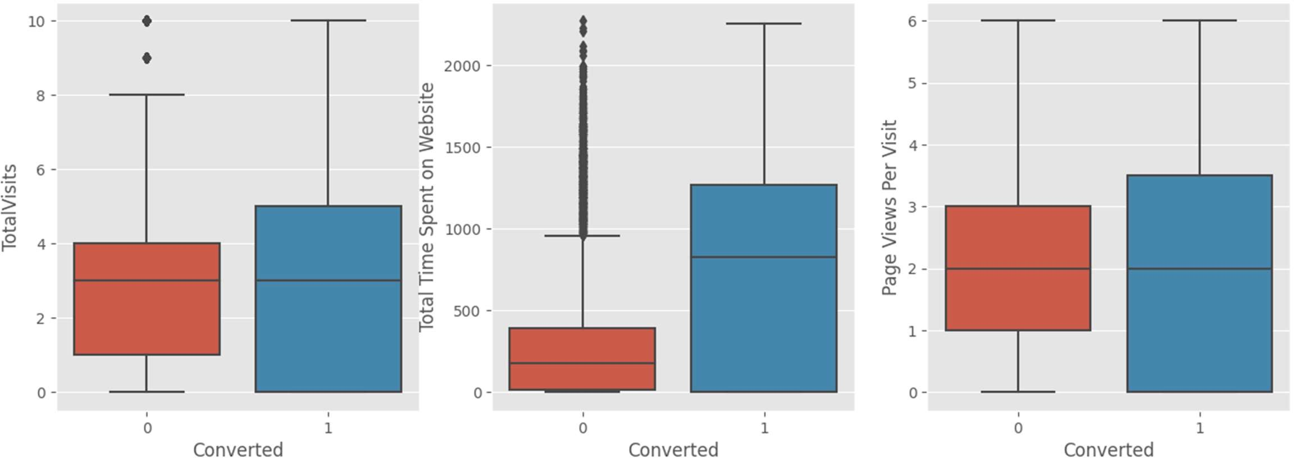
People spending more time on website are more likely to get converted.

Slide 8




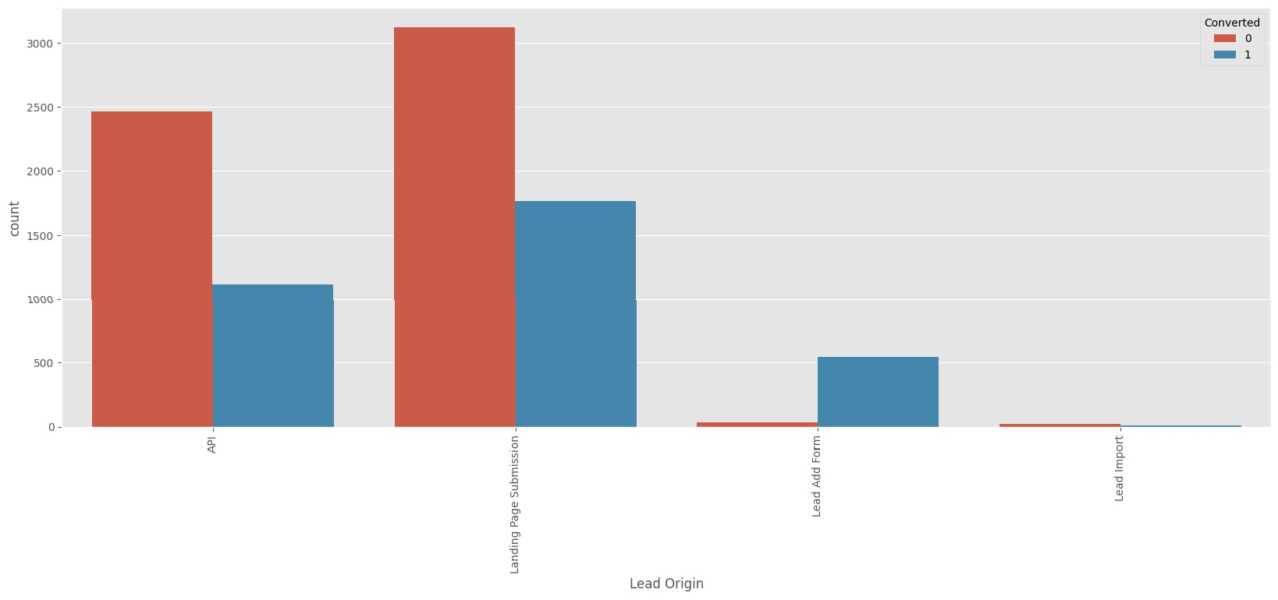
‘API’ and ‘Landing Page Submission’ generate the most leads but have less conversion rates, whereas ‘Lead Add Form’ generates less leads but conversion rate is great.
Tryto increase conversion rate for ‘API’ and ‘Landing Page Submission’, and increase leads generation using ‘Lead Add Form’.

Slide 9
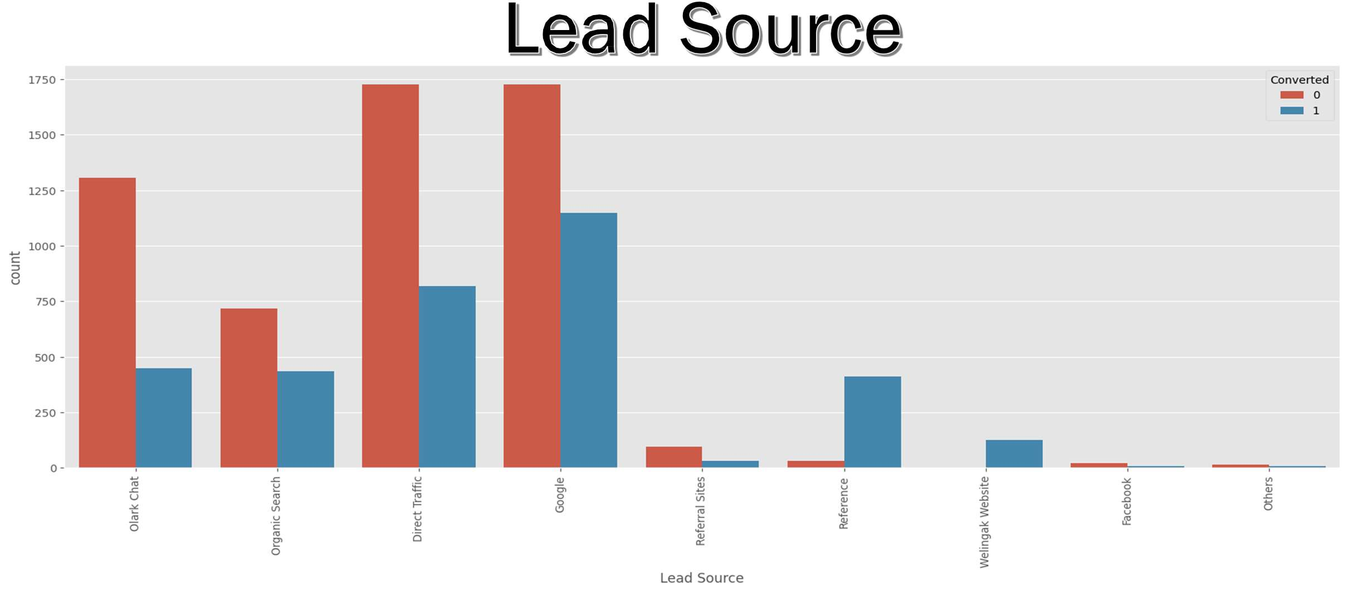


Very high conversion rates for lead sources ‘Reference’ and ‘Welingak Website’
Most leads are generated through ‘Direct Traffic’ and ‘Google’.

Slide 10





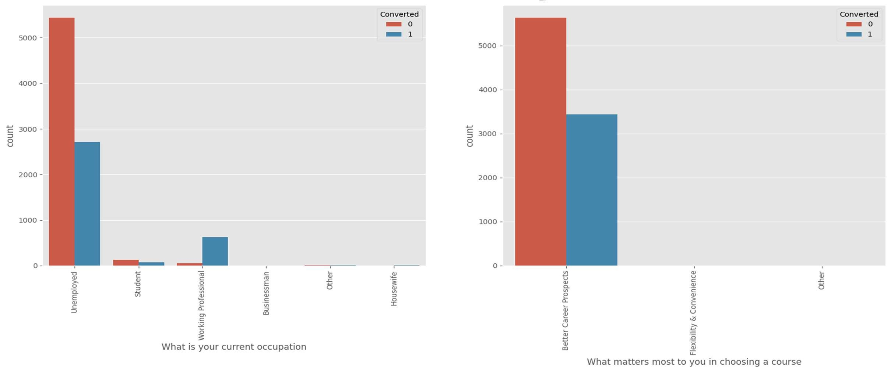
Working Professionals are most likely to get converted.

Slide 11
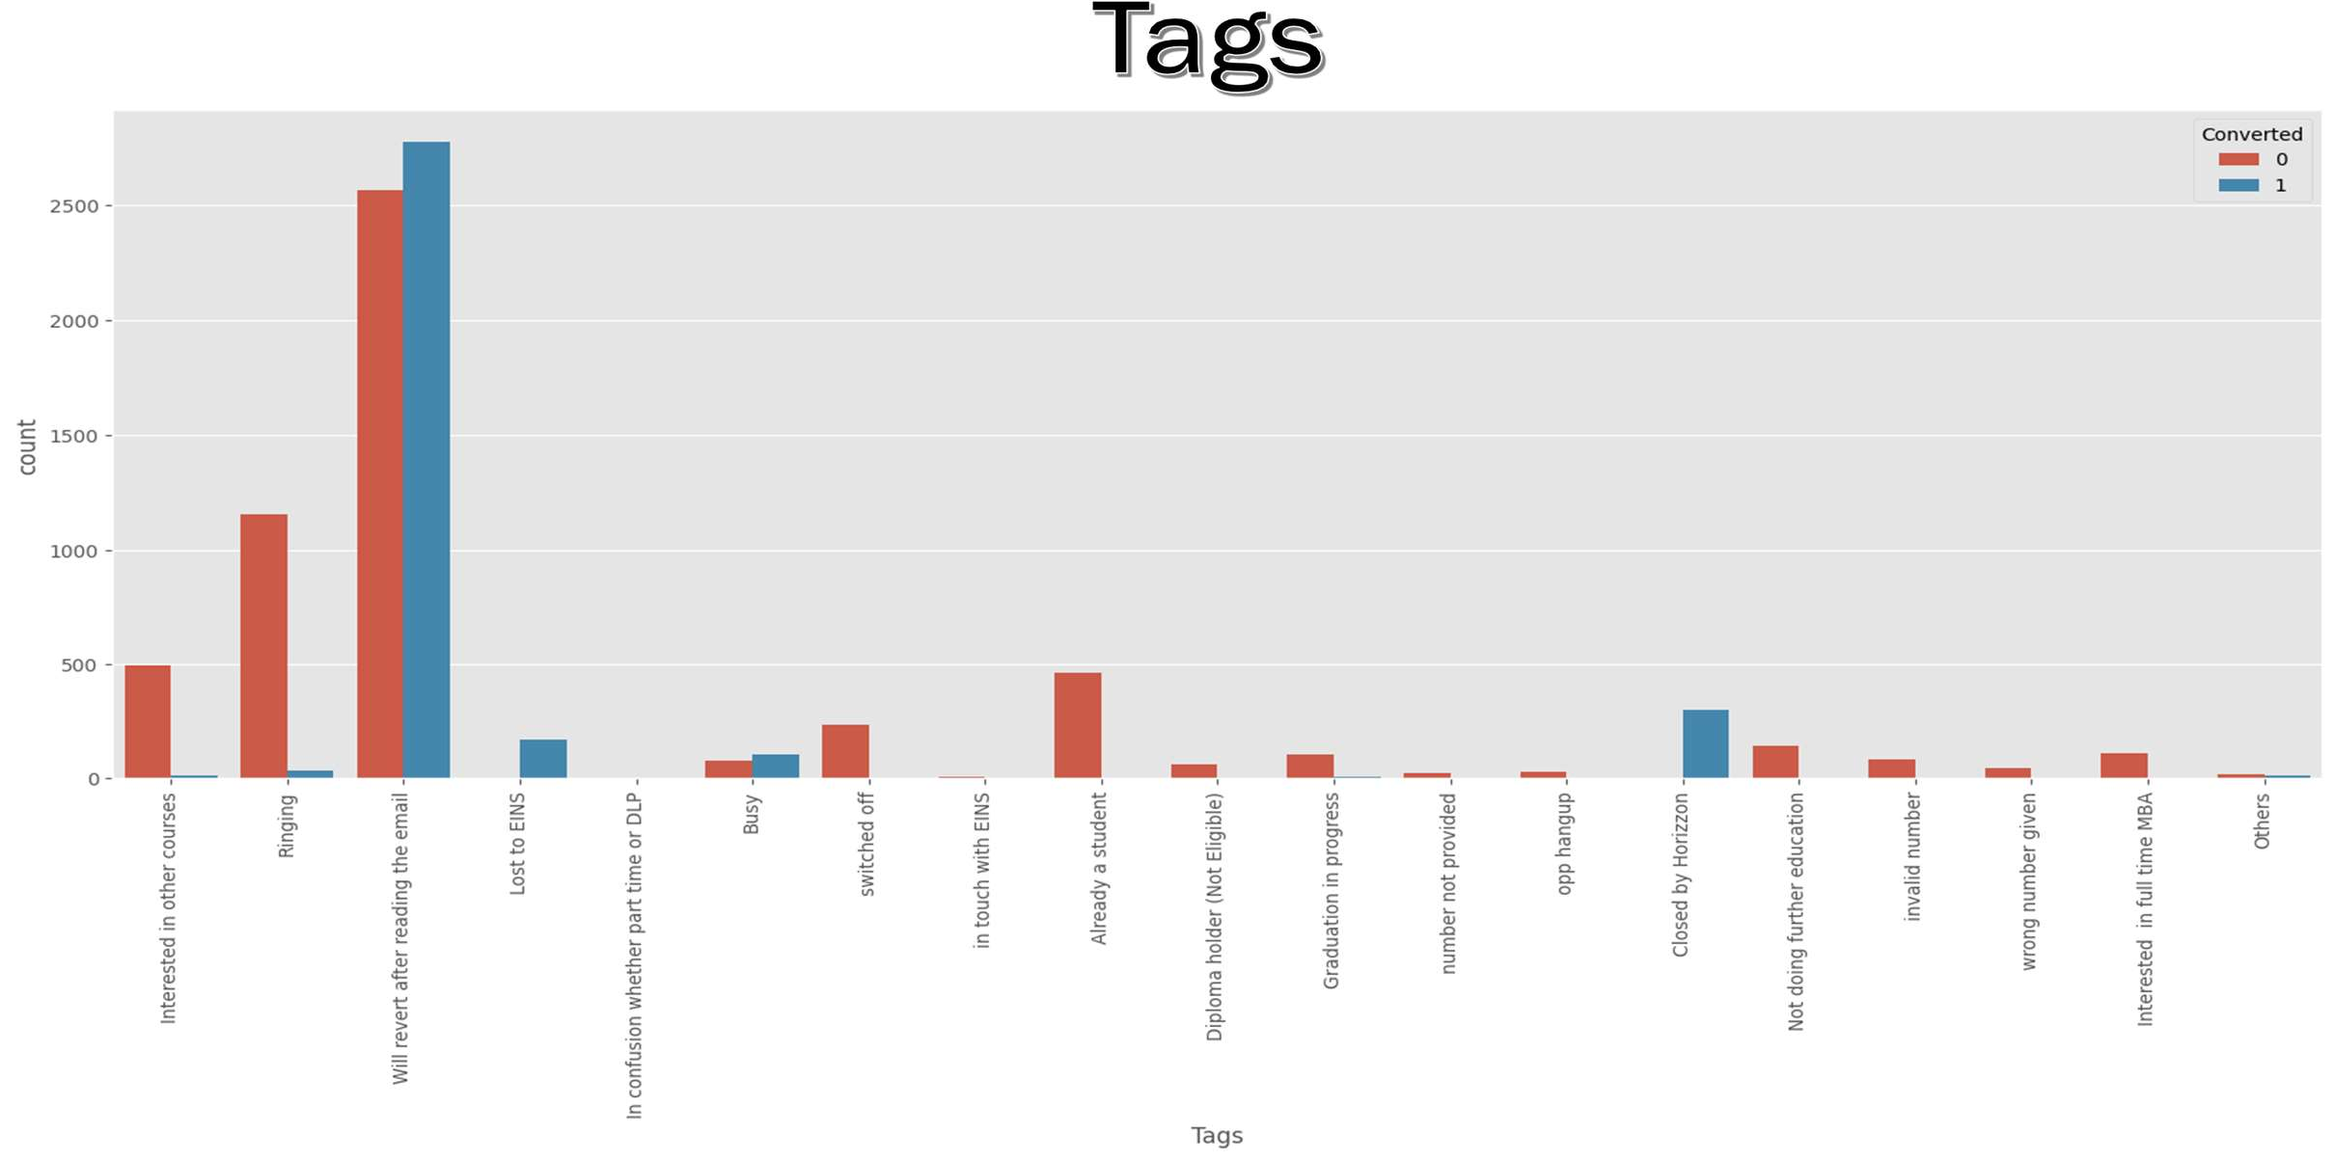
High conversion rates for tags ‘Will revert after reading the email’, ‘Closed by Horizon’, ‘Lost to EINS’, and ‘Busy’.

Slide 12
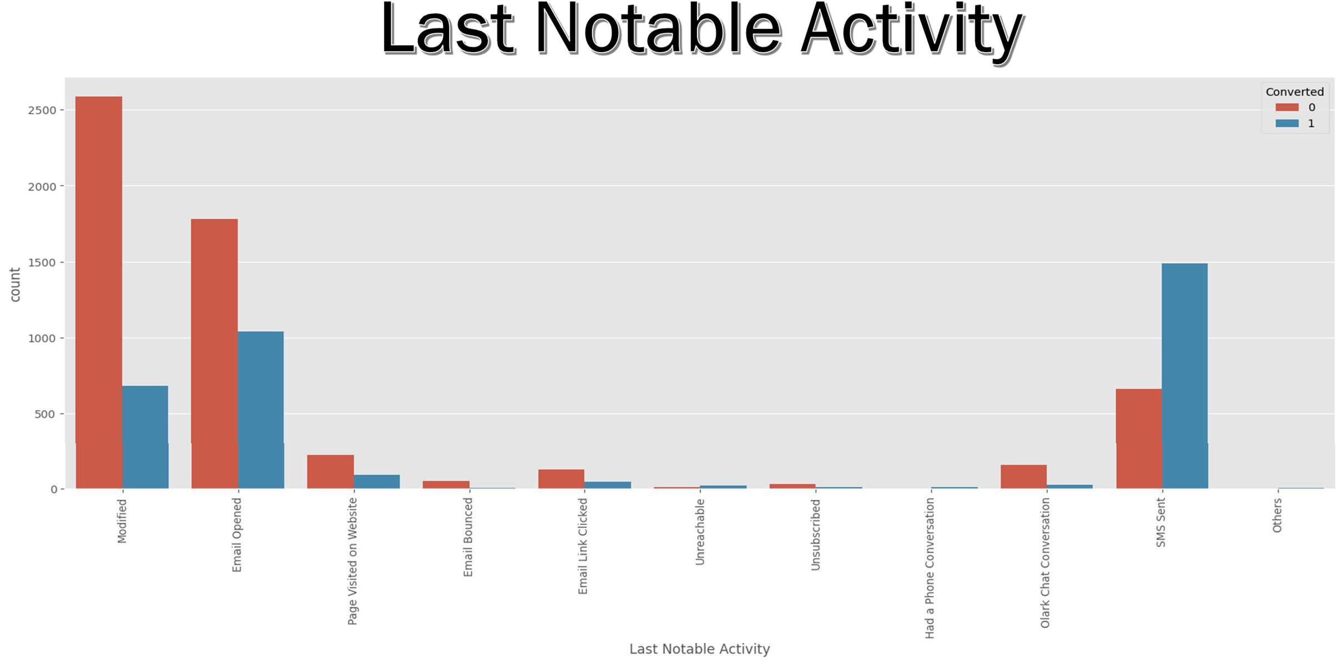
Highest conversion rate is for the last notable activity ‘SMSSent’.

Slide 13
MODEL EVALUATION

Slide 14
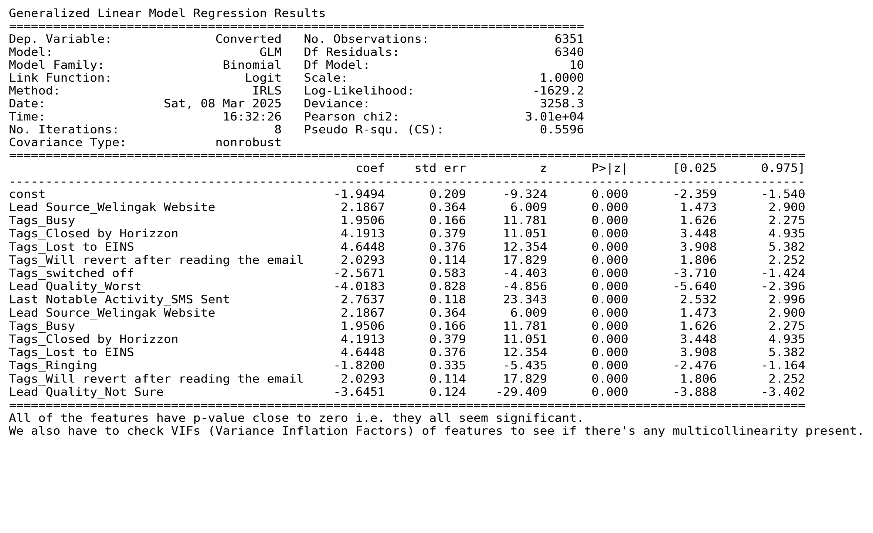
Final Model Summary: Al p-values are zero

Slide 15
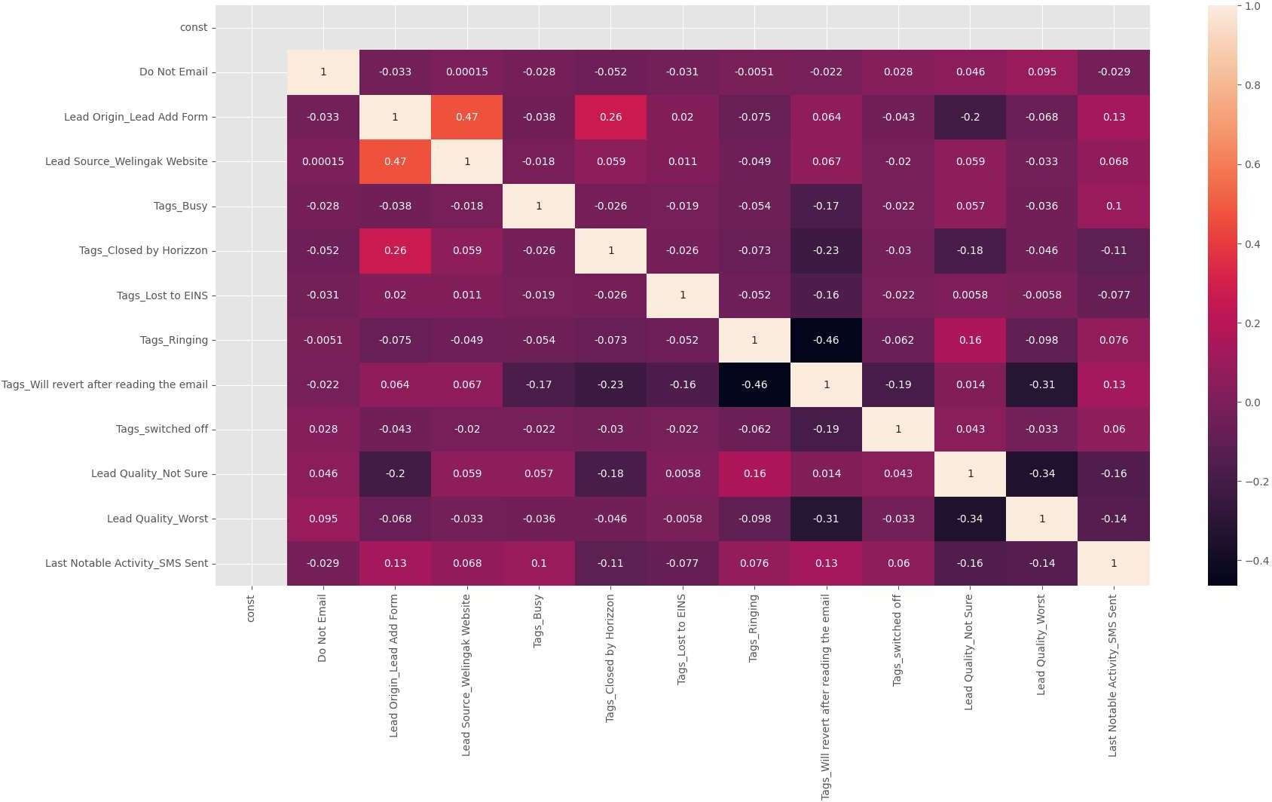
Correlations between features in the final model are negligible.

Slide 16
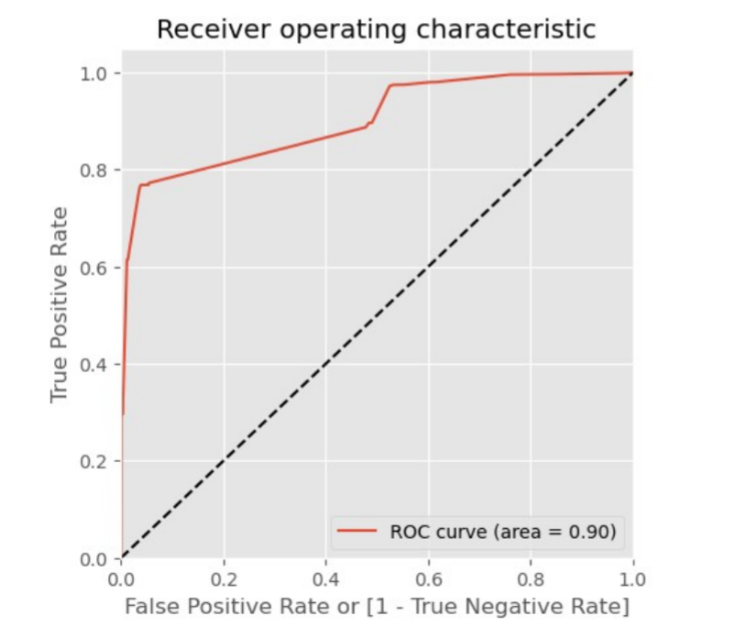
Area under curve = 0.90

Slide 17




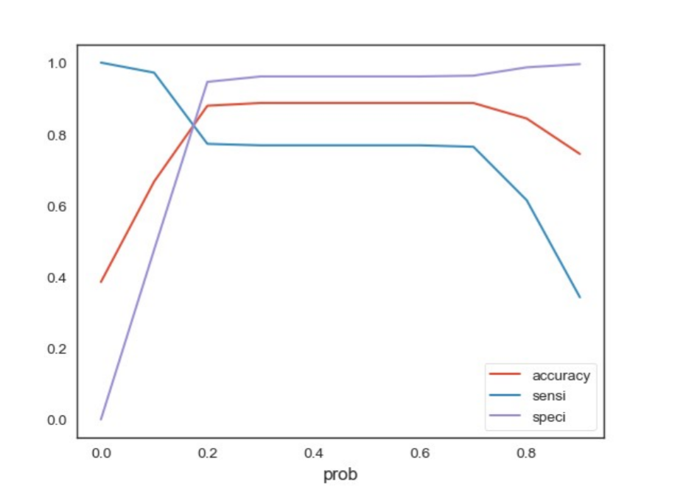
Graph showing changes in Sensitivity, Specificity and Accuracy with changes in the probability threshold values
Optimal cutoff = 0.20

Slide 18

Data | Train set | Test set
Accuracy | 0.8776 | 0.9070
Sensitivity | 0.7686 | 0.8402
Specificity | 0.9460 | 0.9452
False Positive Rate | 0.0540 | 0.0541
Positive Predictive Value | 0.8991 | 0.8974
Negative Predictive Value | 0.8671 | 0.9120
AUC | 0.9009 | 0.9362

Slide 19
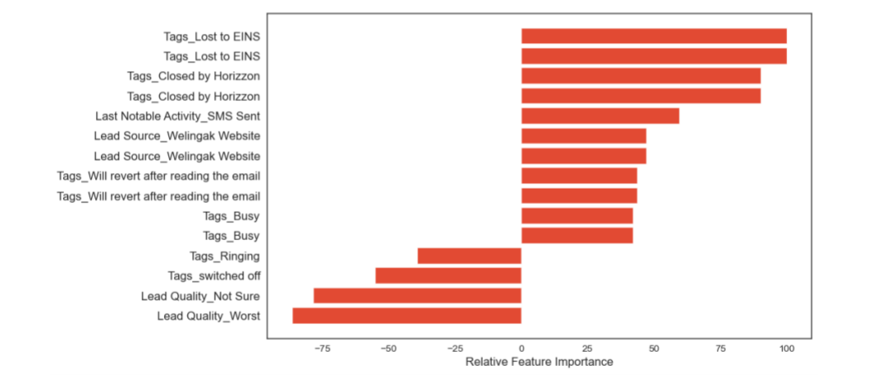

Slide 20

INFERENCES

Slide 21

Three variables which contribute most towards the probability of a lead conversion in decreasing order of impactare:
Tags_Lost to EINS
Tags_Closed by Horizzon
Tags_Wi l revert after reading the email
These are dummy features created from the categorical variableTags.
All three contribute positively towards the probability of a lead conversion.
These results indicate that the company should focus more on the leads with these three tags.

Slide 22
By referring to the data visualizations, focus on
Increasing the conversion rates for th generating categories more leads and conversion.
Generating more leads for categories having high rates.
Pay attention to the relative importance of the features in the model and their positive or negative impact on the probability of conversion.
Based on varying business needs, modify the probability threshold value for identifying potential leads.

Slide 23
THANK YOU

