Slide 1

TDD WORKSHOP

Slide 2
OVERVIEW
Types of tests and software testing
What is TDD and how it works
Pair programming in practice

Slide 3
What is testing?
Why we write tests?
Tests are not the goal

Slide 4
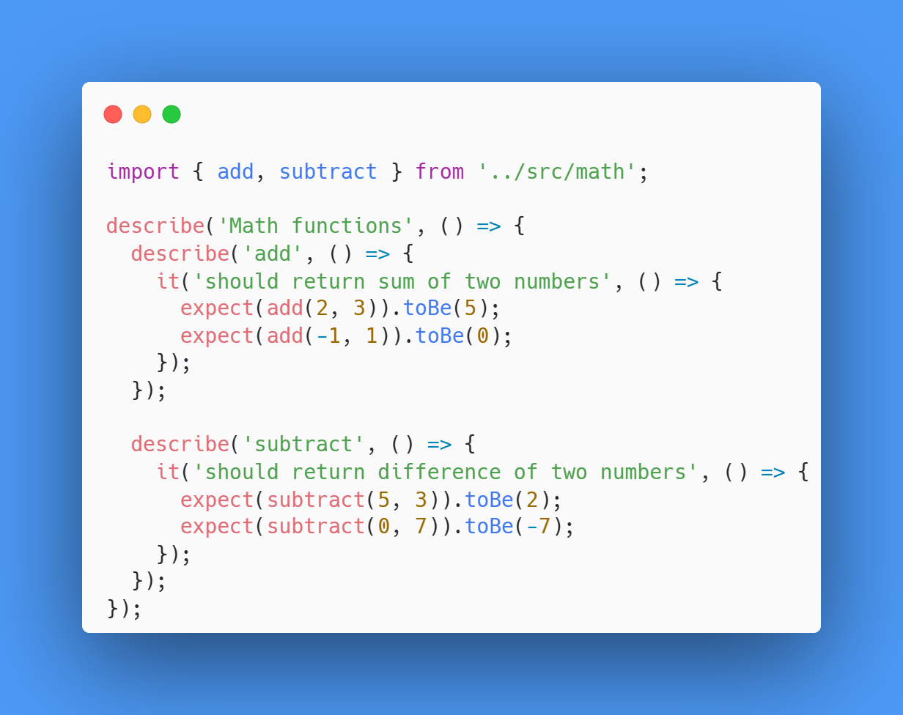

Slide 5
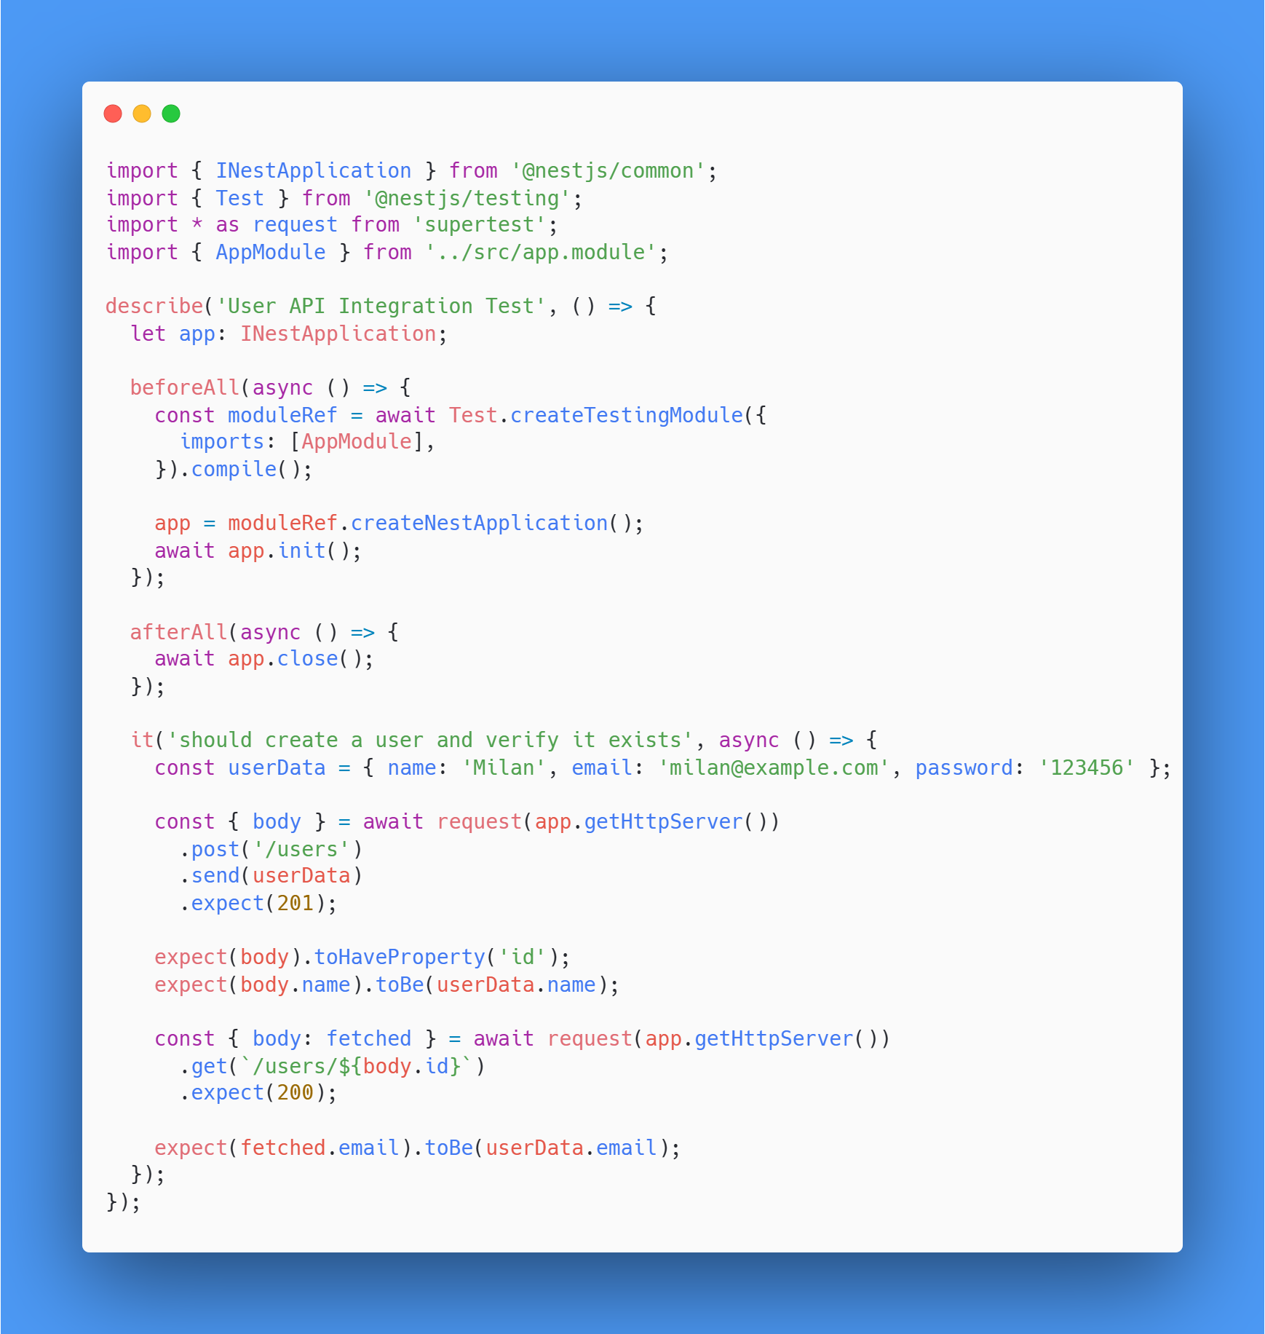

Slide 6
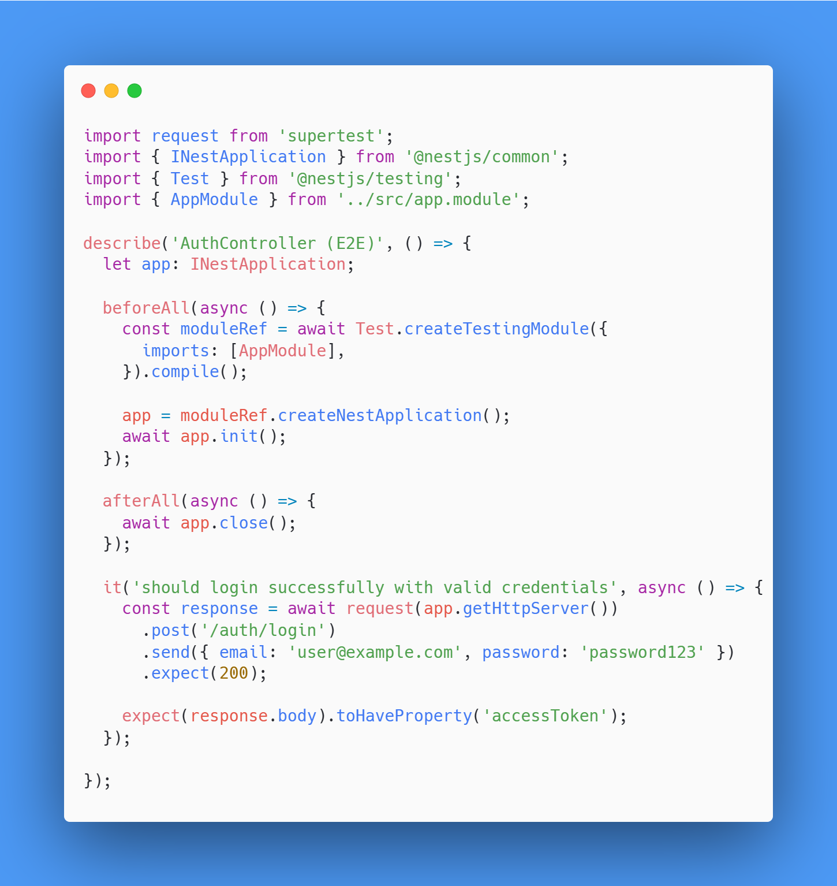

Slide 7
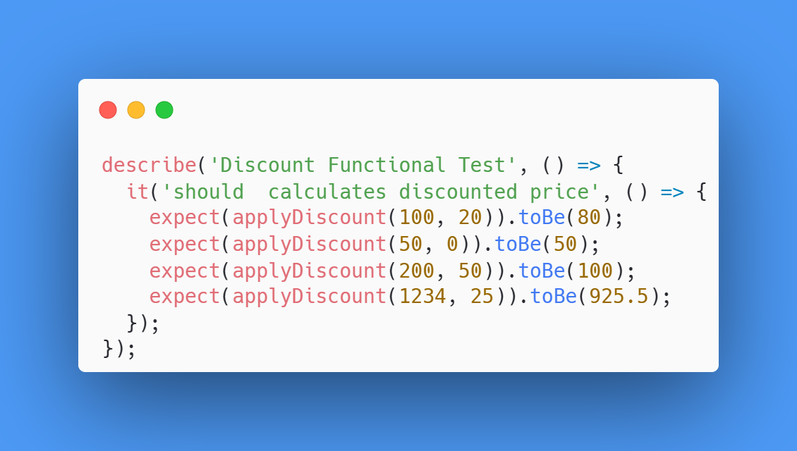

Slide 8
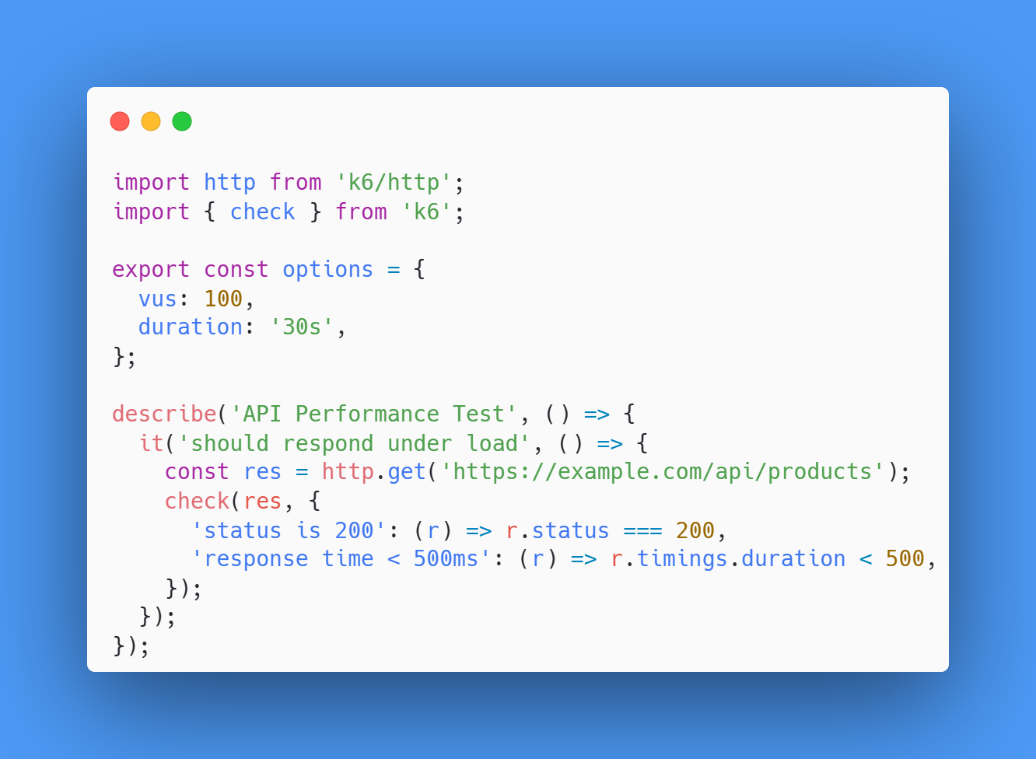

Slide 9
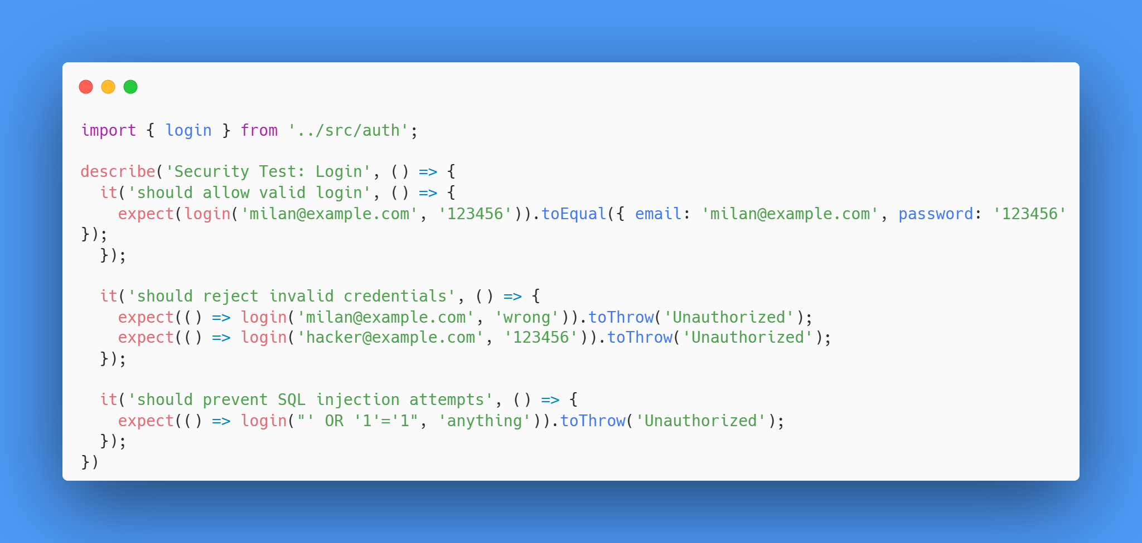

Slide 10
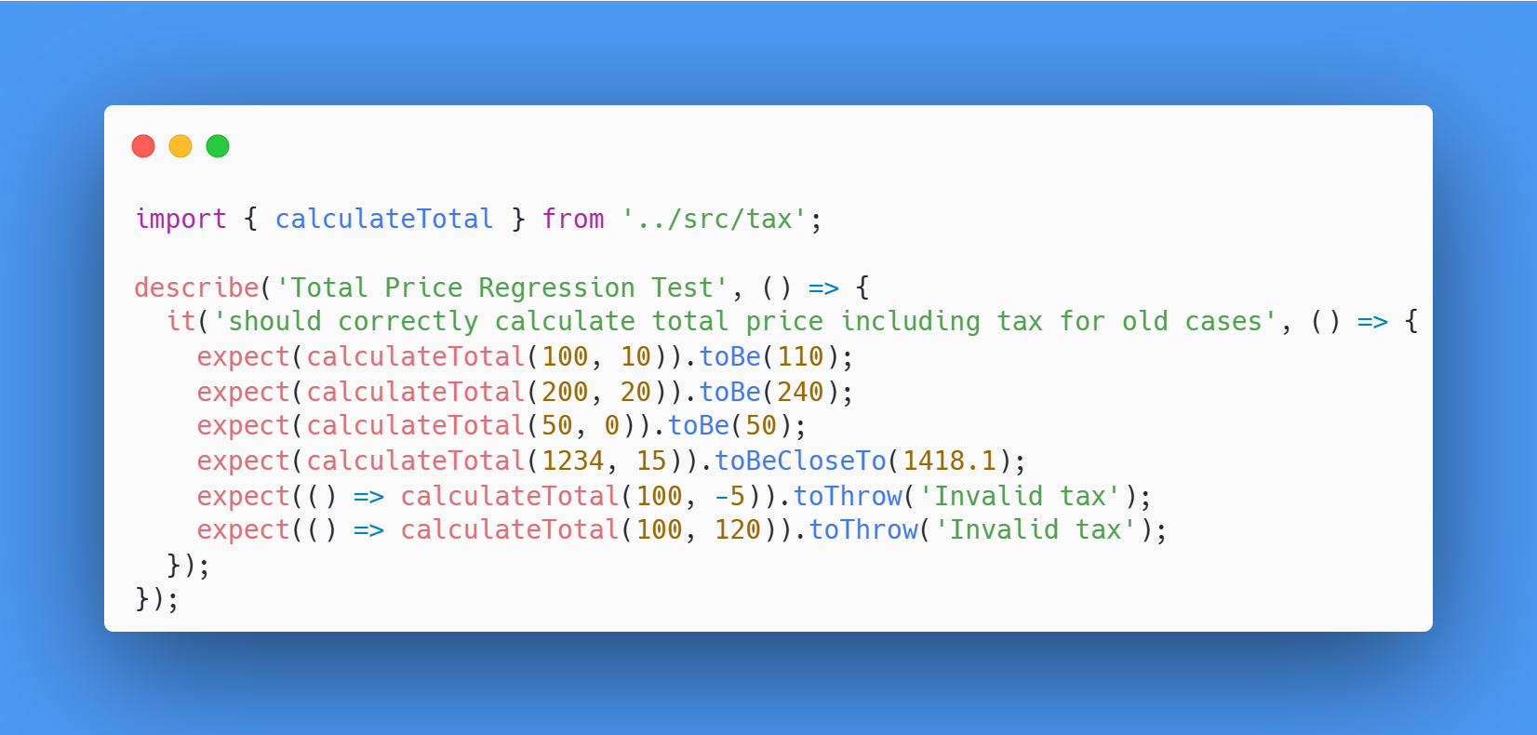

Slide 11
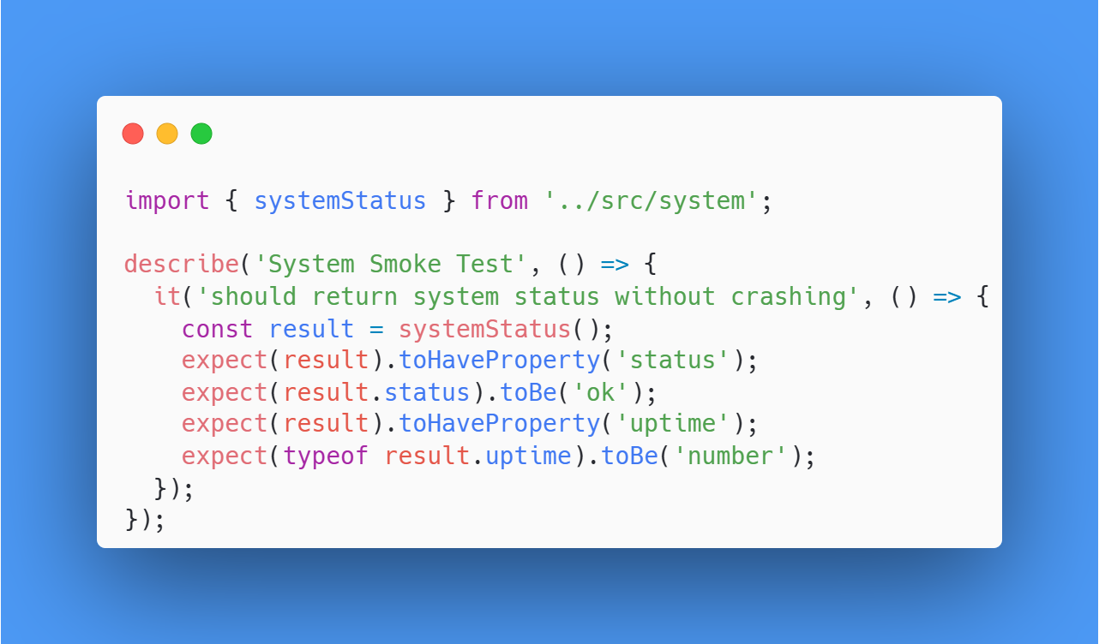

Slide 12
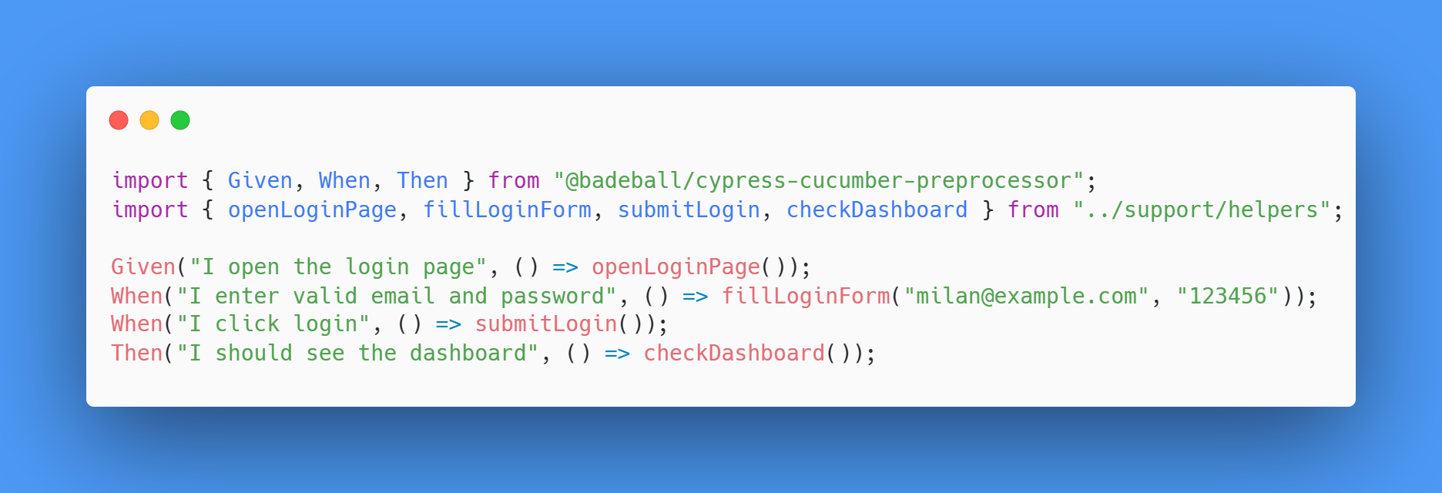

Slide 13
TDD
Test-Driven Development
Red → Green → Refactor

Slide 14
PAIR PROGRAMMING
Navigator
Driver
Switch

Slide 15
QUESTIONS?

