Slide 1
Problem Statement
PhishShield: Real-time Phishing URL Detector.
Develop a browser extension or app that can detect and block phishing websites in real-time, with a scoring system and visual alert for the user.

Slide 2
Problem Description
Phishing has become one of the most widespread and damaging cyber threats, targeting millions of users each year. By creating fake but convincing websites, attackers trick individuals into revealing sensitive data such as:
Login credentials
Banking information
Personal details.
These sites often impersonate trusted services—banks, e-commerce portals, social media platforms—using lookalike domains, copied designs, and even valid security certificates. The sophistication of such attacks makes them extremely difficult for ordinary users to detect.

Slide 3
Solution Overview
Our Solution is to build a real-time phishing detection and blocking system as a browser extension . It will run directly while we browse, checking every site we visit and evaluating whether it’s doing phishing related activities. To do this, I’ll combine several layers:
> Blacklist checks against known phishing domains
> Heuristic analysis of suspicious URL patterns
> SSL/TLS certificate validation
> Page content inspection to catch fake login forms or hidden scripts.

Slide 4
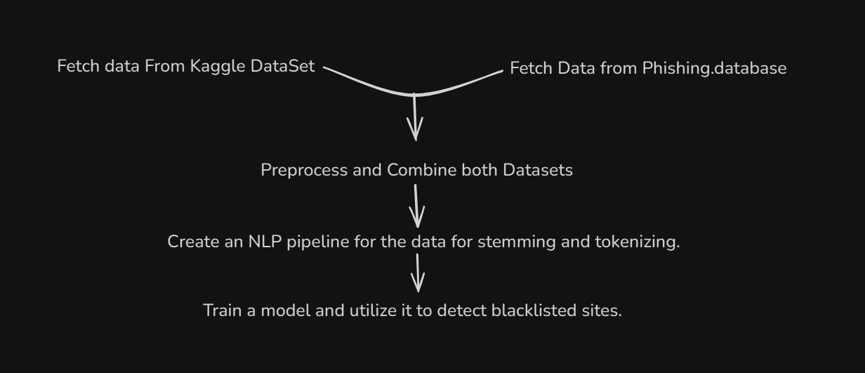
Blacklisted Sites ML model pipeline
This makes the blacklist detection much faster as compared to basic search algorithms.

Slide 5
How Phishing Score Works
We have defined a Phishing score through which our extension determines whether a visited site is engaged in phishing or not.
It is based on:
Heuristic Score
Certificate Verifiable or Not
URL is trying to impersonate some popular website.
Whether the site is listed in Blacklist or not.
(Checked by the ML model)
URL is trying to initiate some login form.
6. Extension is suspicious.
7. Leading to some IP address instead of a domain name.
8. Too many subdomains or URL being too long.

Slide 6
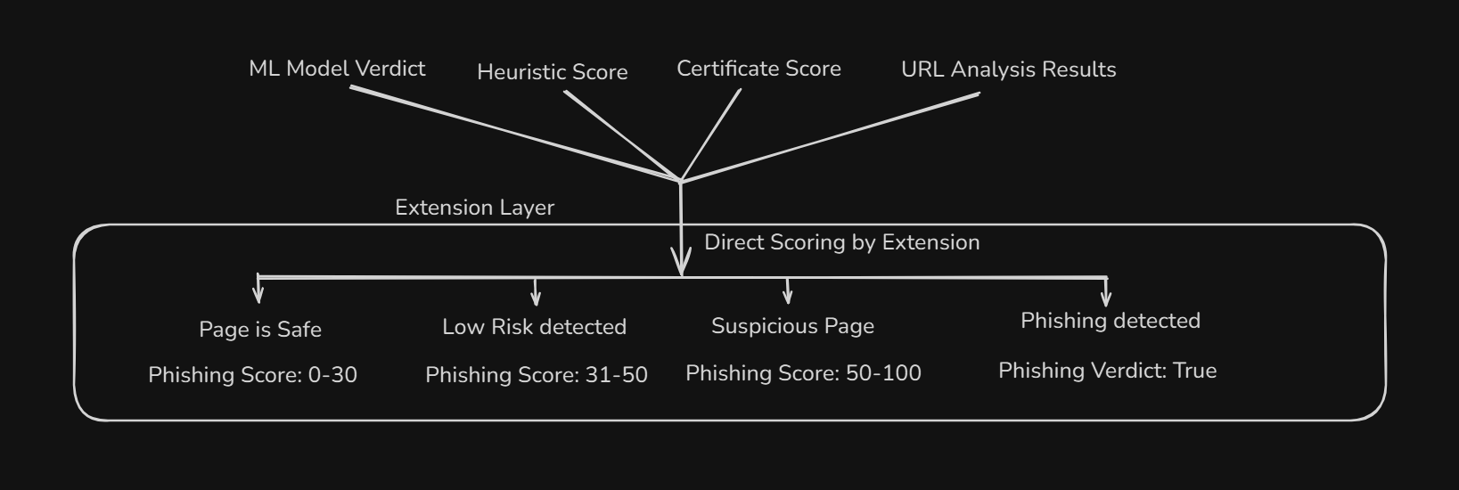
How Extension Functions

Slide 7
Suggested Tech Stack
ML (Scikit-learn)
XGBoost, Optuna Hyperparameter tuned
React JS for extension
VirusTotal API for URL analysis through antivirus softwares
Flask backend to simulate CRUD API for sending and receiving requests by the extension.
DataSet Used
Phishing Site Urls on Kaggle.
Phishing.database project on GitHub.

Slide 8
Challenges Overview
Mobile Browser Limitations.
User Fatigue and Trust Loss.
Integration with Other Security Tools.
SSL False Sense of Security.
User Frustration with Blocking.
Model Misclassifies Popular Sites (False Positives).

Slide 9
Future Scope
Cloud-based Threat Intelligence Hub.
Deploy a central server that continuously aggregates phishing reports from all users.
Real-time updates of blacklists and heuristics for all extension users.
Advanced Machine Learning / Deep Learning.
Implement federated learning so models improve collaboratively without exposing user data.
Cross-Platform Support.
Extend support beyond Chrome to Firefox, Edge, Safari, and mobile browsers.

