Slide 1

Group -12
Project Guide
Mrs.Josna Jose
Group Members
Ferbin Santhosh
Georgekutty Titus
Milan Sha
Shaun Jo Aji

Slide 2
Table of contents
01
04
02
05
03
06
Introduction
Tech Stack
Key Features
Screenshots
Models
Conclusion

Slide 3
Introduction
The rapid adoption of electric vehicles (EVs) necessitates the development of efficient and user-friendly tools to facilitate access to charging infrastructure.
The EV Charging Station Finder App enhances the experience for EV users, offering features like advanced filtering, slot booking, notifications, and a favorites system to simplify locating and using charging stations.
The app integrates several functionalities including advanced filtering options, slot booking capabilities, push notifications, and a favorites system, aimed at providing a comprehensive solution for EV charging needs.

Slide 4
Key Features
Slot Booking System: To address the challenge of station unavailability, the app includes a slot booking feature.
Push Notifications: The app provides real-time updates and notifications to keep users informed about the status of their bookings, availability of nearby charging stations.
Virtual Queue Management: Allow users to join a virtual queue for busy charging stations, providing estimated wait times and notifications when their turn is approaching.
Emergency Assistance: Provide an emergency assistance feature that will provide answers to users basic questions on the working of the app.

Slide 5
Modules
User Module: Allows users to locate and book charging stations easily.
Owner Module: Enables station owners to add and manage their charging stations in the app.
Admin Module: Provides admin oversight, with the ability to monitor activities and add or remove users, owners, and stations.

Slide 6
User Module
Station Search & Filtering: Users can search for nearby charging stations and filter by amenities (e.g., charging speed, connector type).
Slot Booking: Users can reserve a slot at a charging station, ensuring availability upon arrival.
Real-Time Notifications: Get alerts for booking confirmations, cancellations, or when a favorite station has open slots.
Favorites System: Save frequently used charging stations for quick access.

Slide 7
Owner Module
Station Registration: Owners can add new charging stations to the app, providing details like location, type of chargers, and amenities.
Booking Management: Owners have tools to view, confirm, or adjust bookings made by users.
Analytics & Insights: Access usage data, including station popularity and peak usage times, to help with station management.
Real-Time Updates: Quickly update station status (e.g., availability, maintenance) to keep users informed.

Slide 8
Admin Module
User & Owner Management: Admins can add or remove users and station owners to ensure system integrity and security.
Station Oversight: The admin has full control over all registered stations, including the ability to edit or remove stations as needed.
System Monitoring: Admins receive reports and alerts on app activity and usage trends to identify any issues or areas for improvement.
Content Moderation: Ensures accurate, reliable information across the app by verifying station details and user feedback.

Slide 9
Limitations of Existing Website
Limited Coverage
Inaccurate or Outdated Information may lead to inconsistent performance
No Slot Booking system
No information on whether its fast charging or normal charging.
No feature to find the peak timings
Lack of Assistance from admin side to help the user to use the website.
No notifications provided to user

Slide 10
Technology Stack
Frontend: Developed using XML to provide a seamless user experience on Android.
Backend: Powered by Java for real-time database management, user authentication, and scalable cloud storage.
Database: SQL for handling user data, charger details, and booking information.
APIs: Google Maps API for navigation and third-party APIs for entertainment and amenities suggestions.

Slide 11
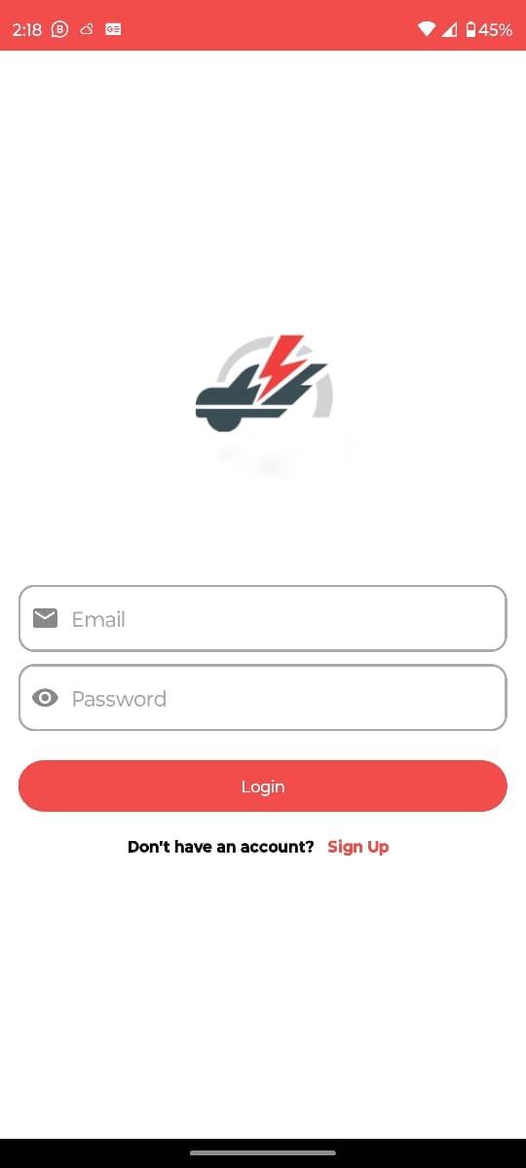
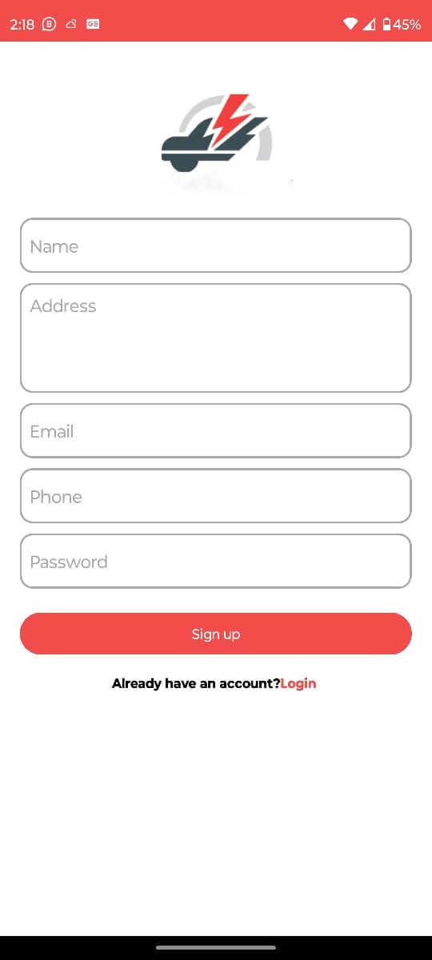
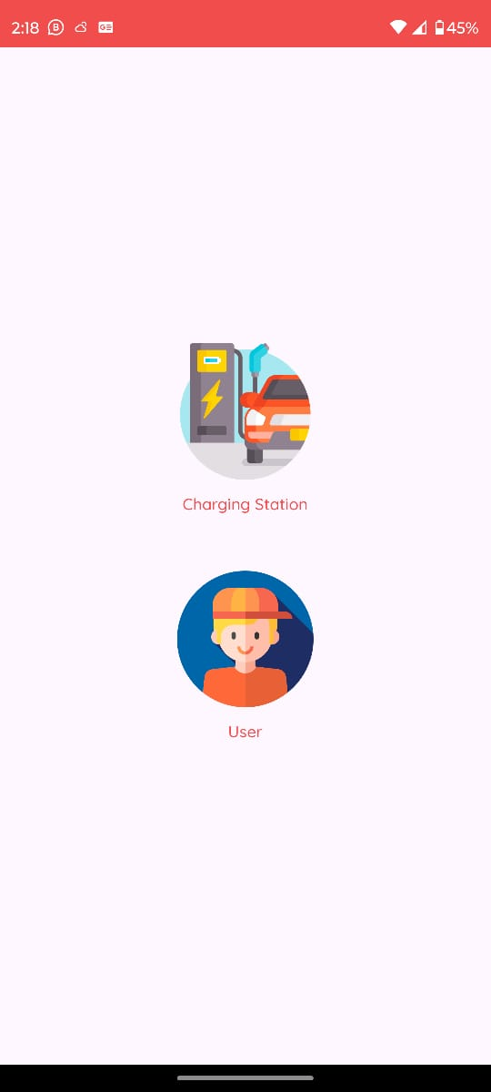
Sample Screenshots

Slide 12
Conclusion
The EV Charging Station Finder App enhances the EV charging experience through advanced filtering, slot booking, real-time notifications, and a favorites feature.
It promotes efficient and sustainable charging but faces challenges like infrastructure dependence, data accuracy, compatibility, and privacy.
With ongoing improvements and industry collaboration, this app has strong potential for growth.

Slide 13
Thank You

