Slide 1
CIS 509: Final Presentation
By Team 211: Kaitlyn Skamas, Milan Paremajalu Suresh, Sandeep Kaur, Surbhee Dewan, and Shraddha Saraf

Slide 2
Table of contents
01
04
02
05
03
06
Business Problem
Analytical Methods
Business Context
Visualization
Dataset Summary
Managerial Insights

Slide 3
Business Problem:
About Panda Express:
Panda Express is an American fast food restaurant chain that serves American Chinese cuisine.
It is the largest Asian restaurant chain in the United States.
Competitors Include: Pei Wei, Bamboo Garden, and P.F Changs
Explain Purpose:
Our project focuses on analyzing customer reviews for the popular food chain, Panda Express.
We analyzed this food chain across four different statewide locations, Arizona, California, Indiana, and Florida.
We aimed to find the emotions driving positive and negative reviews.
Why this is significant?
The purpose of our project is to understand location- specific sentiments.
Our goal is to provide managerial insights for Panda Express in order to improve customer satisfaction and customer retention.
For researchers, this analysis contributes to sentiment analysis and its practical applications in the service industry, providing insights into customer behavior and regional differences.

Slide 4
Business Context: Basic Summary Statistics
Number of Reviews: 1839
Average Review Length: 89.41
Average Stars Per Review: 2.39
Number of Unique Words: 12196
Total Number of Tokens: 164428
Number of Unique Businesses: 50
Average Useful Votes per Review: 0.75
Average Funny Votes per Review: 0.26
Average Cool Votes per Review: 0.30

Slide 5
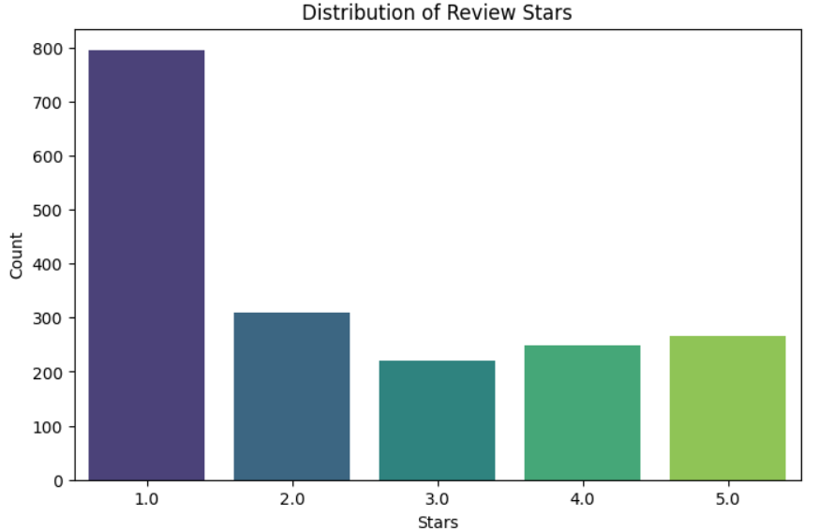
Average Review Analysis
The majority of reviews for Panda Express are 1-star, indicating significant customer dissatisfaction.
The polarized distribution suggests a need to improve service and food consistency to reduce negative experiences.

Slide 6
Dataset Summary
Observations
Justification of Data issues
Data Acquisition Process
We acquired this data via the Yelp Review dataset. We then converted the JSON files to CSV files. This dataset contains business details such as location, ratings (stars, review count), operational status, and other attributes (parking, ambiance, etc…
Location Bias: If the dataset has more urban locations than rural ones, insights drawn might not be applicable to all Panda Express locations.
Review Bias: If reviews are mostly negative, it may not mean overall customer satisfaction is low, just that dissatisfied customers are more vocal.
Operational Status: Certain attributes are subjective and may not be consistently reported across locations.
The dataset of Panda Express contains 50 business IDs , after filtering out 4 states.
There are 1,840 rows in this dataset.

Slide 7
Analytical Methods
Methods | How this helped us achieve our goal
TF-IDF | Helped to identify significant terms in customer feedback, enabling insights into regional preferences or recurring issues at specific locations.
BERT Topic | Helped us to see the overall sentiment distribution and also sentiment distribution by each of the 4 states.
Tokenization | Tokenization was used to break a sentence into set of words and further to identify the root words and categorise it into different forms of sentences and flag it as positive, negative or neutral words. This flagging was then useful in finally identifying the sentiment of the review and the reviewer.
Word Cloud | Helped to visually highlight the most frequent terms in positive, neutral and negative reviews, as well as by location. It helped us to identify key themes and sentiments driving customer opinions across different states for Panda Express, aiding in deeper insights into customer preferences.

Slide 8
Sentiment Analysis Comparison – Basic vs. BERTopic
Key Takeaways :
Basic Sentiment Analysis: Higher negative sentiment in all states, few positive reviews detected.
BERTopic Analysis: More neutral and positive reviews detected, showing a more balanced sentiment.
Differences in sentiment classification suggest BERTopic captures more context, while Basic Analysis may overemphasize negativity.
 | BASIC SENTIMENT |  |  | BERTopic SENTIMENT
STATE | Negative | Netural | Positive | Negative | Netural | Positive
Arizona (AZ) | 473 | 308 | 16 | 244 | 390 | 163
California (CA) | 112 | 75 | 13 | 67 | 75 | 58
Florida (FL) | 236 | 203 | 20 | 127 | 177 | 155
Indiana (IN) | 164 | 208 | 11 | 101 | 147 | 135

Slide 9
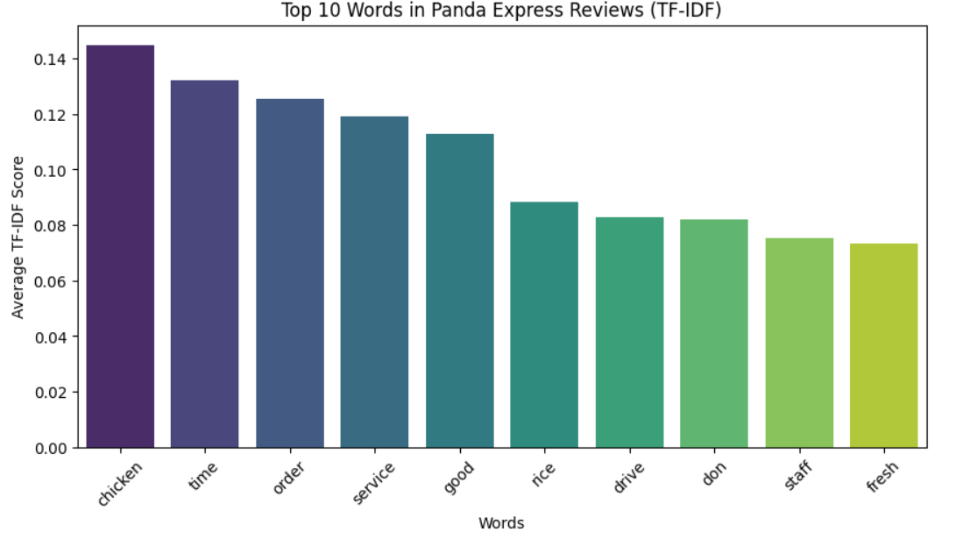
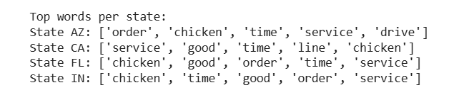
Visualizations and Summarize Findings
Food Quality (eg. fresh)
Service Experience (e.g. staff,service)
Time & Convenience (e.g. Time)
Mixed Customer Sentiment (e.g. Good)
Notes:
Food Quality is a Key Topic
✅ Customers appreciate items like chicken, rice, and fresh ingredients.
❌ Mentions of fresh could indicate concerns about food consistency.
Service Experience is Frequently Discussed
✅ Some reviews highlight efficient service and friendly staff.
❌ Common complaints involve slow service, incorrect orders, or staff behavior.
Time & Convenience Impact Satisfaction
✅ Quick service and drive-thru options are appreciated.
❌ Long wait times and slow drive-thru experiences are recurring issues.
Mixed Customer Sentiment
✅ Positive mentions of good indicate satisfaction with food or service.
❌ Context matters—good might appear in phrases like “not good” or “could be better.”

Slide 10
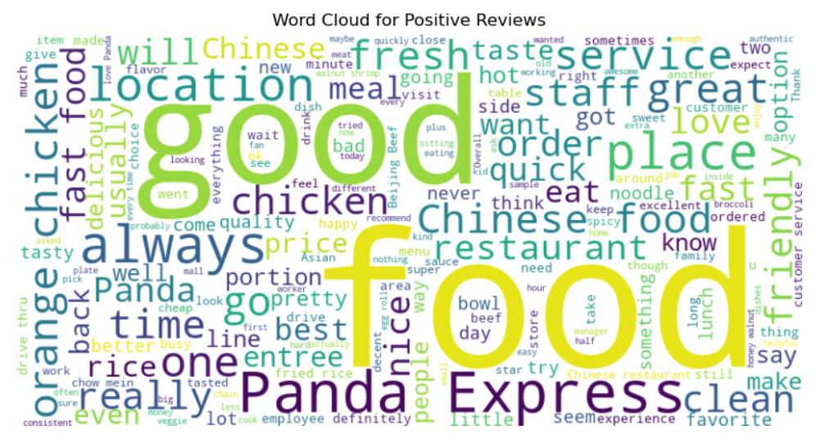
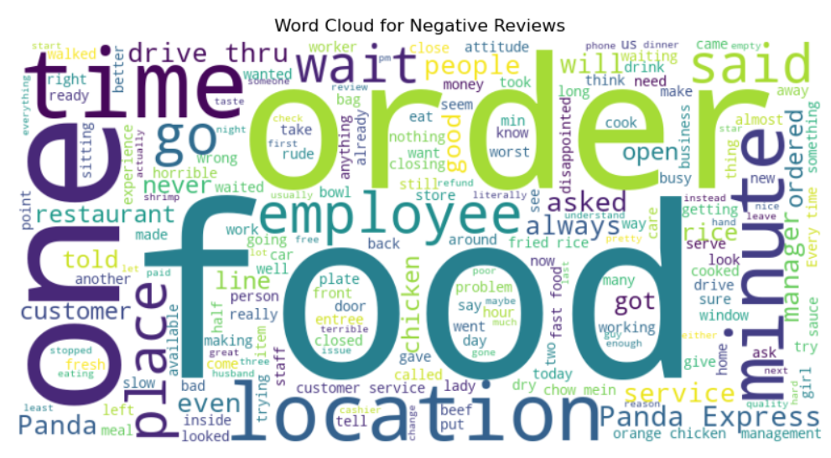
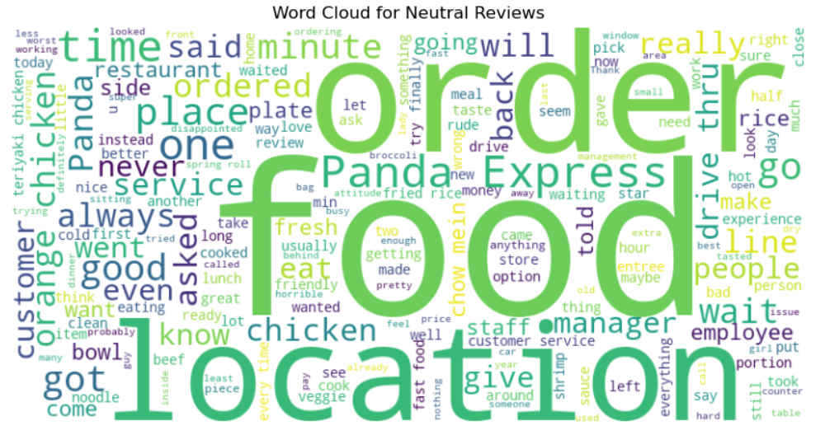
Visualizations and Summarize Findings
Notes:
Business Implications & Recommendations: (positive)
✅ Leverage Strengths:
Highlight fresh ingredients and signature dishes (like Orange Chicken) in marketing campaigns.
Promote quick service and friendly staff as key selling points.
📌 Opportunities for Growth:
Ensure consistency in food quality and freshness across locations.
Reinforce staff training to maintain high service standards.

Slide 11
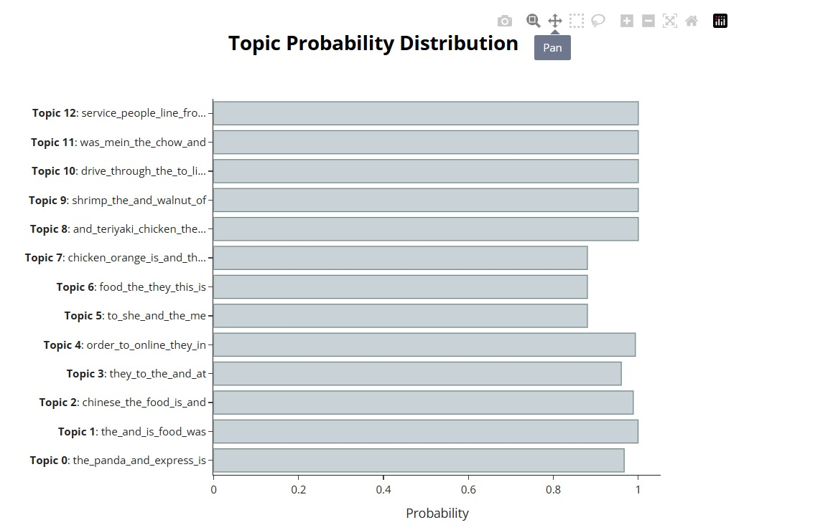
Probability Distribution
This distribution suggest that customer services , order accuracy, food quality, and drive thru experiences are major talking points in Panda Express reviews. Problems with service issues and online ordering experiences have high probabilities and indicate negative sentiments in this area.

Slide 12
Managerial Insights & Conclusion - 1
Overall insights
Negative vs. Positive Reviews
Across all four state locations, Panda Express has a low average of 2.39 star reviews per restaurant, indicating limited customer engagement. A common trend in the reviews highlights poor customer service. To address this, we recommend that Panda Express invest in an enhanced staff training program to improve customer experience and satisfaction.
Customers typically leave reviews when they are unsatisfied compared to when they have a positive dining experience.

Slide 13
Managerial Insights & Conclusion - 11
Additional Focuses for Panda Express
Recommended Target Marketing
We recommend that Panda Express should also track these 4 metrics because they are clear indicators of positive reviews:
Customers willingness to tip
Customer Retention
Revenue Trends
Ability to acquire new customers
Most customers commented on their love for the Orange Chicken and Walnut Shrimp dishes.
Our recommendation is that Panda Express should make a targeting marketing effort towards promoting these products. This could include more commercial advertisement or a discounted meal deal.

Slide 14
THANK YOU VERY MUCH!

