Slide 1

Online Examination Portal
Team 2:
Manisha Jogi
Milan Sai
Poorvika R
Rishabh Srivastav
Tarun Rao K

Slide 2
Introduction
The Online Examination system should allow the user to register and login into the system.
The system should show all the different kind of exams available to the user and the user must be able to take any of the tests.
The exams list should be maintained regularly by the system.
The user should be allowed to take the test only once. After the test, the system must display the results.
The system should allow the creation of new users in the system. It should be accessible by two kinds of users:
1) The system administrator
2) The users
The administrator should be able to upload the question bank.
The admin should also be able to load the tests and make changes accordingly.
The admin should also manage the users.

Slide 3

Key features
System should maintain all the data about the user and admin
3
Admin must be able to load the question bank as well as the tests
4
The user must be able to take tests
5
The system should allow the user to register with the system and only the registered users should be able to take the tests
1
The system should also allow for the creation and validation of the users
2

Slide 4
Technology Stack
Back-end
Build Tool: Apache Maven
JDK: 1.8 and above
Spring Framework : Spring Microservices, Spring Boot
IDE: STS(Spring Tool Suite)
Data Layer: Spring Data JPA
Netflix tools – FeignClient
DBMS - MySQL
Front-end
Building UI components: ReactJS, Bootstrap,
Material Design UI
Amazon Web Services(AWS).
JIRA-For allocating task and see the progress.
GitHub

Slide 5
Microservices
Exam service – contains methods that allow Admin to view an exam by Id, view all exams, add an exam and delete an exam. Questions by question Id are stored in examdb.
User service – contains methods that allow user to view their profile, see and take an exam, and evaluate score of a user. Admin makes use of methods in this service to view all users and delete a user if they want to.
Admin service – contains details of Admin. Admin has rights to modify a user and questions in an exam.

Slide 6
User Id
User Id
User Name
User
Authenticate
Dashboard
Email Id
Password
Exams
Admin Id
Admin Id
Admin Name
Admin
Authenticate
Dashboard
Email Id
Password
User
Modify
Exams

Slide 7
Application Folder Structure
Controller Package : consists the controller class for every micro-service, contains all the links to various URIs in the project
Model Package : consists of the Bean classes for every micro-service
Repository Package : to access the JPA Repository
Service Package : contains all the function definitions and function body for each micro-service
Proxy Package : to access services from other micro-services
Exception Package : to handle various exceptions for each microservice

Slide 8
Previous Sprint Highlights :
Brainstorming sessions to decide the layout of all the model classes
Using Spring Tool Suite as IDE and MySQL as the database software
Developing the entire backend modules of all the 3 microservices
Testing end points using Postman
Final Sprint Highlights :
Identifying various components required to render on to the UI
Designing the UI components using ReactJS along with bootstrap and Material design UI
Code review carried out by all the participants to check for redundant codes
Deployment of all the 3 microservices and React App on AWS Cloud

Slide 9
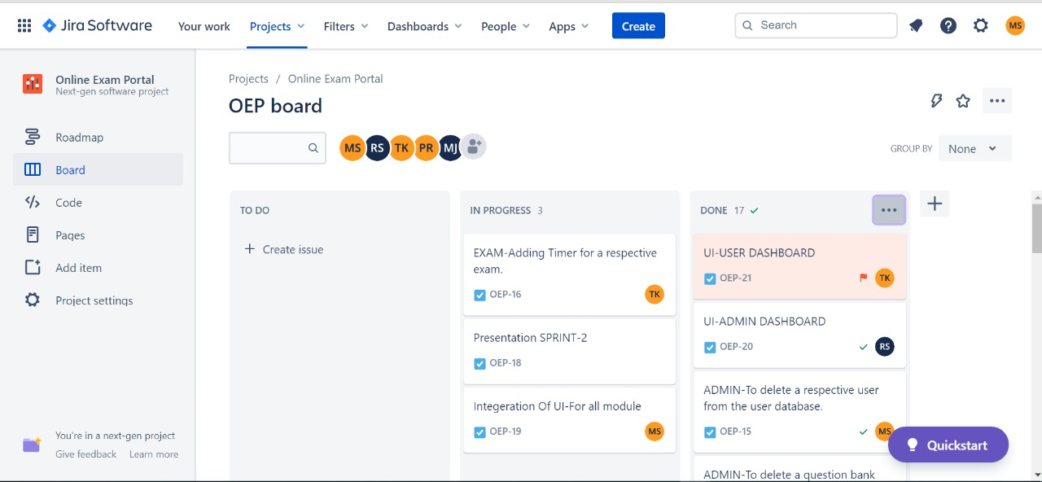
JIRA BOARD (TO KEEP TRACK OF THE PROGRESS )

Slide 10
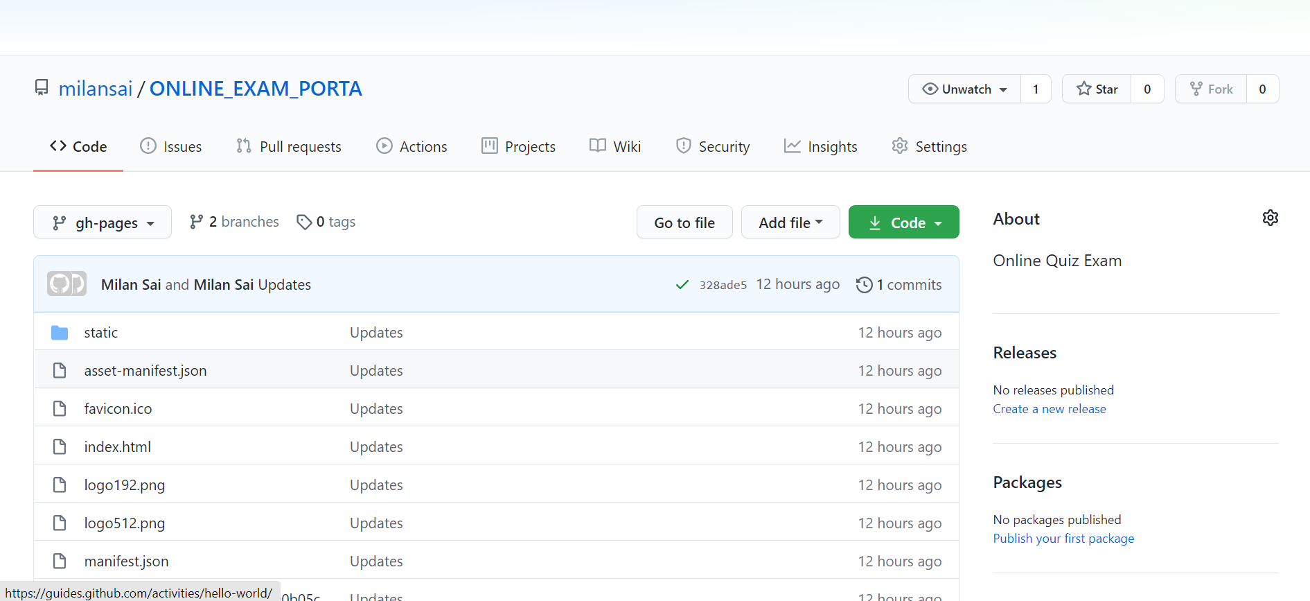
GitHub Repository

Slide 11

Demonstration

