Slide 1
GREY WATER MANAGEMENT AND REUSE WET LAND MANAGEMENT WATER CONSERVATION
NAME : MILAN D
REG NO : 922525106196
DEPARMENT: 2nd ECE
PROJECT TITLE : GREY WATER MANAGEMENT AND REUSE WETLAND MANAGEMENT WATER CONSERVATION

Slide 2

Introduction
Water scarcity is increasing worldwide. Freshwater resources are limited. Grey water can be treated and reused. Water conservation is essential for sustainable development.

Slide 3
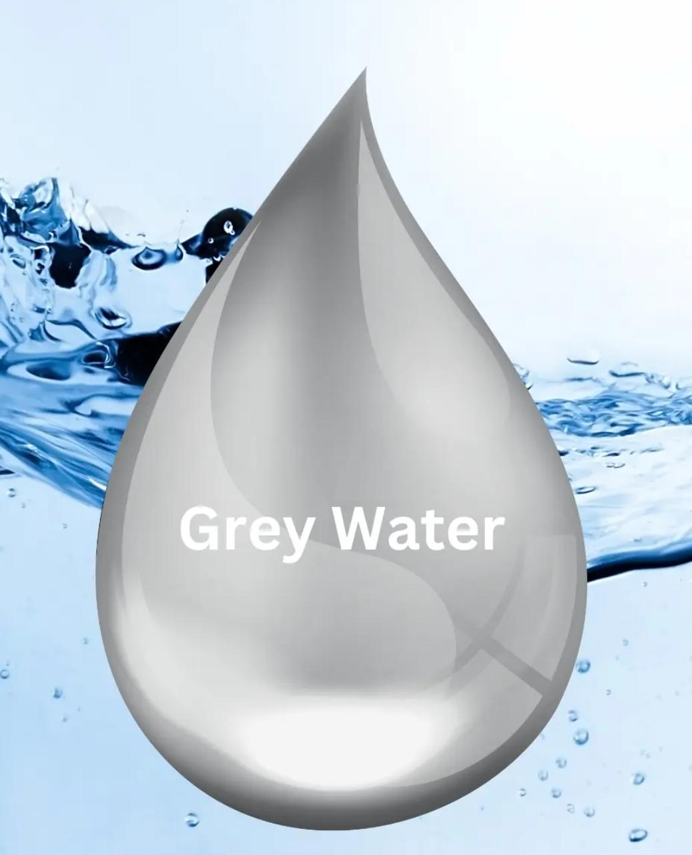
What is Grey Water?
Water from sinks, showers, baths, laundry, and dishwashers Does not include toilet waste (that’s “black water”) Contains soap, dirt, hair, and minor contaminants

Slide 4
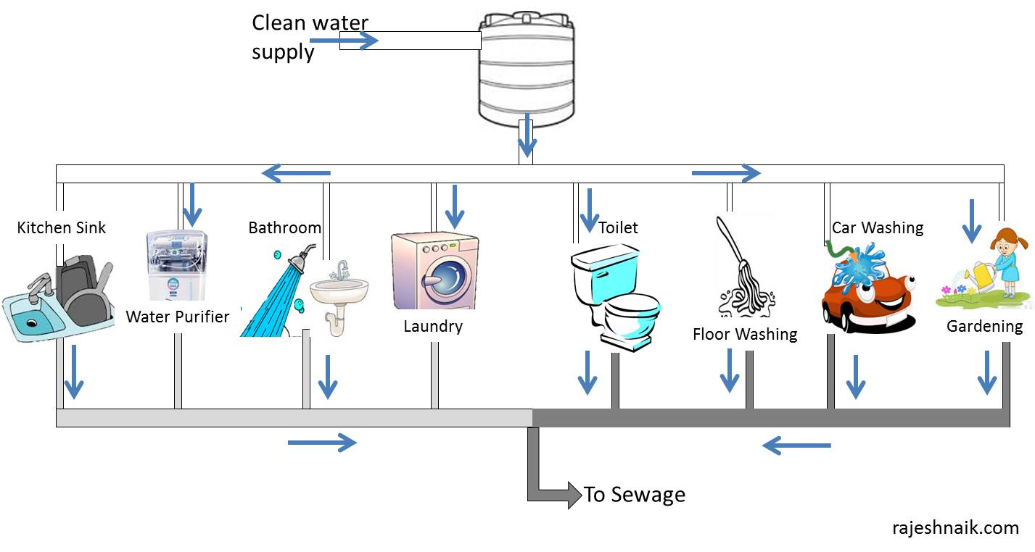
Sources
Bathroom sinks & showers Washing machines Kitchen sinks (sometimes classified separately) Bathtubs

Slide 5

Problem Statement
Rapid population growth. Increasing water demand. Water pollution. Climate change. Need to reduce freshwater consumption.

Slide 6

Objectives
Reduce water wastage. Reuse household grey water. Improve water conservation. Develop a low-cost treatment system. Protect the environment.

Slide 7
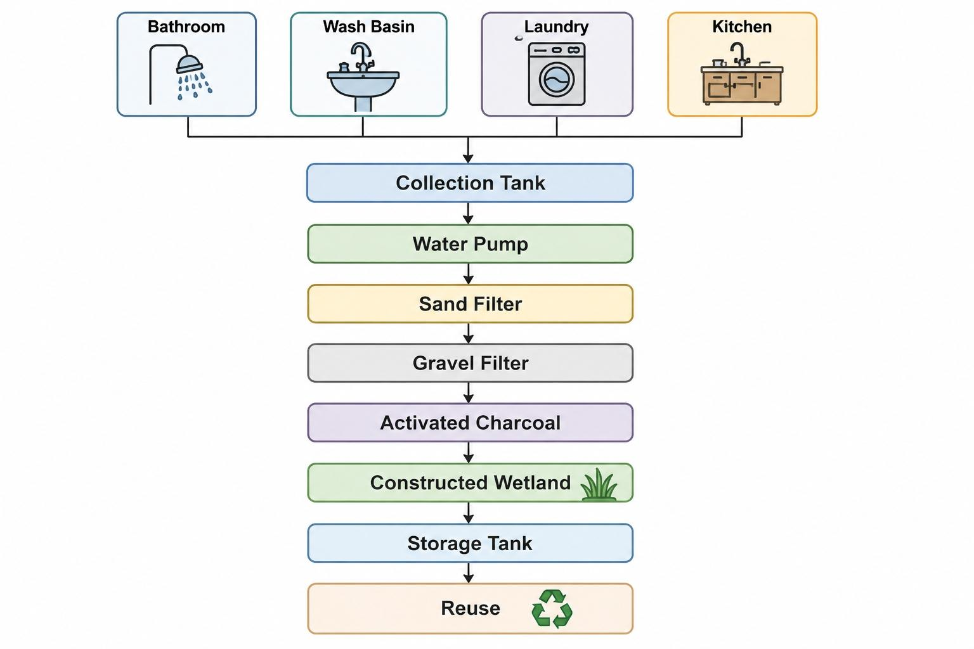
Block Diagram

Slide 8
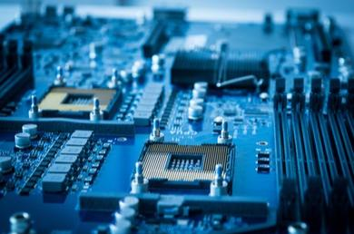
Hardware Components
Collection Tank PVC Pipes Water Pump Arduino Uno Relay Module Water Level Sensor Sand Filter Gravel Filter

Slide 9

Hardware Components
Activated Carbon Wetland Tank Wetland Plants Storage Tank Power Supply

Slide 10

Hardware Description
Arduino Uno - Controls the system automatically. Water Pump - Pumps water through filters. Relay Module - Turns pump ON/OFF. Water Level Sensor - Prevents overflow. Storage Tank - Stores treated water safely

Slide 11

Filtration Process
Gravel Layer Sand Layer Charcoal Layer Wetland Plants (optional) Final Filter

Slide 12
Constructed Wetland
Removes
Nitrogen Phosphorus Organic matter Harmful bacteria
Constructed Wetland is an artificial ecosystem where plants naturally clean wastewater
Plants Used
Vetiver Grass Reed Grass Cattail

Slide 13

Working Principle
Grey water enters collection tank. Water level sensor detects level. Arduino activates pump. Water passes through gravel. Water passes through sand. Activated charcoal removes odor. Water flows through wetland plants. Purified water enters storage tank. Water is reused.

Slide 14

Arduino Automation
Inputs Water Level Sensor Processing Arduino Uno Outputs Pump ON Pump OFF LCD Display (optional) Alarm (optional) Benefits Saves electricity Prevents overflow Fully automatic Start

Slide 15

Flow Chart
Start ↓ Collect Grey Water ↓ Check Water Level ↓
Pump on
↓ Filtration ↓ Wetland Treatment ↓ Store Water ↓ Reuse ↓ Stop

Slide 16

Expected Results
Reduced Turbidity Reduced Odor Reduced Suspended Solids Better Water Quality

Slide 17
Water becomes suitable for
Gardening Toilet Flushing Floor Cleaning Irrigation

Slide 18

Applications
Homes Schools Colleges Hotels Apartments Industries Agriculture Parks

Slide 19

Future Scope
IoT-based monitoring. Mobile app control. Solar-powered operation. AI-based water quality prediction. Smart city integration.

Slide 20

Results
Water saving. Reduced freshwater usage. Cleaner environment. Lower water bills. Sustainable water management.

Slide 21
Conclusion
Grey water reuse is an effective solution for water conservation. The system is economical and environmentally friendly. It supports sustainable water management for future generations.

Slide 22
References
Textbooks on water treatment. Research papers. Government water conservation resources. Arduino documentation.

Slide 23


