Slide 1
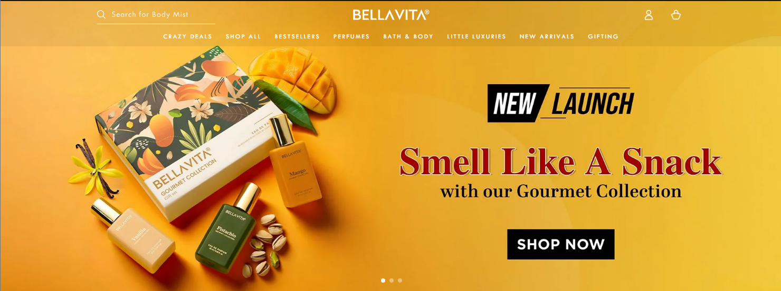
1
2
3
Need scroller like this-like in https://www.nisarabeauty.com/
Need menu like how in https://bellavitaluxury.co.in/
These images should be my image-
Product_1.png, Product_2.png and Product_3.png
Menu should change color based on the product banner and should be white with black text when hovered-like above
4

Slide 2
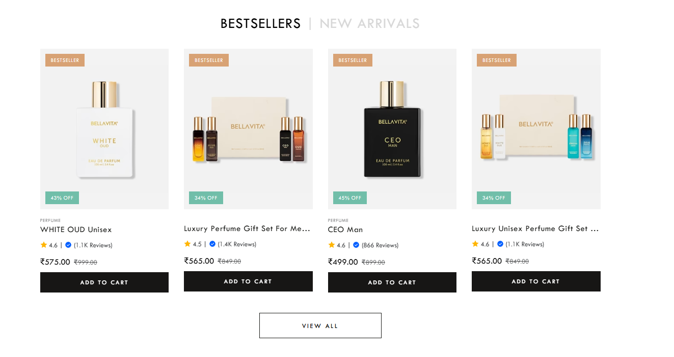
5
Should see this section with below images

Slide 3
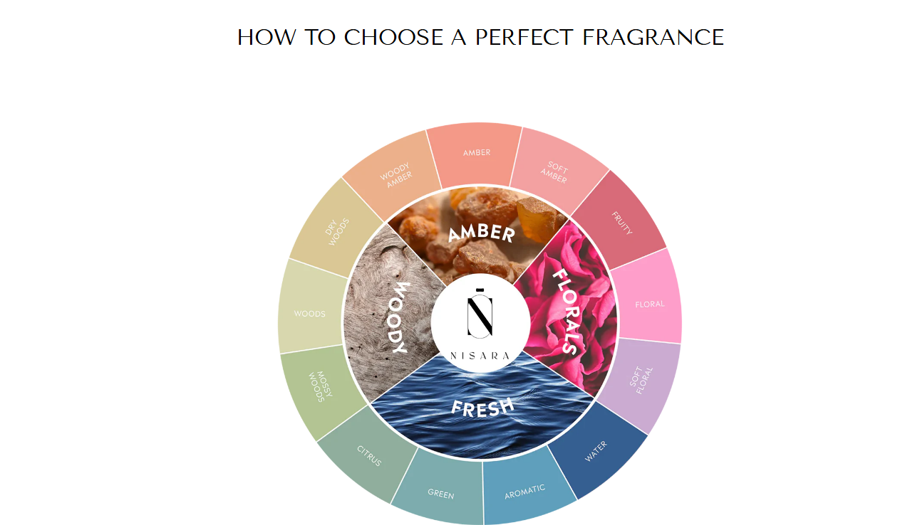
6
Should see this option but this has to be animated

Slide 4

7
Should see this section above fotter

Slide 5
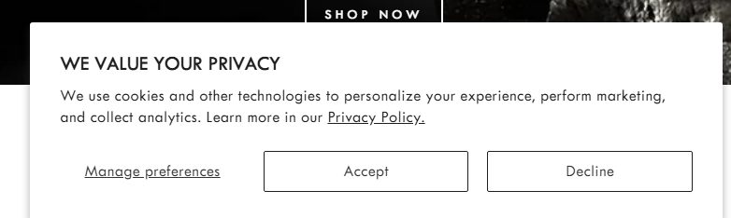
8
Should see this option when I login to the website

Slide 6
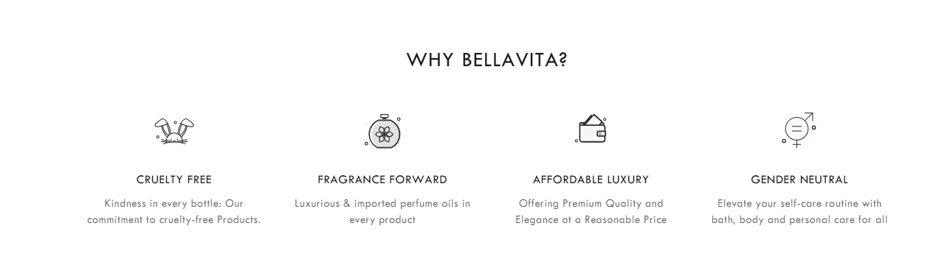
9
Want this section

Slide 7
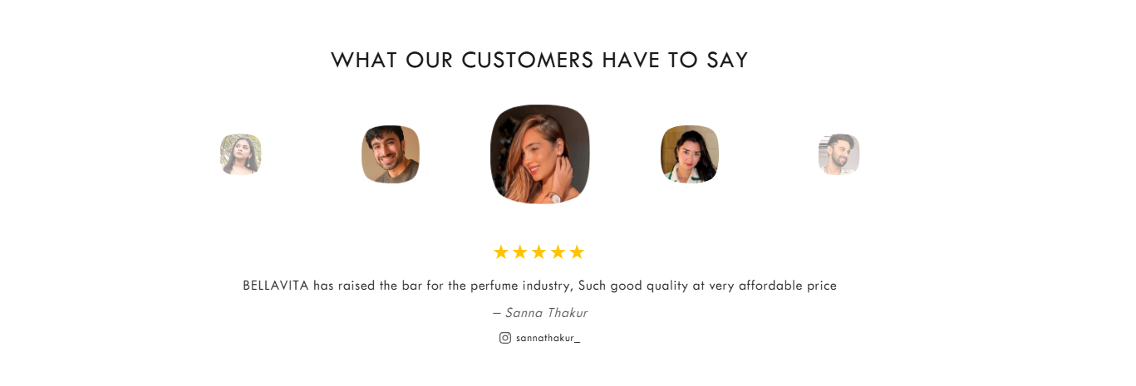
10
Want this testimonials section which should be dynamic and scrolling

Slide 8
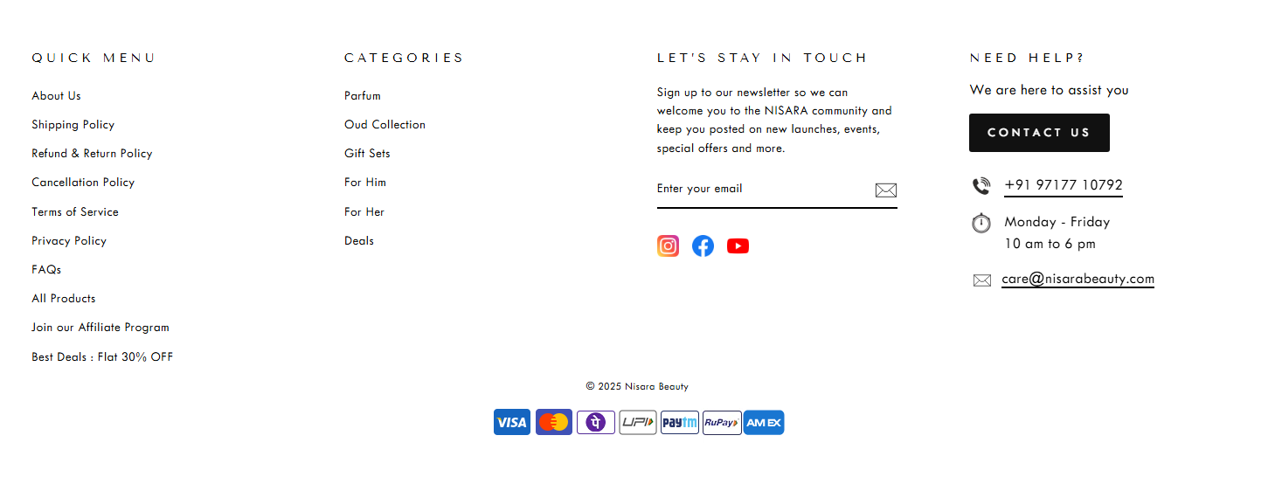
11
And finally, footer

