Slide 1
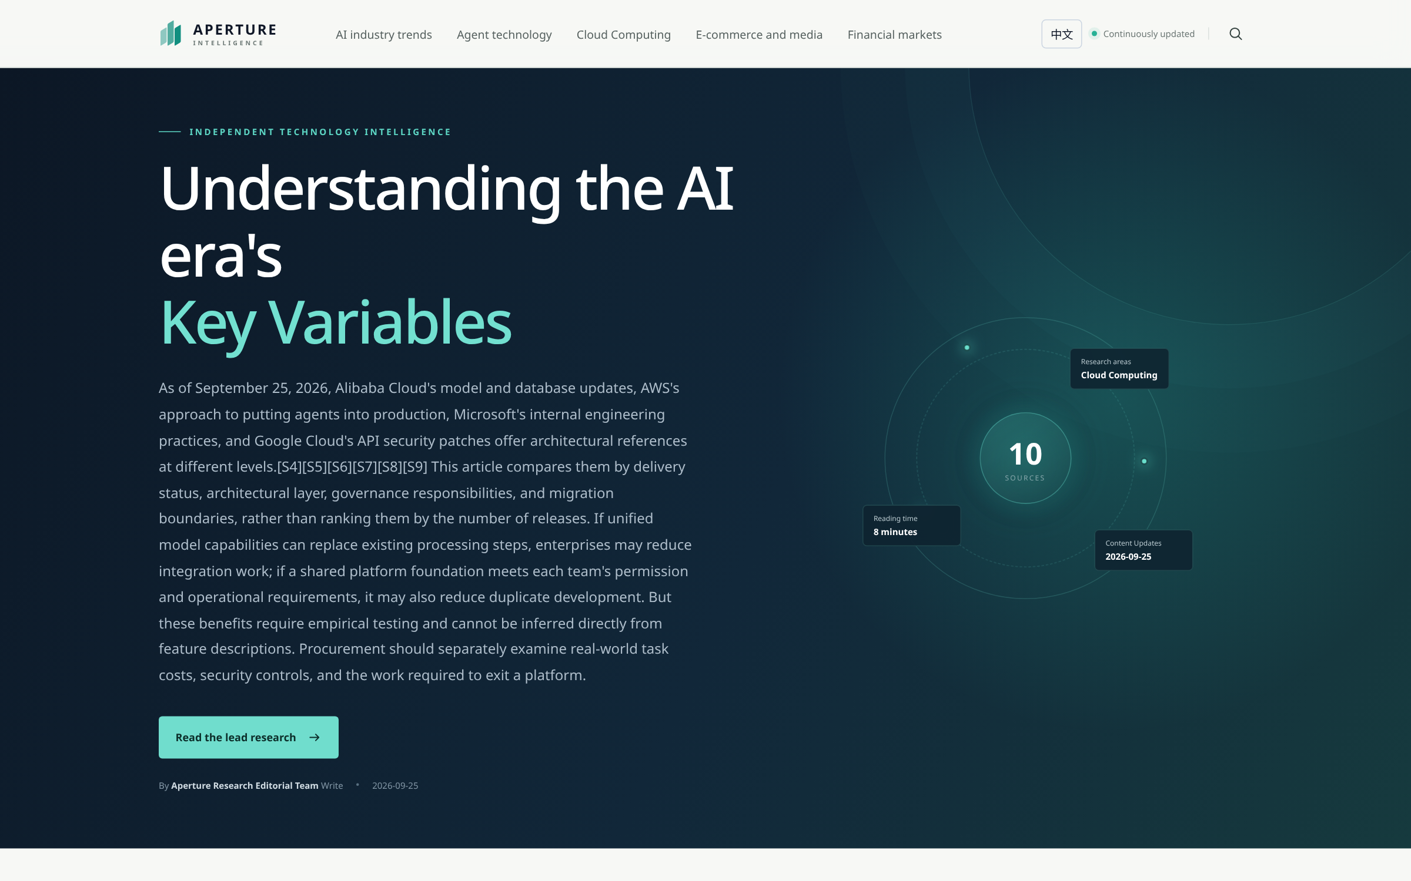
AWS REFERENCE APPLICATION
Aperture Intelligence
From public evidence
to reviewed research.
English-first publishing.
Permanent public URLs.
Programmatic agent access.
Technical overview • 25 September 2026
APERTURE INTELLIGENCE / ENGLISH EDITION / 25 SEP 2026
01
Notes:
Technical review and project demonstration. Snapshot date: 2026-09-25. The application connects research production to stable bilingual delivery, search and agent access.
Screenshot: English research homepage
Source: https://aperture.zhangwangshu.com/
Captured: 2026-09-25T15:52:45.564271+00:00
SHA-256: 9c82935557e6fe5977e2b59f7b633f66ce8d0698df785d212acc014dccbd8096
Region: viewport. Actual English interface, no substituted text or synthetic data.

Slide 2
PURPOSE
One system, three useful outcomes
01
02
03
Research with evidence
Publish for discovery
Serve people and agents
Collect public material, save source evidence, and review generated conclusions.
Serve readable English and Chinese editions at stable, crawlable URLs.
Offer public HTML, open JSON and an x402 payment-protocol demonstration.
Built for engineers exploring the full research-to-publication lifecycle.
APERTURE INTELLIGENCE / ENGLISH EDITION / 25 SEP 2026
02
Notes:
Purpose statements describe the implemented workflow. Citation, indexing and revenue are outcomes to measure, not guarantees. The x402 deployment is a Base Sepolia testnet demonstration.

Slide 3
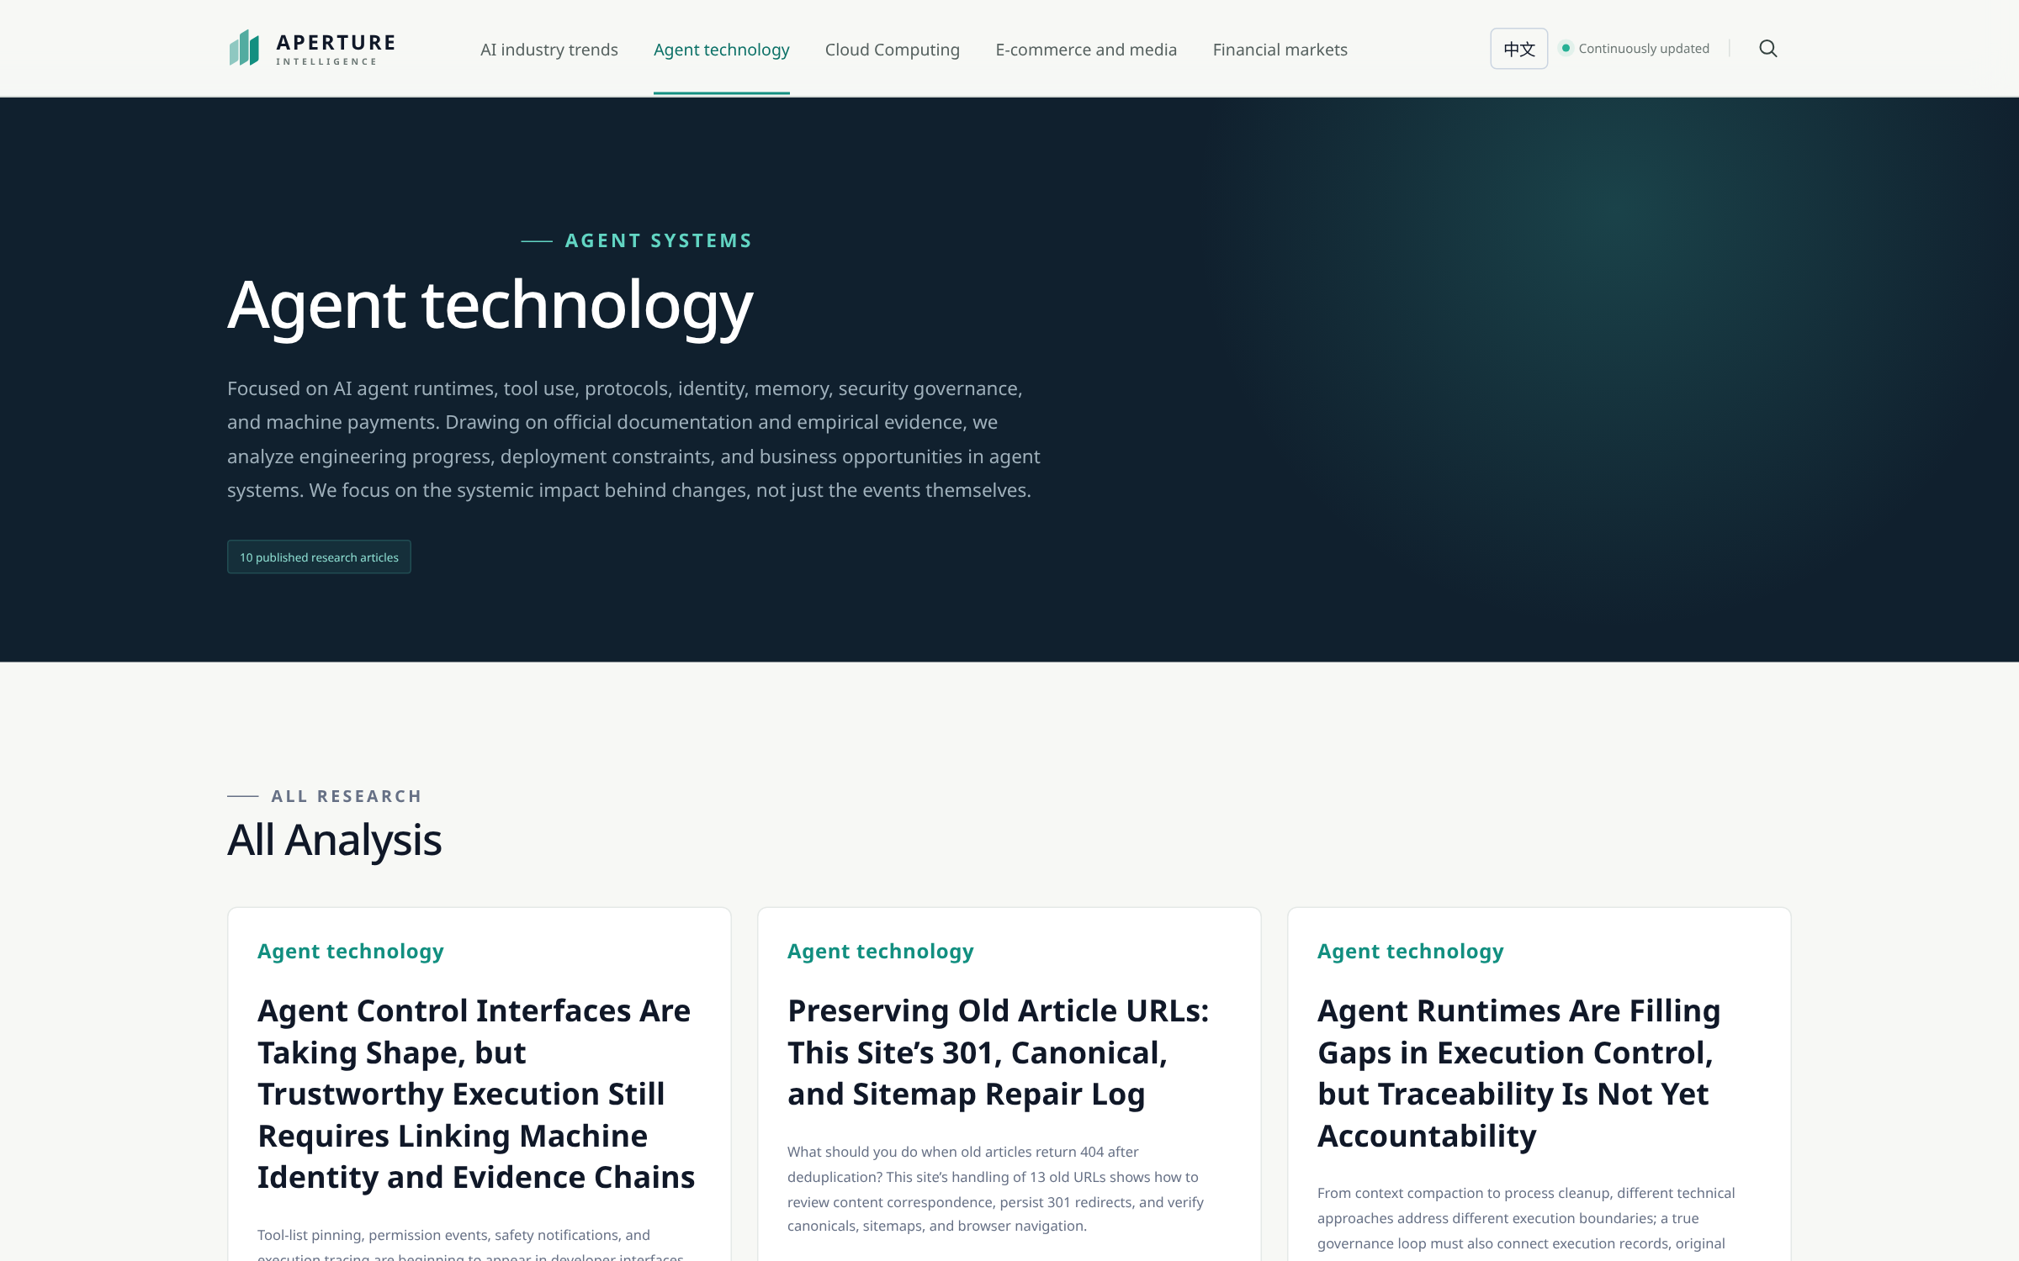
PUBLIC EXPERIENCE
A browsable research publication
Five research areas
AI industry
Agent technology
Cloud computing
Commerce and media
Financial markets
Complete categories,
server-rendered links.
APERTURE INTELLIGENCE / ENGLISH EDITION / 25 SEP 2026
03
Notes:
Real production category page. Full category lists come from SSR and are not capped at three cards or the home API default.
Screenshot: Complete Agent technology category
Source: https://aperture.zhangwangshu.com/category/agent
Captured: 2026-09-25T15:52:46.877701+00:00
SHA-256: 79c9a3a456597de54df40d13a65d209be5a951831785ba0f2f1eb043b05869a0
Region: viewport. Actual English interface, no substituted text or synthetic data.

Slide 4
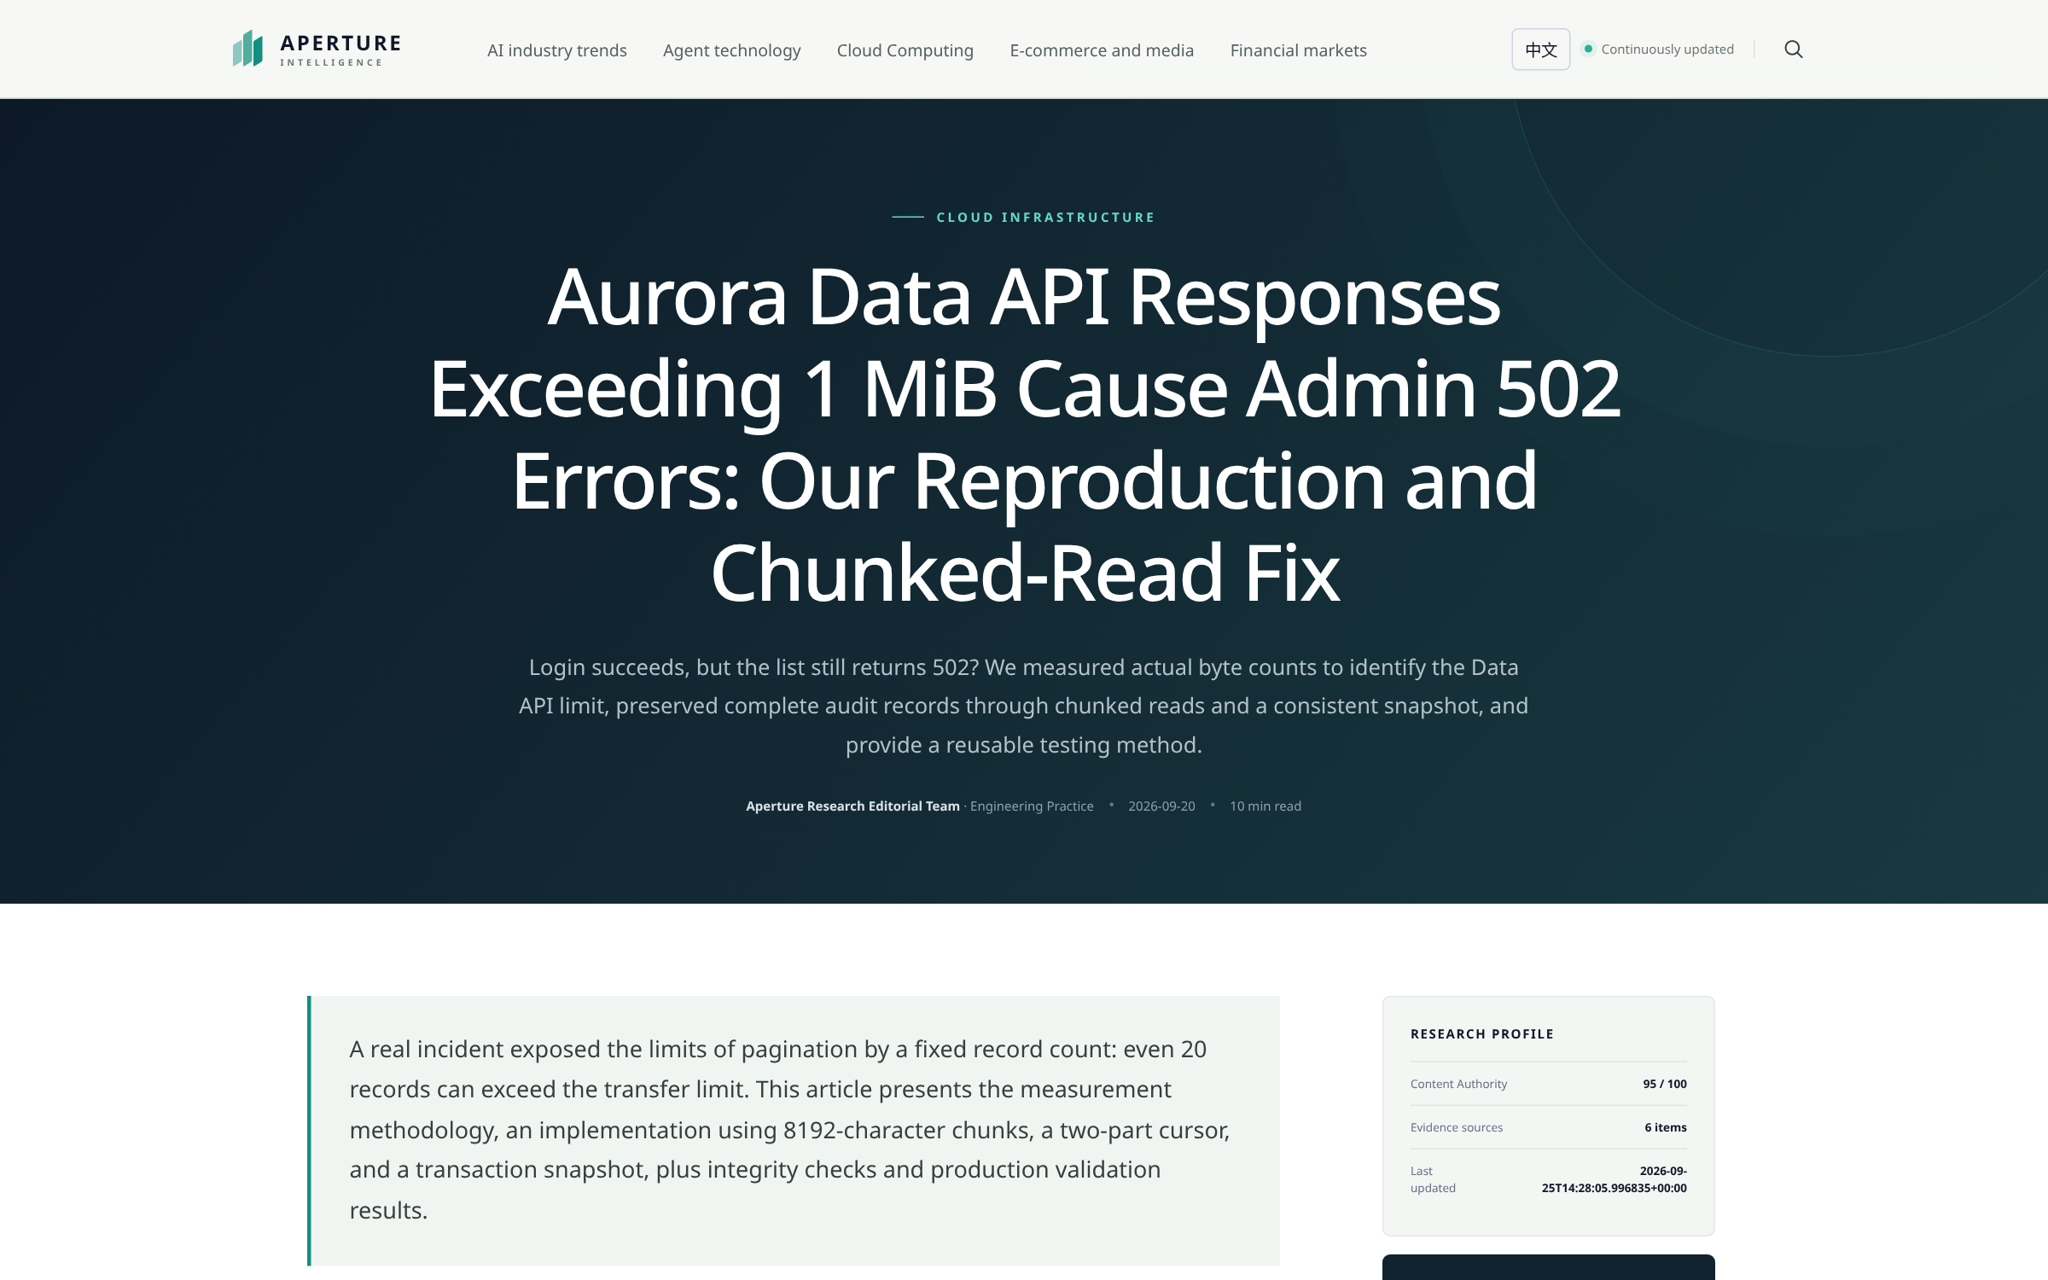
BILINGUAL DELIVERY
English by default, Chinese alongside
One article, two editions
EN /article/{slug}
ZH /zh/article/{slug}
Full reviewed translations.
Page-preserving switching.
Canonical + hreflang.
Bilingual sitemap and RSS.
APERTURE INTELLIGENCE / ENGLISH EDITION / 25 SEP 2026
04
Notes:
41 approved English editions existed in the September 25 audit. Chinese drafts and original evidence are preserved. English and Chinese refer to the same article ID. See docs/bilingual-publication.md.
Screenshot: Published English engineering article
Source: https://aperture.zhangwangshu.com/article/aurora-data-api-1mb-502-chunked-read
Captured: 2026-09-25T15:52:48.294136+00:00
SHA-256: b08b4f5c737fbd1d49442ec86e42bb4b5f4f3d271e99a1670d9d01bbce40ab11
Region: viewport. Actual English interface, no substituted text or synthetic data.

Slide 5
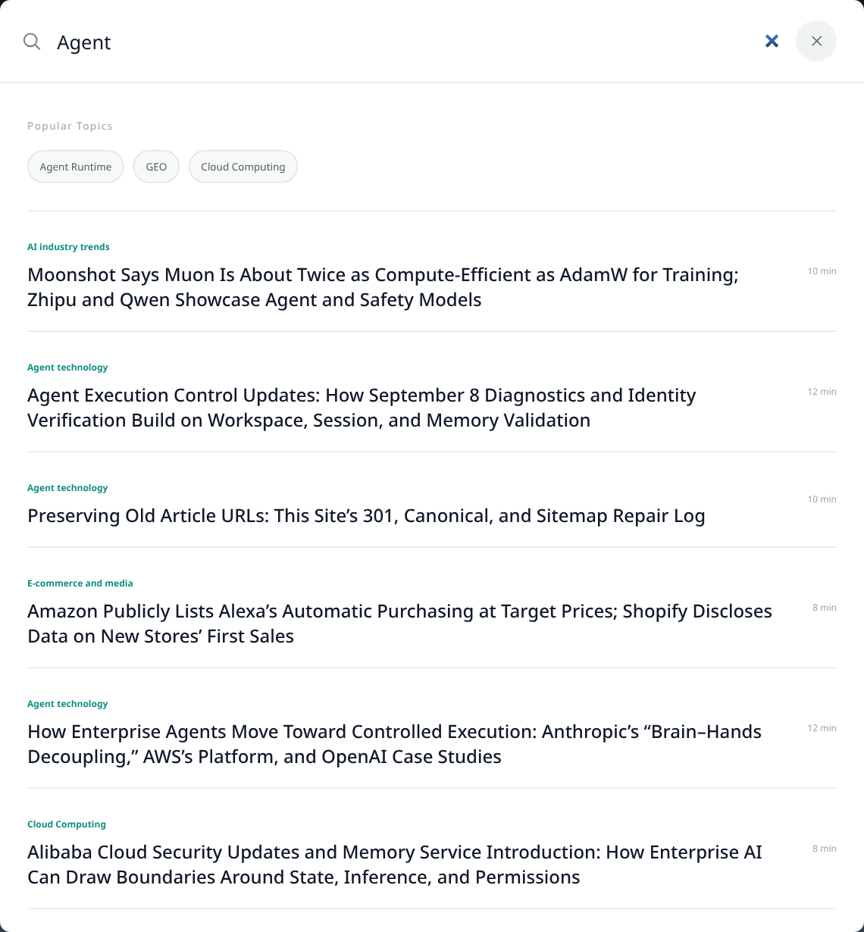
SEARCH AND NAVIGATION
Discovery continues inside the site
Search the reviewed catalogue
Search results use the selected language.
Categories expose every published article.
Related reading and RSS offer a next step.
Direct visits and client navigation share SSR.
Verified discovery paths. No ranking guarantee.
APERTURE INTELLIGENCE / ENGLISH EDITION / 25 SEP 2026
05
Notes:
Actual English search overlay opened through normal UI controls. The query was Agent. Navigation preserves metadata, language and browser history; temporary failures are distinguished from real 404s.
Screenshot: English search results
Source: https://aperture.zhangwangshu.com/article/aurora-data-api-1mb-502-chunked-read
Captured: 2026-09-25T15:52:50.124050+00:00
SHA-256: 7f5b26abe1945566035dcd6b64f522a8366c1ed682807946fcb62236beb24c46
Region: .search-panel. Actual English interface, no substituted text or synthetic data.

Slide 6
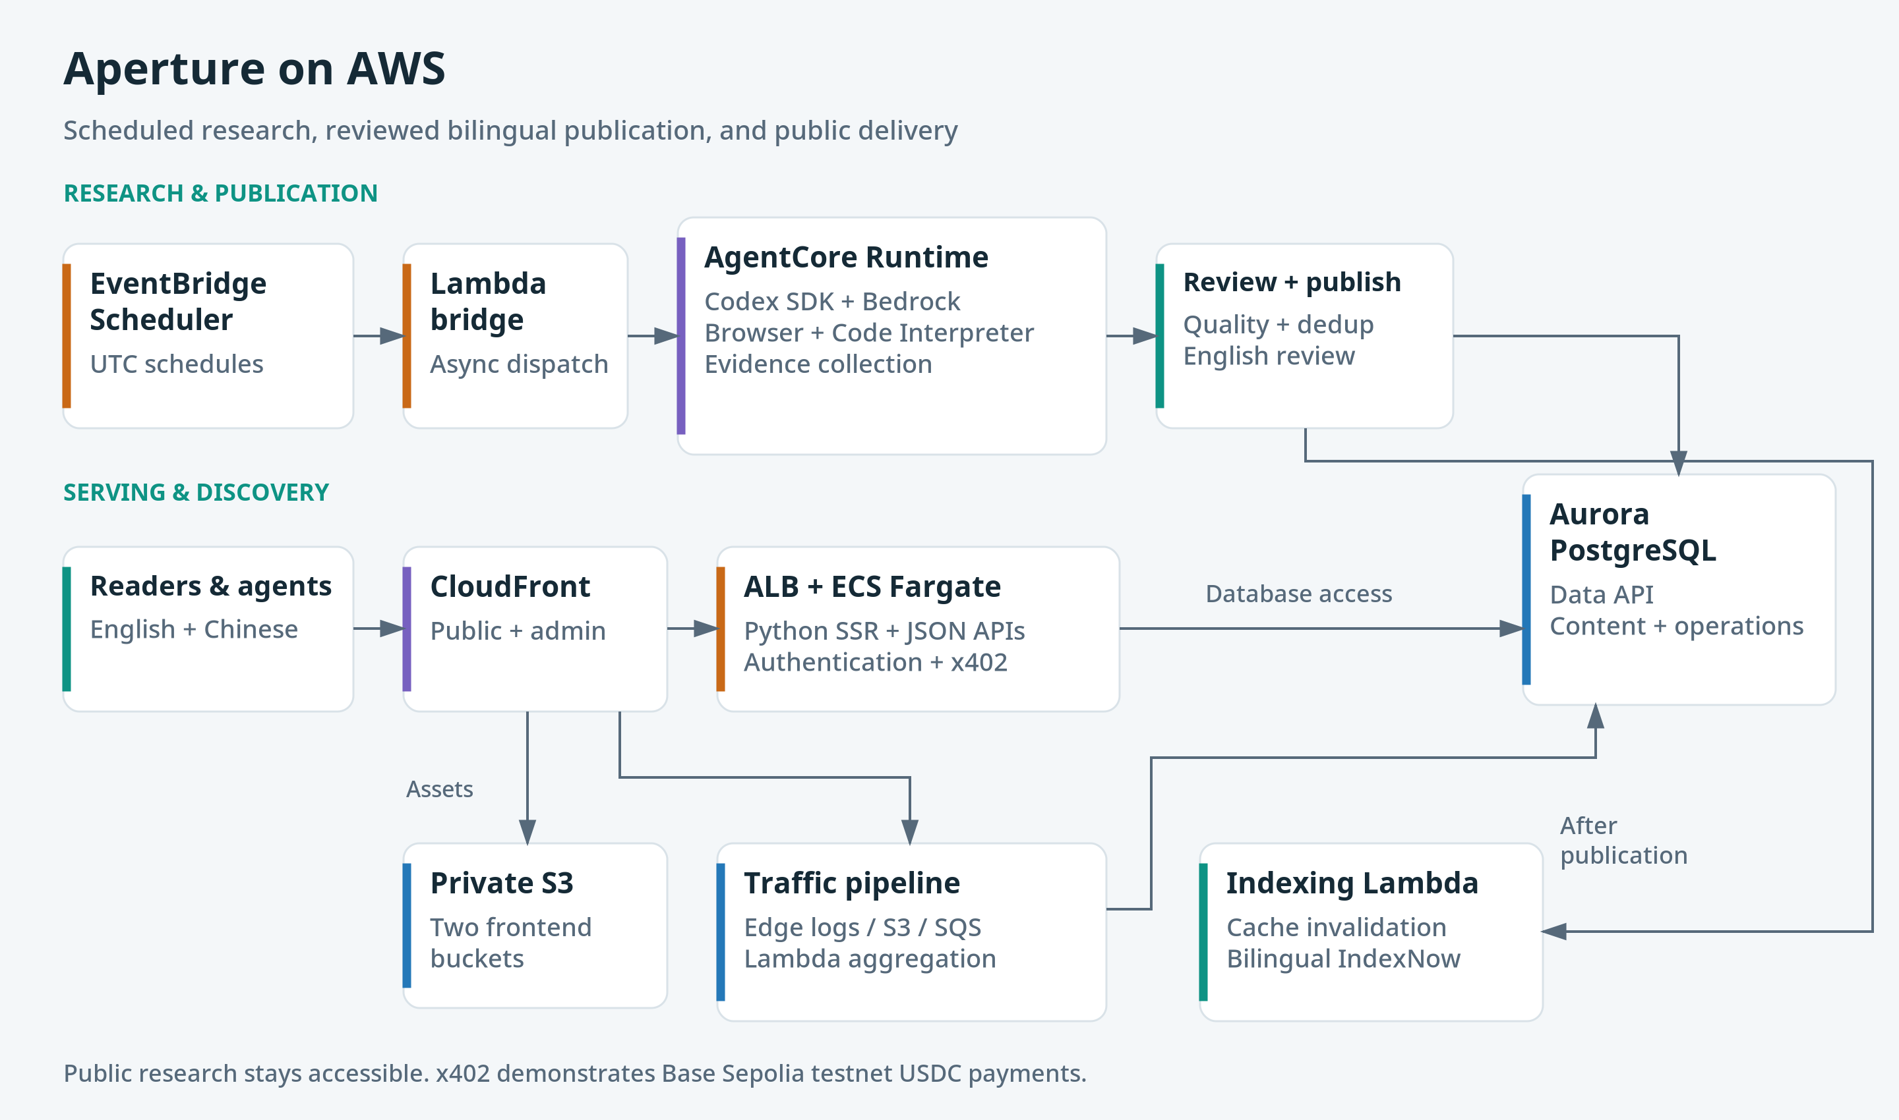
APERTURE INTELLIGENCE / ENGLISH EDITION / 25 SEP 2026
06
Notes:
Logical component/data flow, not a VPC/subnet topology. The indexing worker is invoked by the publisher/API after a successful commit; Aurora does not directly invoke Lambda. Read docs/architecture.md for security and persistence boundaries.
Editable source: docs/architecture/aperture-aws.drawio, page Aperture on AWS.

Slide 7
IMPLEMENTATION
Research runs asynchronously
1
2
3
Schedule and dispatch
Collect and analyze
Record and review
EventBridge schedules a Lambda bridge. The bridge waits for runtime acceptance.
The runtime selects sources, generates crawler code and retrieves evidence with managed tools.
Aurora stores job state, evidence, research output and publication decisions.
Codex SDK generates crawler code; Browser and Code Interpreter perform retrieval and execution.
APERTURE INTELLIGENCE / ENGLISH EDITION / 25 SEP 2026
07
Notes:
Sources: aws_scheduler/lambda_function.py, aws_runtime/app.py, aws_runtime/crawler_tools.py, agent_runtime/codex_crawler.ts. The runtime uses Bedrock. Scheduler delivery retries and Lambda async retries are separate policies.

Slide 8
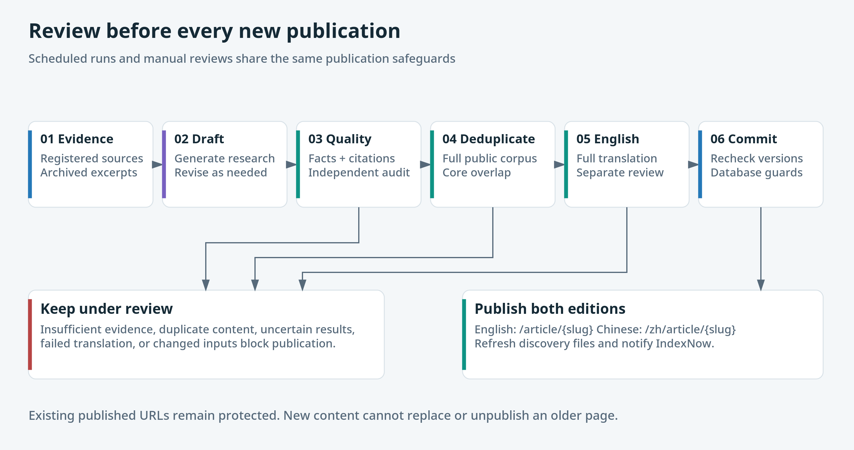
APERTURE INTELLIGENCE / ENGLISH EDITION / 25 SEP 2026
08
Notes:
Quality and full published-catalogue semantic comparison precede translation. Independent English review requires score >=90 and no issues. A final transaction rechecks source/article hashes and the published catalogue. Semantic review is not a mathematical uniqueness guarantee. Source: aws_runtime/publication.py and docs/bilingual-publication.md.
Editable source: docs/architecture/aperture-aws.drawio, page Review before every new publication.

Slide 9
PUBLICATION AND SEARCH
New content must not erase old URLs
41
104
19
published articles
bilingual public URLs
legacy redirect mappings
Published status and slugs are protected by the database.
Reviewed repairs use a specific 301 or restore the original URL.
New duplicates remain under review; existing pages stay available.
Snapshot: 25 Sep 2026 • Bing accepted the update; acceptance does not confirm indexing.
APERTURE INTELLIGENCE / ENGLISH EDITION / 25 SEP 2026
09
Notes:
September 25 verification snapshot: 41 articles, 104 bilingual public URLs, 19 legacy redirect mappings. 312 crawler page checks and 26 site checks passed. Bing accepted 104 URLs at 15:29:24 UTC with HTTP 200. The Bing Webmaster indexed-page report was not accessed; Google does not use IndexNow.

Slide 10
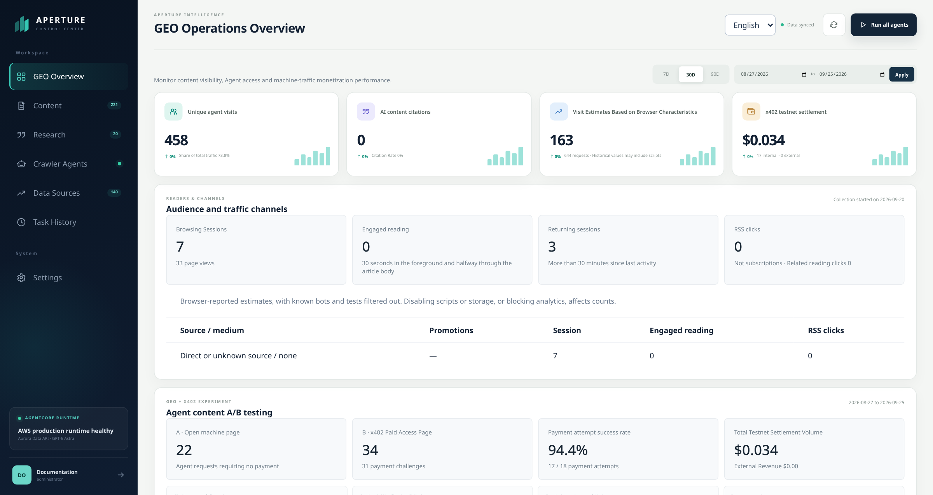
ADMINISTRATION
An English console for daily operations
Traffic estimates, reader attribution, research activity and x402 testnet events in one view.
APERTURE INTELLIGENCE / ENGLISH EDITION / 25 SEP 2026
10
Notes:
Actual production overview, captured in an 1600x850 viewport. Historical original-language logs below the viewport were not edited. Displayed USDC values are testnet activity and must not be described as production revenue.
Screenshot: Live English overview and x402 testnet metrics
Source: https://deu7vkdd3jf5.cloudfront.net/
Captured: 2026-09-25T15:53:00.786607+00:00
SHA-256: 093560b814192255af7864fa53049d3d42bb48485ad7d8804a412ed401827f08
Region: viewport. Actual English interface, no substituted text or synthetic data.

Slide 11
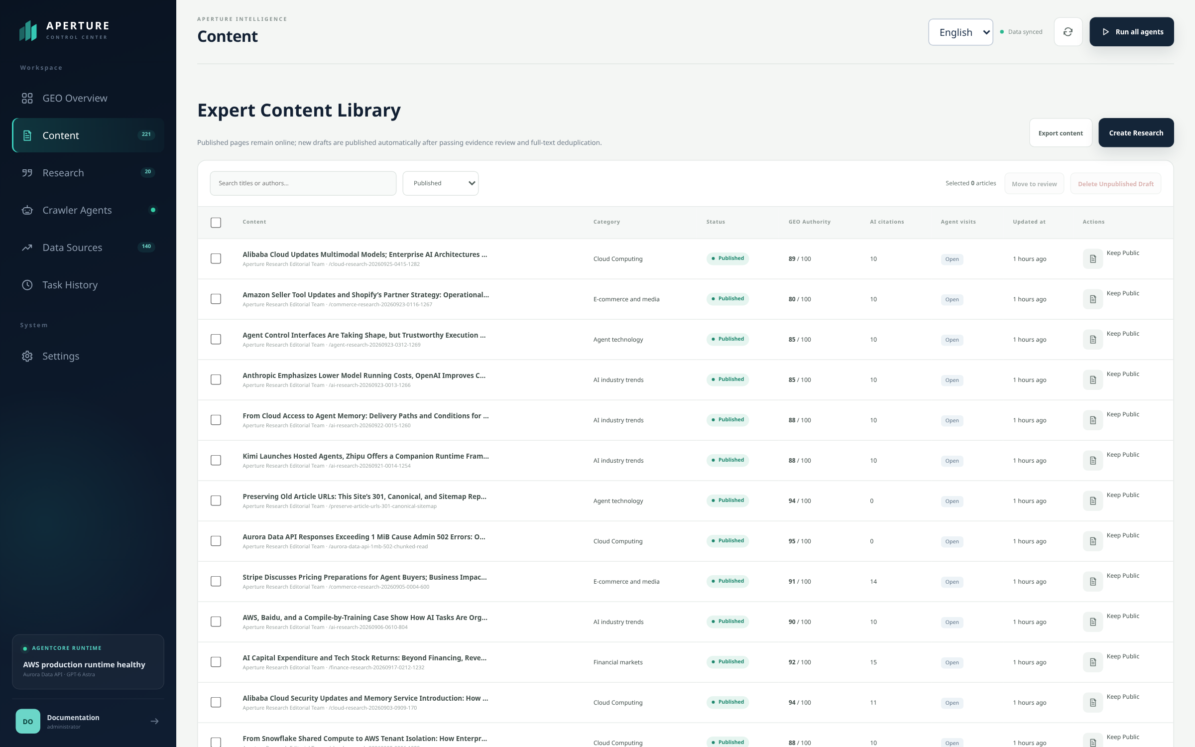
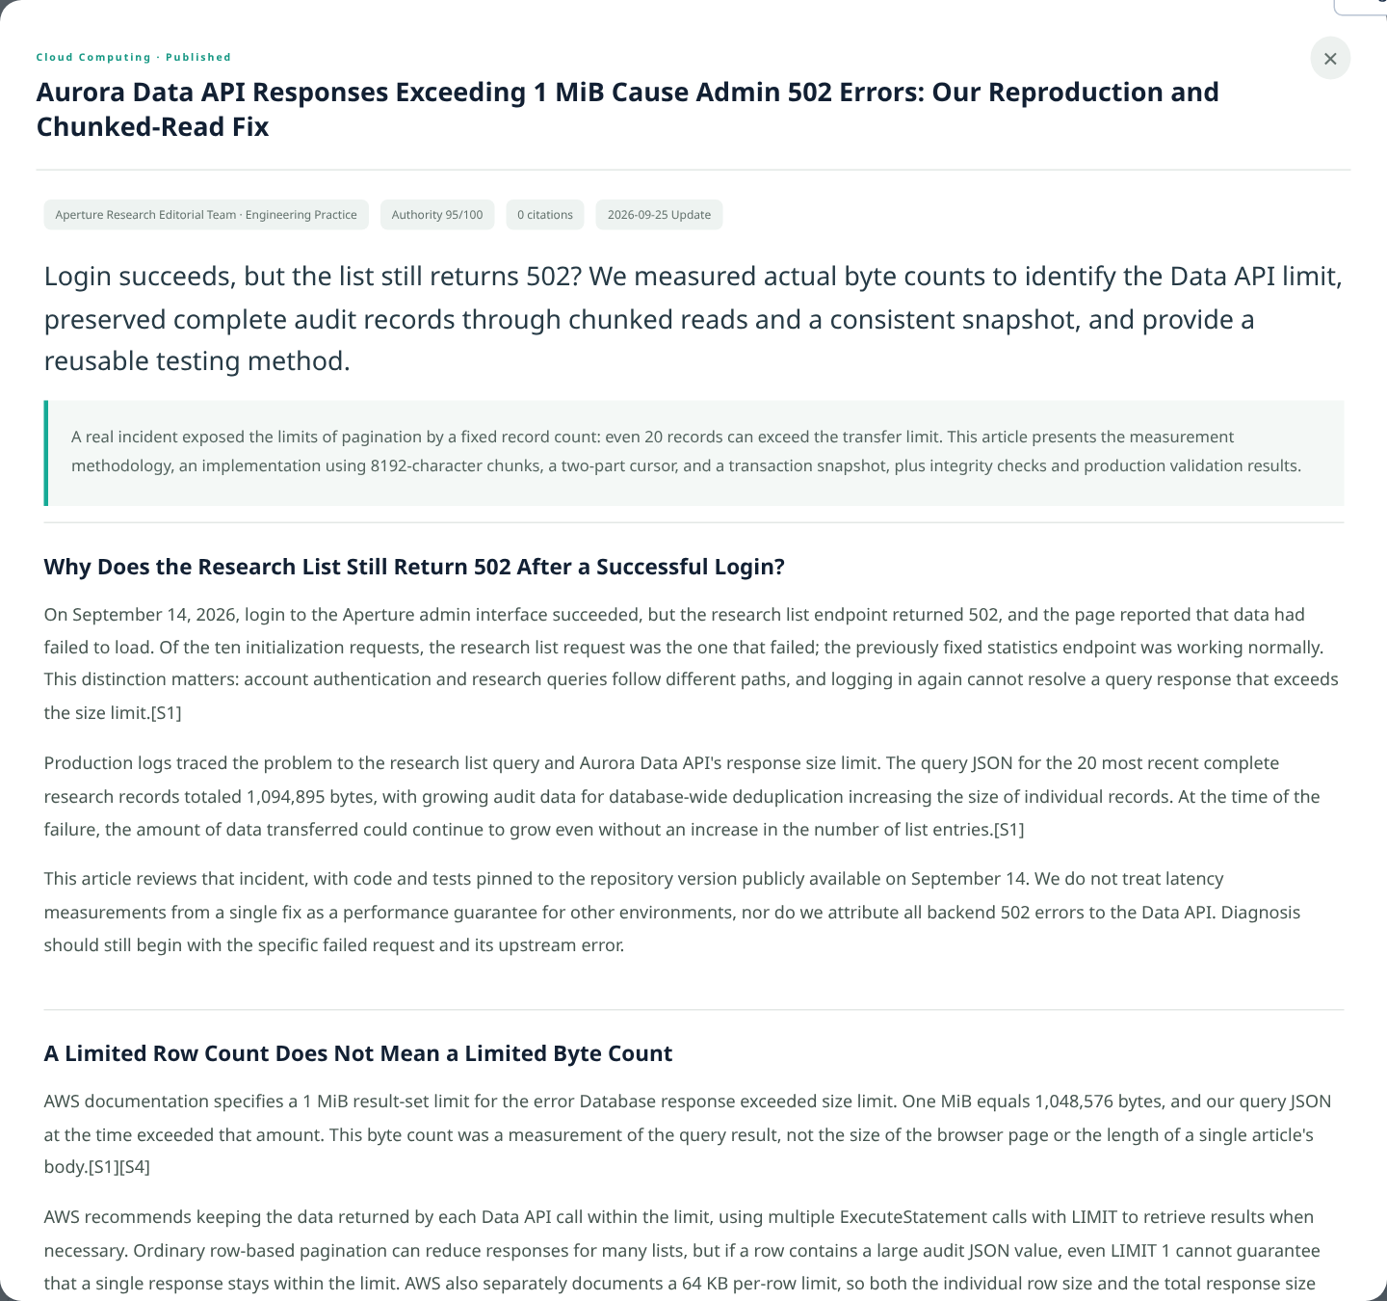
CONTENT OPERATIONS
Published content uses reviewed English editions
PUBLISHED CATALOGUE
REVIEWED ARTICLE DETAIL
Original drafts and source evidence retain their original language and audit history.
APERTURE INTELLIGENCE / ENGLISH EDITION / 25 SEP 2026
11
Notes:
Actual content view with the normal Published filter; original unpublished drafts are not translated through DOM substitutions. The second screenshot is the actual reviewed English article detail modal. Content mutations were not performed.
Screenshot: Published content filter in the English console
Source: https://deu7vkdd3jf5.cloudfront.net/
Captured: 2026-09-25T15:53:01.288526+00:00
SHA-256: acdd79ad787df8fca98fdb332325313b29fd9e66a1bc20e6e41c07c64fde7b1b
Region: viewport. Actual English interface, no substituted text or synthetic data.
Screenshot: Reviewed English article detail
Source: https://deu7vkdd3jf5.cloudfront.net/
Captured: 2026-09-25T15:53:02.673807+00:00
SHA-256: 96189fd17a4a748177c3645c1e06719c59fa1194eddbc18cede53770b8a2ab55
Region: .detail-modal. Actual English interface, no substituted text or synthetic data.

Slide 12
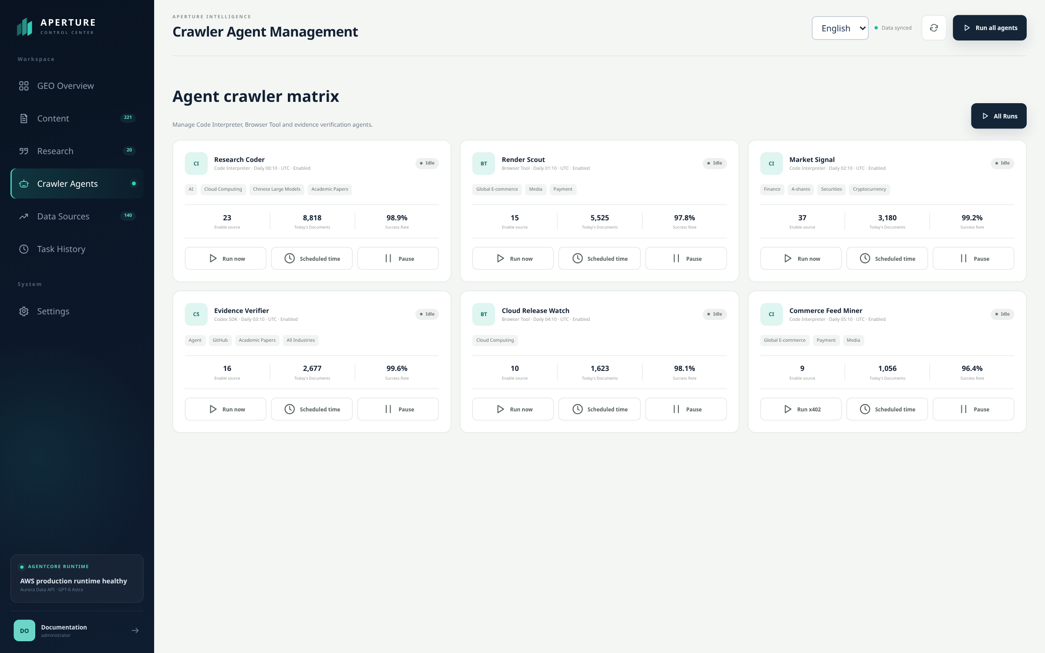
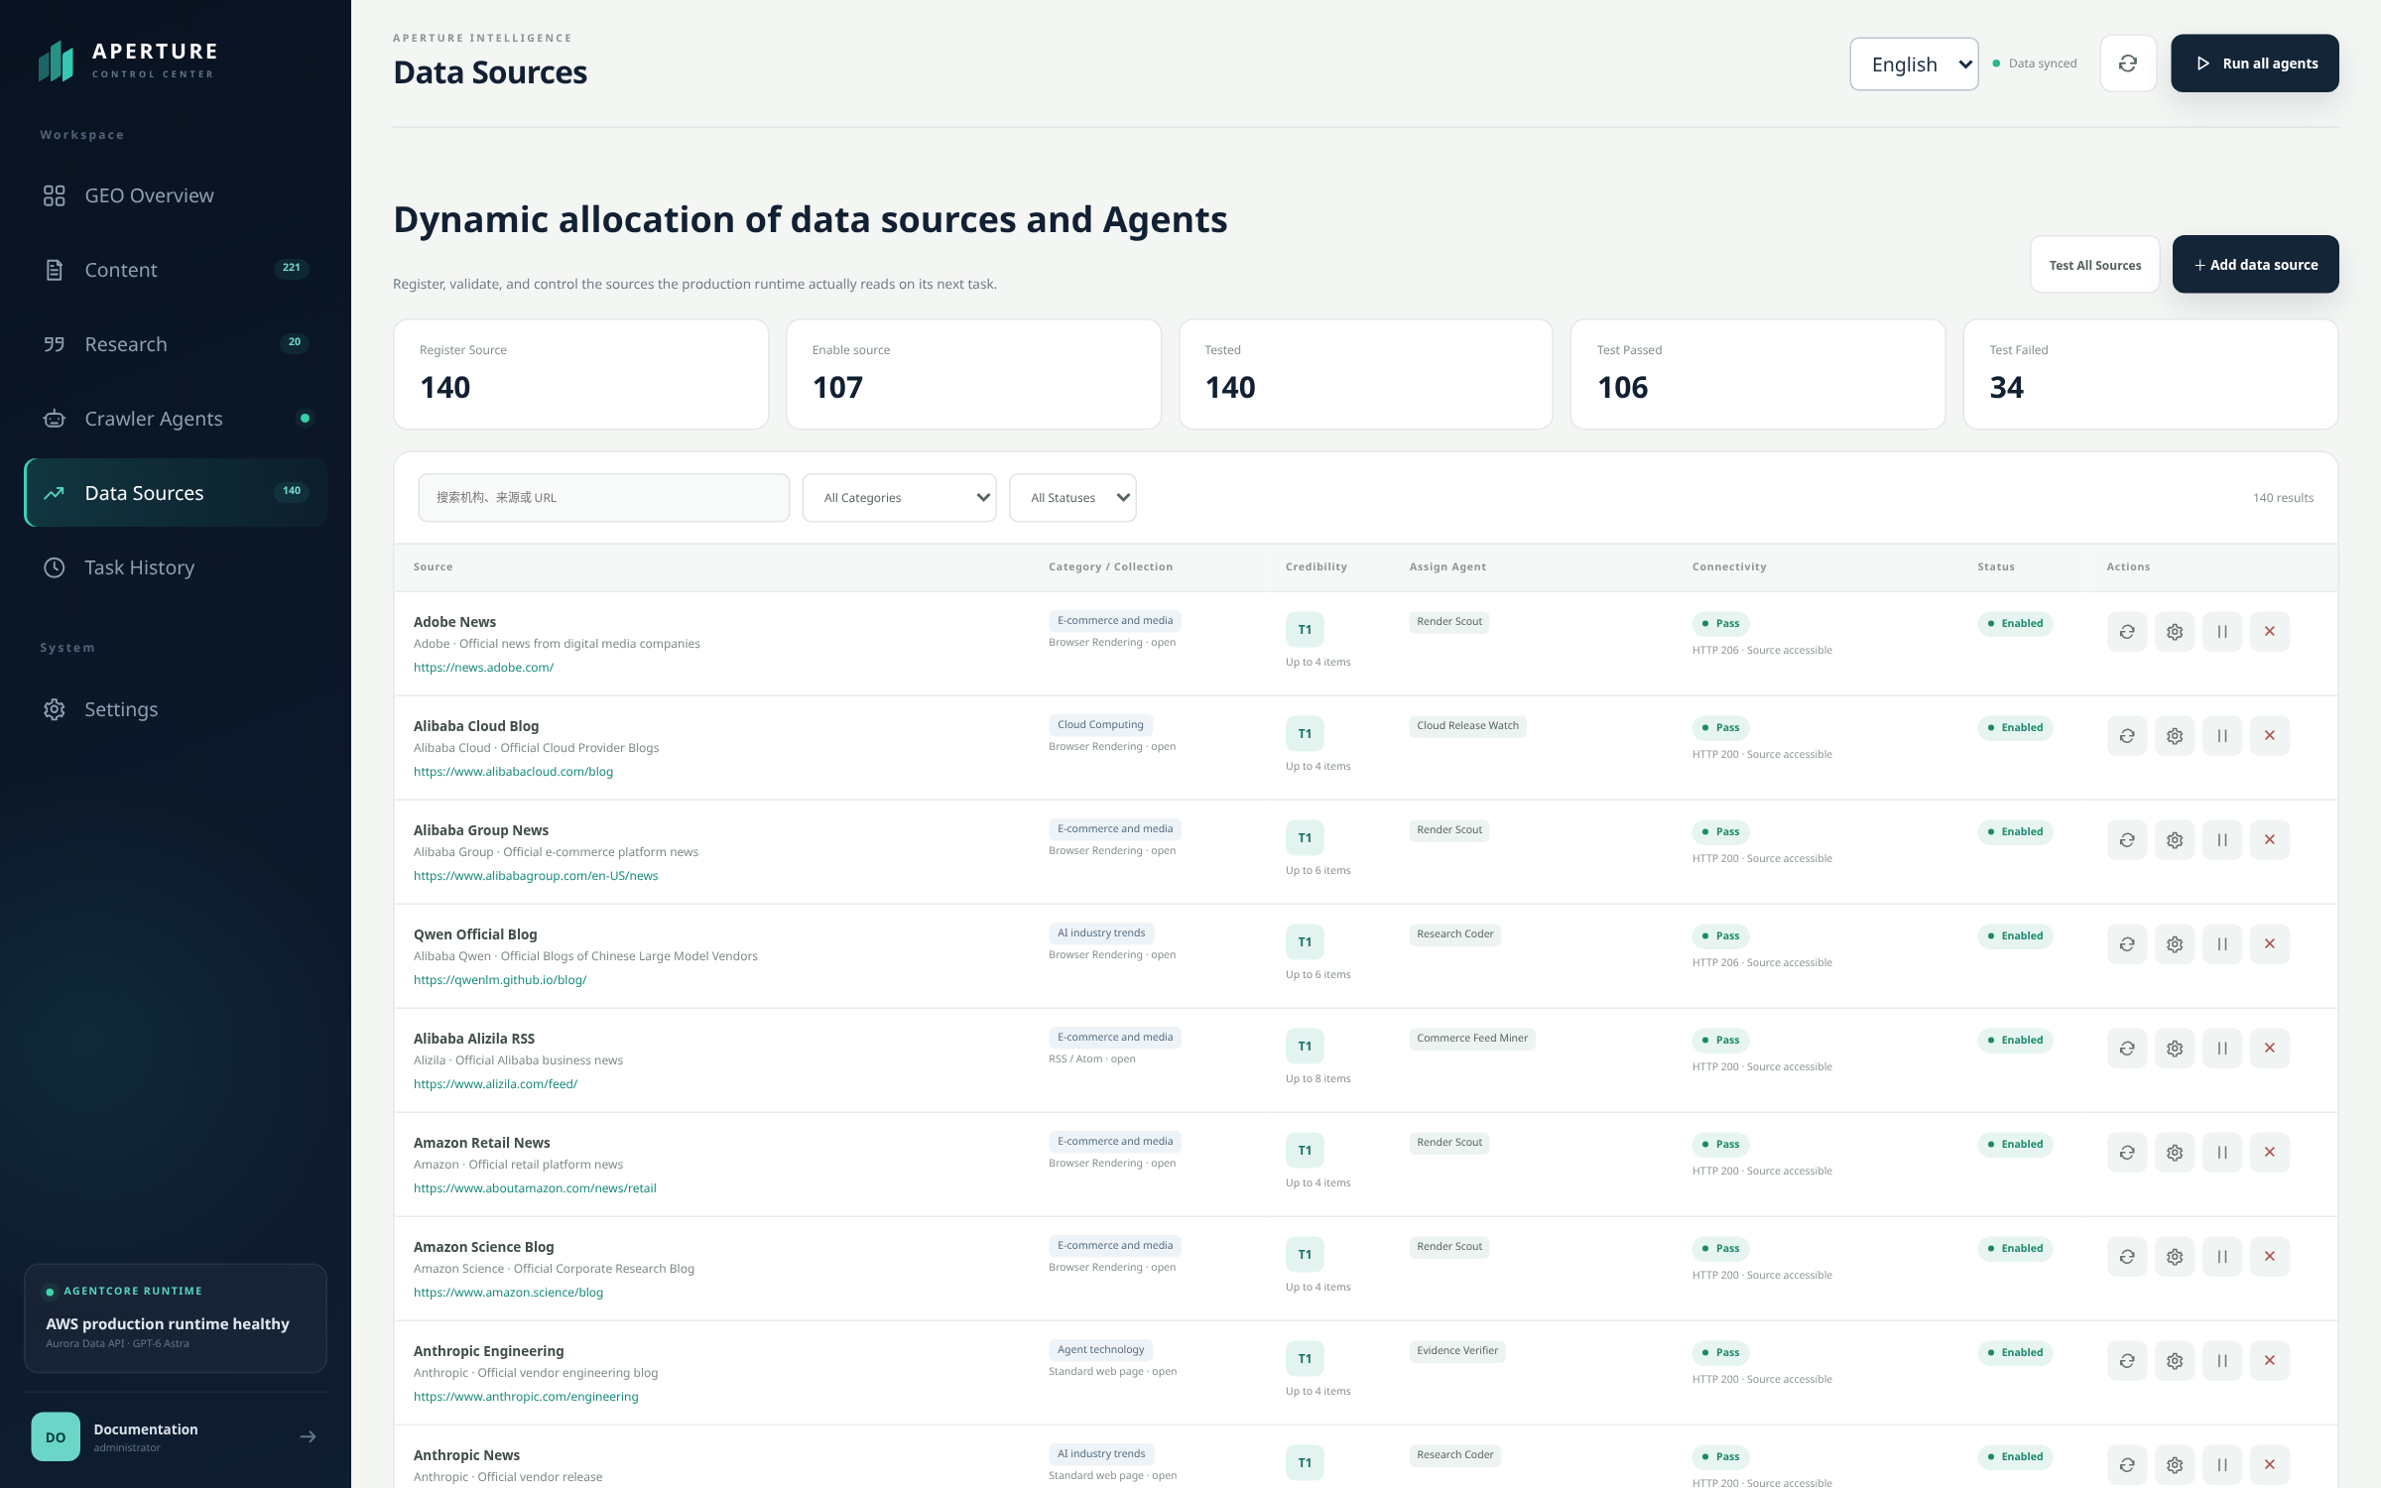
RESEARCH OPERATIONS
Sources and schedules remain inspectable
Crawler state, UTC schedules
and recorded job outcomes.
Registered sources, assignments
and connection-test workflows.
APERTURE INTELLIGENCE / ENGLISH EDITION / 25 SEP 2026
12
Notes:
Actual English crawler and source registry screens. Source counts are operational data and can change. Settings and source edits were not saved during capture. Source credentials are never embedded in the presentation.
Screenshot: Live crawler agents and UTC schedules
Source: https://deu7vkdd3jf5.cloudfront.net/
Captured: 2026-09-25T15:53:03.425214+00:00
SHA-256: fe9d18e56d6efb13673fcb62c50649035688ba6e96f136fceaec89a5f2b496bd
Region: viewport. Actual English interface, no substituted text or synthetic data.
Screenshot: English source registry
Source: https://deu7vkdd3jf5.cloudfront.net/
Captured: 2026-09-25T15:53:03.870613+00:00
SHA-256: fddd2e69a1fa5739776c3d57820c7e01441ade4cf1118a4a9c0b04e42e2fcb8c
Region: viewport. Actual English interface, no substituted text or synthetic data.

Slide 13
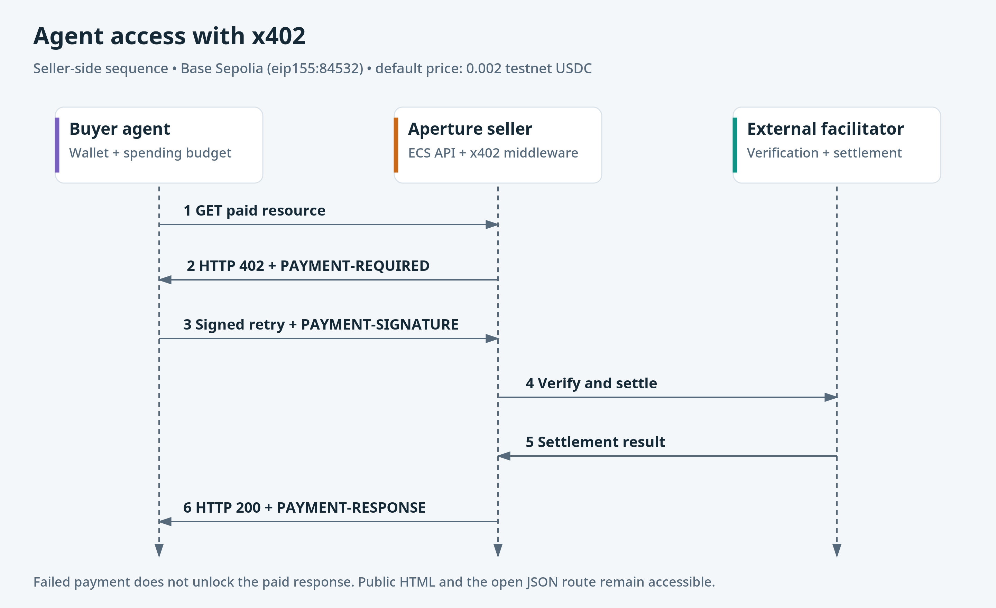
APERTURE INTELLIGENCE / ENGLISH EDITION / 25 SEP 2026
13
Notes:
Seller implementation: backend/x402_payment.py. Payments are verified and settled by an external facilitator. The optional research buyer uses AgentCore Payments separately. Base Sepolia testnet USDC only; default 0.002. No payment was executed while capturing or producing this presentation. Successful response includes content and PAYMENT-RESPONSE.
Editable source: docs/architecture/aperture-aws.drawio, page Agent access with x402.

Slide 14
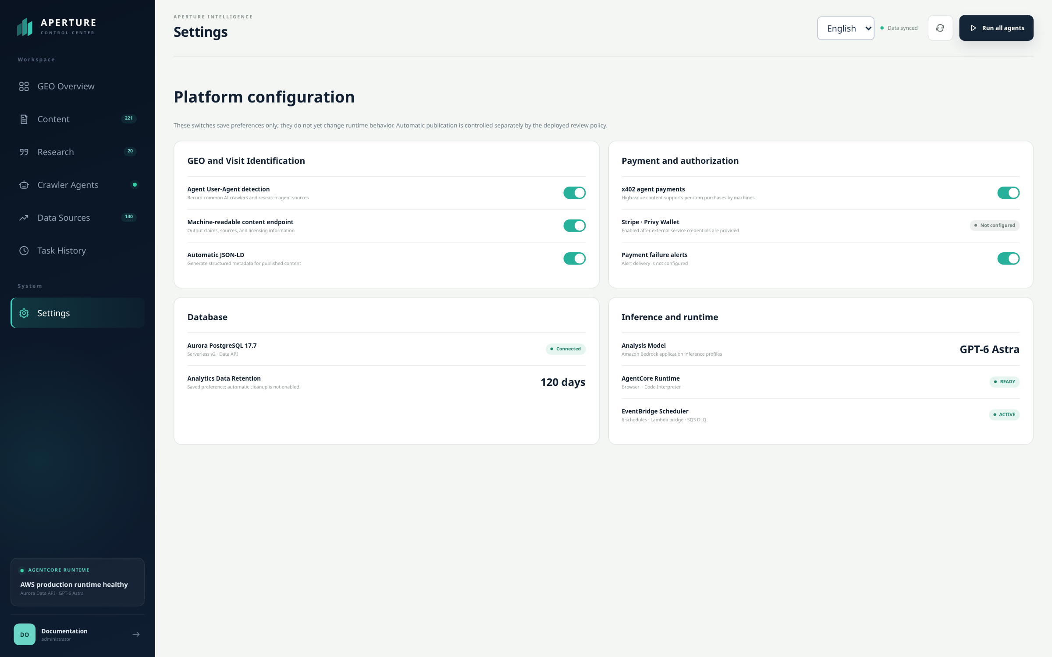
ANALYTICS AND CONTROLS
Measure observed behavior and expose limits
Two measurement sources
Edge logs: requests and visitor estimates.
Browser events: sessions, reading,
return visits and referral channels.
Exclude diagnostics from growth.
RSS clicks do not prove subscription.
Testnet payments are not revenue.
Preference-only controls are labeled in the actual UI.
APERTURE INTELLIGENCE / ENGLISH EDITION / 25 SEP 2026
14
Notes:
CloudFront -> S3 -> SQS -> Lambda -> Aurora aggregates. HLL and browser events are approximate. S3 raw logs have a lifecycle policy; automatic Aurora analytics cleanup is not configured. Settings switches persist preferences, not runtime controls. See docs/functional-verification.md.
Screenshot: English settings with explicit feature limits
Source: https://deu7vkdd3jf5.cloudfront.net/
Captured: 2026-09-25T15:53:04.273522+00:00
SHA-256: 30769c4262026a5eba1e165b930fb5a67e19d966417b87d6e68f72600766a04d
Region: viewport. Actual English interface, no substituted text or synthetic data.

Slide 15
CODE ORGANIZATION
A small application with explicit boundaries
frontend/public + frontend/admin
Reader experience and operations console
backend
SSR, APIs, auth, locales, persistence and x402 seller
aws_runtime + agent_runtime
Research orchestration, tools and publication gates
aws_scheduler + aws_indexing_notifier
Asynchronous invocation and discovery notifications
aws_traffic_aggregator
Edge-log classification and hourly aggregates
scripts + infrastructure/aws
Release workflows, tests, maintenance and IAM examples
Large Data API responses use bounded reads; review history and evidence remain intact.
APERTURE INTELLIGENCE / ENGLISH EDITION / 25 SEP 2026
15
Notes:
Python HTTP/SSR backend with vanilla frontend assets; managed AWS research tools and a TypeScript Codex worker. Aurora Data API reads are bounded with pagination/chunks and consistent snapshots for large admin responses. No separate graph/vector database is part of the implemented architecture.

Slide 16
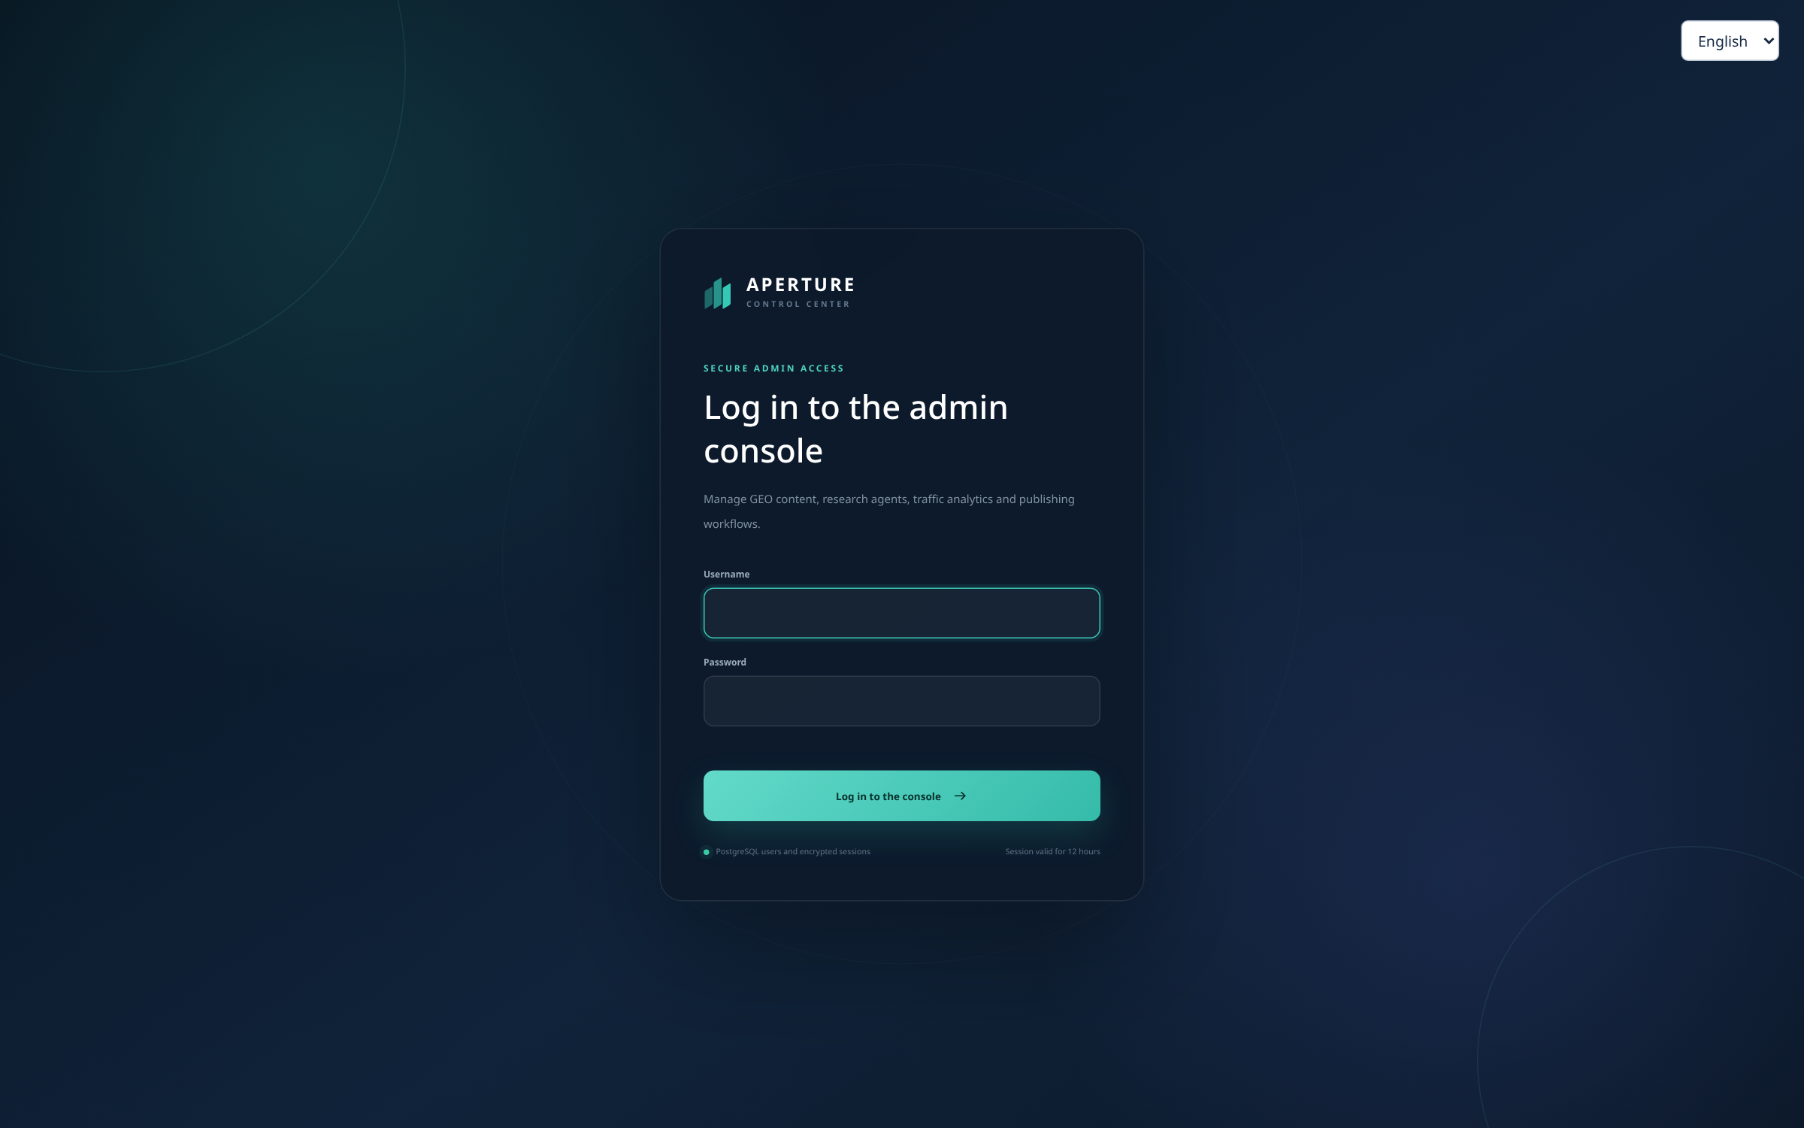
INSTALL
Run the application locally
Python 3.10+ • Docker Compose
git clone https://github.com/milan9527/geo.git
cd geo
./scripts/start.sh
Public :4173 / Admin :4174 / API :8000
Create an admin with scripts/create_admin_user.py.
The command prompts for a password.
Node.js 24+ is needed for the crawler worker build.
See docs/deployment.md for configuration.
Actual English production login screen
APERTURE INTELLIGENCE / ENGLISH EDITION / 25 SEP 2026
16
Notes:
Source: scripts/start.sh, scripts/create_admin_user.py and docs/deployment.md. Startup creates a venv, installs dependencies and starts local PostgreSQL. Do not load production credentials for local tests. The admin image is the actual production English login screen, included as UI illustration, not a claim of a local capture.
Screenshot: English admin login; no credentials shown
Source: https://deu7vkdd3jf5.cloudfront.net/
Captured: 2026-09-25T15:52:51.037042+00:00
SHA-256: 0732eb337e9e5044a32b15ba3ef6b1b82153ae48c95b82ef2cf1d79473f78e5e
Region: viewport. Actual English interface, no substituted text or synthetic data.

Slide 17
DEPLOY
Release into an existing AWS environment
Export .env.aws and .env.deploy.aws with your resource settings.
Provision the required AWS services before running release scripts.
./scripts/deploy_web_ecs.sh
./scripts/deploy_agent_runtime.sh --auto-publish
./scripts/deploy_scheduler_bridge.sh
Build and scan images → update services → upload assets → invalidate caches.
Wait for deployment and cache completion, then verify live bilingual routes.
Keep isolated tests separate from the production database.
APERTURE INTELLIGENCE / ENGLISH EDITION / 25 SEP 2026
17
Notes:
Source: docs/deployment.md, infrastructure/aws/README.md and scripts/deploy_*.sh. These scripts are not complete new-account infrastructure bootstraps. Account-specific policy/scheduler files must be adapted. Do not delete/update the legacy CloudFormation stack that still owns live resources. Never run mutating smoke tests against production.

Slide 18
VERIFICATION
Verified behavior, with evidence you can inspect
106
312
11
automated tests passed
crawler page checks passed
real English UI captures
Both languages. Publication gates. Navigation and admin workflows.
Legacy redirects. Payment responses. Traffic attribution.
Explore the site aperture.zhangwangshu.com
Read the code github.com/milan9527/geo
Reproduce checks docs/functional-verification.md
APERTURE INTELLIGENCE / ENGLISH EDITION / 25 SEP 2026
18
Notes:
Sources: reports/functional-coverage-2026-09-25.md and JSON; docs/screenshots/manifest.json. 106 tests and 312 crawler checks were completed before this documentation task. Screenshot captures are additional read-only evidence. Known uncached category latency and preference-only controls are documented. Test results do not establish search ranking or adoption.

