Slide 1

Project BY_
Milan Shrestha (325489)
Bishal Subedi (325483)
Benjin Lama (325480)

Slide 2


PRESENTERS_
MILAN $HRESTHA
BISHAL D SUBEDI
BENZENE LAMA
CREATOR
EDITOR
ANIMATOR

Slide 3
TABLE OF CONTENTS
Introduction
Background
Objectives
Significance
Features
System Analysis
Requirement Gathering Process
Feasibility study
System Design and Development
Function Analysis
Algorithm
Flowchart
System Development and Implementation
Programming Platform
Test Plan
Result Analysis
Termination
Conclusion
Limitations
Future Enhancement
In this brief presentation we will be presenting the following things
About contents surrounding the project in C++ programming
Notes:
So here I am going to talk about
JVC, and why modern VHS tapes were so life changing then
I am going to talk about how modern VHS tapes were considered to be a time shifter
And how people could record entire day’s worth of TV in a single tape
Then I am going to talk about the movie industry wanting to get in the VHS tapes

Slide 4
Chapter 1: INTRODUCTION

Slide 5
1.1 Background
1
Chess is the game that has been played since middle ages
Feature of Object Oriented Programming such as class and object, inheritance, etc
Graphics User Interface was chosen over Console based application
Stockfish chess engine was used for the A. I
Textures, sprites were used for the graphics
Strings were used for keeping record of the relative position of the board

Slide 6
1.2 Objectives
2
The main objective of the project is :
To implement GUI based application that provides entertainment to the end-user in smooth and efficient manner

Slide 7
1.3 Significance
3
This project provides a gateway to integrating third-party libraries into the C++ programming language
This project provides amusement for the parties interacting with the application
This project allows for improvement in the player's skill by playing against the A. I and being able to analyze the game

Slide 8
1.4 Features
4
It offers a visually pleasing graphical interface
2. It allows reverting the currently made move
3. It allows for both single-player and multiplayer mode
4. Allows analyzing the game against an A. I engine
5. Advance concepts such as En passant and casting are allowed

Slide 9
Chapter 2: System Analysis

Slide 10
Requirement gathering
process

Slide 11
Requirement No. | Requirement Name | Requirement description | Process of gathering | Function number
1 | loadPositon | Loads the position of the chess pieces | Discussion | 1
2 | VideoMode | Function that load the window in screen space | Team Discussion | 2
3 | loadFromFile | Functions that allows the loading of texture from file | Prototyping | 3 and 4
4 | window.pollEvent() | Polls whether any event has occurred or not in the screen space | Workshop | 5
5 | getNextMove | Gets the next move from the chess engine | Story board | 6
5

Slide 12
2.1 Feasibility Study
6
To make this project possible
Firstly, for creating this project it was taken into account that a GUI element was required and hence external library was used
Visual Studio was the IDE of choice, it was chosen because of its proper integration and accessibility is provided to make use of external libraries.
This program required there to be multiple texture loading and unloading of each frame and hence require a strong computer system to run it.
Windows 10 was used as Operating System.
Microsoft Word was used to create the documentation.

Slide 13
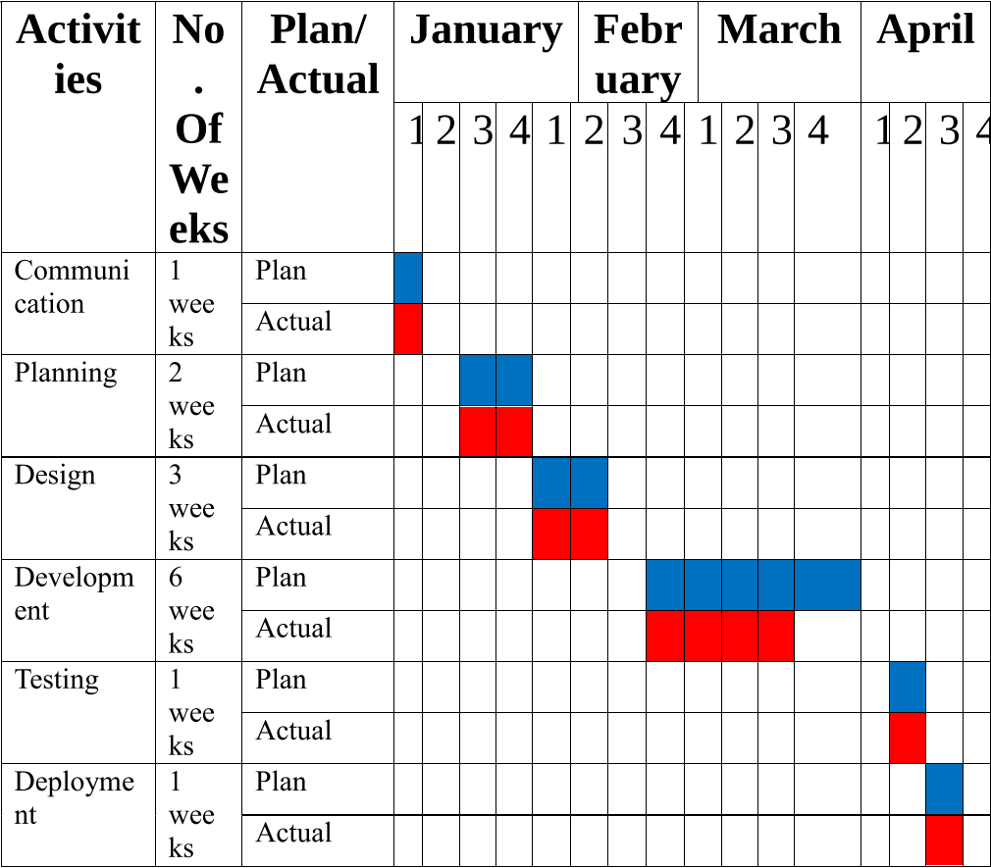
8
Fig 2.2 A planned Gantt chart
Project was completed within the allocated time. Project deadline was set accordingly so that it matched our skill set. Functions were divided among team members and each of the members were able to come within a week of margin of error and submit their respective tasks on time.
6

Slide 14
Chapter 3: System Design and Development

Slide 15
3.1 Functional Analysis
9
Function No. | Function Name | Function description
1 | toChessNote | Converts 2 dimensional vector into string
2 | toCoord | Converts string into 2 dimensional vector
3 | move | Checks the condition whether or not the move is allowed, if allowed moves
4 | ConnectToEngine | Connects the GUI with the chess engine
5 | getNextMove | Gets the next move from the chess engine
6 | window.isOpen() | Returns a true value if the window is opened

Slide 16
7 | window.pollEvent(e) | Returns true is any event hass occured
8 | getGlobalBounds().contains(pos.x,pos.y) | Return a x and y coordinate of the mouse
9 | getPosition | Gets the position of the sprite
10 | isKeyPressed | Checks whether or not the key has been pressed
11 | setTextureRect | Sets the value of each texture to the sub set of original texture

Slide 17
3.2 Algorithm
10
STEP 1: START
STEP 2: DISPLAY MAIN MENU
STEP 3: ASK FOR USER CHOICE
STEP 4: IF CHOICE IS 1
STEP 4.1: DISPLAYS STUDENT MENU AND ASK FOR USER CHOICE
STEP 4.2: IF CHOICE IS 1
STEP 4.2.1: LET USER ENTER ID AND DISPLAY THE CORRESPONDING STUDENT RECORD
STEP 4.3: IF CHOICE 2
STEP 4.3.1: LET USER ENTER FIRST NAME AND DISPLAY THE CORRESPONDING STUDENT RECORD
STEP 4.4: IF CHOICE 3
STEP 4.4.1: LET USER ENTER LAST NAME AND DISPLAY THE CORRESPONDING STUDENT RECORD STEP 4.5: IF CHOICE 4
STEP 4.5.1: LET USER ENTER FIELD AND DISPLAY THE CORRESPONDING STUDENT RECORD
STEP 4.6: IF CHOICE 5
STEP 4.6.1: LET USER ENTER SEMESTER AND DISPLAY THE CORRESPONDING STUDENT/S RECORD
STEP 4.7: IF CHOICE 6
STEP 4.7.1: DISPLAY ALL EXISTING RECORD OF THE STUDENTS
STEP 5: IF CHOICE IS 2
STEP 5.1: DISPLAY ALL EXISTING RECORD OF THE TEACHERS
STEP 6: IF CHOICE IS 3
STEP 6.1: DISPLAY THE ROUTINE OF CURRENT DATE
STEP 7: IF CHOICE IS 4
STEP 7.1: DISPLAY ALL EXISTING NOTICE

Slide 18
STEP 8: IF CHOICE IS 5
STEP 8.1: DISPLAY EDIT MENU AND ASK FOR USER CHOICE
STEP 8.2: IF CHOICE IS 1
STEP 8.2.1: LETS USER CREATE NEW STUDENT RECORD
STEP 8.3: IF CHOICE IS 2
STEP 8.3.1: LETS USER CREATE NEW TEACHER RECORD
STEP 8.4: IF CHOICE IS 3
STEP 8.4.1: DISPLAY THE ROUTINE AND ASK FOR USER TO SELECT PERIOD
STEP 8.4.2: ASK USER FOR NEW SUBJECT NAME
STEP 8.5: IF CHOICE IS 4
STEP 8.5.1: LET USER CREATE NEW NOTICE
STEP 8.6: IF CHOICE IS 5
STEP 8.6.1: ASK USER FOR STUDENT ID
STEP 8.6.2: ASK USER FOR CORRESPONDING STUDENT'S GPA
STEP 8.7: IF CHOICE IS 6
STEP 8.7.1: ASK USER FOR STUDENT'S ID AND DELETE THE CORRESPONDING RECORD
STEP 8.8: IF CHOICE IS 7
STEP 8.8.1: ASK USER FOR TEACHER'S ID AND DELETE THE CORRESPONDING RECORD
STEP 9: IF CHOICE IS 6
STEP 9.1: DISPLAY ALL THE EXAMINATION RESULT OF EXISTING STUDENTS
STEP 10: IF CHOICE IS 7
STEP 10.1: CLOSE THE APPLICATION
11

Slide 19
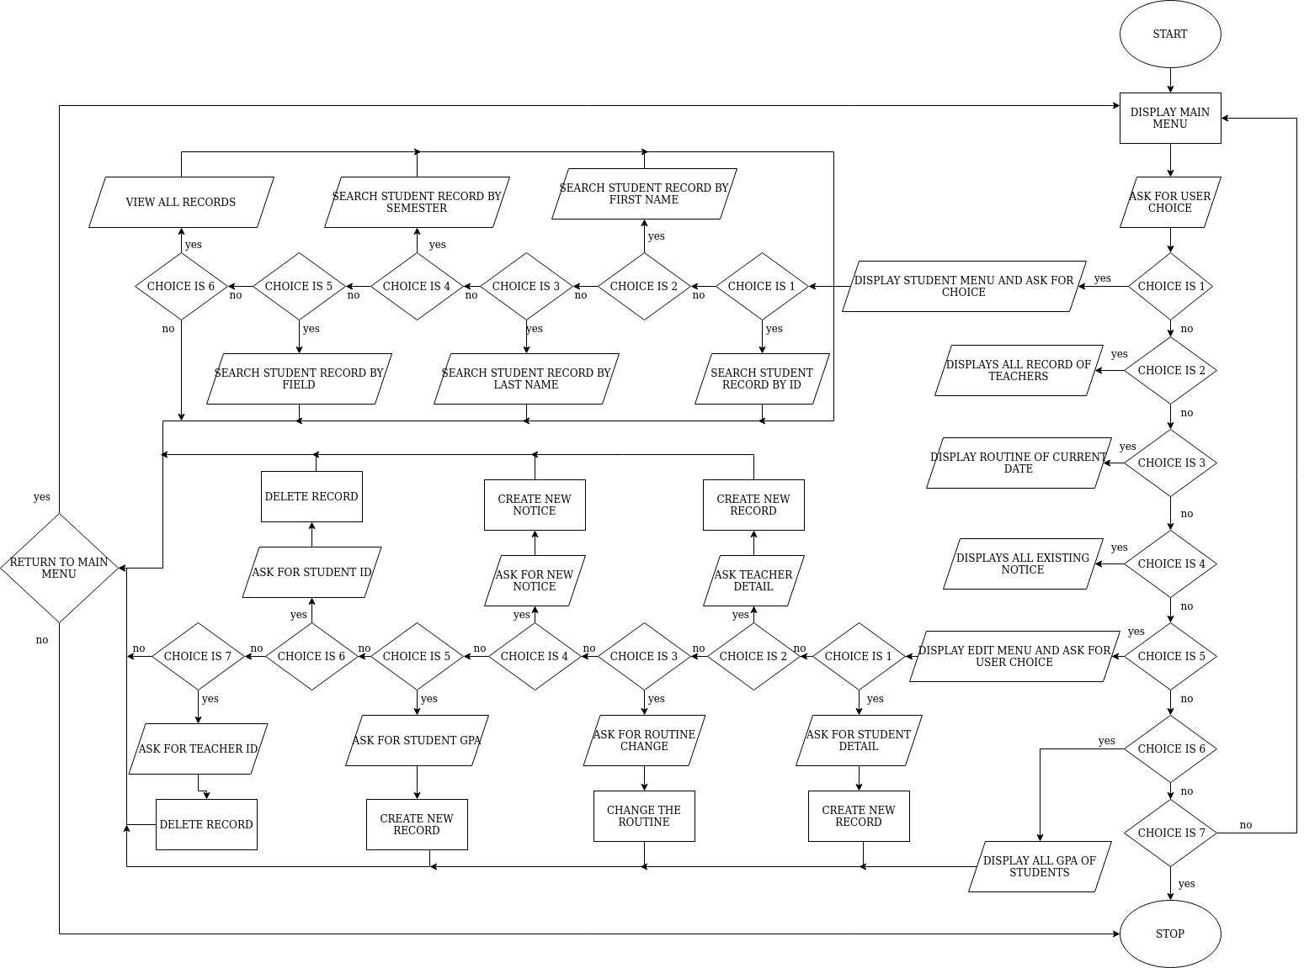
3.3 Flowchart
12
9

Slide 20
Chapter 4: System Development and Implementation

Slide 21
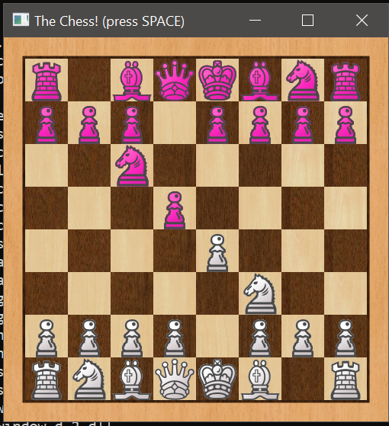
4.1Programming platform
4.2 Implementation and result analysis
Chess
13
Programming platform use for this project was C++ programming and ide Visual Studio
SFML( Simplified Fast Multimedia Library) library was used
This images were took as a screenshots from the game’s window.
10

Slide 22
4.3 Test plan
14
Waterfall methodology was used to create the program. And unit testing, integration testing, and system testing were conducted to ensure their proper risk management.
Objective of Testing
Ensure the Application Under Test conforms to functional and non-functional requirements
Ensure the complete system performed as per the main objective of the project
Bugs/issues are identified and fixed before final submission

Slide 23
Roles and Responsibility
Detail description of the Roles and responsibilities of different team members like
Test Manager – Milan Shrestha
Unit testing – Benjin Lama
Integration testing – Bishal D Subedi
System testing – Milan Shrestha
Amongst others
4.2.2 Testing Methodology
Defect clustering was carried out for proper risk management
Then individual function that each of us created were testing individually
Then integration testing was conducted
Finally system test was carried out
The functionality was tested from end-to-end before submitting the program for presentation
15

Slide 24
Bug Trials
The goal of the trial is to
To define the type of resolution for each bug
To prioritize bugs and determine a cluster defects
4.2.3 Test Completeness
A few criteria to check Test Completeness of this project were
100% test coverage
All Manual test were executed
All open bugs were fixed
16

Slide 25
Chapter 5: Conclusion and Future Enhancement

Slide 26
5.1 Conclusion
5.2 Limitations
17
Chess is an entertaining and engaging game that challenges the chess player of any level.
A better GUI interface and easier implementation for difficult calculations.
stockfish Chess engine.
Libraries is very system resource intensive and hence may not work in less powerful system.
5.3Future Enhancement
Better libraries with advance features could be used
Saving current game could be implemented
Training courses could be added to the game
12

Slide 27
THANK YOU
For Your Time.

