Slide 1
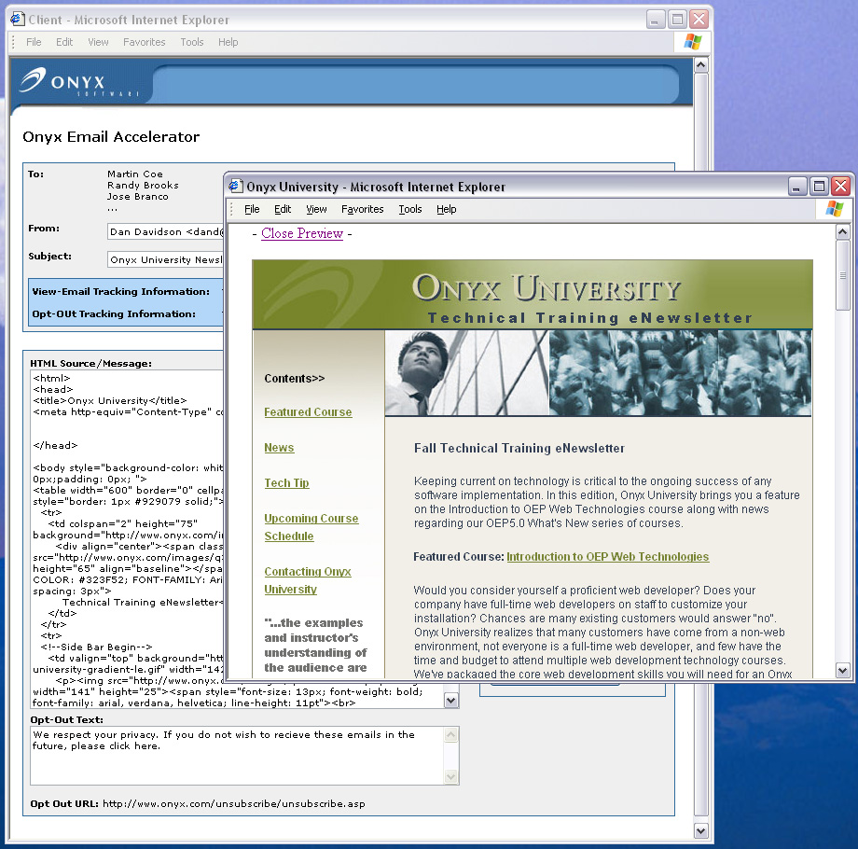
Onyx Email Accelerator

Slide 2
Why Onyx Email Accelerator?
  Lower bulk email costs
    Eliminate dependency on 3rd party
    One time flat fee vs. recurring per email charge
  Email personalization
    Send emails from any user or mailbox in the organization
    Personalize the email body with first name, last name and company
  Reduce spam attributes
    Emails sent from your company instead of 3rd party vendor
    Email sender matches server domain
    Tracking mechanism avoids common spam attributes
  Integration with OEP version 5.0
    Streamline workflow and reduce manual processes
    Real-time tracking of email actions
Notes:
The Onyx Email Accelerator extends the functionality of OEP 5.0 to provide email marketing capabilities.

Slide 3
Key Functionality
  Data querying and list building
    Integrated with Onyx List Manager
    Build targeted lists based on data and preferences in Onyx
  Quickly assign a list for mass email
    Single click action to send the list
  Email personalization “to” and “from”
    Send email from any user or group within an organization
    Email body can be personalized with first name, last name and company
  Email preview and testing capability
    Ensures accuracy

Slide 4
Key Functionality
  Real-time tracking of opened emails
    Integrated with Onyx Campaign functionality
    Generate reports measuring campaign activity
  Real-time opt-out/unsubscribe management
    Integrated with Onyx Campaign functionality
    Generate reports measuring campaign activity
  Email history captured
    A new Onyx table stores email details (recipient, campaign, date sent)
  Pre-packaged email templates
    5 HTML templates for quick setup

Slide 5
Onyx Internal Case Study
  Used internally since June 2004
  First blast resulted in $10,000 to Q3 Services revenue
  Over 25% of recipients are now viewing emails which is significantly higher than with a 3rd party
  Onyx is saving $3,000/month

Slide 6
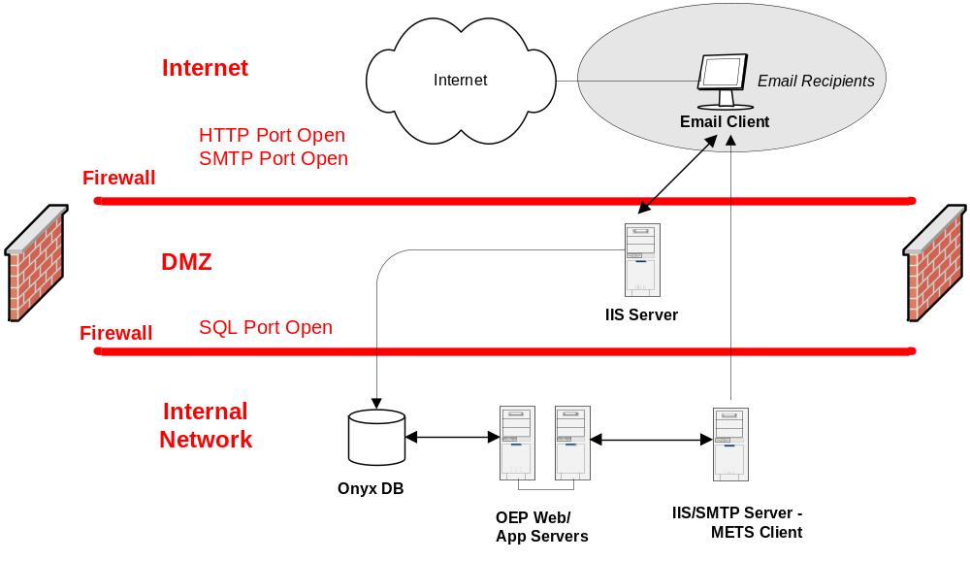
Onyx Email Accelerator Topology

Slide 7
Product Parameters
Item | Parameter
Platform Support | Supports OEAS and OEP 5.0 SQL Edition
Language Support | English only
Geo Support | English speaking geographies
System Requirements | Internal web server running IIS/SMTP Services, Windows 2000 or Windows 2003 Server and Microsoft Internet Explorer (IE) version 6.0 or higher for client External web server running .NET framework and Windows 2000 or Windows 2003 Server (for tracking recipient actions) Onyx Employee Portal version 5.0
Performance Benchmarks | ~3,500 emails / minute using a dedicated server class IIS/SMTP machine with the following specifications: Pentium 4 with 2.8 GHZ with 512 MB RAM and running Windows Server 2003

