Slide 1

Predicting Aging Inventory
NEHA MAHESHWARI | PARAM ATTRI | NEELAV JYOTI NATH | MILAN BANSAL

Slide 2
Data Set
Size :- 300 different rows depicting 300 laptops and desktops
Features : Intrinsic and Extrinsic
Intrinsic: Features that have to be present in a laptop
Brand name , OS , Internal Memory, Processor, RAM, resolution.
Extrinsic: Features that may or may not be present
Bluetooth, port replicator, Fingerprint, external battery, subwoofer, etc.

Slide 3

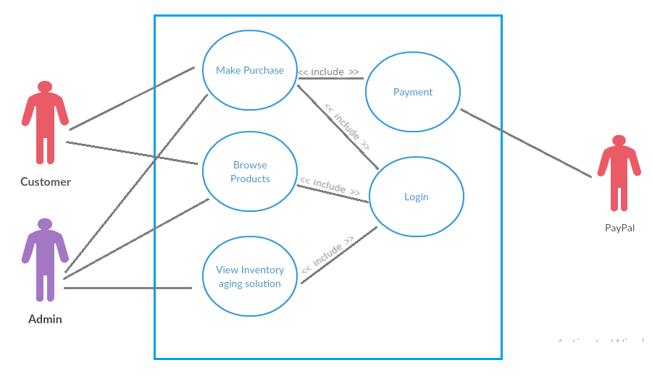
Use Case Diagram

Slide 4
Approach
Target Product : Laptops and Desktops
We trained our algorithm on the basis of the specs of laptops which are already sold and later we tested for the unsold products. From this we can get demand for a particular specs in an area and then shift the product to a new 3PL.
Output : New location of 3rd Party Logistics
Input Dataset
Pre-Processing of Dataset
Prediction Model
Predicted New 3PL Location

Slide 5
Assumptions
From the dataset, the unsold products were assumed to be more than 90 days aged.
We considered sold products to be our training data and unsold products to be our testing data.

Slide 6
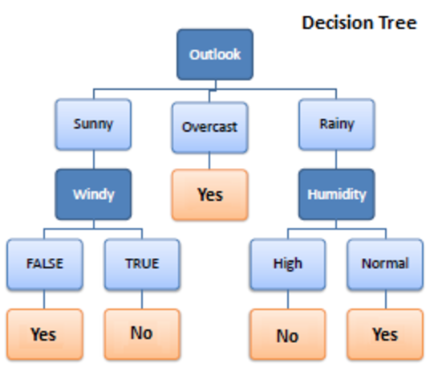
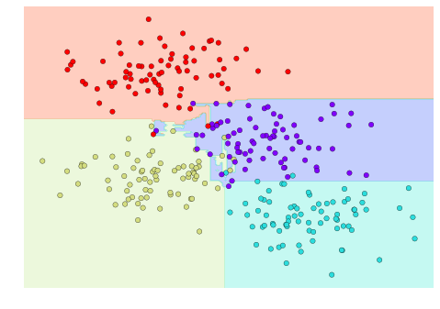
Random Forest Classification
A random forest is simply a collection of decision trees whose results are aggregated into one final result.

Slide 7
Why Random Forest Algorithm?
This algorithm can be used for both Classification and Regression problems.
Overfitting is one critical problem that may make the results worse, but for random forest algorithm, if there are enough trees in the forest classifier won’t over fit the model.
Random forest can handle missing values.
Random forest classifier can be modelled for categorical values.

Slide 8
What makes our model unique?
Keeping in mind the customers, we have offered a discounted price for every product that is moving to a new 3PL, based on the factor that more the number of quantity, more is the discount.
We trained machine learning algorithms, like KNN and SVM but the best result was given by Random forest.

Slide 9

Future Work
Using social media as a tool to target specific audience.
Giving suggestion to user during checkout for related products.
Pay-per-Click(PPC) advertising on social media platforms.

Slide 10
Thank You!

