Slide 1
Leave Slide 1

Slide 2
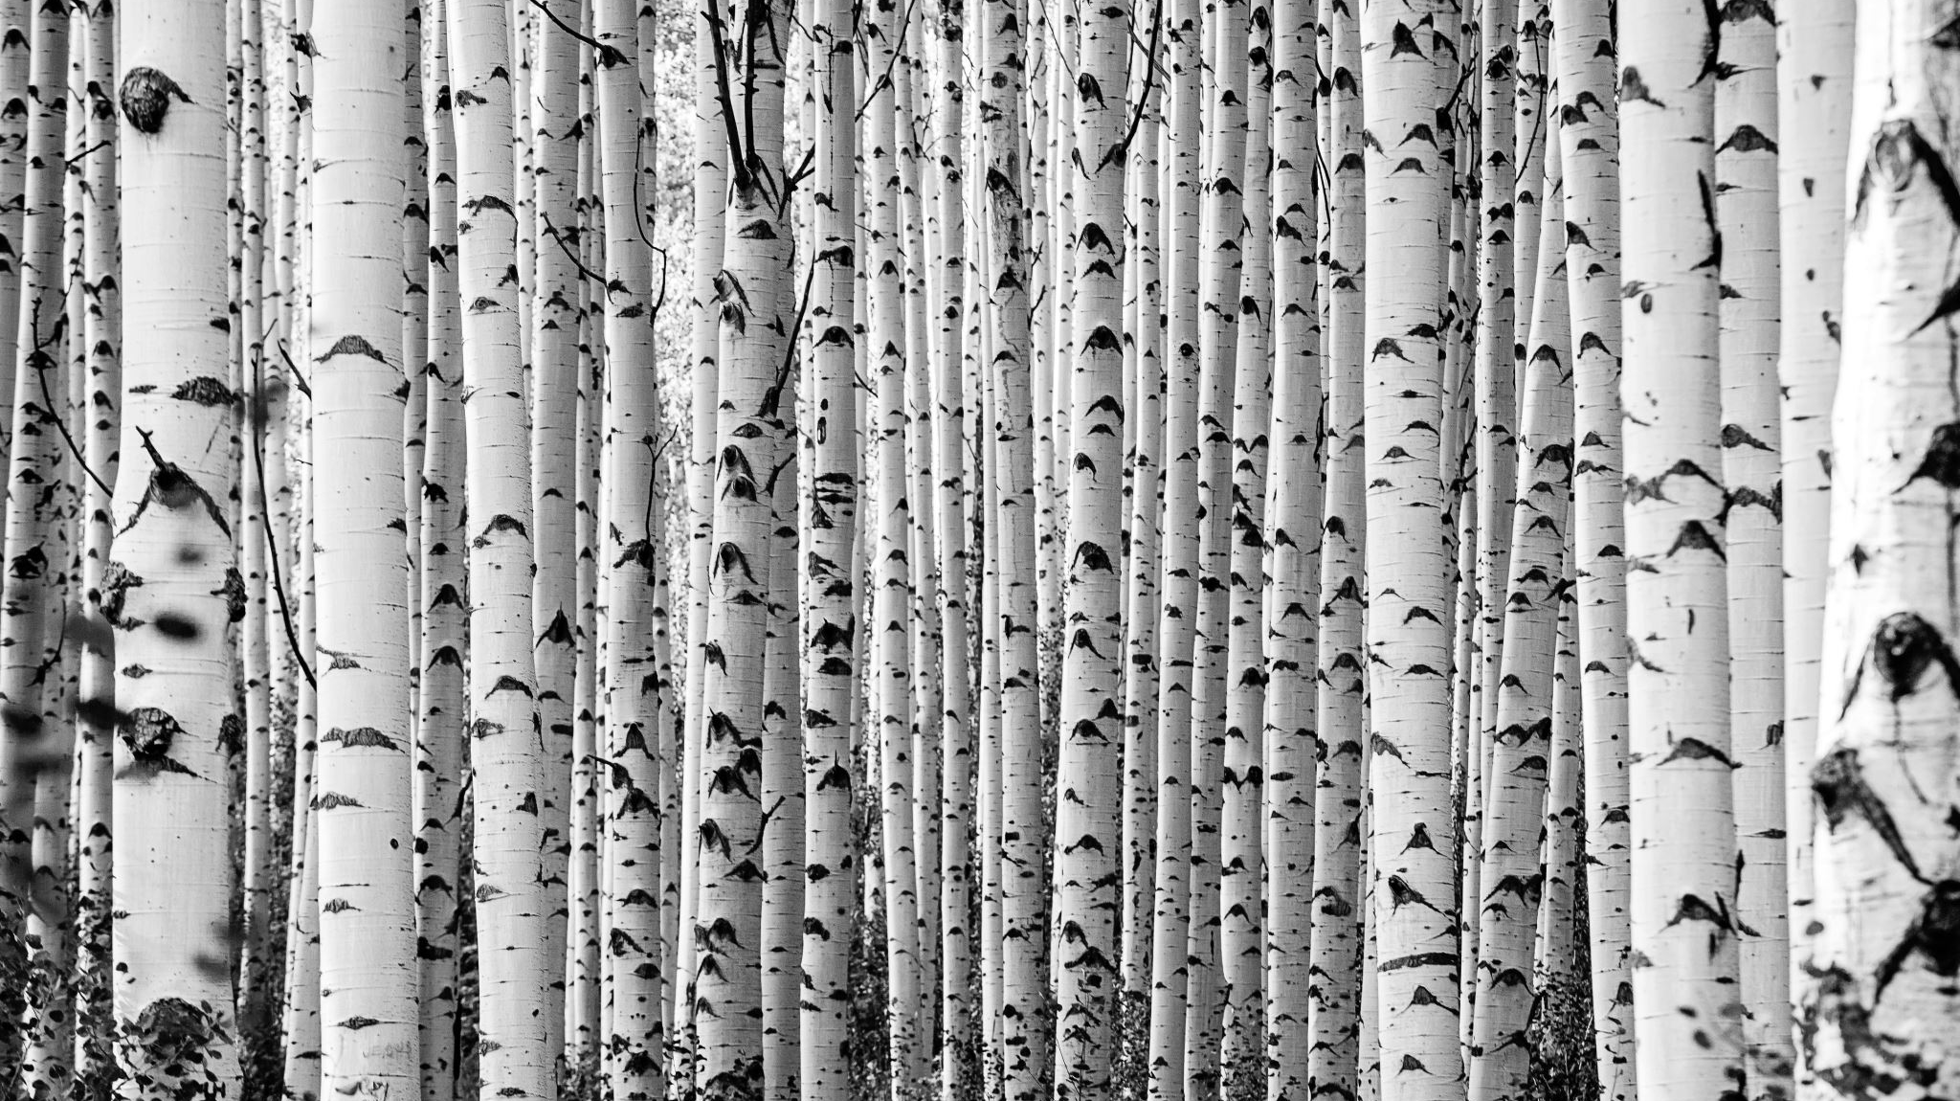
PPT1

Slide 3
PPT2

Slide 4
PPT3

