Slide 1
Comparison of three trans-impedance amplifiers for current-mode receivers

Slide 2
Contents
Materials used in this work
Background and motivation
Operational Transcendence Amplifier
Operational Transcendence Amplifier with merged common mode feedback stage
Comparison

Slide 3
Materials used in this work
Analysis and modeling of 1/f noise in mosfets: The joint effect of channel length and channel resistance, Hardev Singh; R.K Sarin; Sarabjeet Singh; 2012 International Conference on Devices, Circuits and Systems (ICDCS)
Characterization of 1/f noise vs. number of gate stripes in MOS transistors, Hsin-Shu Chen; A. Ito, 1999 IEEE International Symposium on Circuit and Systems
Microelectronic circuits, A.S Sedra; K.C Smith, 2011, Oxford University Press
High-frequency nonlinearity analysis of common-emitter and differential-pair transconductance stages, Keng Leong Fong; R. G. Meyer, 1998, IEEE Journal of Solid-State Circuits

Slide 4
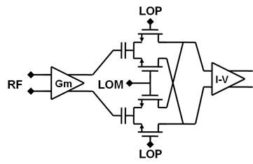
Background
Transimpedance Amplifier (I-V in the picture) converts current into voltage.
Large effect on overall receiver
performance
Requirements:
low input impedance, some gain,
high linearity and low noise.
Current mode receiver

Slide 5
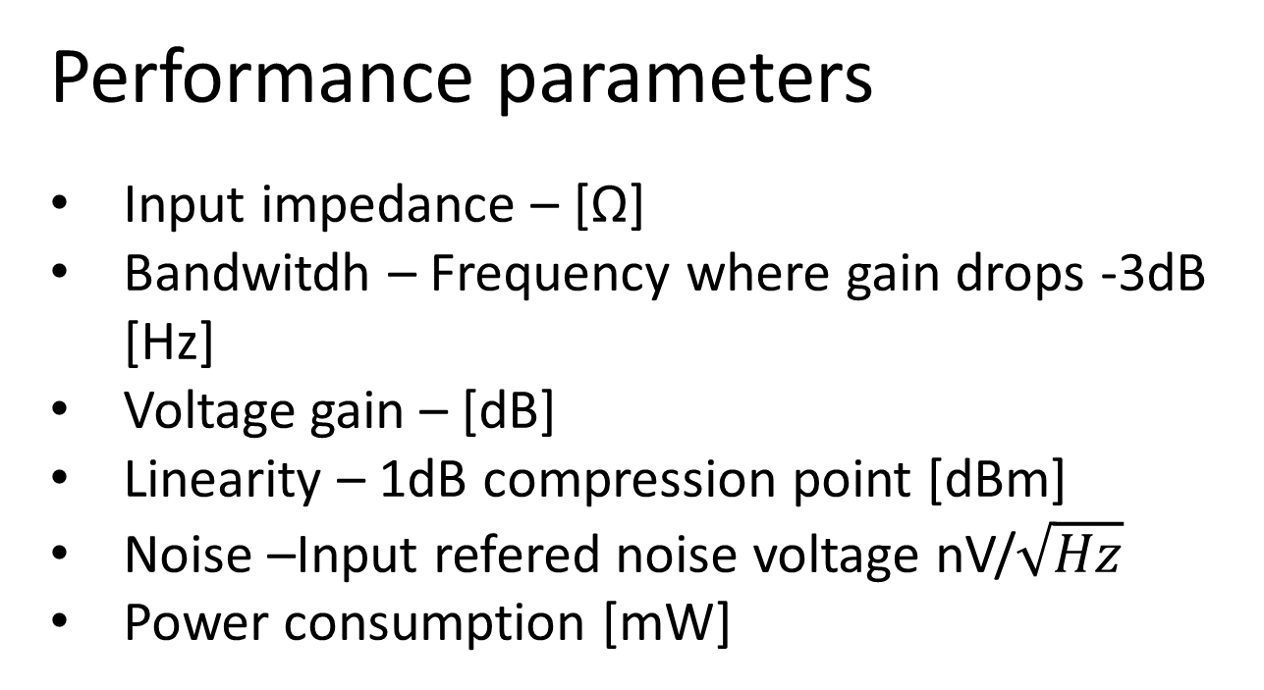
Performance parameters
Input impedance – [Ω]
Bandwitdh – Frequency where gain drops -3dB [Hz]
Voltage gain – [dB]
Linearity – 1dB compression point [dBm]
Noise –Input refered noise voltage nV/$\sqrt{Hz}$
Power consumption [mW]

Slide 6
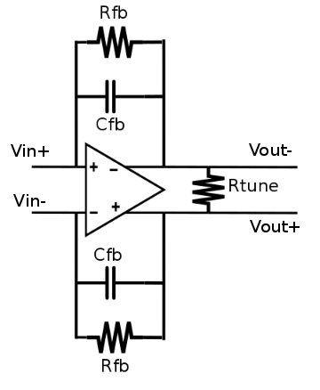
Operational Trancendence Amplifier
Closed loop gain is defined by feedback resistor and tuning resistor.
Gain can be increased with larger feedback resistor, but increases input impedance.
Feedback capacitor is used to set the bandwidth.
Low pass type response.

Slide 7
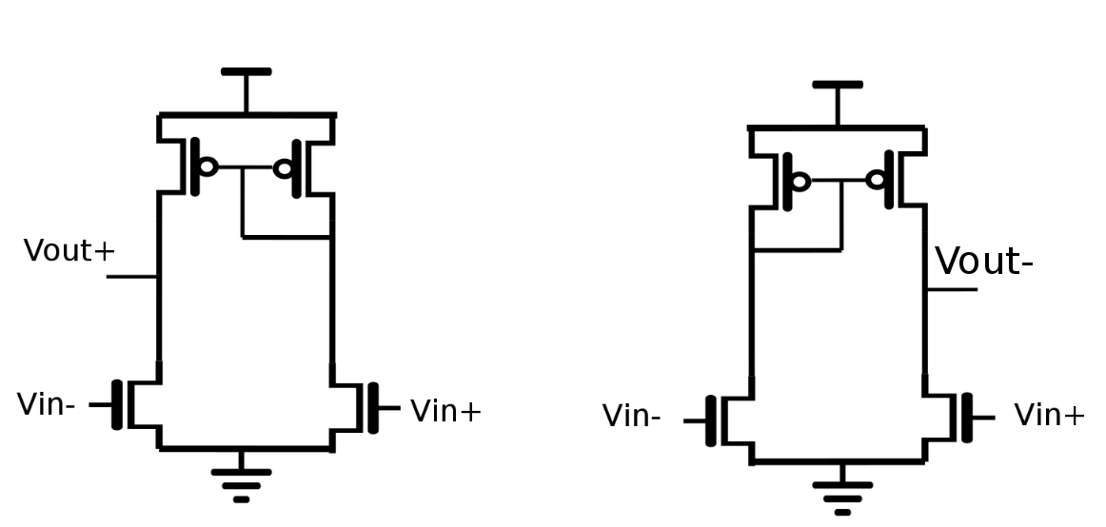
Operational Transcendence Amplifier
Both sides are symmetrical
Gain is NMOS gm*Rout
1/f noise is reduced by increasing overall transistor area and by PMOS L > NMOS L
Bandwidth is limited by paracitic capacitances at output
Linearity vs. Noise trade-off

Slide 8
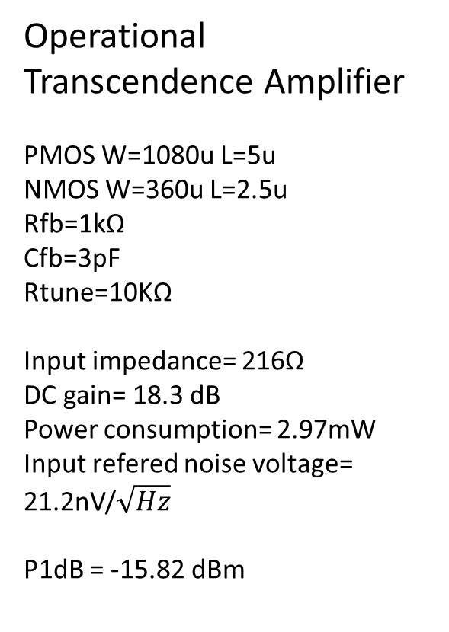
Operational Transcendence Amplifier
PMOS W=1080u L=5u
NMOS W=360u L=2.5u
Rfb=1kΩ
Cfb=3pF
Rtune=10KΩ
Input impedance= 216Ω
DC gain= 18.3 dB
Power consumption= 2.97mW
Input refered noise voltage=
21.2nV/$\sqrt{Hz}$
P1dB = -15.82 dBm

Slide 9
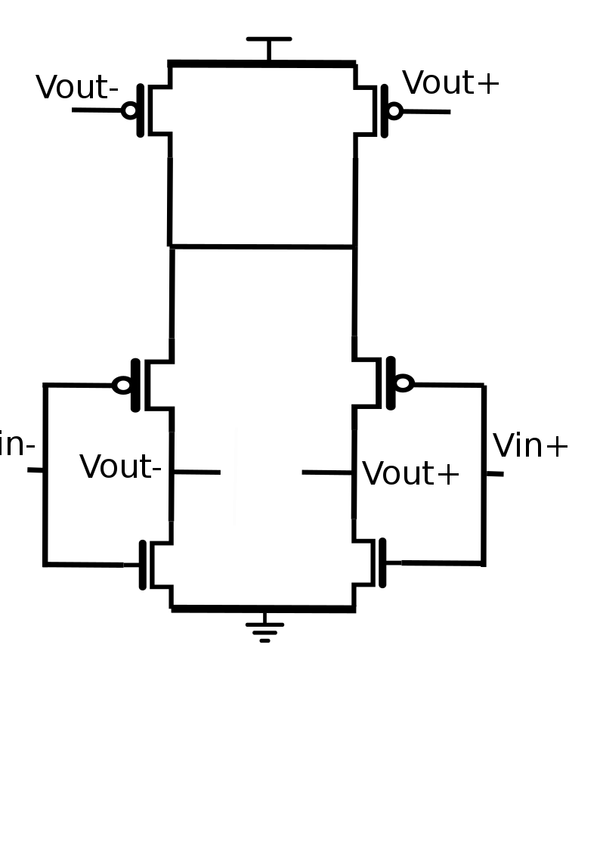
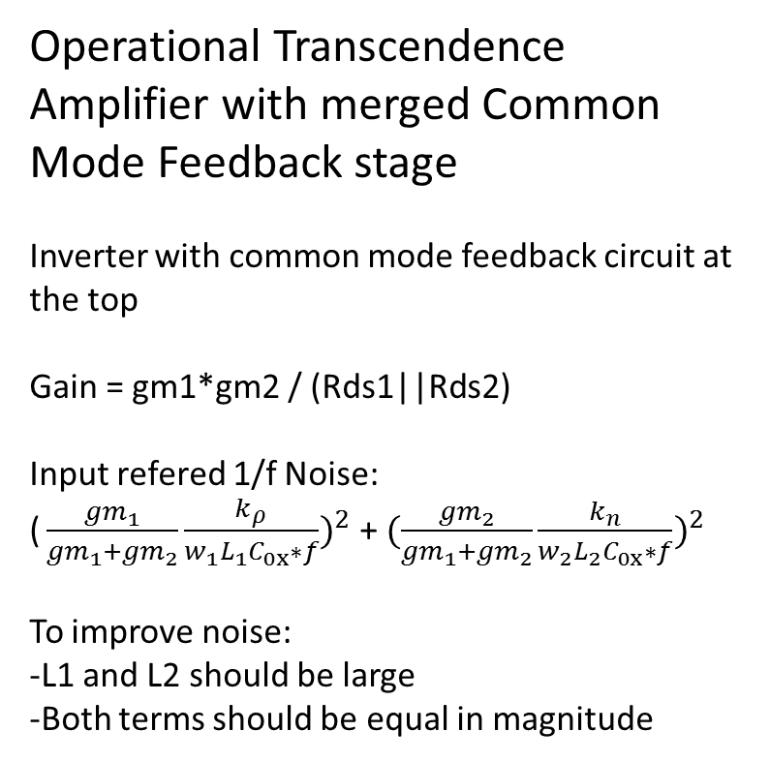
Operational Transcendence Amplifier with merged Common Mode Feedback stage
Inverter with common mode feedback circuit at the top
Gain = gm1*gm2 / (Rds1||Rds2)
Input refered 1/f Noise:
${\text{(}\frac{{gm}_{1}}{{gm}_{1}{+gm}_{2}}\frac{k_{ρ}}{w_{1}L_{1}C_{0x}∗f})}^{2}$ + ${(\frac{{gm}_{2}}{{gm}_{1}{+gm}_{2}}\frac{k_{n}}{w_{2}L_{2}C_{0x}∗f})}^{2}$
To improve noise:
-L1 and L2 should be large
-Both terms should be equal in magnitude

Slide 10
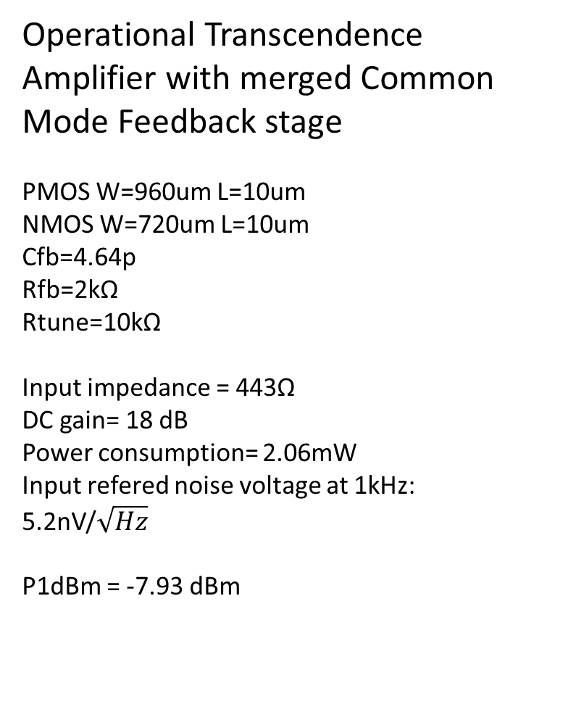
Operational Transcendence Amplifier with merged Common Mode Feedback stage
PMOS W=960um L=10um
NMOS W=720um L=10um
Cfb=4.64p
Rfb=2kΩ
Rtune=10kΩ
Input impedance = 443Ω
DC gain= 18 dB
Power consumption= 2.06mW
Input refered noise voltage at 1kHz:
5.2nV/$\sqrt{Hz}$
P1dBm = -7.93 dBm

Slide 11
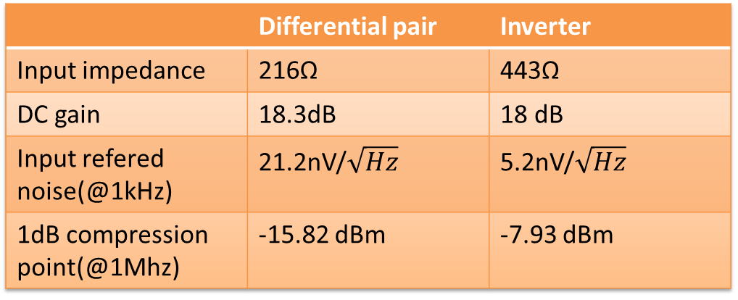
Comparison
 | Differential pair | Inverter
Input impedance | 216Ω | 443Ω
DC gain | 18.3dB | 18 dB
Input refered noise(@1kHz) | 21.2nV/$\sqrt{Hz}$ | 5.2nV/$\sqrt{Hz}$
1dB compression point(@1Mhz) | -15.82 dBm | -7.93 dBm
Notes:
Input impedance= 216Ω
DC gain= 18.3 dB
Power consumption= 2.97mW
Input refered noise voltage=
21.2nV/$\sqrt{Hz}$
IIP3 = -3.15 dBm
P1dB = -15.82 dBm

