Slide 1
Digital Design Project
Posit Multiplication Accumulation Block Design for AI Accelerator
Instructor: LINGYUN Yao
Student: DAOUDI-CARACCI Milane

Slide 2
Contents
Materials used in this work
Background and motivation
Verilog Implementation of posit addition and multiplication
Simulation Results
FPGA Synthesis
Comparison

Slide 3
Materials used in this work
Gustafson, J. L. (2015). Beating floating point at its own game: Posit arithmetic. Retrieved from http://www.johngustafson.net/pdfs/BeatingFloatingPoint.pdf
Parimala6. (n.d.). Floating-point-MAC-verilog [Source code]. GitHub. Retrieved April 17, 2025, from https://github.com/Parimala6/Floating-point-MAC-verilog
Xiong, J., Wang, W., Sedcole, P., & Cheung, P. Y. K. (2019). A design methodology for efficient implementation of complex floating-point DSP blocks on FPGAs. IEEE Transactions on Circuits and Systems I: Regular Papers, 66(6), 2084–2097. https://doi.org/10.1109/TCSI.2018.2889441

Slide 4
Background

Slide 5
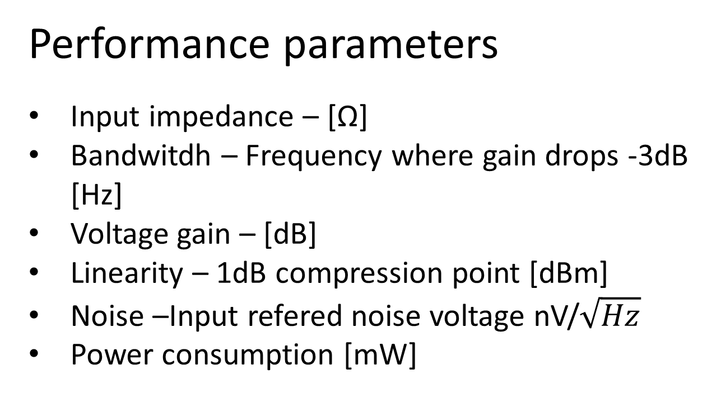
Performance parameters
Input impedance – [Ω]
Bandwitdh – Frequency where gain drops -3dB [Hz]
Voltage gain – [dB]
Linearity – 1dB compression point [dBm]
Noise –Input refered noise voltage nV/
Power consumption [mW]

Slide 6
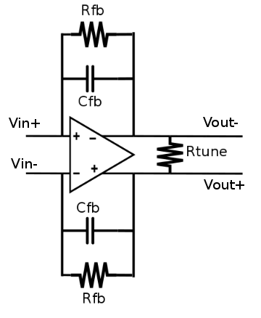
Operational Trancendence Amplifier
Closed loop gain is defined by feedback resistor and tuning resistor.
Gain can be increased with larger feedback resistor, but increases input impedance.
Feedback capacitor is used to set the bandwidth.
Low pass type response.

Slide 7
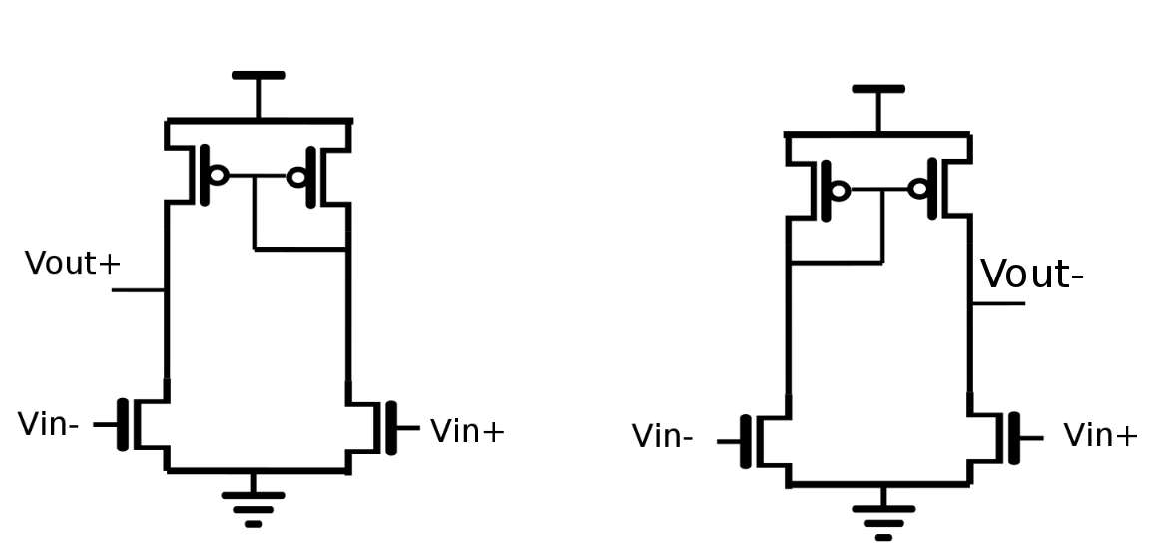
Operational Transcendence Amplifier
Both sides are symmetrical
Gain is NMOS gm*Rout
1/f noise is reduced by increasing overall transistor area and by PMOS L > NMOS L
Bandwidth is limited by paracitic capacitances at output
Linearity vs. Noise trade-off

Slide 8
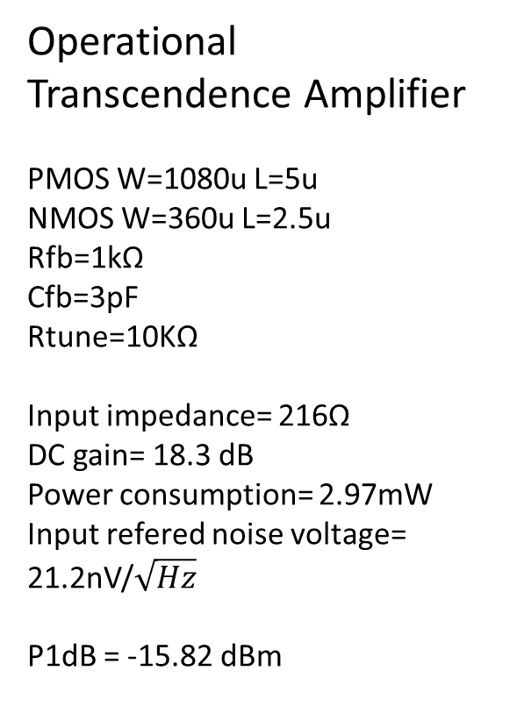
Operational Transcendence Amplifier
PMOS W=1080u L=5u
NMOS W=360u L=2.5u
Rfb=1kΩ
Cfb=3pF
Rtune=10KΩ
Input impedance= 216Ω
DC gain= 18.3 dB
Power consumption= 2.97mW
Input refered noise voltage=
21.2nV/
P1dB = -15.82 dBm

Slide 9
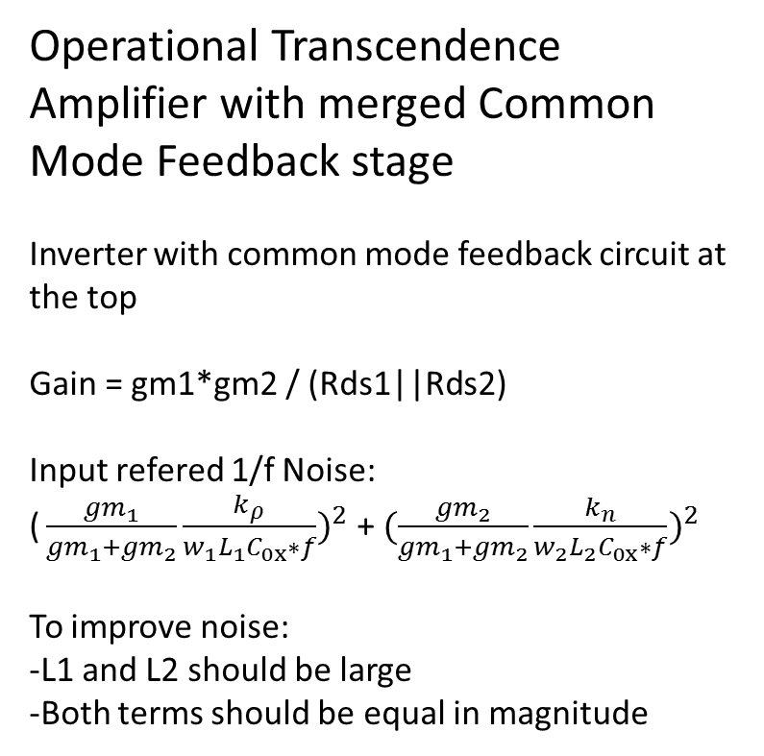
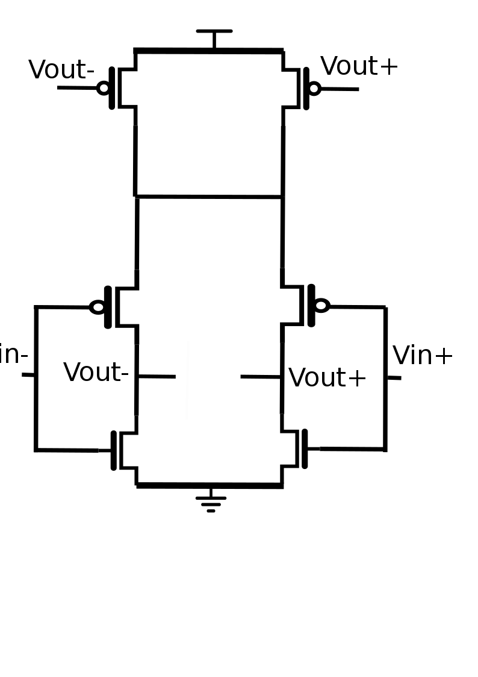
Operational Transcendence Amplifier with merged Common Mode Feedback stage
Inverter with common mode feedback circuit at the top
Gain = gm1*gm2 / (Rds1||Rds2)
Input refered 1/f Noise:
+
To improve noise:
-L1 and L2 should be large
-Both terms should be equal in magnitude

Slide 10
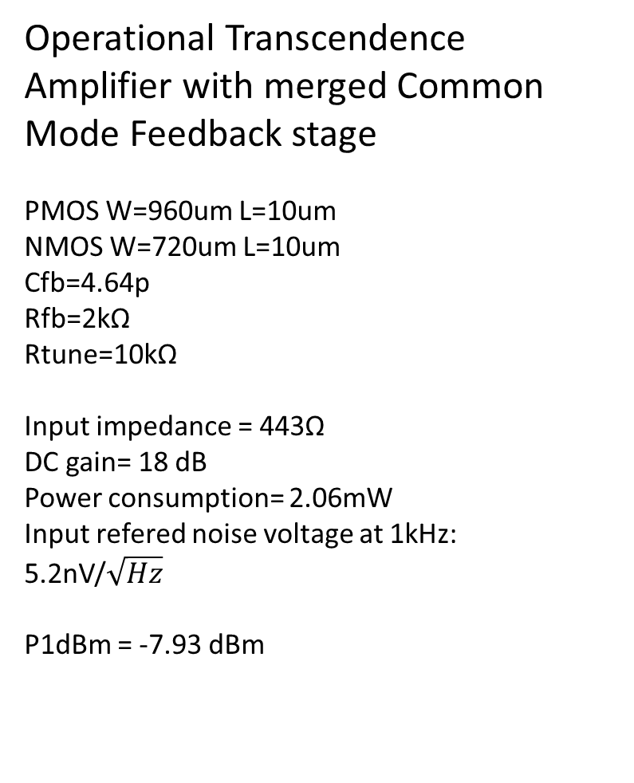
Operational Transcendence Amplifier with merged Common Mode Feedback stage
PMOS W=960um L=10um
NMOS W=720um L=10um
Cfb=4.64p
Rfb=2kΩ
Rtune=10kΩ
Input impedance = 443Ω
DC gain= 18 dB
Power consumption= 2.06mW
Input refered noise voltage at 1kHz:
5.2nV/
P1dBm = -7.93 dBm

Slide 11
Comparison
 | Differential pair | Inverter
Input impedance | 216Ω | 443Ω
DC gain | 18.3dB | 18 dB
Input refered noise(@1kHz) | 21.2nV/ | 5.2nV/
1dB compression point(@1Mhz) | -15.82 dBm | -7.93 dBm
 | Differential pair | Inverter
Input impedance | 216Ω | 443Ω
DC gain | 18.3dB | 18 dB
Input refered noise(@1kHz)
1dB compression point(@1Mhz) | -15.82 dBm | -7.93 dBm
Notes:
Input impedance= 216Ω
DC gain= 18.3 dB
Power consumption= 2.97mW
Input refered noise voltage=
21.2nV/
IIP3 = -3.15 dBm
P1dB = -15.82 dBm
Input impedance= 216Ω
DC gain= 18.3 dB
Power consumption= 2.97mW
Input refered noise voltage=
21.2nV/√𝐻𝑧
IIP3 = -3.15 dBm
P1dB = -15.82 dBm

