Slide 1

NYPD
Shooting
Analysis

Slide 2

Project Agenda
1. Introduction
2. Data Preprocessing
3. Time Trend Analysis
4. Geographic Analysis
5. Profiling Analysis
6. ARIMA Forecasting
7. Conclusion

Slide 3
Introduction
Data Source:
The dataset contains 27,000+ shooting cases from 2006 to 2022.
Each record includes location, timestamp, and people profiles.
This data was manually collected by NYPD with potential bias.
Objective:
Timeline Trend Analysis - WHEN
Geographic Analysis - WHERE
Suspects & Victims Analysis - WHO
Time Series Forecasting - WHAT

Slide 4

Project Agenda
1. Project Introduction
2. Data Preprocessing
3. Time Trend Analysis
4. Geographic Analysis
5. Profiling Analysis
6. ARIMA Forecasting
7. Conclusion

Slide 5
Data Preprocessing
1. Selecting Attributes
4. Handling Missing Values
2. Modifying Column Names
5. Changing Data Types
3. Adjusting Format
6. Removing Duplicates

Slide 6

Project Agenda
1. Project Introduction
2. Data Preprocessing
3. Time Trend Analysis
4. Geographic Analysis
5. Profiling Analysis
6. ARIMA Forecasting
7. Conclusion

Slide 7
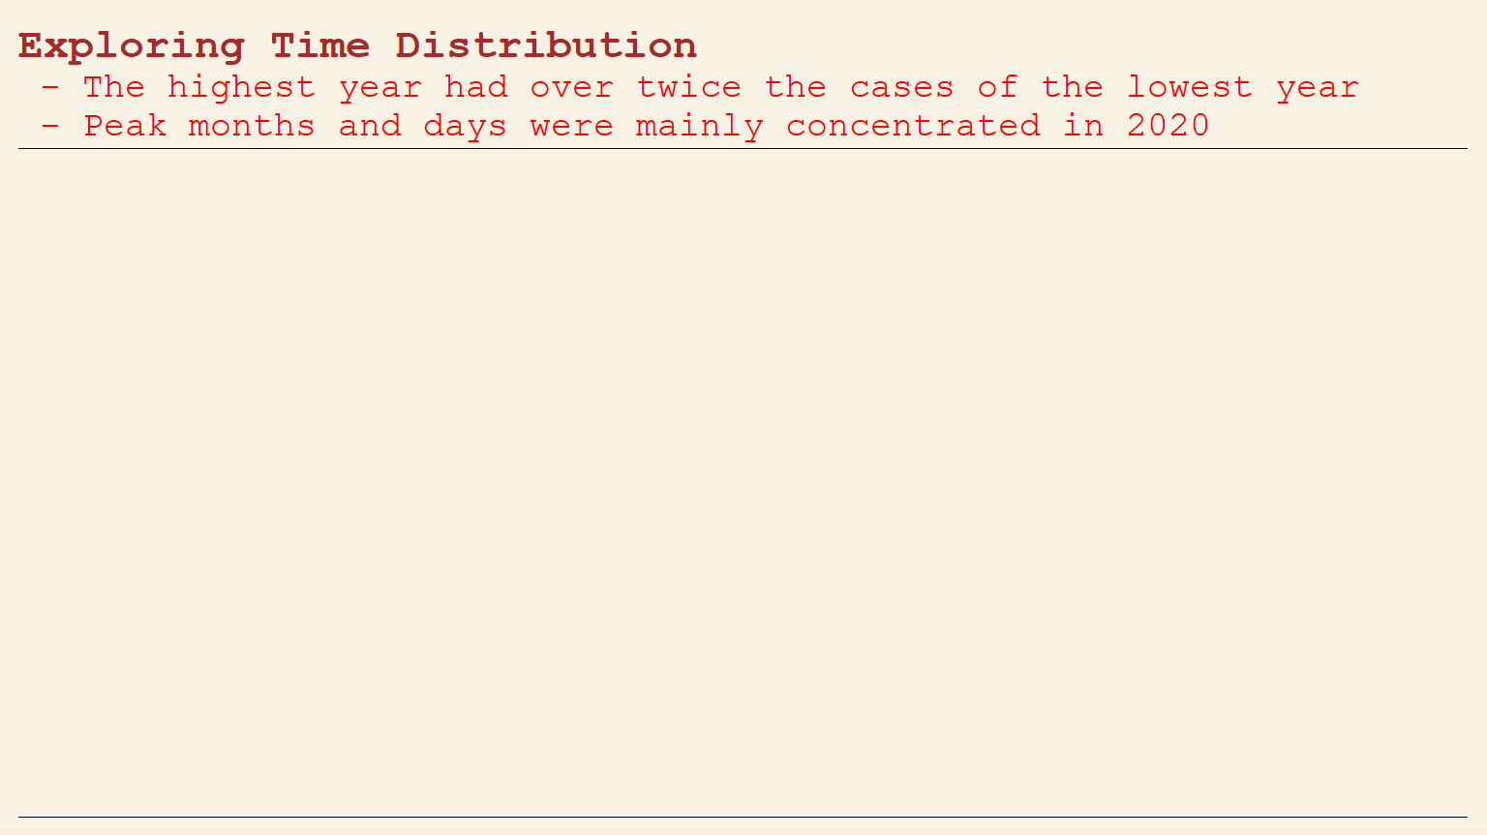
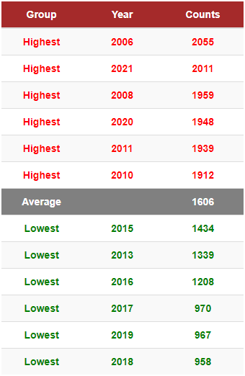
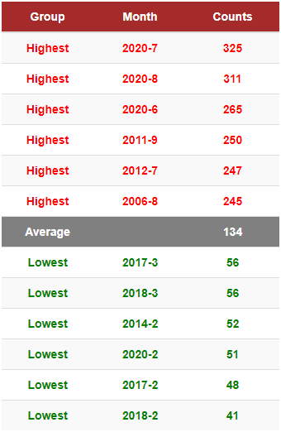
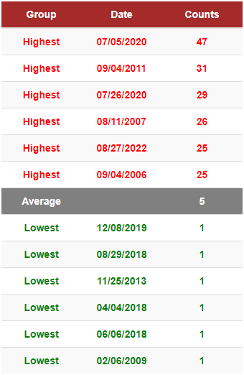

Slide 8
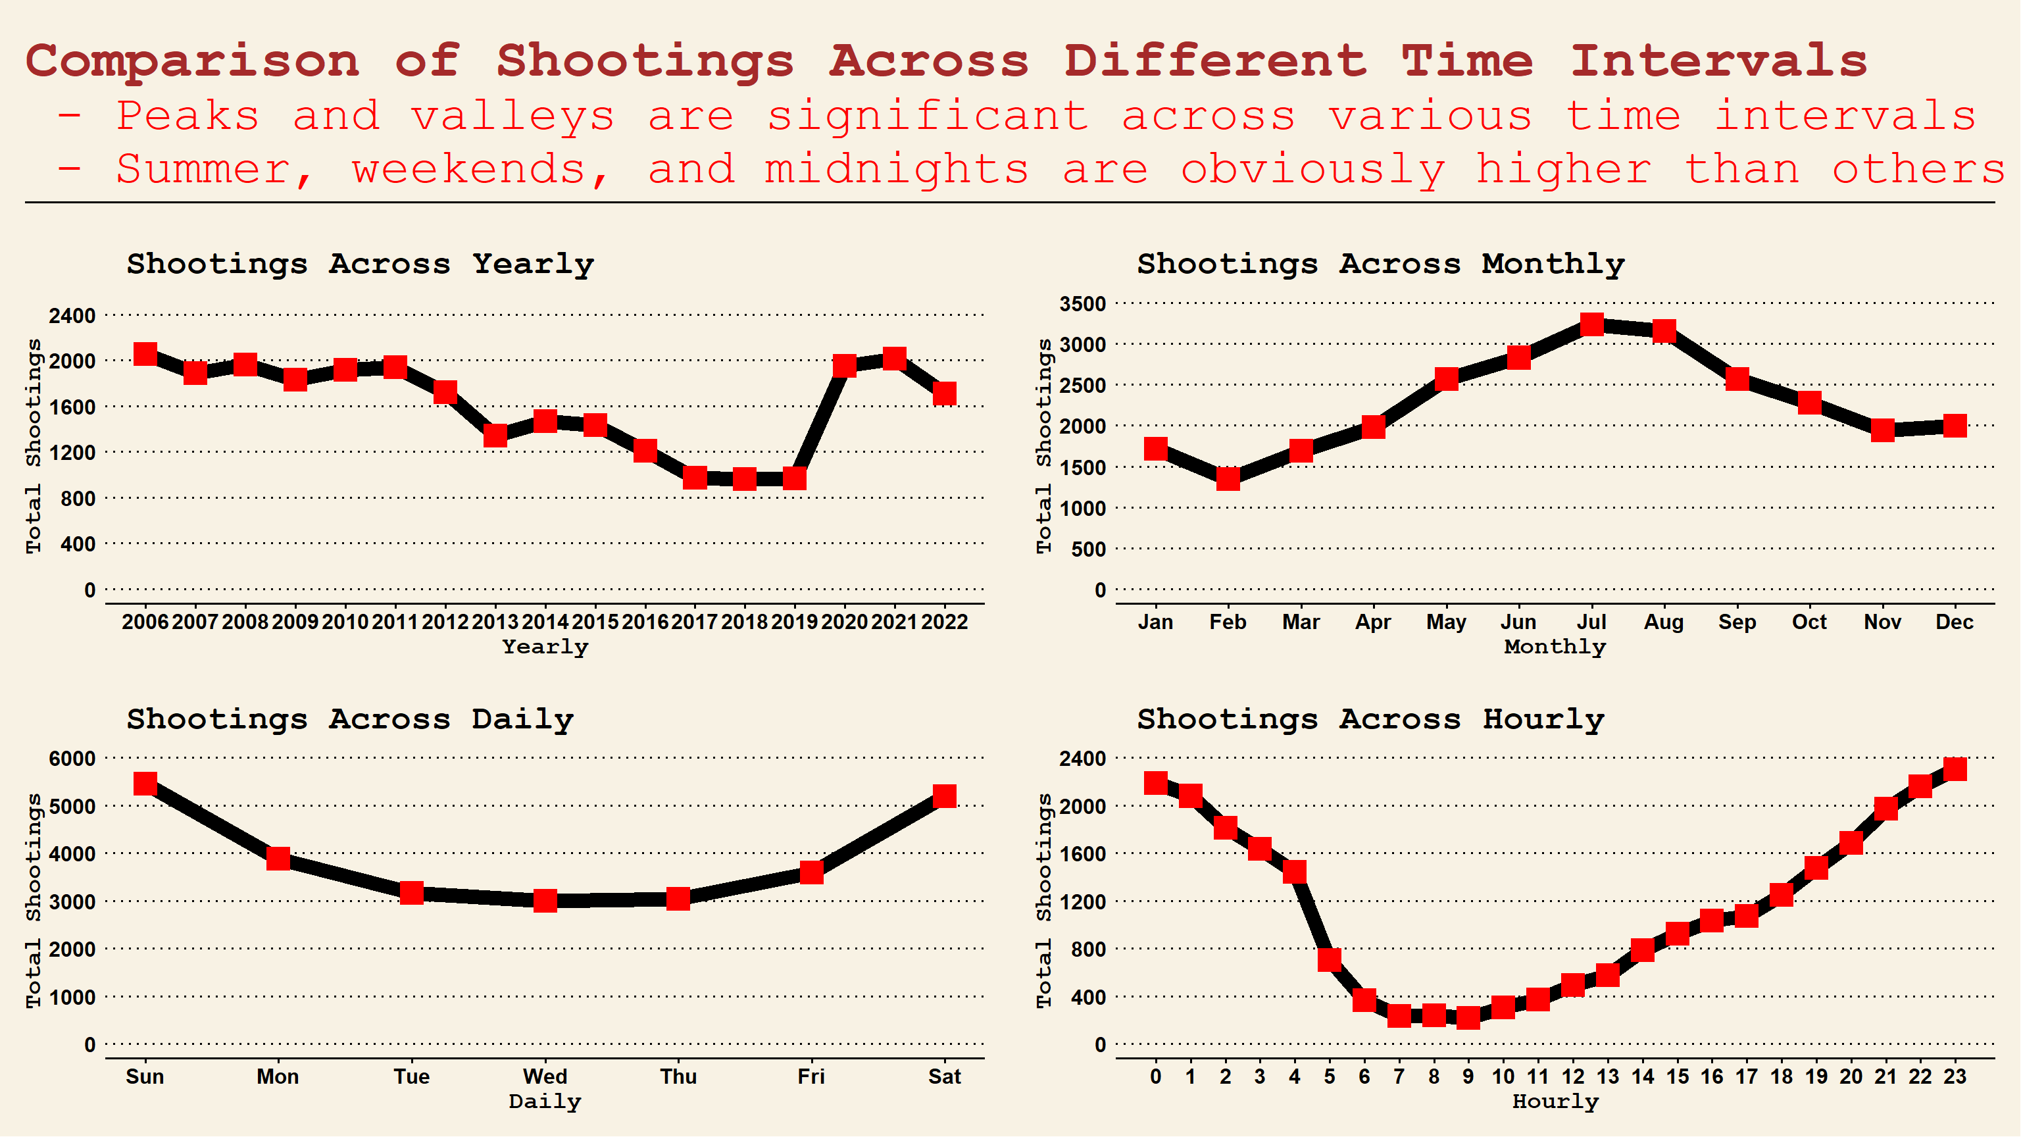

Slide 9
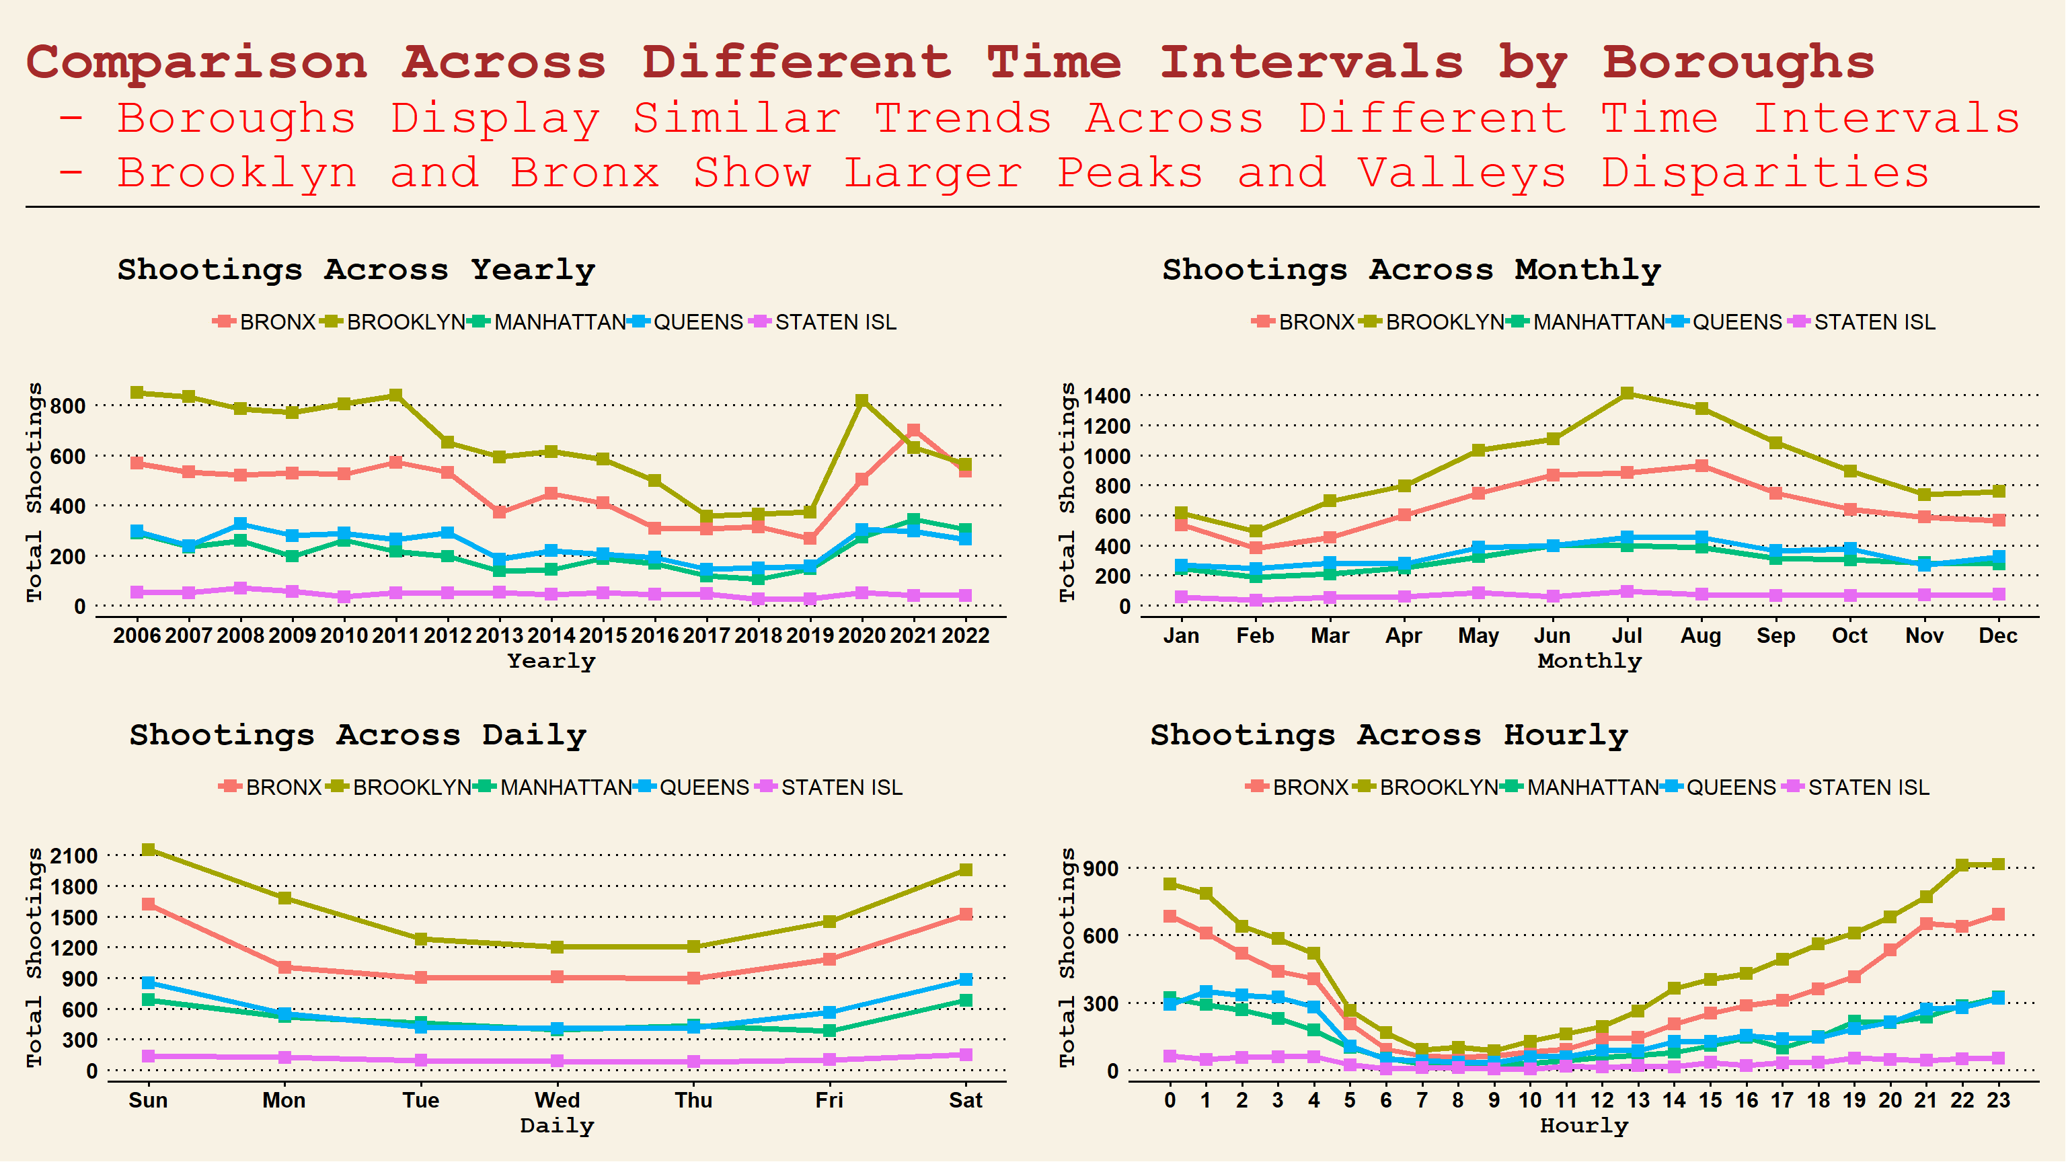

Slide 10

Project Agenda
1. Project Introduction
2. Data Preprocessing
3. Time Trend Analysis
4. Geographic Analysis
5. Profiling Analysis
6. ARIMA Forecasting
7. Conclusion

Slide 11
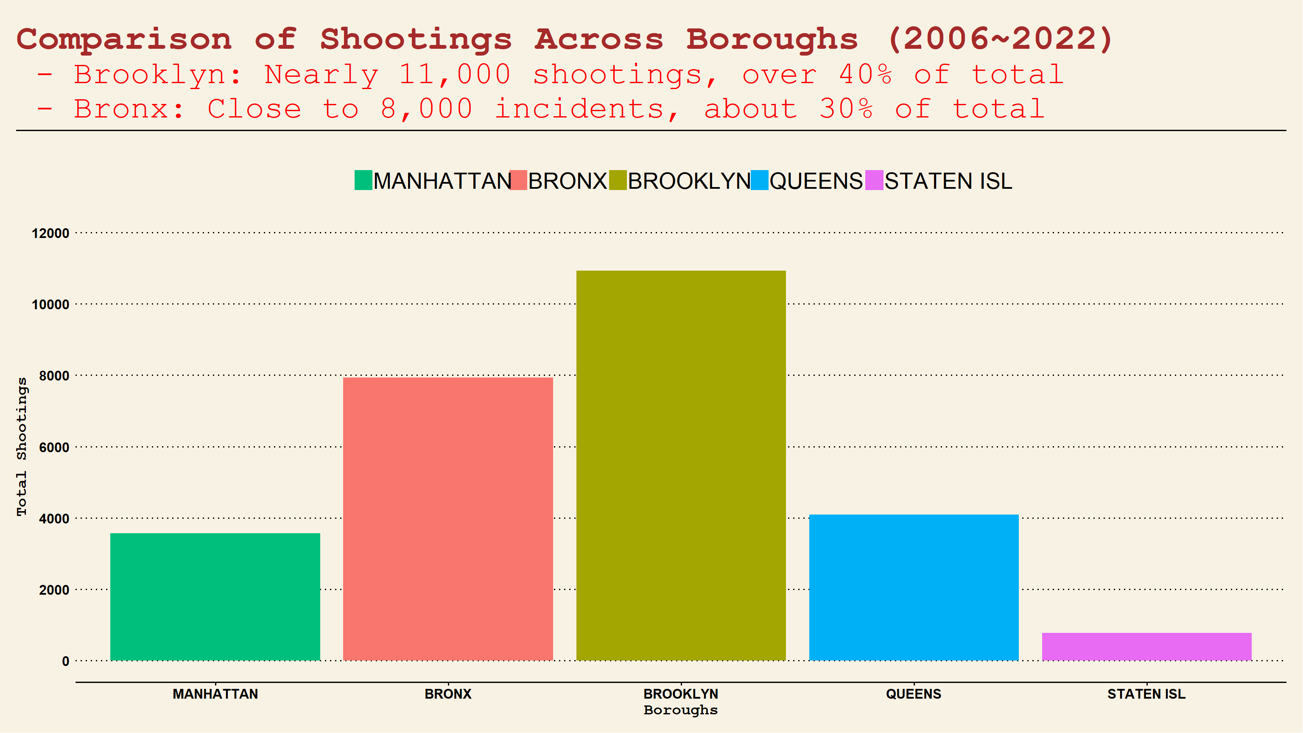

Slide 12
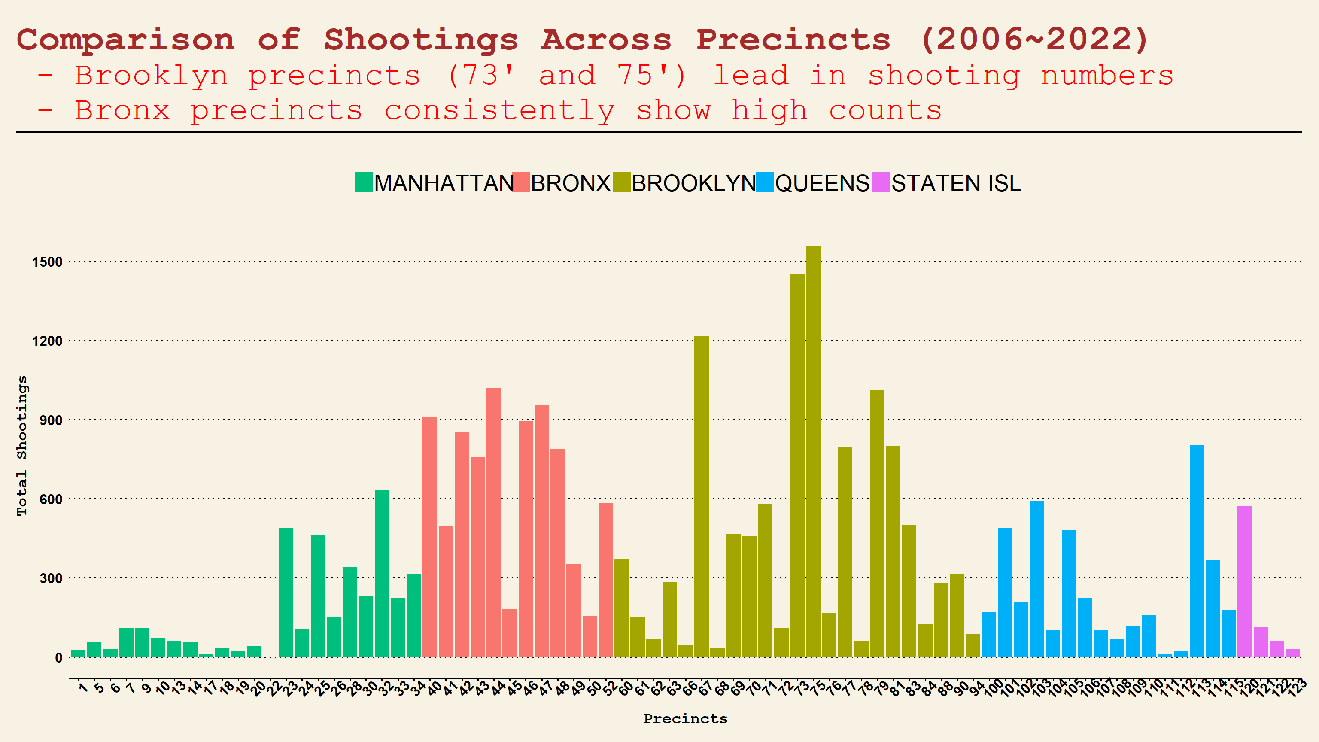

Slide 13
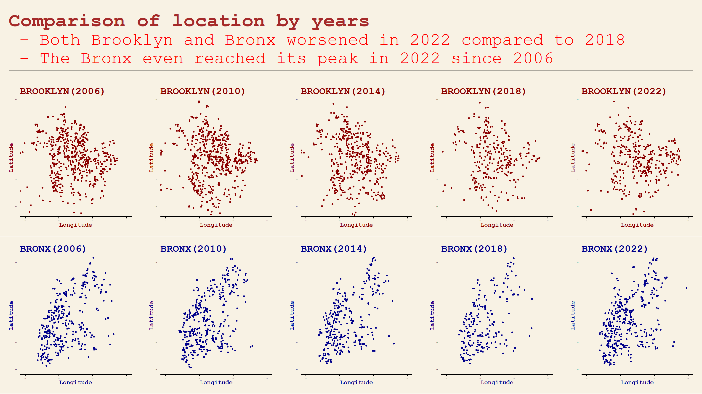

Slide 14
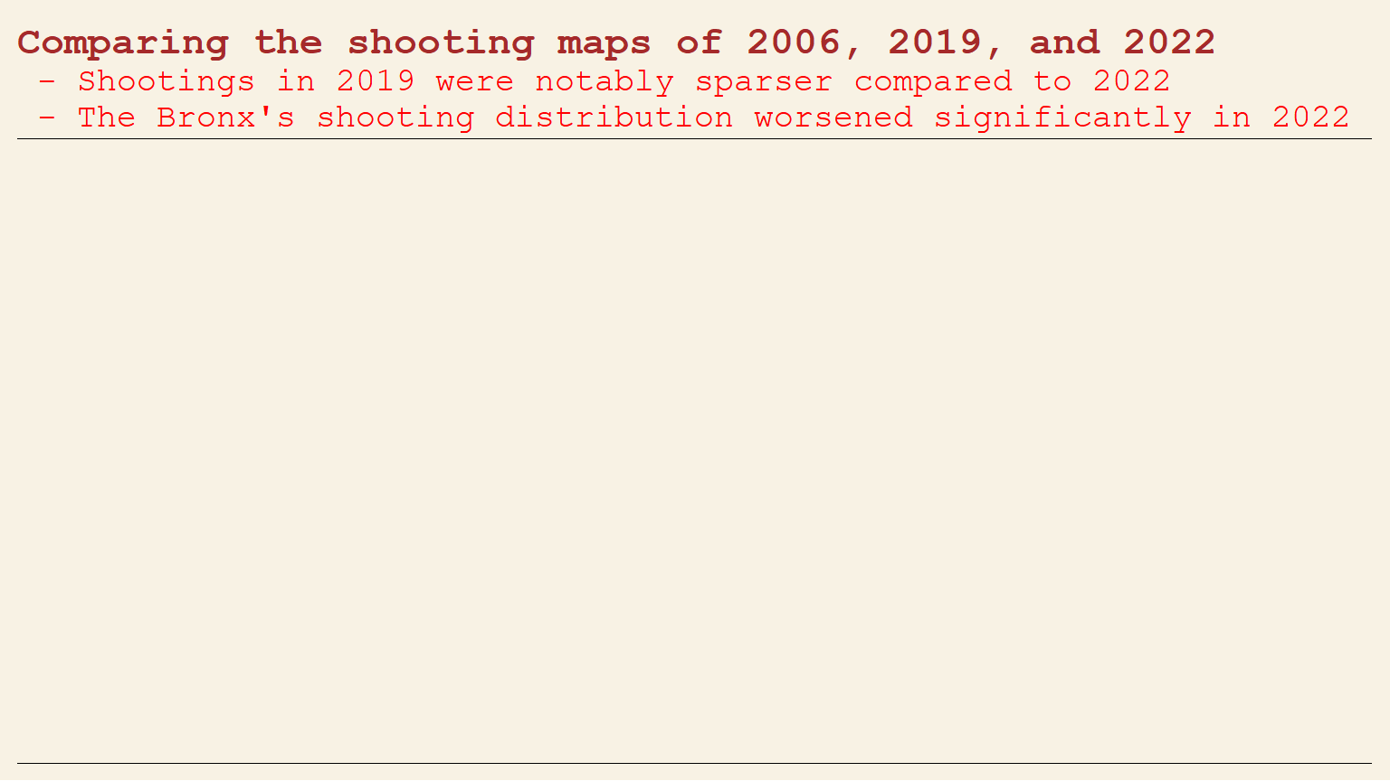
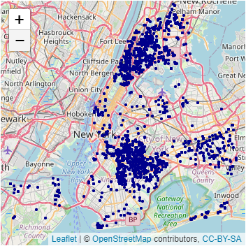
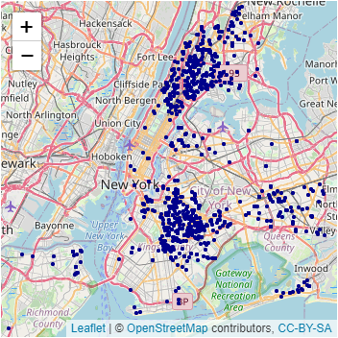
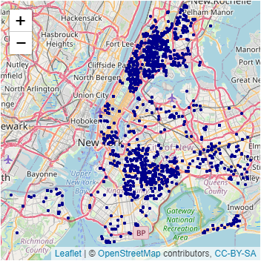
Year 2006
Year 2019
Year 2022

Slide 15

Project Agenda
1. Project Introduction
2. Data Preprocessing
3. Time Trend Analysis
4. Geographic Analysis
5. Profiling Analysis
6. ARIMA Forecasting
7. Conclusion

Slide 16
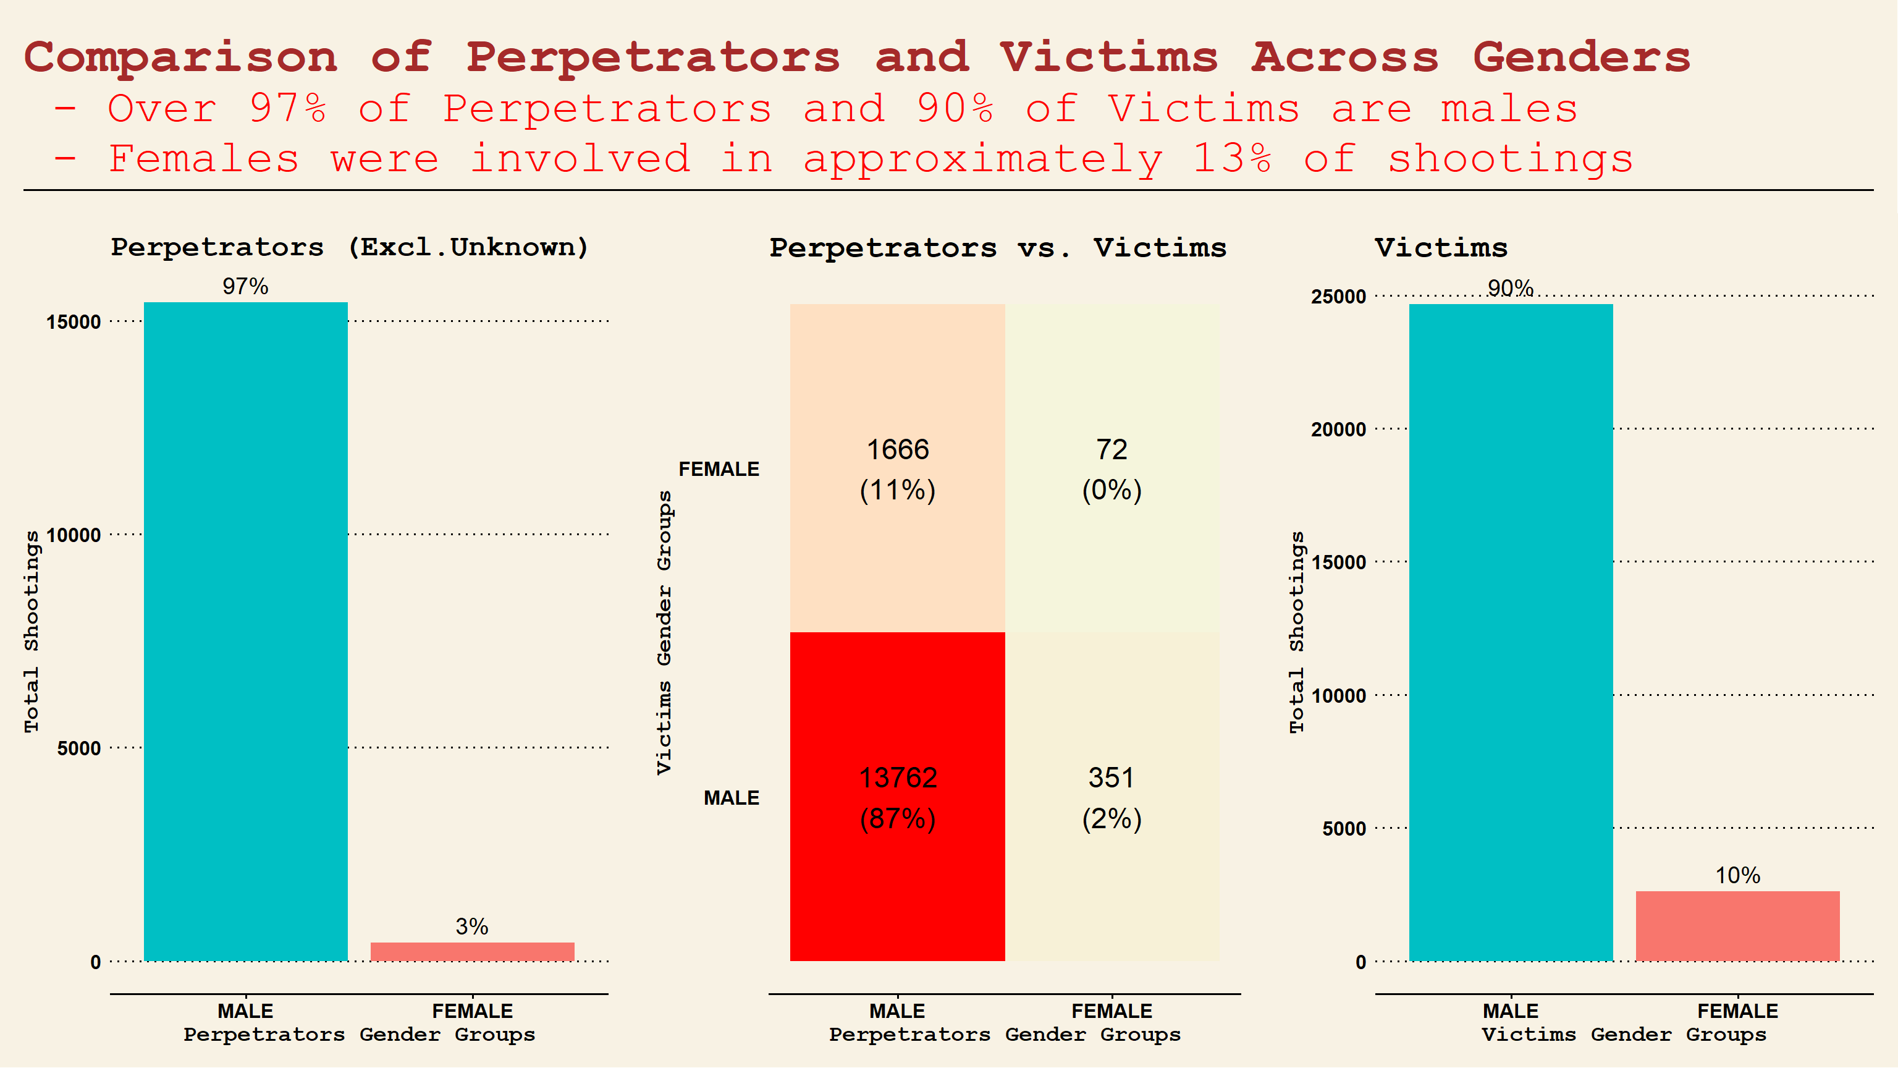

Slide 17
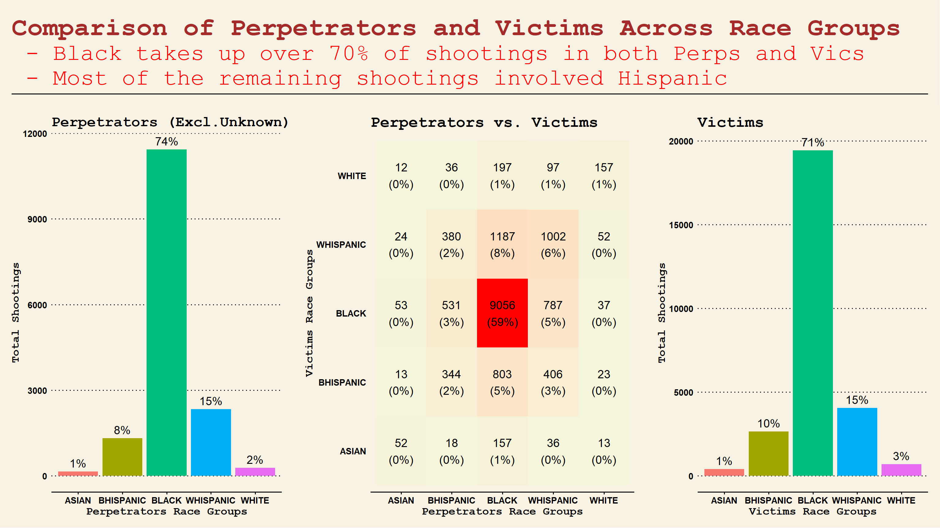

Slide 18
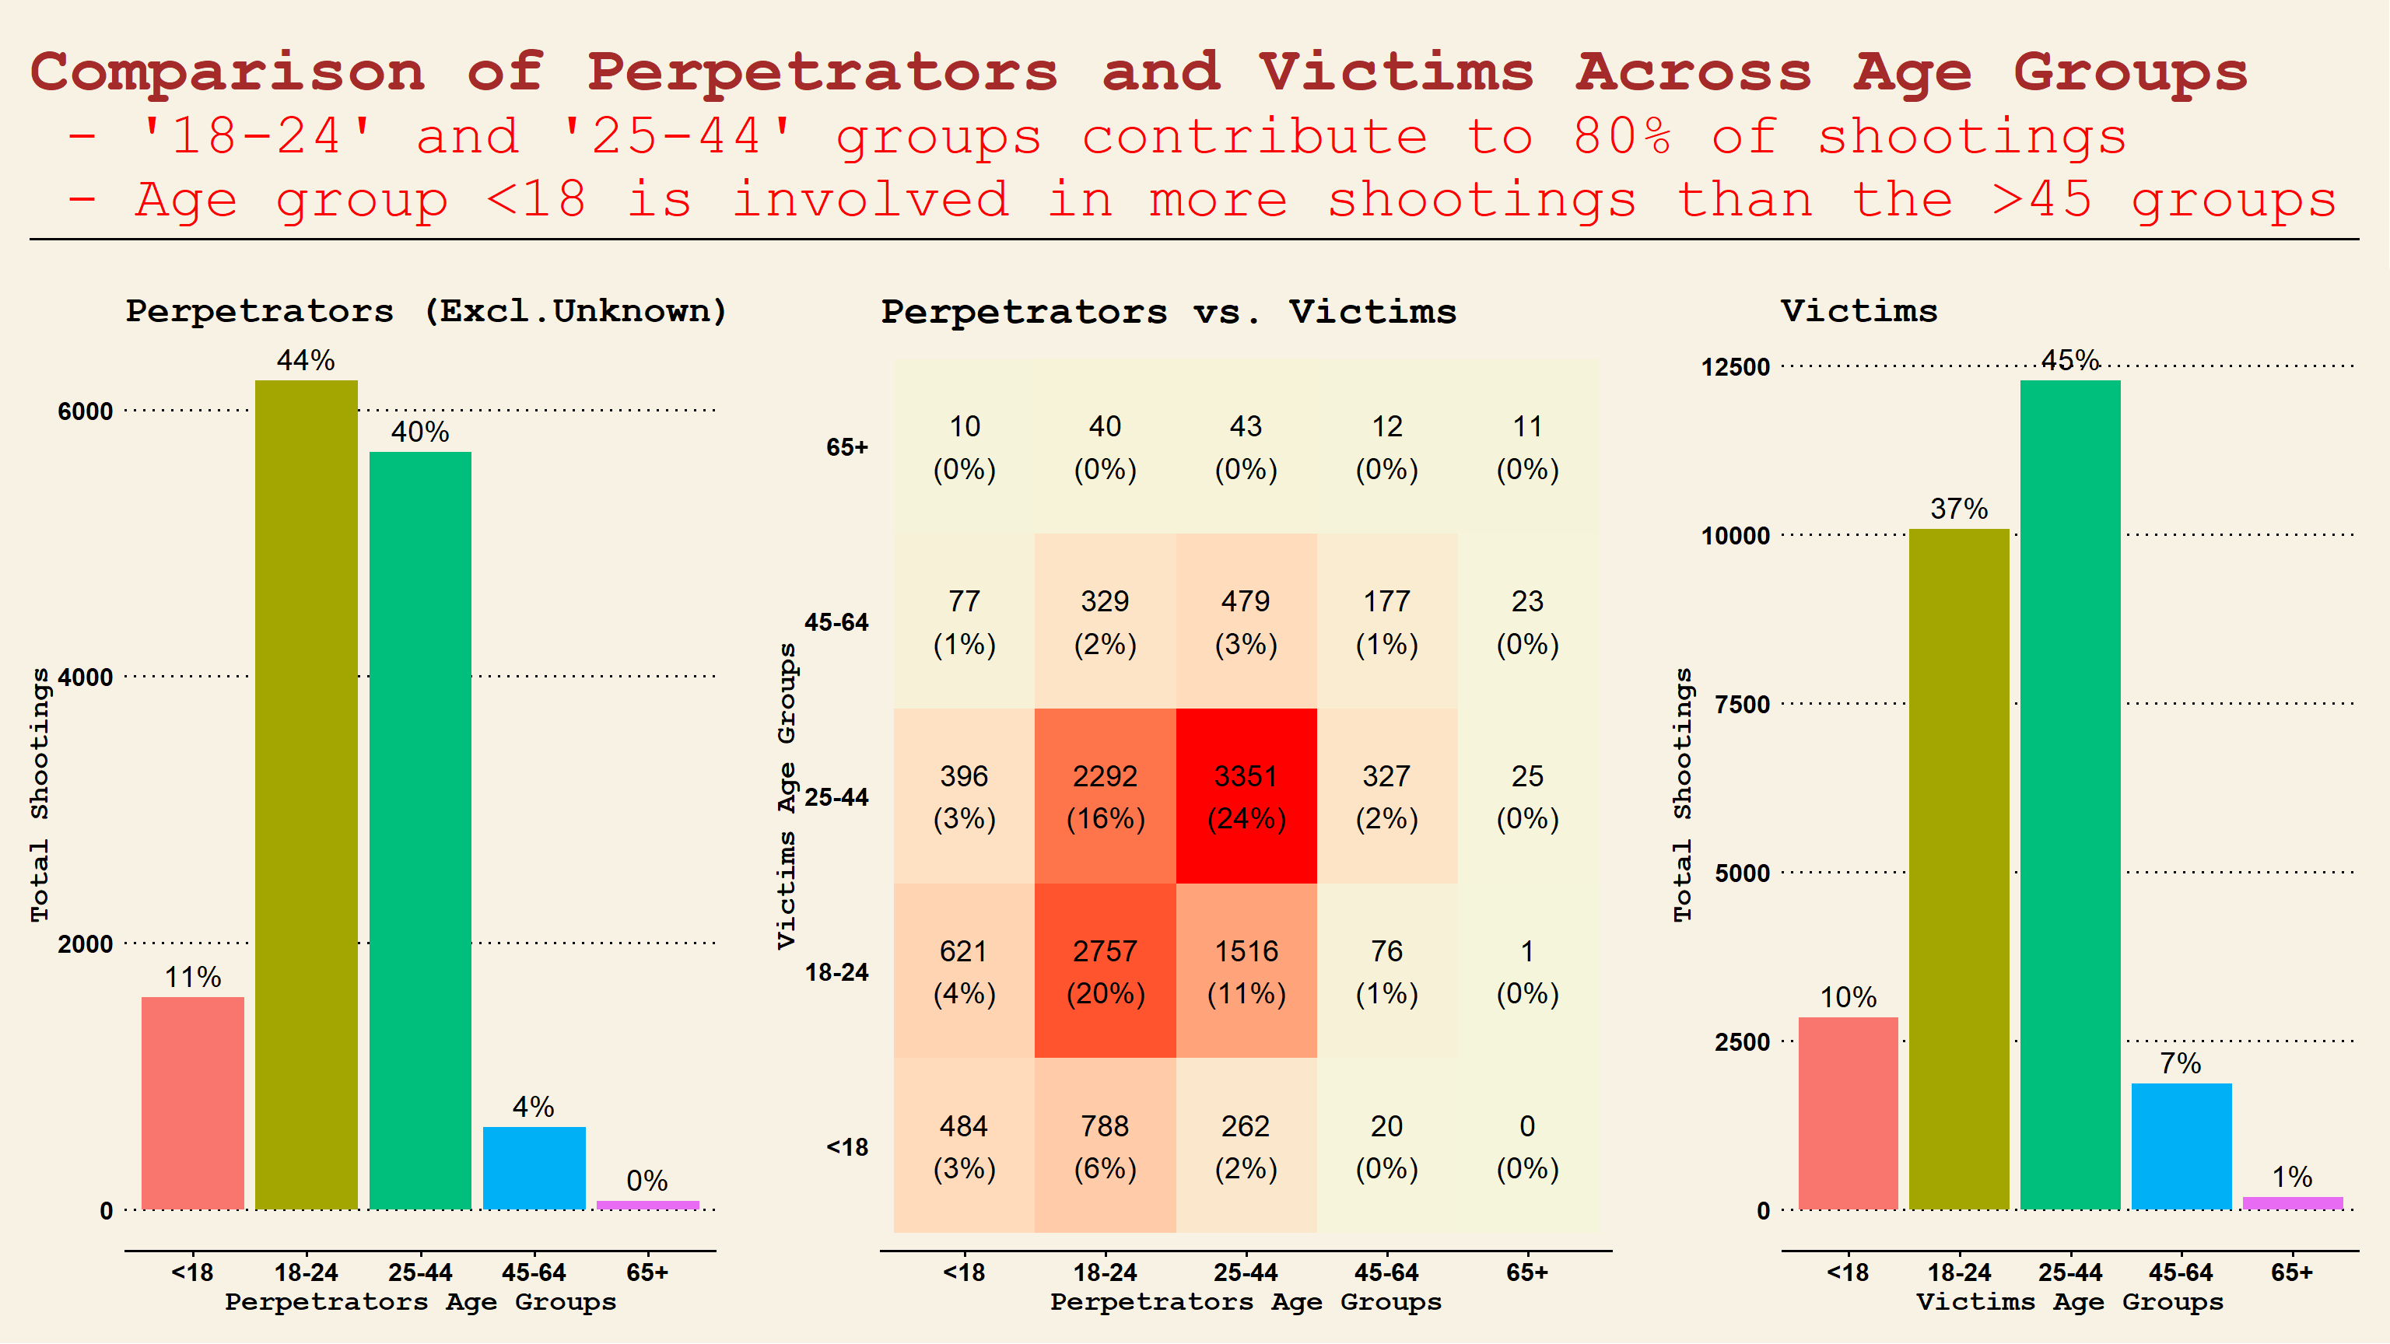

Slide 19
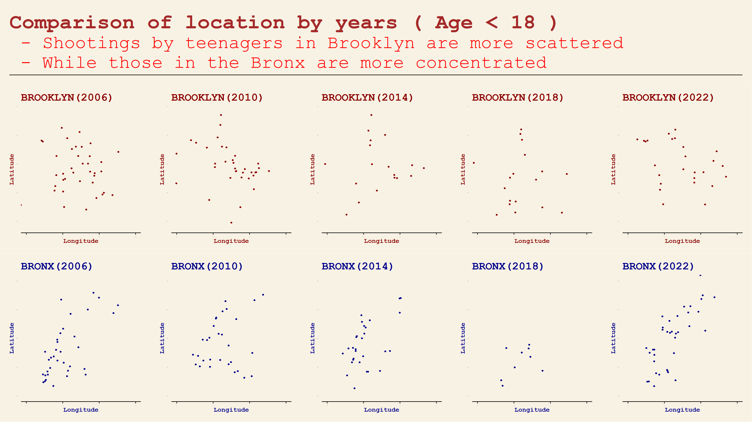

Slide 20

Project Agenda
1. Project Introduction
2. Data Preprocessing
3. Time Trend Analysis
4. Geographic Analysis
5. Profiling Analysis
6. ARIMA Forecasting
7. Conclusion

Slide 21
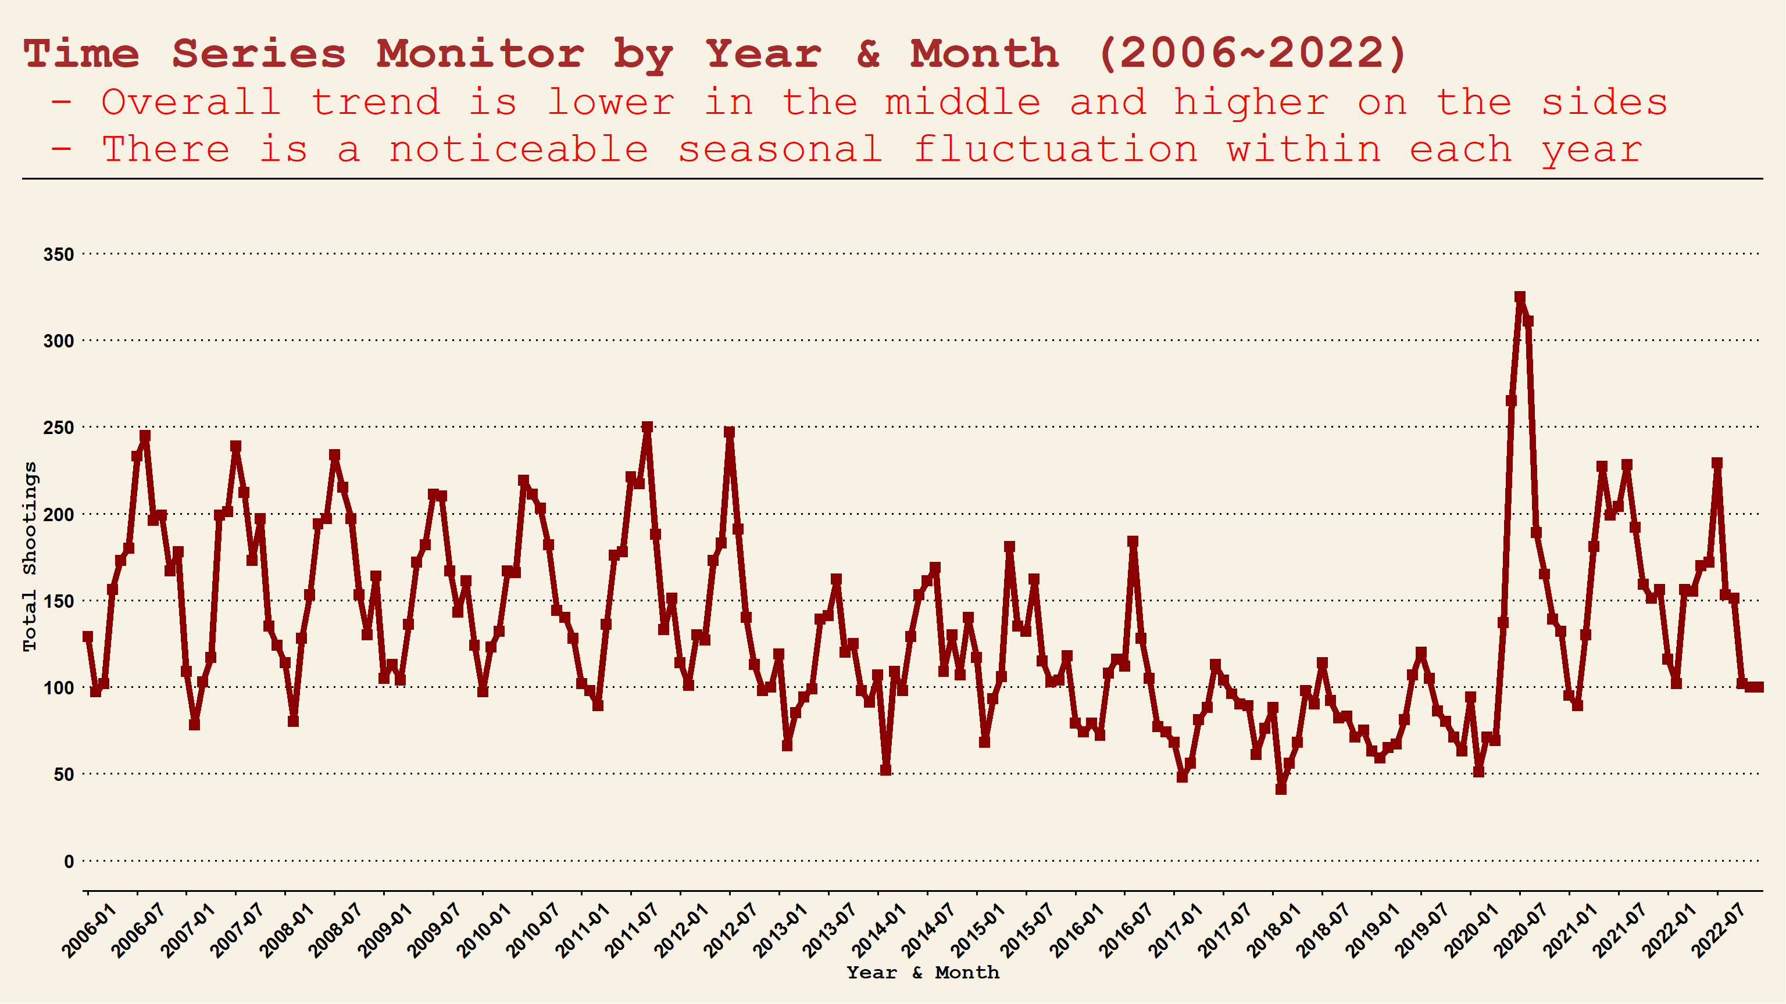

Slide 22
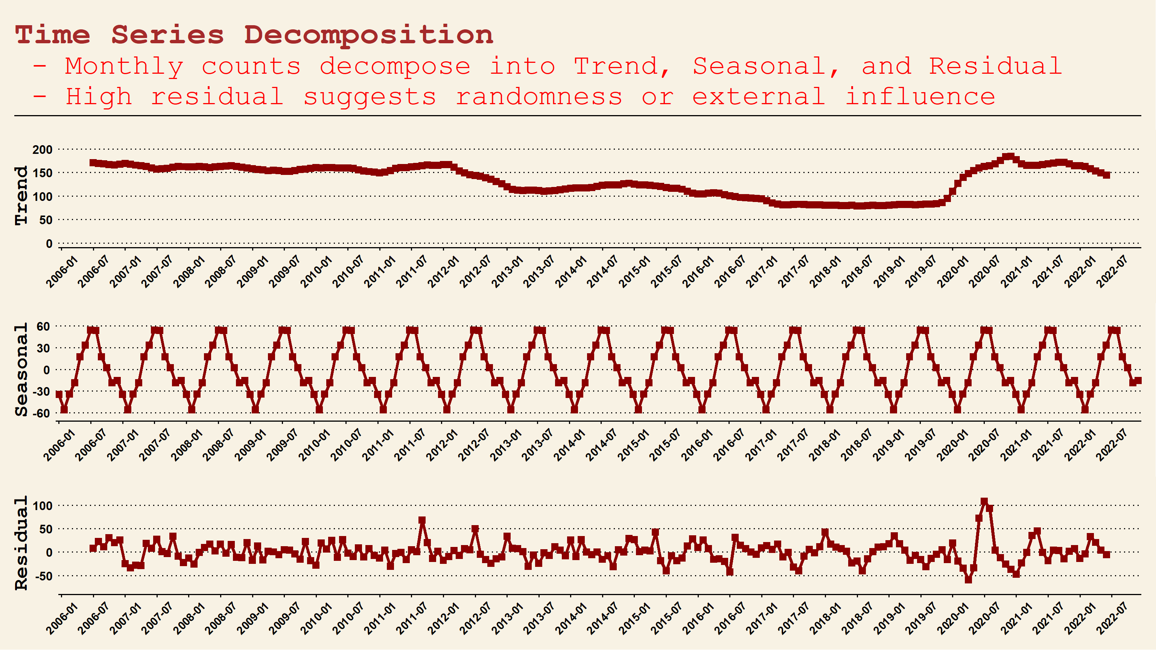

Slide 23
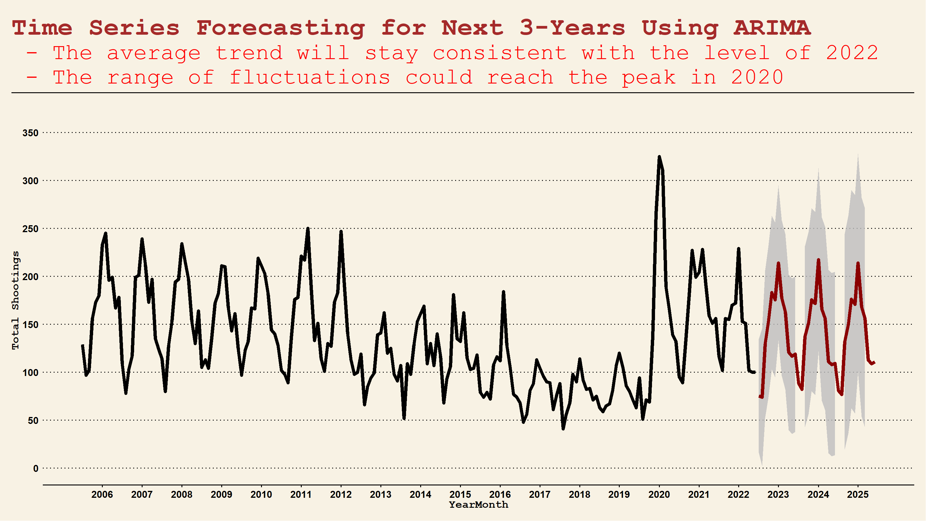

Slide 24

Project Agenda
1. Project Introduction
2. Data Preprocessing
3. Time Trend Analysis
4. Geographic Analysis
5. Profiling Analysis
6. ARIMA Forecasting
7. Conclusion

Slide 25
Conclusion
Through Timeline Trend Analysis: we explored the overall trend and found significant peaks during summer, weekends, and midnight
Through Geographic Analysis: we investigated the spatial patterns of case distribution by boroughs and precincts
Through Suspects & Victims Analysis: we identified distinct perpetrator features and a trend towards involving more teenagers
Through Time Series Analysis: we identified evident seasonal patterns and forecasted shooting counts for the next 3 years

Slide 26
Conclusion
Report Bias
Further Actions
Bias in Data Source:
Potential bias in NYPD data recording overly focuses on particular boroughs and race groups
Suggest to adjust patrol schedules and fund allocation based on Geographic Analysis.
Suggest to conduct comprehensive inquiries into organized crime based on Profiling Analysis.
Suggest to prepare preventative measures for significant events by utilizing Time Series Analysis.
Bias in Data Analysis:
We utilize more dimensions to explore correlations within cases, rather than solely concentrating on perpetrator profiles.

Slide 27
Thanks
for Watching

