Slide 1
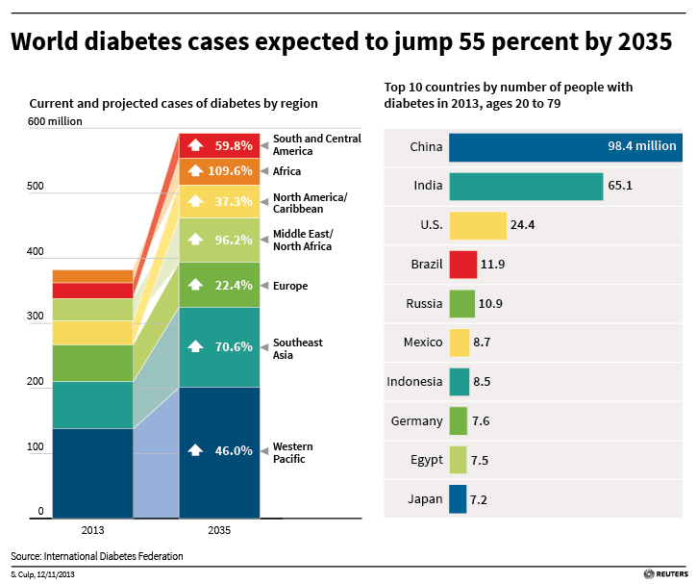
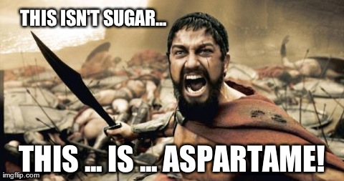
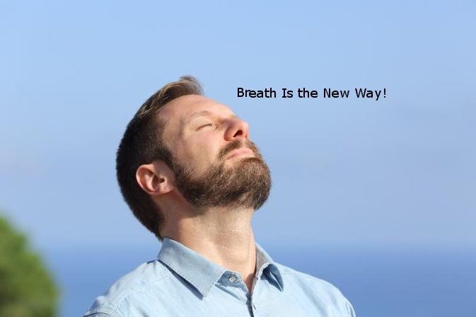
DIABETES CASES STILL TO GROW IN FUTURE
HealthOG
The Method
THE PRESENT METHOD OF CHECKING BLOOD SUGAR IN A PATIENT.
A NEW WAY OF TESTING THE BLOOD SUGAR LEVEL
D
ACETONE BASED NON-INVASIVE DETECTION OF BLOOD GLUCOSE LEVELS
C
PRESENTATION
B
BY-DATSEA CORPORATION
A
PRESENTATION BY: DATSEA CORPORATION
MedicaOTG
THEME: BIOINFORMATICS
PROJECT NAME :- ZOR

Slide 2
Problems With Present Methods
Costly
Everytime New Strips to be used
Time Consuming
Can Cause Infection

Slide 3

What We Have Done
We eliminated the insulin,
So no need to worry about it’s price going Up

Slide 4
What Else?
Well,No need to worry about Pricing.
We eliminated the use of strips
No fear for any kind of infections.

Slide 5
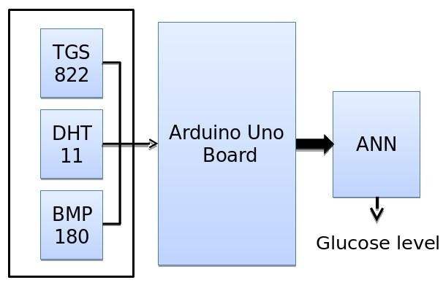
BLOCK DIAGRAM OF THE SYSTEM

Slide 6
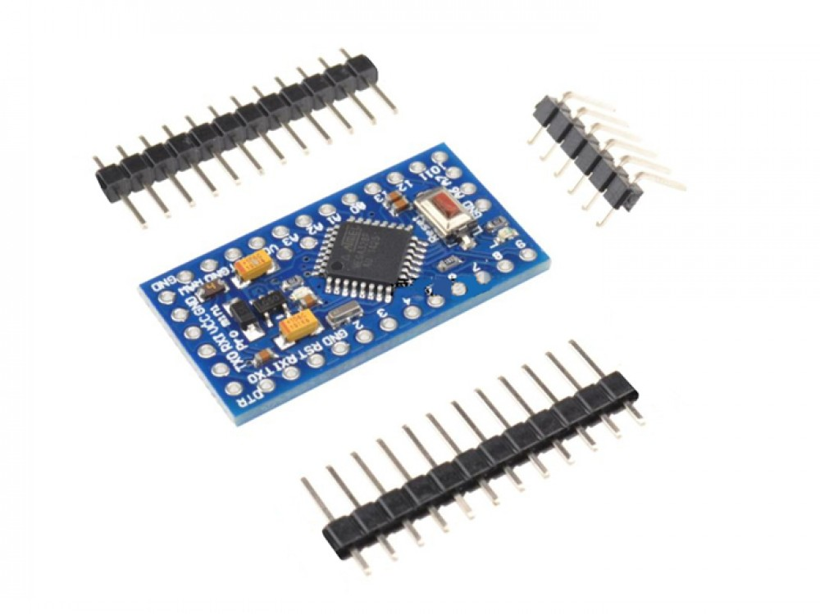
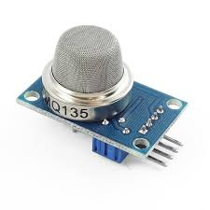
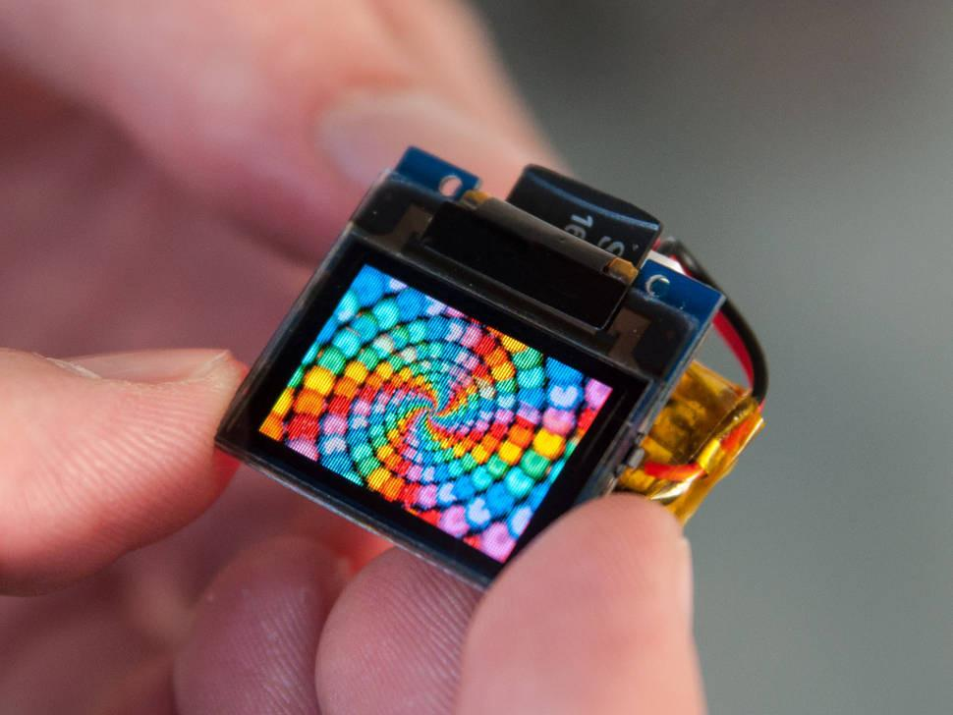
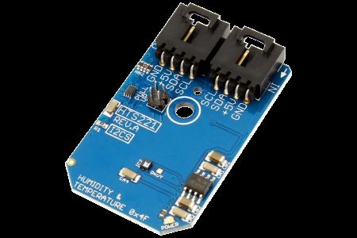
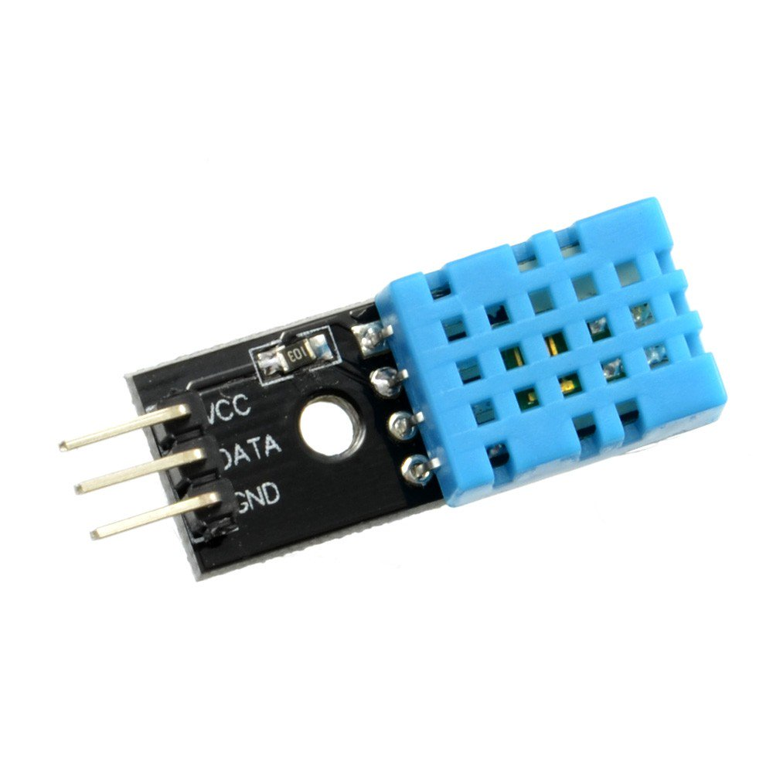
COMPONENTS USED
OLED DISPLAY
MQ 135
ARDUINO PRO MINI
BMP 180
DHT 11
An organic light-emitting diode (OLED) is a light-emitting diode (LED) in which the emissive electroluminescent layer is a film of organic compound that emits light in response to an electric current.
The MQ-135 gas sensor senses the gases like ammonia nitrogen, oxygen, alcohols, aromatic compounds, sulfide and smoke.
The BMP180 Breakout is a barometric pressure sensor with an I2C (“Wire”) interface. Barometric pressure sensors measure the absolute pressure of the air around them.
The DHT11 is a basic, ultra low-cost digital temperature and humidity sensor. It uses a capacitive humidity sensor and a thermistor to measure the surrounding air, and spits out a digital signal on the data pin
The Arduino Pro Mini is a microcontroller board based on the ATmega328. It has 14 digital input/output pins, 6 analog inputs, an on-board resonator, a reset button, and holes for mounting pin headers

Slide 7
ARTIFICIAL NEURAL NETWORK
To analyze and get the relation between the recorded
parameters and glucose levels Neural Networking is used.
Later with the help of this we are able to analyse the data.

Slide 8
RESULT
An mobile application acts as an interface for the user.
With the help of Machine Learning we can take the data of the users and help them in lot of ways.
-A user can have the diet plan according to their diabetic level .
-A user could know when do they require the care of the hospital
and when not.

Slide 9
CONCLUSION
This product is useful for every diabetic patient.
Our focus is to make sure that every patient gets a pain free medication.
We help the user to live his life at his best.
We help them to take a proper diet suitable for themselves.
And we make sure that they get painless diagnosis.

Slide 10
Thank You

