Slide 1
REACT REDUX

Slide 2
Redux main topic
1
Action
Reducer
Store
Function accosiate with store(create store())

Slide 3
Quotations are commonly printed as a means of inspiration and to invoke philosophical thoughts from the reader.

Slide 4
REDUX FLOW
action
reducer
state

Slide 5
ACTION
Action are plain js object that have a type field
Action only tell what to do

Slide 6
REDUCER
Reducer are function that take the current state and an action as arguments and return new state result

Slide 7
STORE
Redux store bring together state, actions and reducer you will only have a single
store in redux and every store has a single root reducer function

Slide 8
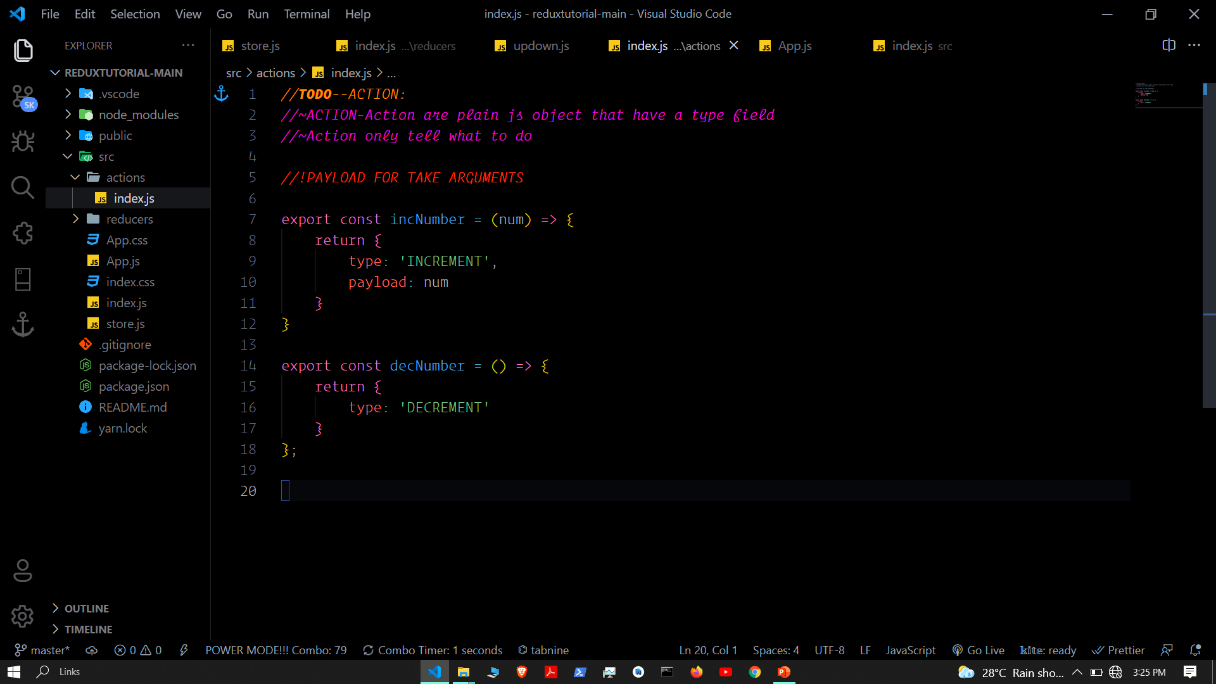

Slide 9
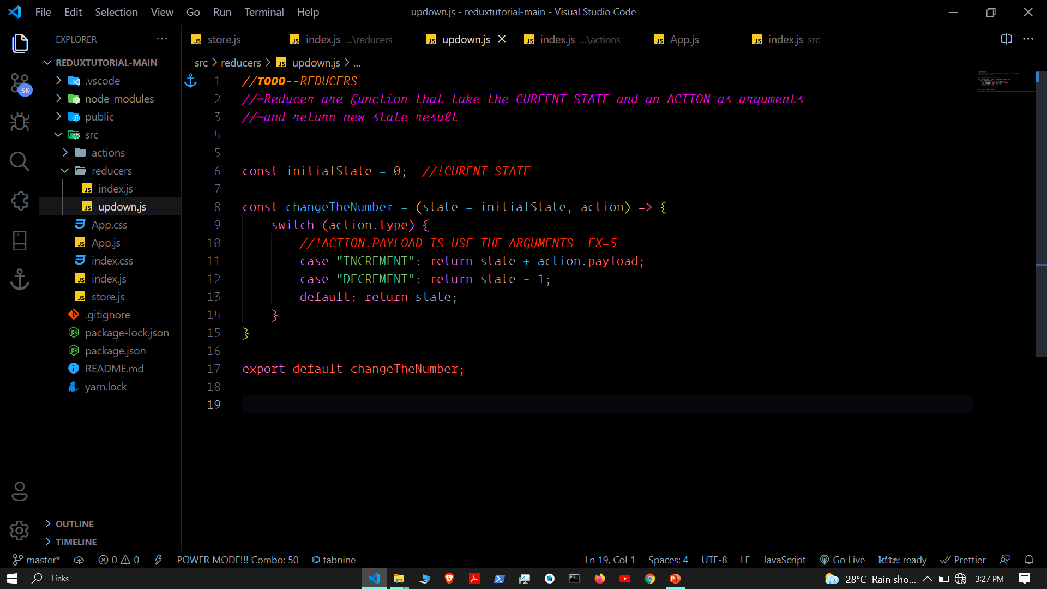

Slide 10
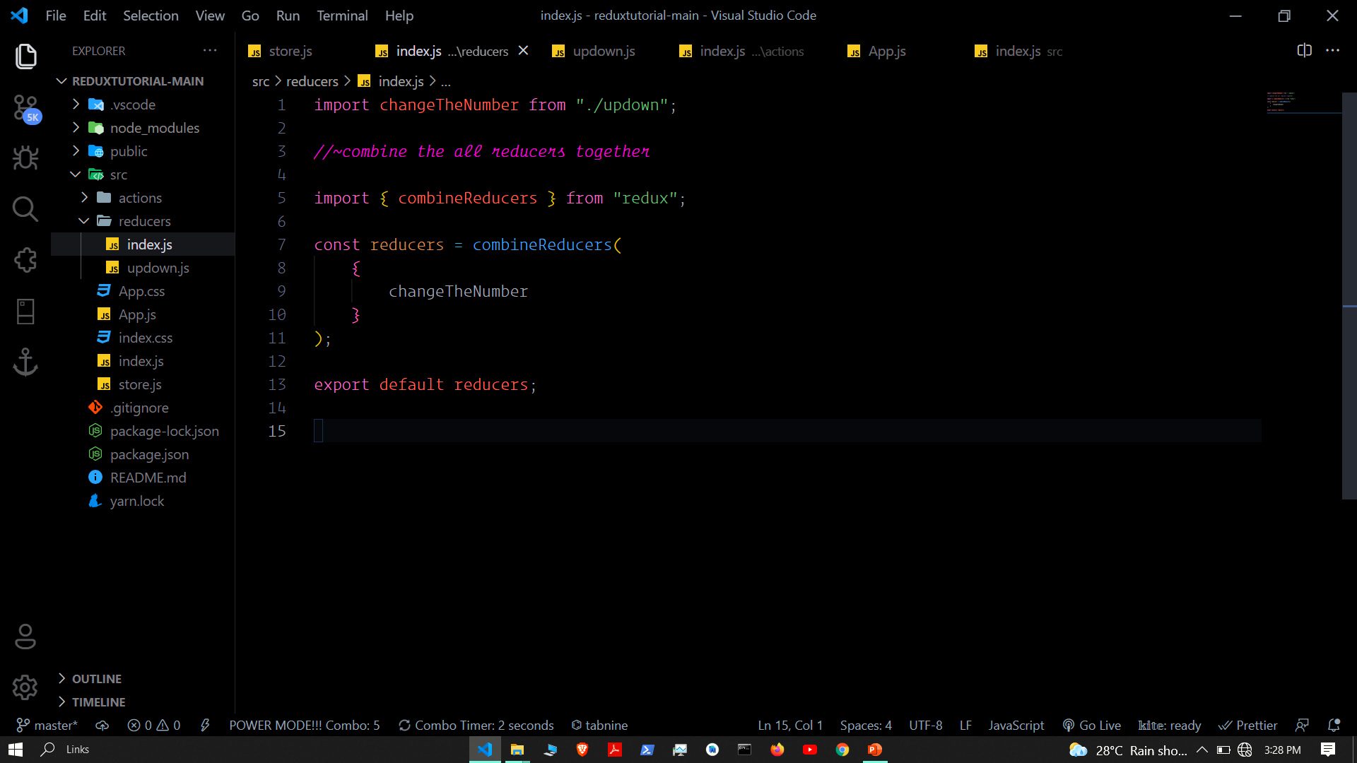

Slide 11
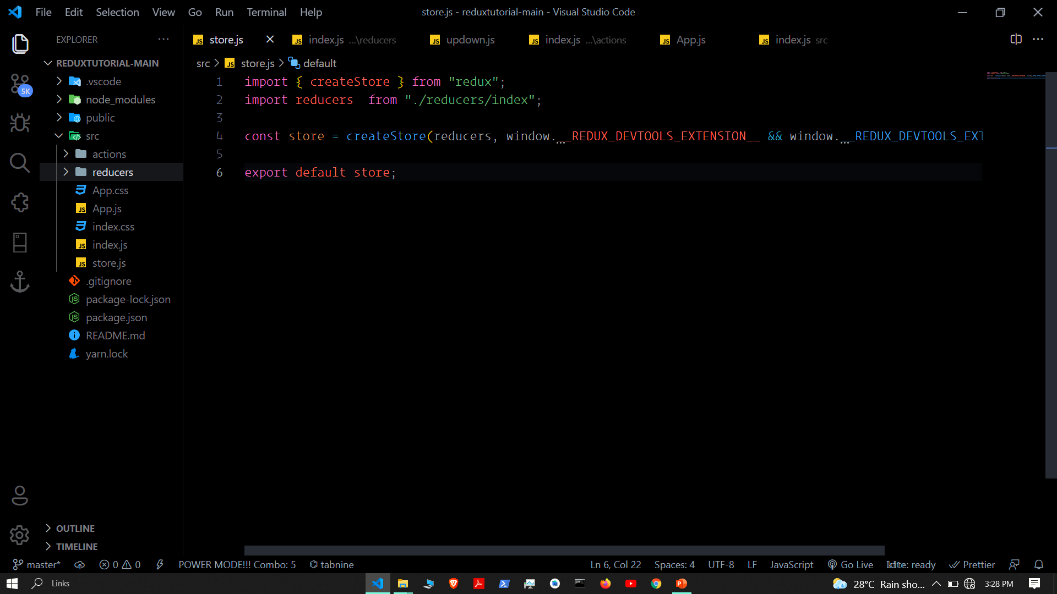

Slide 12
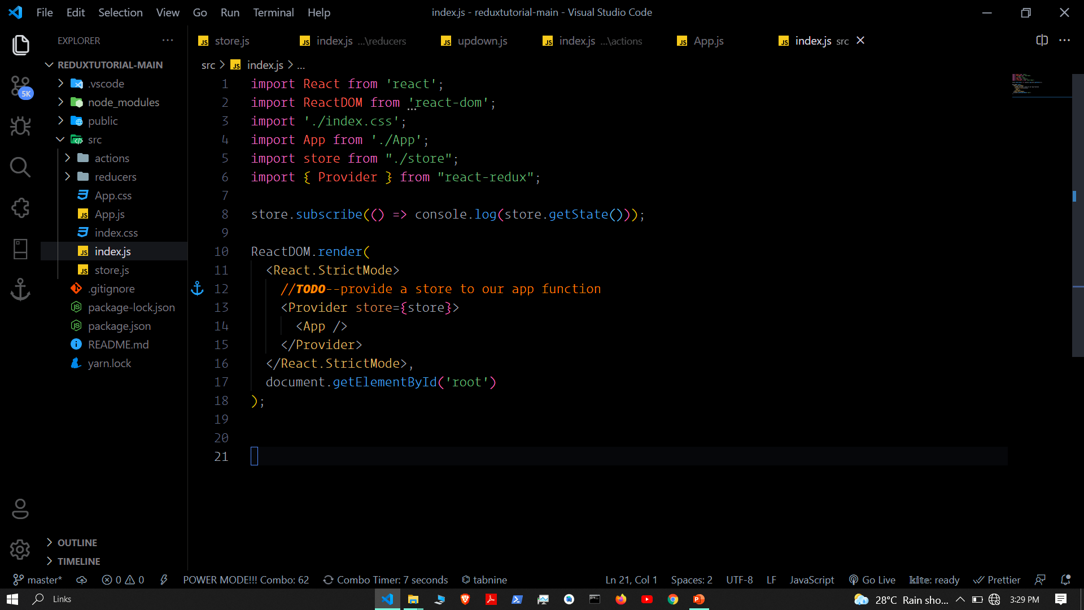

Slide 13
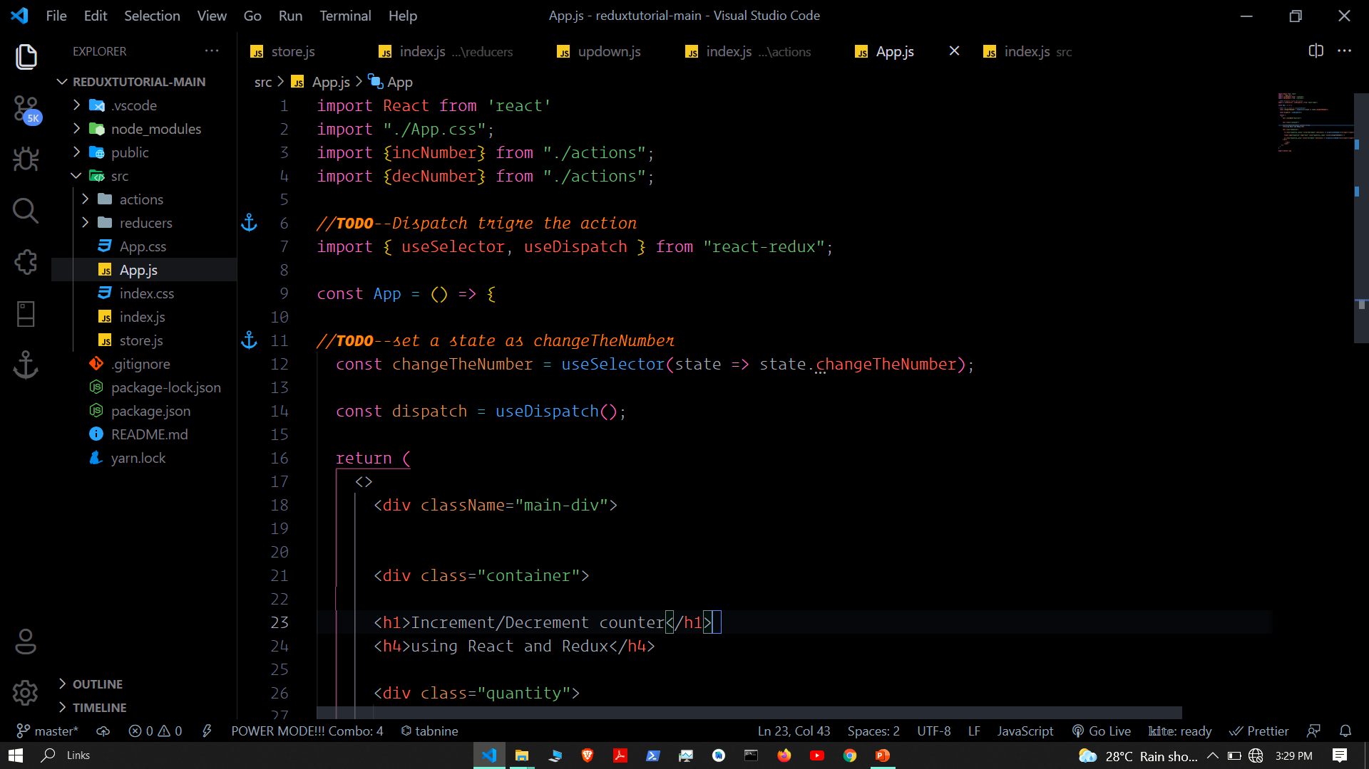

Slide 14
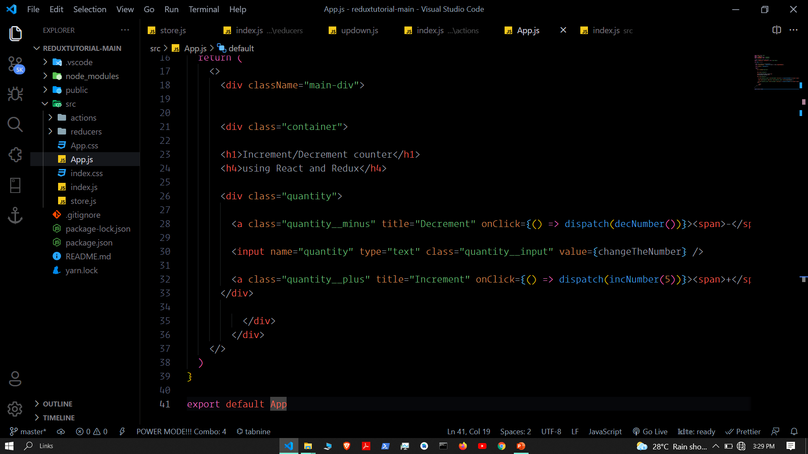

Slide 15
REDUX DEV TOOL

Slide 16
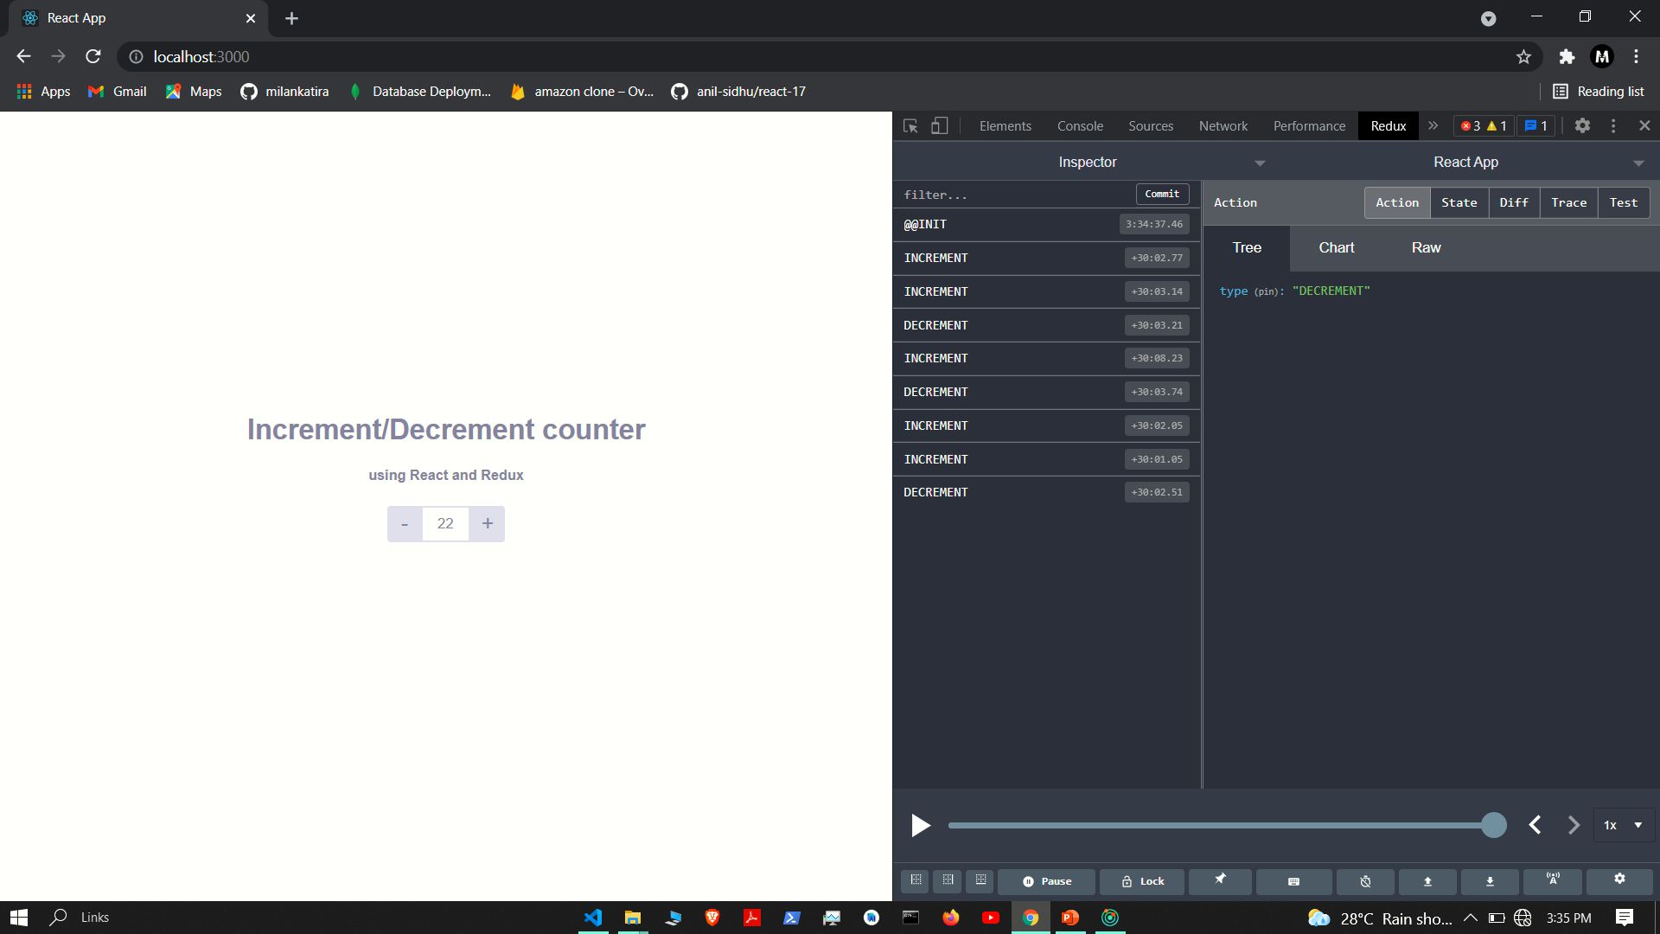

Slide 17
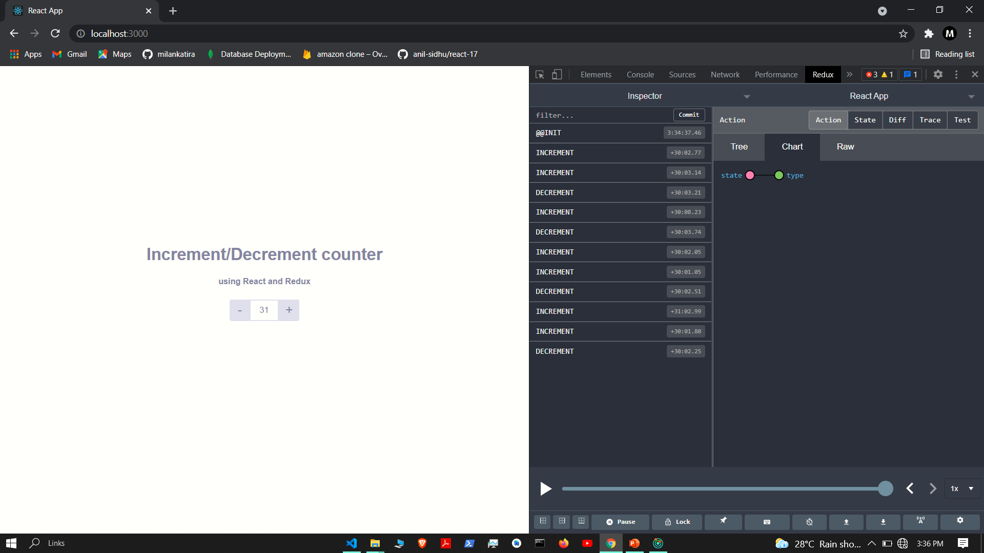

Slide 18
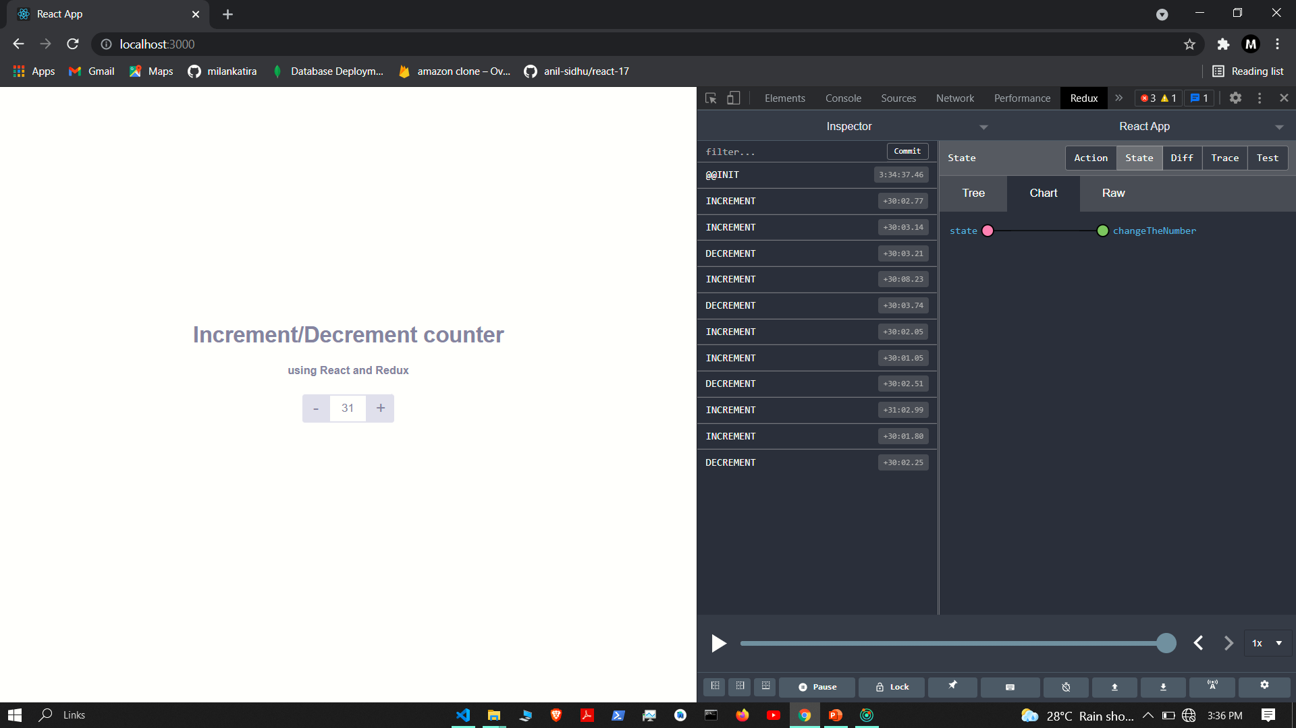

Slide 19


Slide 20


