Slide 1
Solidity

Slide 2
Smart contract compilation
1

Slide 3
.sol file
Solidity compiler
ABI
BYTE CODE
Ethereum
blockchain

Slide 4
First programme
-define variable
-constructor
-make function for return value

Slide 5
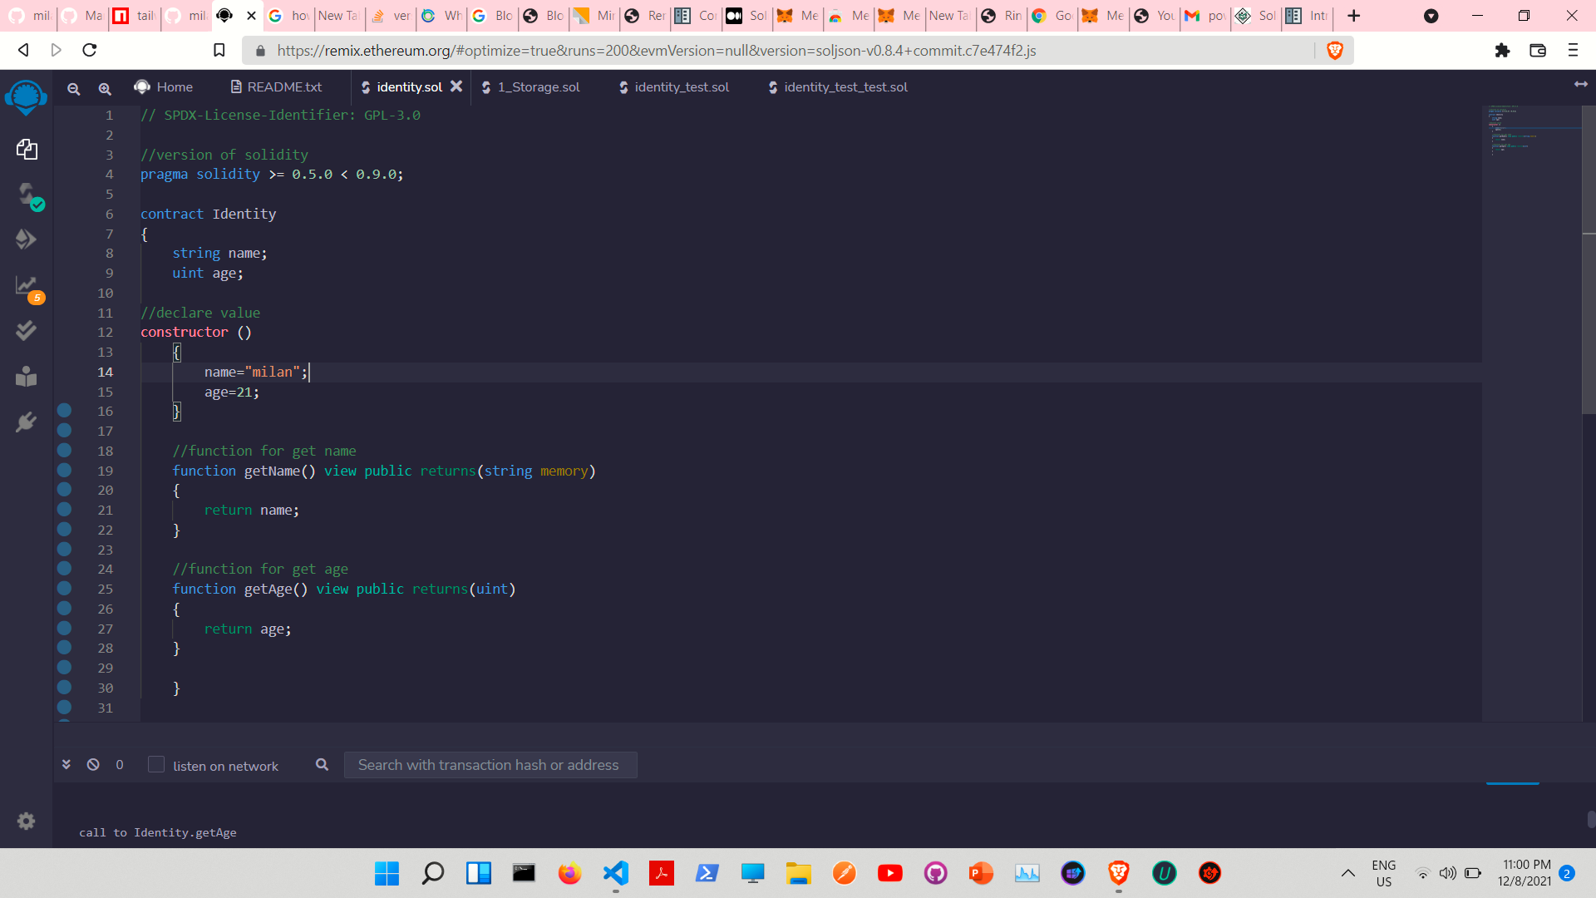

Slide 6
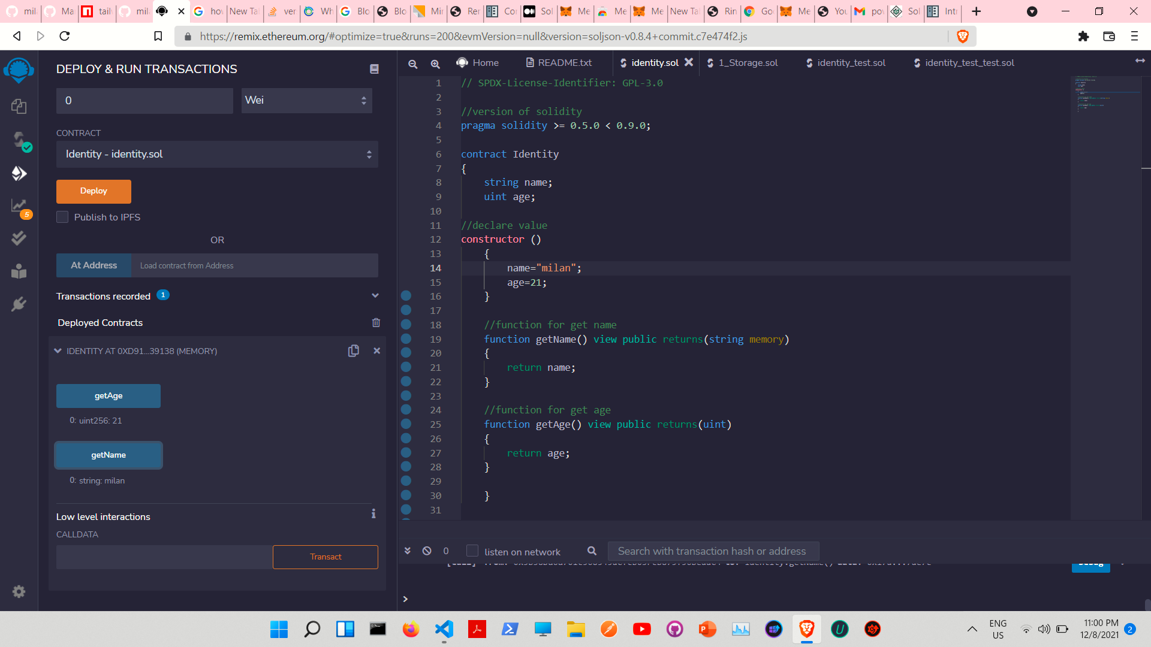

Slide 7
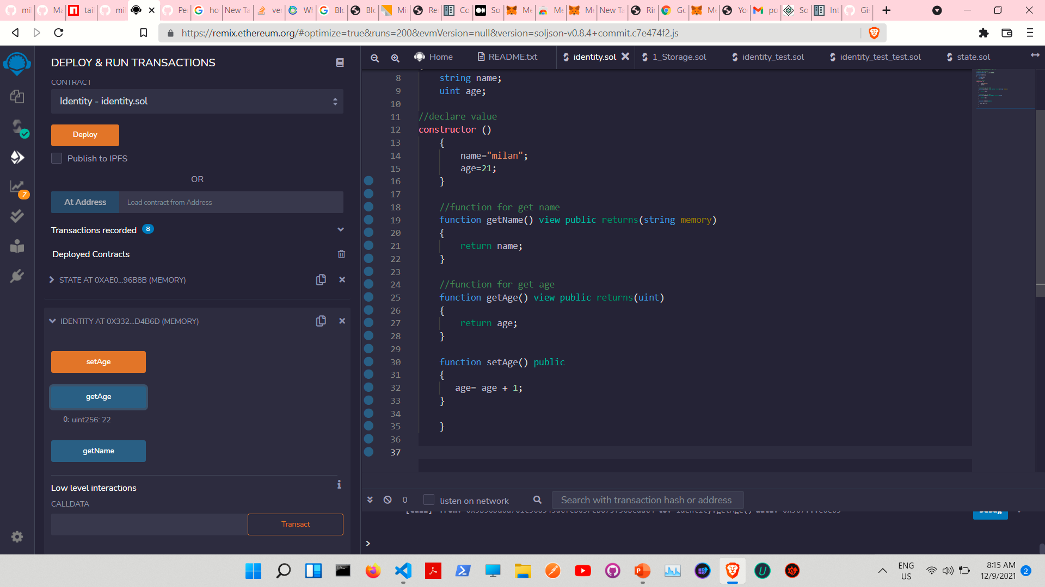

Slide 8
State variables
-to change the values of the state variables
Using constructor
Initializing the var. at declaration
Using the setter function

Slide 9
State variables
-permanently stored in contract storage
-cost gas (expensive)
-storage do not dynamically allocated
-instance of the contract cannot have other state variables besides those already declared

Slide 10
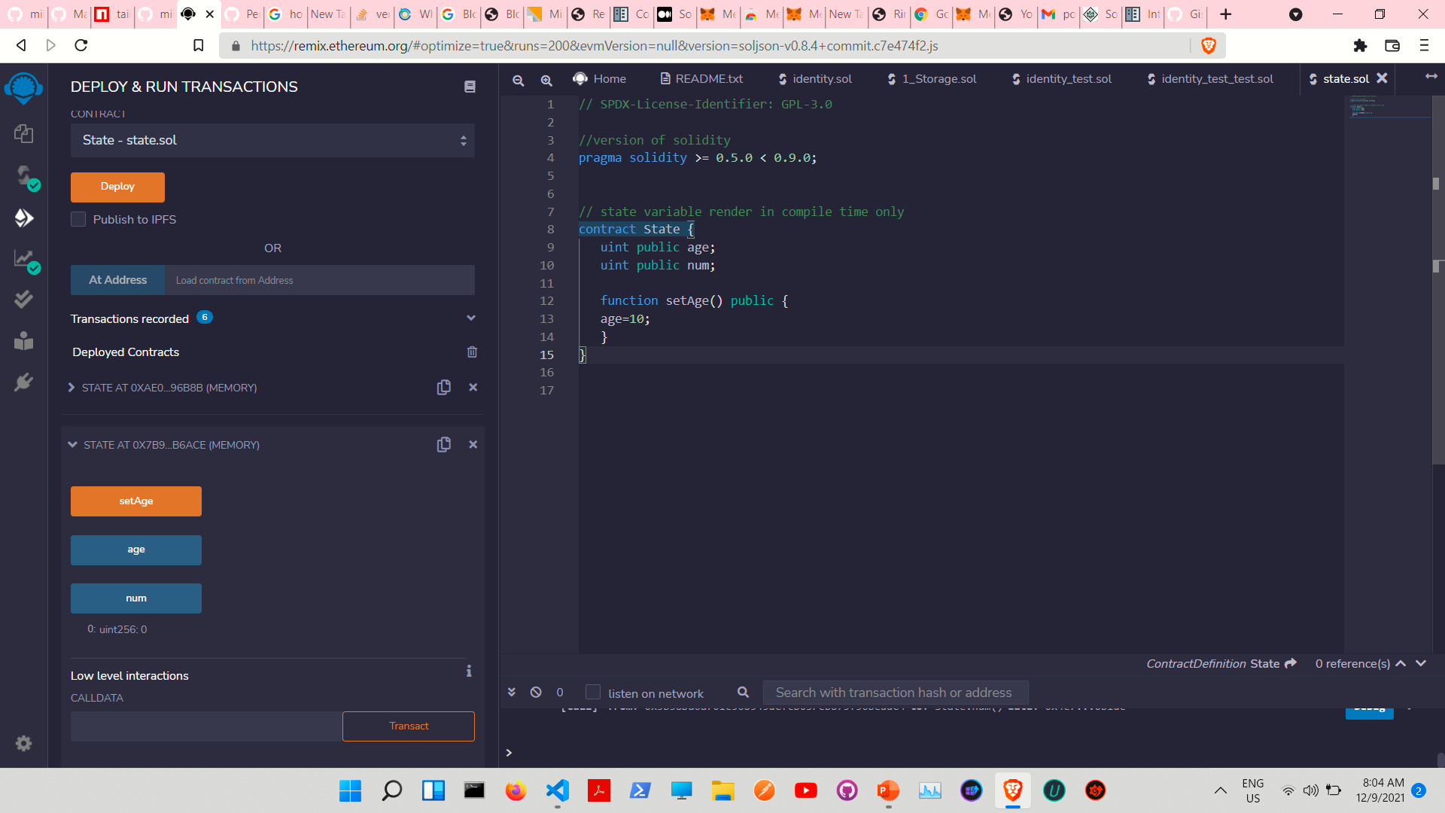

Slide 11
Local variables
-declared inside function and kept on stack not on storage
-don’t cost gas
-there are some types that reference the storage by default

Slide 12
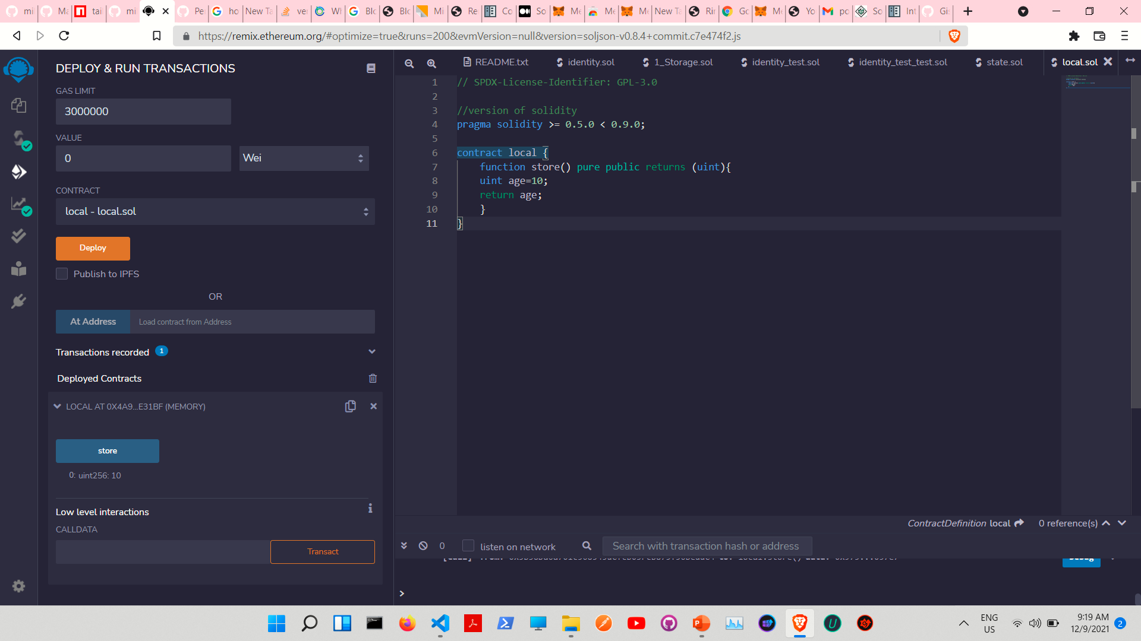

Slide 13
functions
-getters
-setters

Slide 14
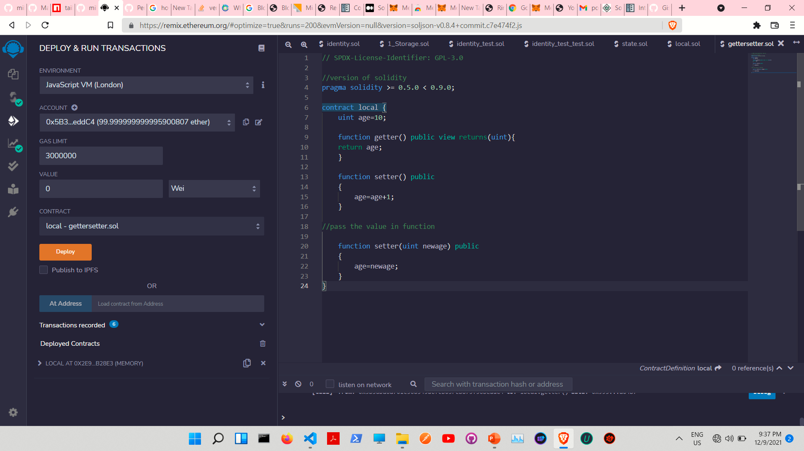
THIS IS A SLIDE TITLE
Here you have:
A list of items
And some text
But remember not to overload your slides with content
Your audience will listen to you or read the content, but won’t do both.

Slide 15
-View
-Pure

Slide 16
View and pure where we cannot modify state value
Pure cannot use when we read value of state variable

Slide 17
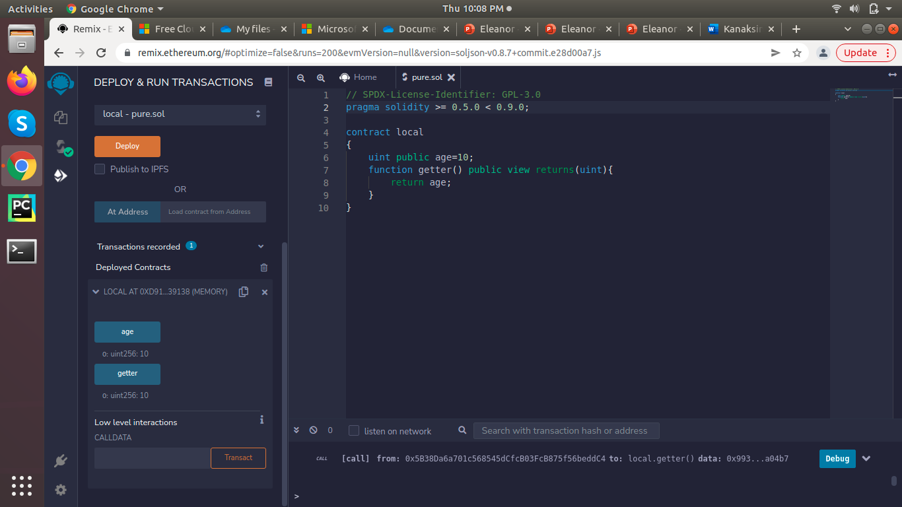
BIG CONCEPT
Bring the attention of your audience over a key concept using icons or illustrations

Slide 18
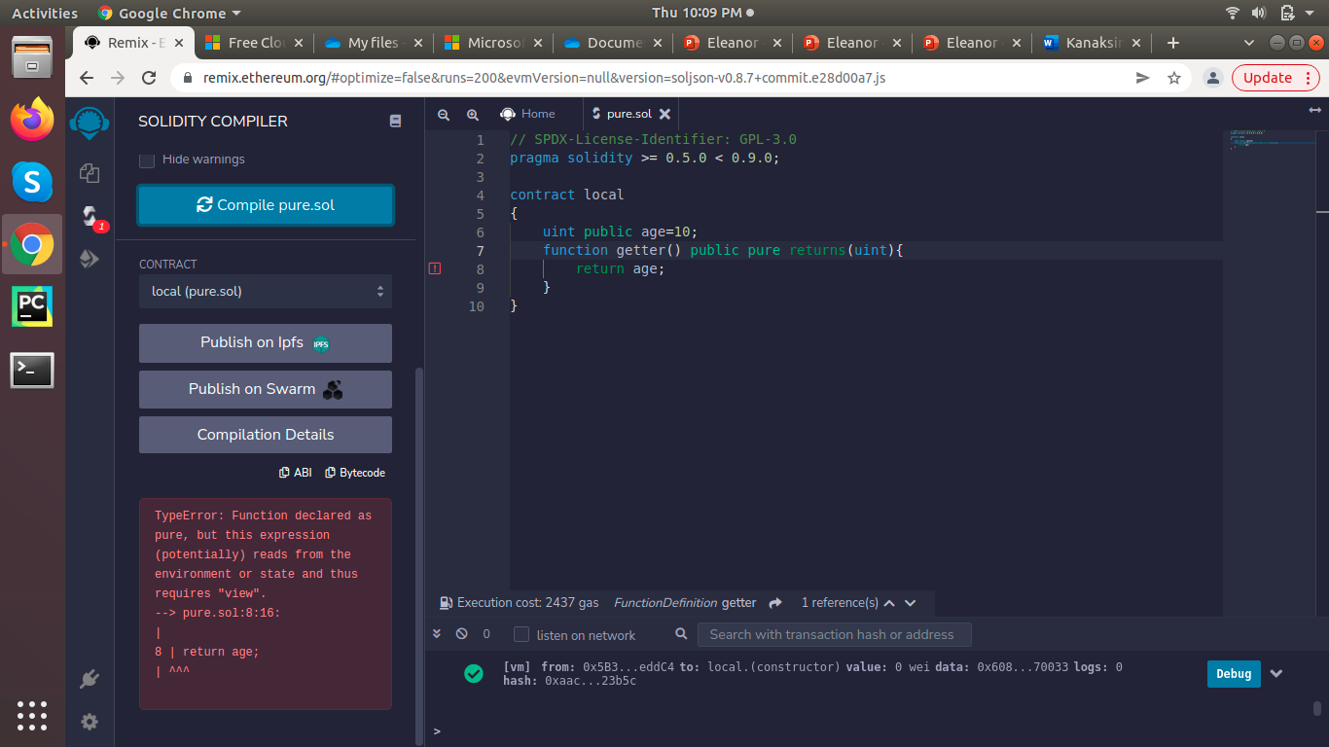
BIG CONCEPT
Bring the attention of your audience over a key concept using icons or illustrations

Slide 19
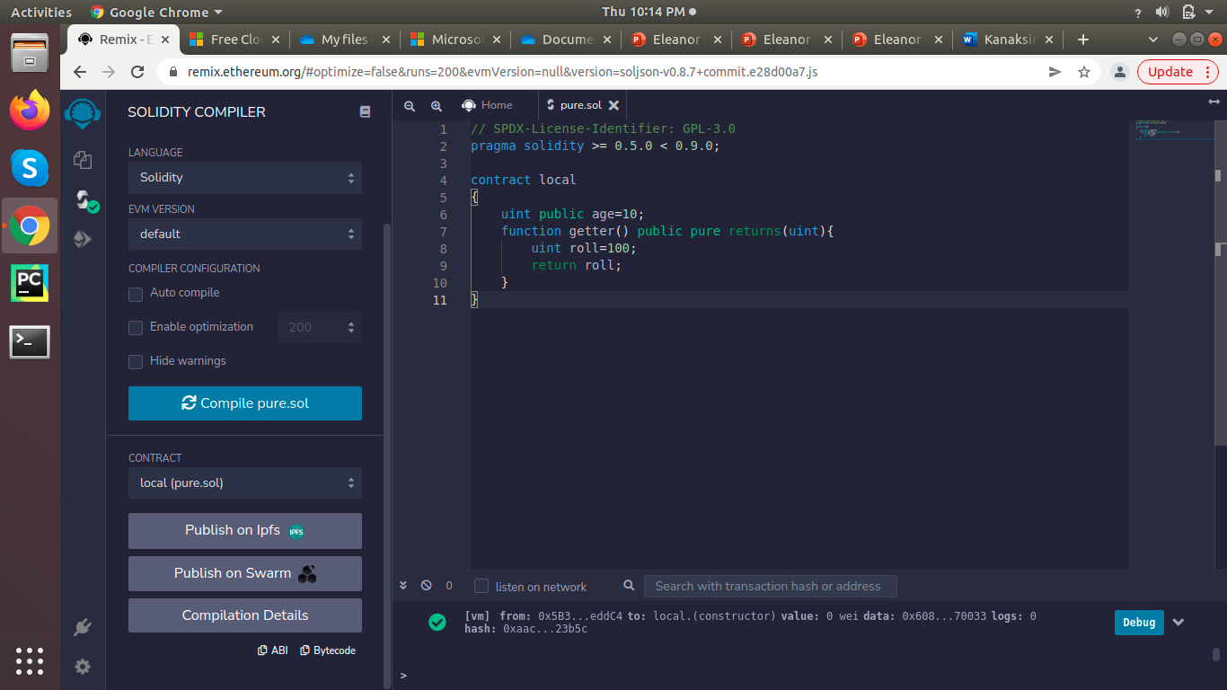
BIG CONCEPT
Bring the attention of your audience over a key concept using icons or illustrations

Slide 20
constructor

Slide 21
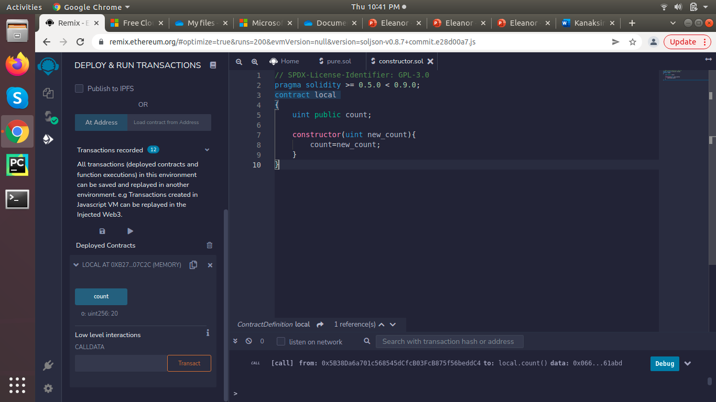
YOU CAN ALSO SPLIT YOUR CONTENT
White
Is the color of milk and fresh snow, the color produced by the combination of all the colors of the visible spectrum.
Black
Is the color of ebony and of outer space. It has been the symbolic color of elegance, solemnity and authority.

Slide 22
Executed only once.
You can create only one constructor and it is optional
A default constructor is created by the compiler if there is no explicitly
Defined constructor

Slide 23
integers

Slide 24
There are 2 type of integer
Int
uint(only positive)

Slide 25
Range
Int8 (-128 to +127)
Uint8 (0 to 255)

Slide 26
array

Slide 27
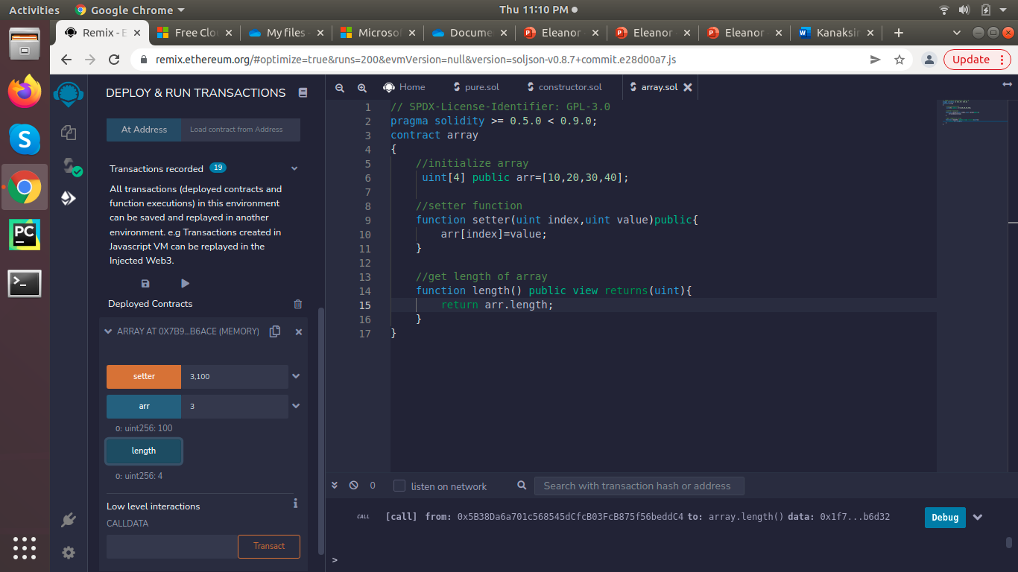
array

Slide 28
Dynamic array

Slide 29
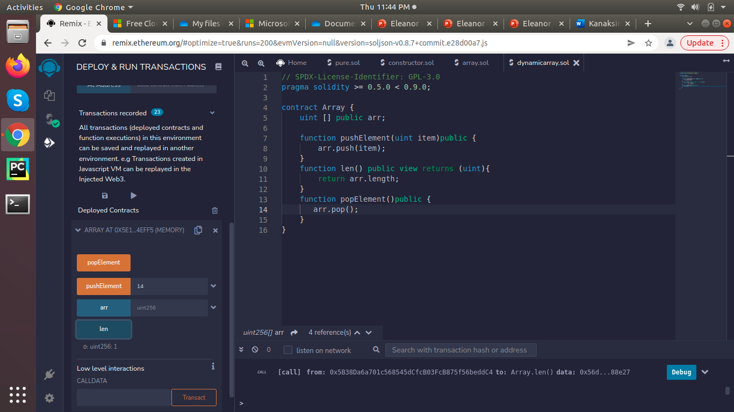
array

Slide 30
loops

Slide 31
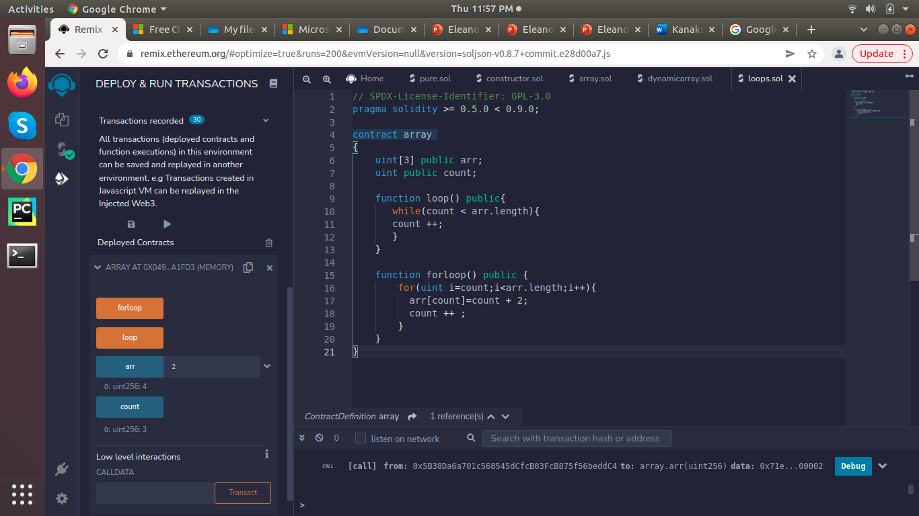
loops

Slide 32
If else

Slide 33
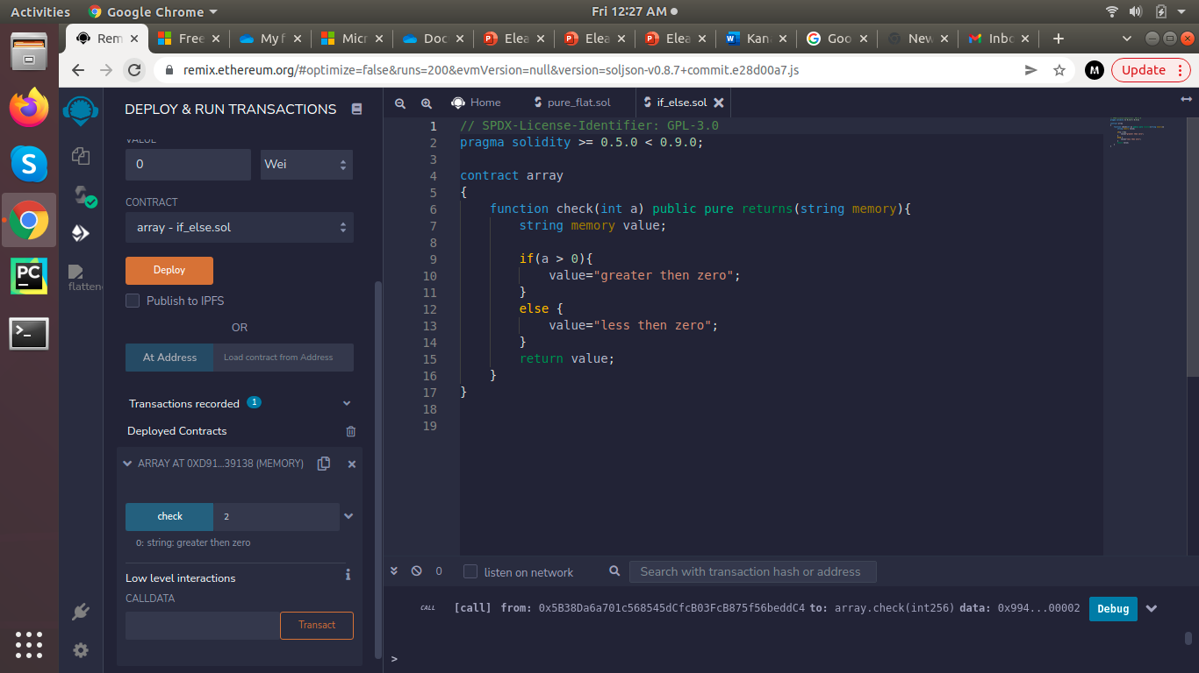
IN TWO OR THREE COLUMNS
Yellow
Is the color of gold, butter and ripe lemons. In the spectrum of visible light, yellow is found between green and orange.
Blue
Is the colour of the clear sky and the deep sea. It is located between violet and green on the optical spectrum.
Red
Is the color of blood, and because of this it has historically been associated with sacrifice, danger and courage.

Slide 34
struct

Slide 35
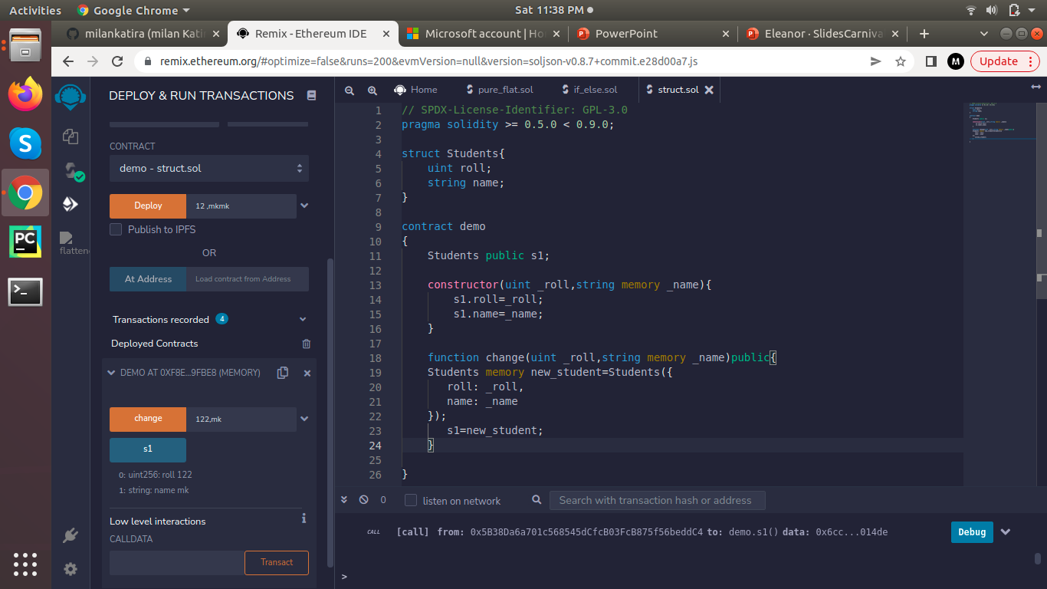
struct

Slide 36
mapping

Slide 37
Rule of mapping
The key cannot be type of mapping,dynamic array,enum,and struct
The value can be of any type
Mapping are always store in storage

Slide 38
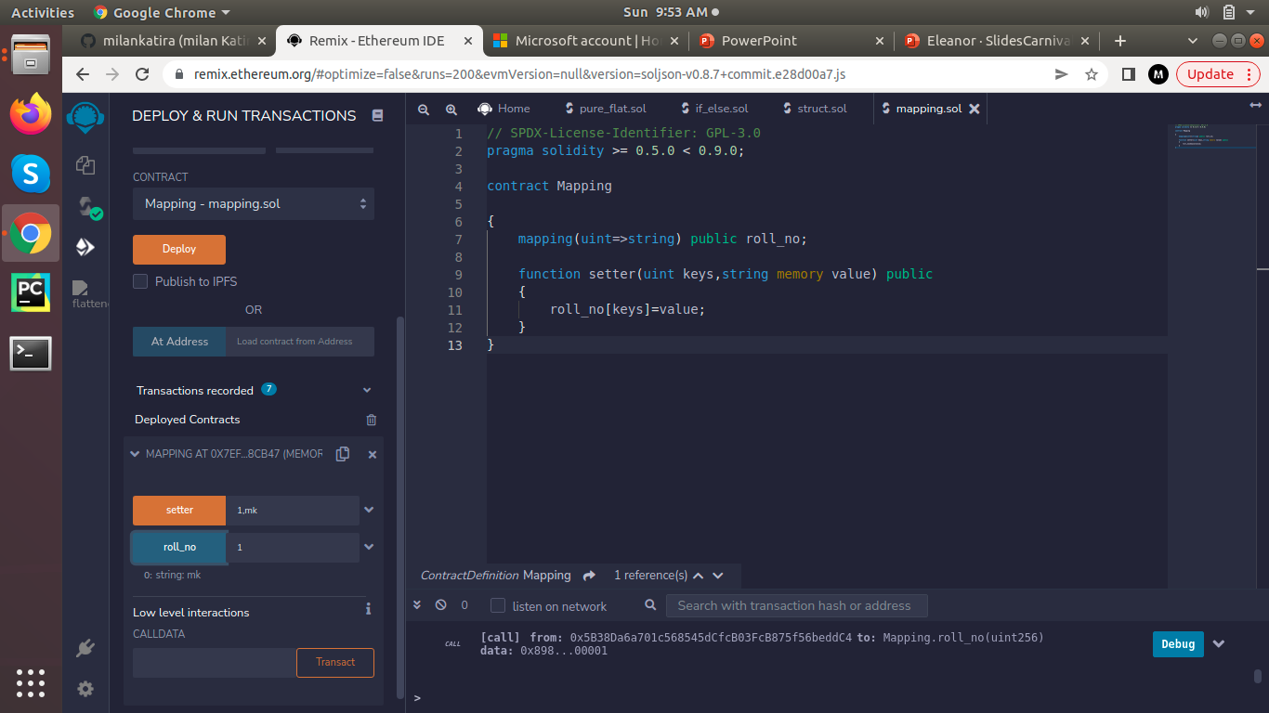
mapping

Slide 39
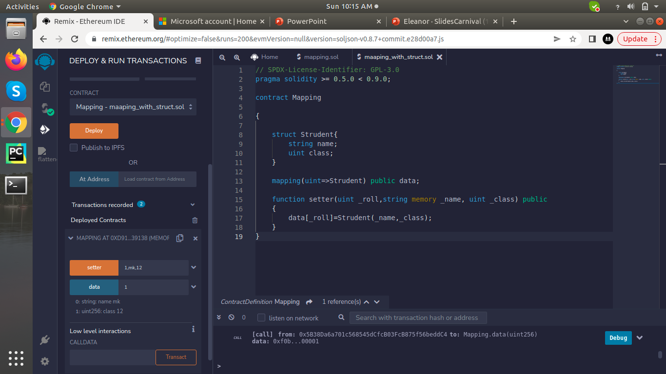
mapping

Slide 40
Storage vs Memory

Slide 41
Storage | Memory
Holds state variables | Holds local variable
Costs gas | No gas
Persistent | Not Persistent
Like HDD | Like

Slide 42
Contract balance

Slide 43
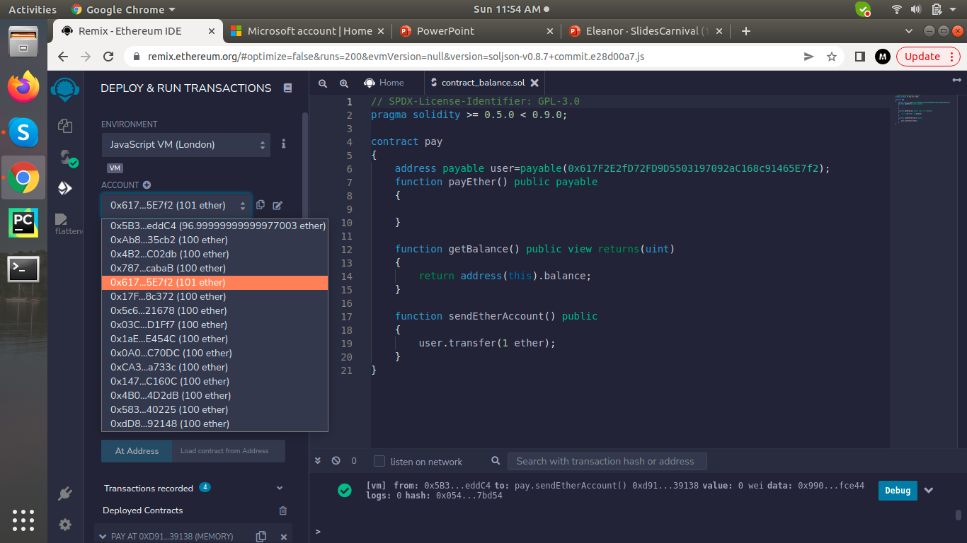

Slide 44
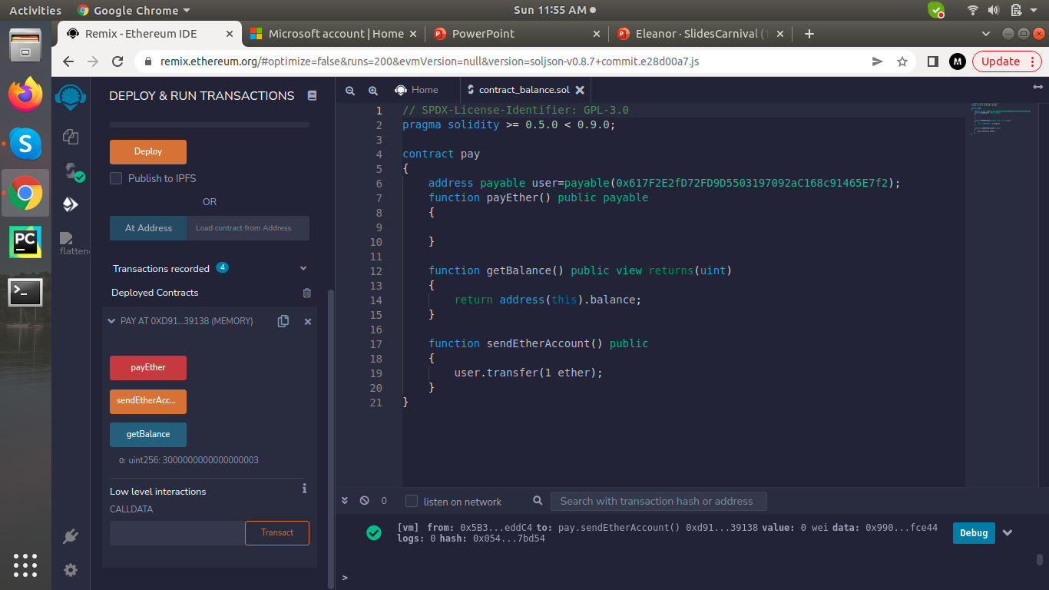

Slide 45
Visibility

Slide 46
Public | Private | External | Internal
Outside | no | no | yes
Within | yes | yes | no
Derived | no | yes | yes
Other | no | no | yes

