Slide 1
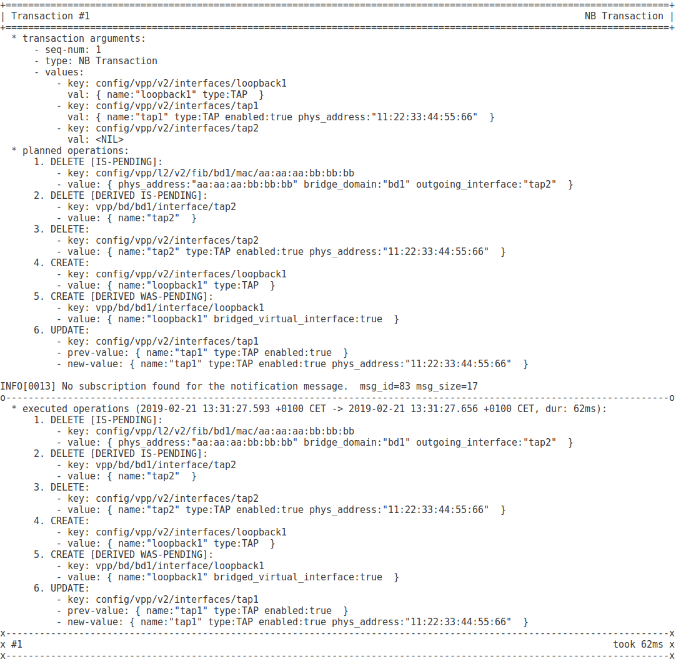
transactions are sequenced, starting with 0
transaction type
(in this case update from NB)
values set by the transaction
nil = value is to be deleted
single operation with parameters
(key, new value, for Update also prev. value)
transaction plan
(graphed walked without executing CRUD operations)
annotations showing value state (+transitions)
IS-* = new value state after the change
WAS-* = previous, no longer current state
STILL-* = value state remained after the change
logs from executed CRUD operations
(i.e. from the descriptors and layers below)
executed transaction operations
(in this order)
how much time it took to execute the transaction

Slide 2
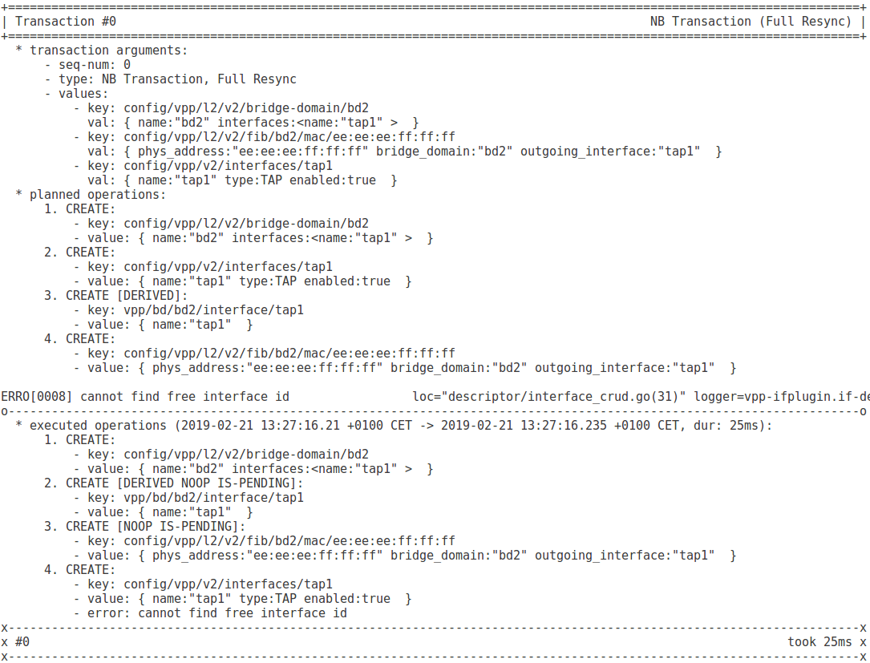
Full Resync between NB and SB
Values set by the resync txn to get SB in-sync with NB
transaction had some errors, therefore the list of executed operations differs from the plan
error during transaction, logged inside the descriptor
this item is pending due to a missing dependency (which failed, see below), therefore the Create operation is delayed until the dependency becomes available
operation ended with an error

Slide 3
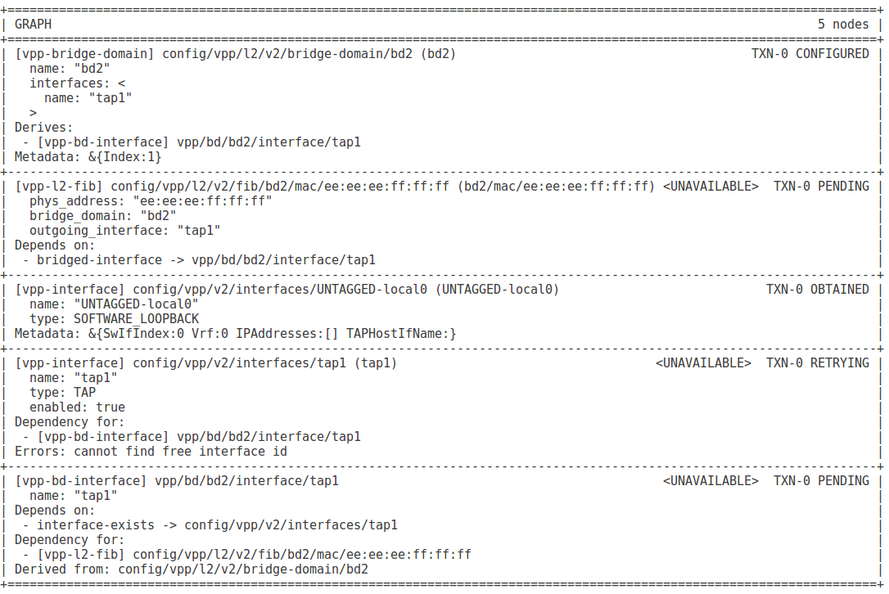
associated descriptor
last transaction (seq. num.) updating the value
value state
value data
value key
associated metadata
value label
flag marking values which are not present in the SB for whatever reason
relations with other values

Slide 4
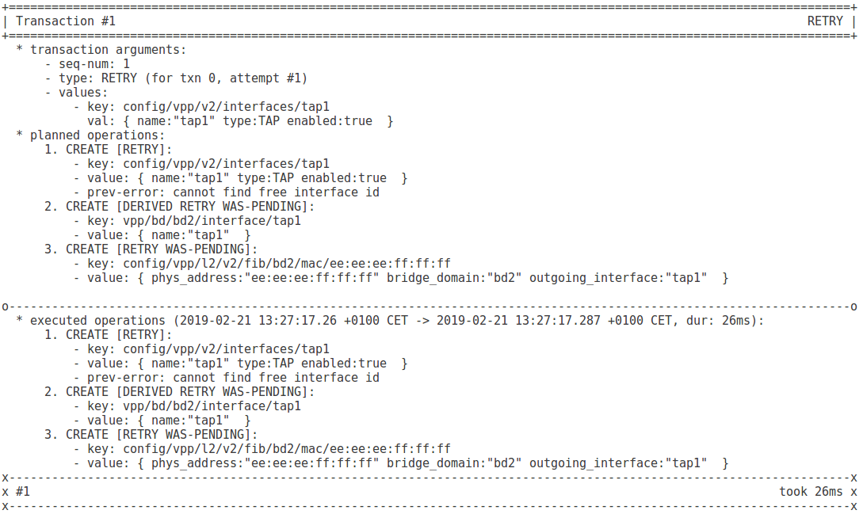
transaction re-trying failed operation(s) from a previous txn
the value which previously failed to be applied
no new error – the retry was successful
values that were waiting for the failed value to be fixed first

