Slide 1
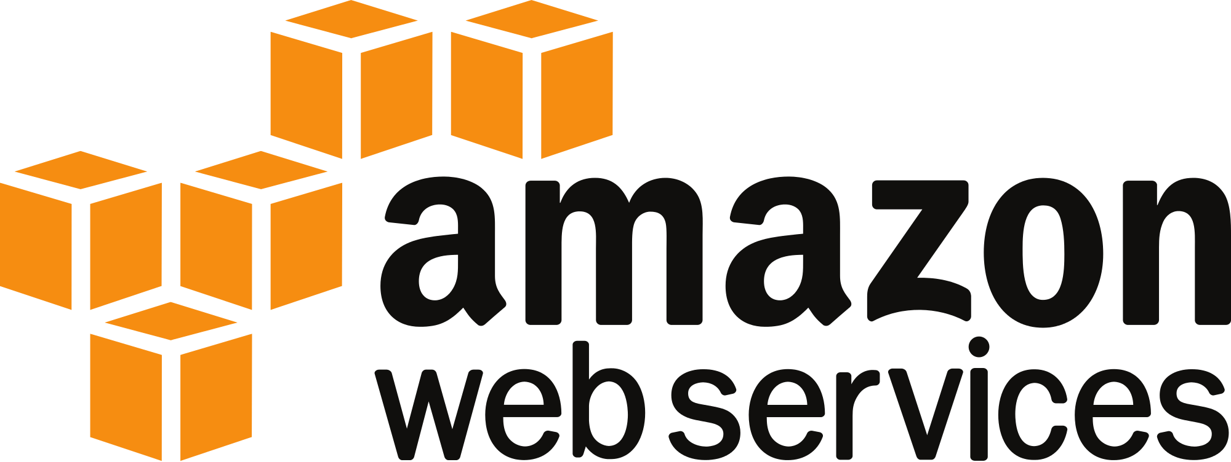

Slide 2
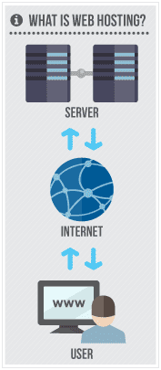

Slide 3
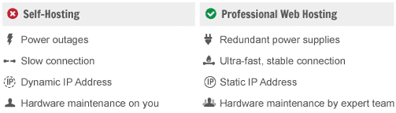

Slide 4
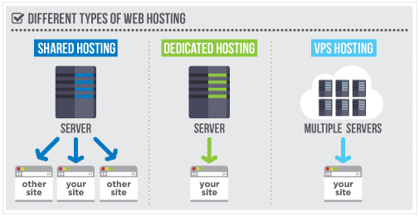

Slide 5
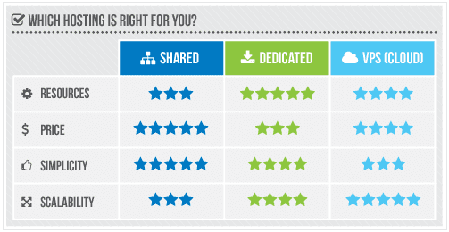

Slide 6
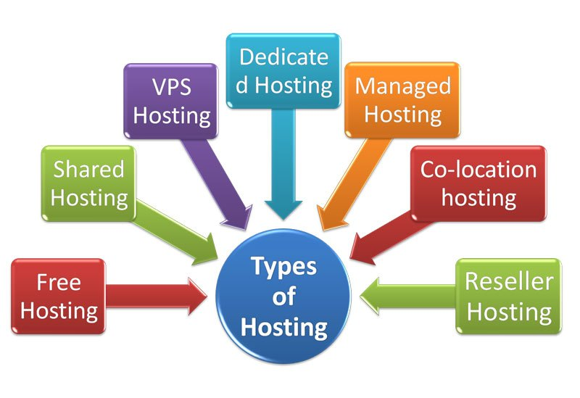

Slide 7
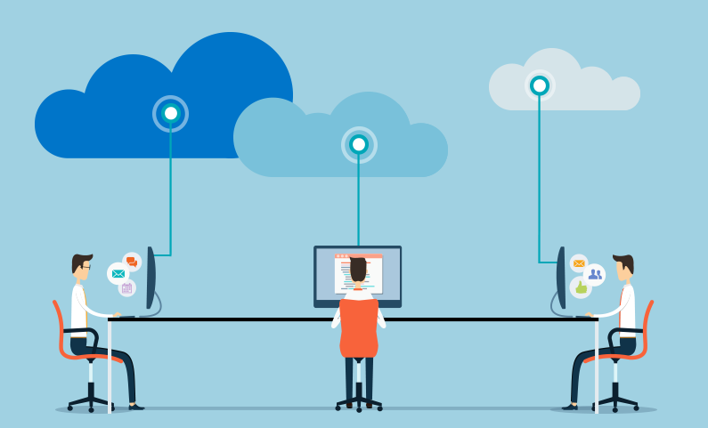

Slide 8
What is Cloud Computing
Cloud Computing is the delivery of services such as storage, computation, networking etc to the customer on demand

Slide 9
Features
Scalability
Elasticity
Resource Pooling
Self Service
Low Cost
Fault Tolerance

Slide 10
Architecture of Cloud
SAAS - Software As A Service
PAAS - Platform As A Service
IAAS - Infrastructure As A Service

Slide 11
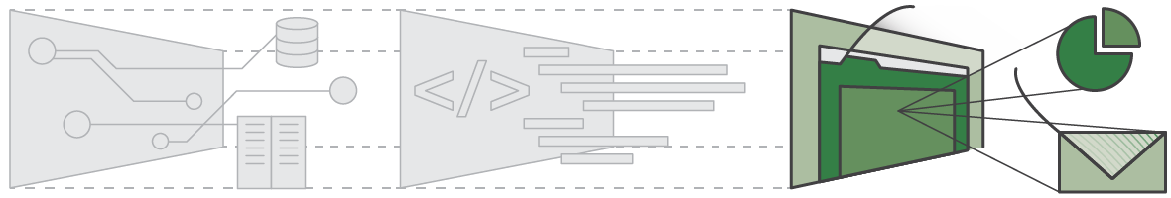
Software As A Service - SAAS

Slide 12
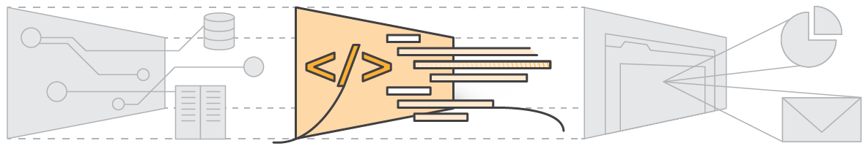
Platform As A Service - PAAS

Slide 13
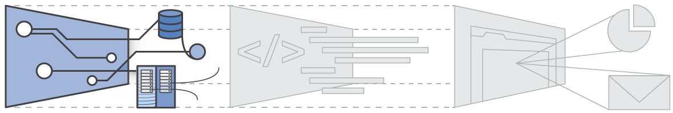
Infrastructure As A Service - IAAS

Slide 14
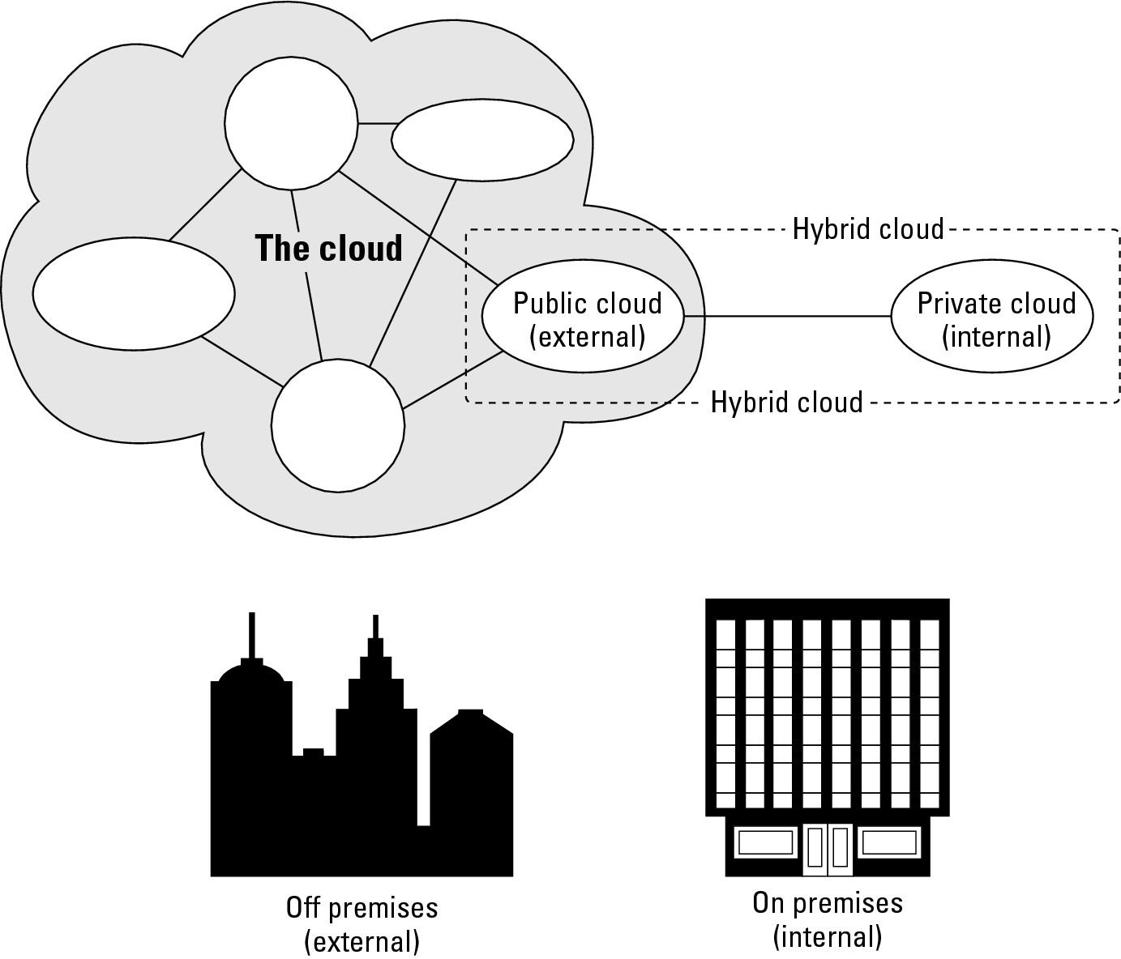
Deployment Models

Slide 15
WHAT IS VIRTUALIZATION?
Virtualization refers to partitioning one physical server into several virtual servers, or machines.
Each virtual machine can interact independently with other devices, applications, data and users as though it were a separate physical resource.

Slide 16
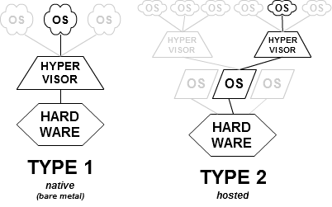
HYPERVISORS

Slide 17
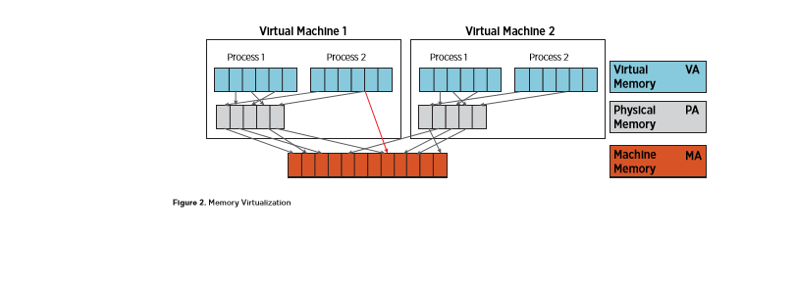
VM ARCHITECTURE AND WORKING
Memory Isolation

Slide 18
DOCKER
Docker is an open-source project that automates the deployment of Linux applications inside software containers.

Slide 19
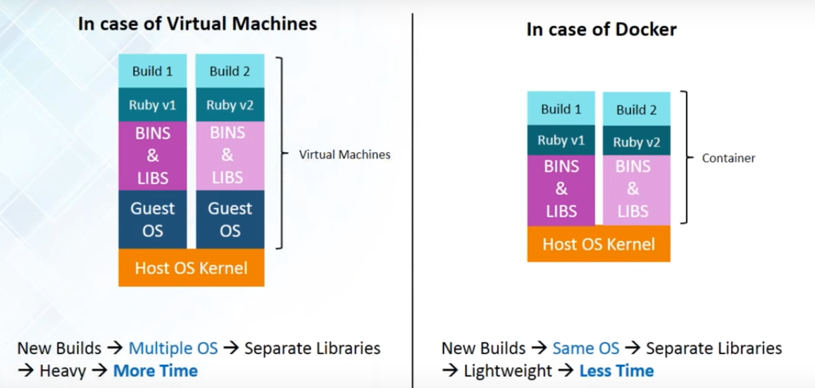

Slide 20
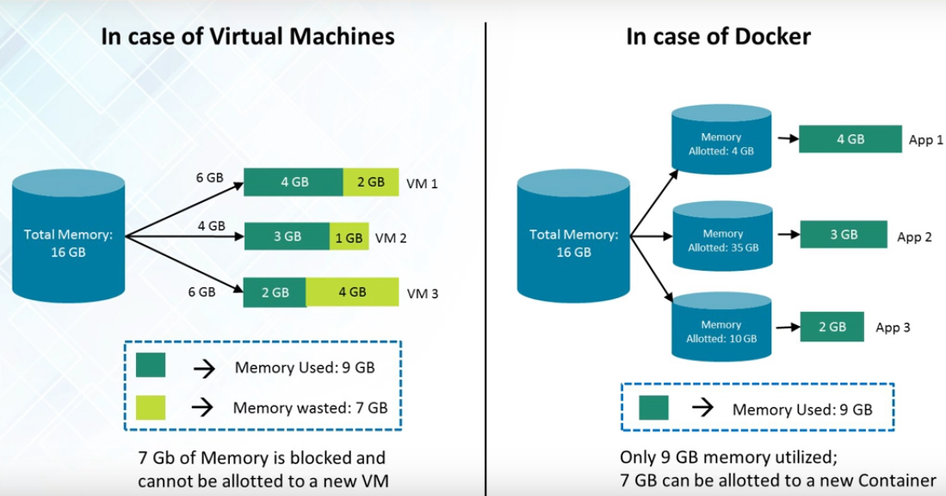

Slide 21
Docker Components
Docker Client and Daemon
Images
Docker registries
Containers

Slide 22
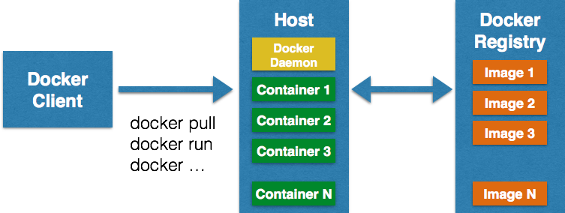
How Does Docker Work?

Slide 23
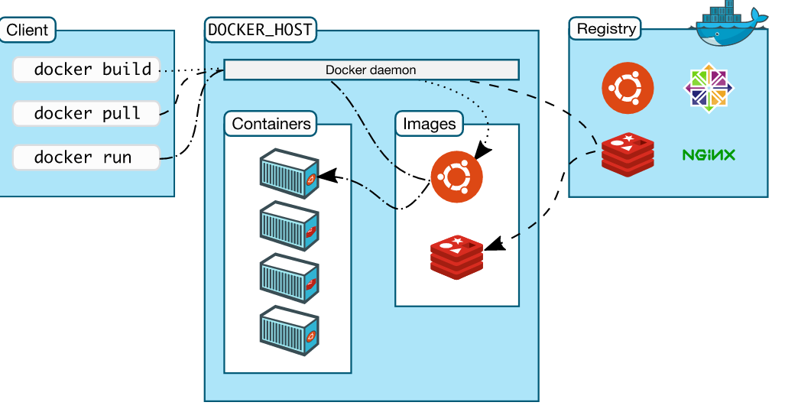

Slide 24
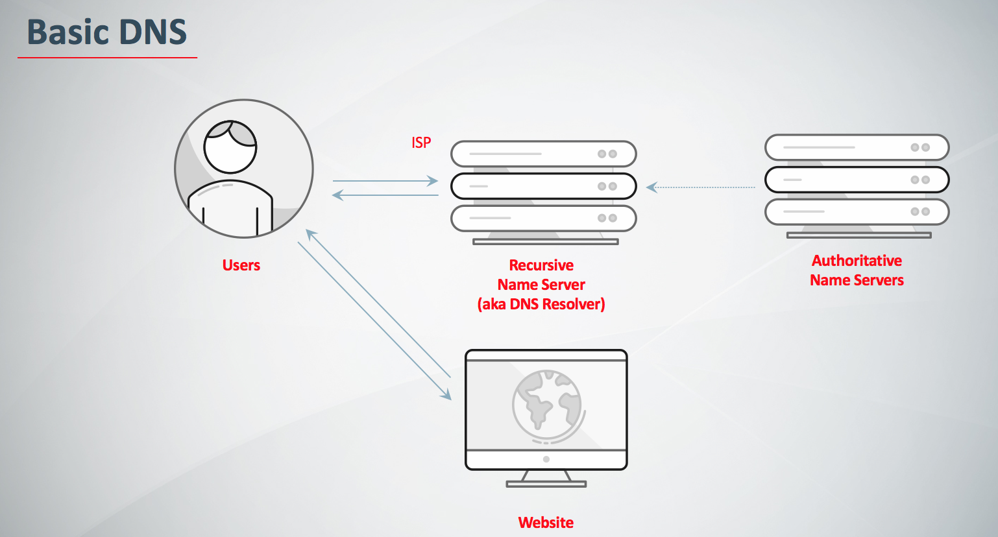

Slide 25
