Slide 1

The Link Wave Network
Szikla Benjamin
Kaszás Simon
Möller Milán

Slide 2

Our Goals at The Beginning
Cloud Factory tasked us to create a network, that connects their factories and warehouses.
This is the biggest challange our company has ever faced yet

Slide 3

Introduction
We are a new networking company, we mainly work with cisco devices, we also plan our networking systems in cisco packet tracer
Cloud Factory has contacted us, and we’re have been asked to make their network
The Logo of Cloud Factory

Slide 4




Our Team
Milán Möller
The Project Manager
System Administrator
Creator of the Presentation
Tester
Simon Kaszás
System Administrator,
Co-creator of The Presentation
Creator of the Documentation
Benjamin Szikla
System administrator
Creator of the Documentation
Co-creator of Presentation

Slide 5











Our nEtwork Consist of
Routers
Switches
PCs
Servers
WiFi Routers
IPV4
VLANs
M.Switch
NAT
Routing(OSPF)
IPV6

Slide 6
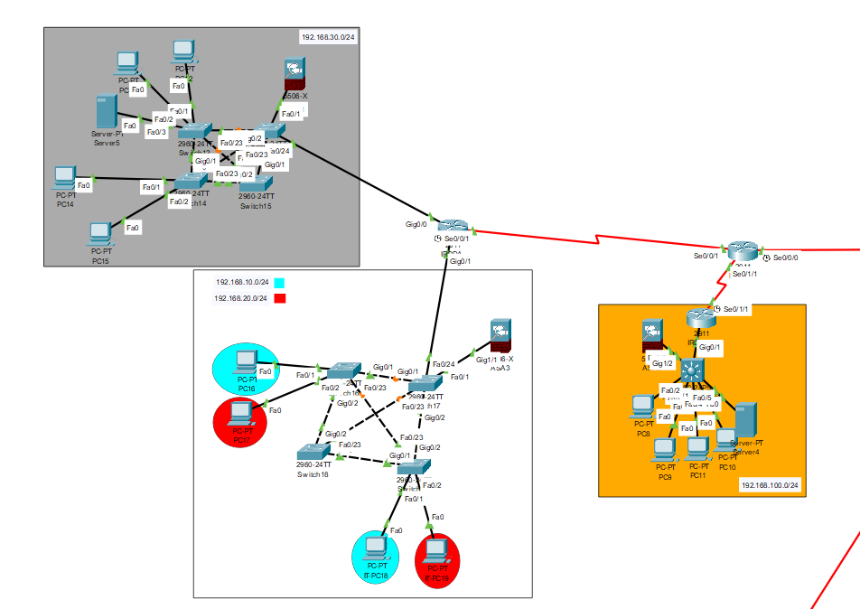
The Office

Slide 7
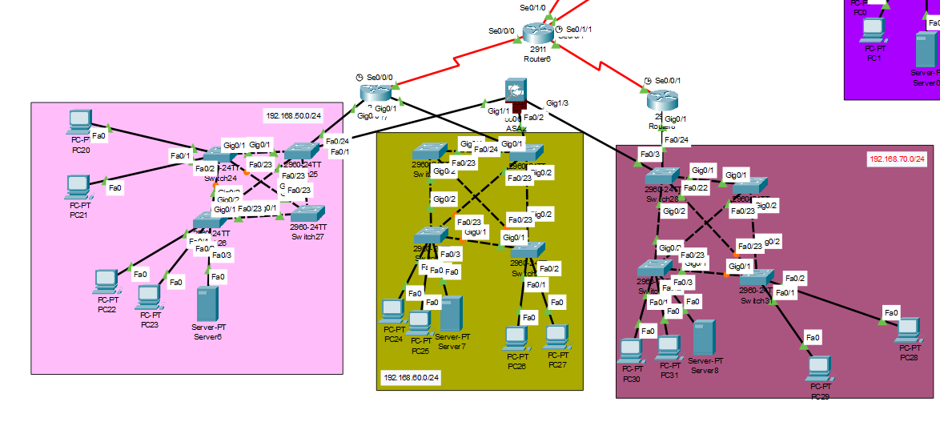
The factories

Slide 8
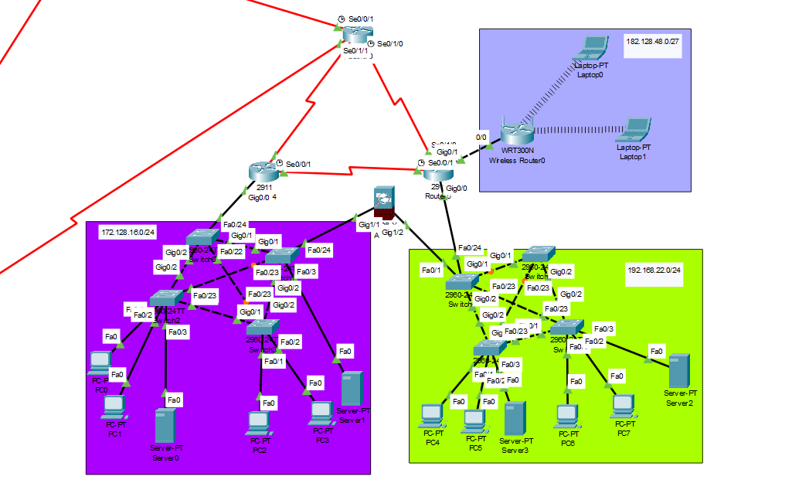
The warehouses

Slide 9
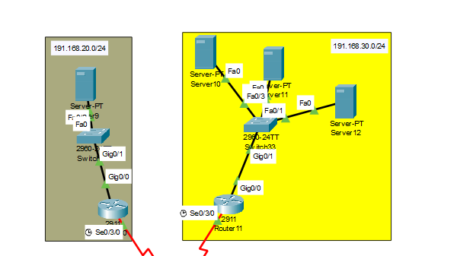
The server room

Slide 10
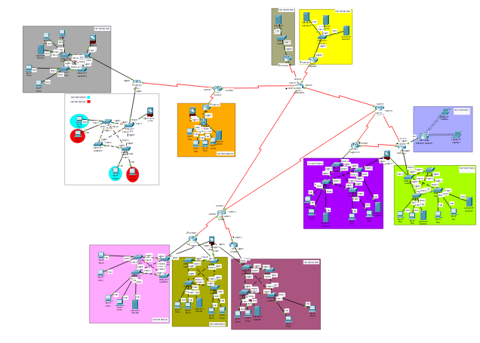
ThE NETWORK AS WHOLE

Slide 11
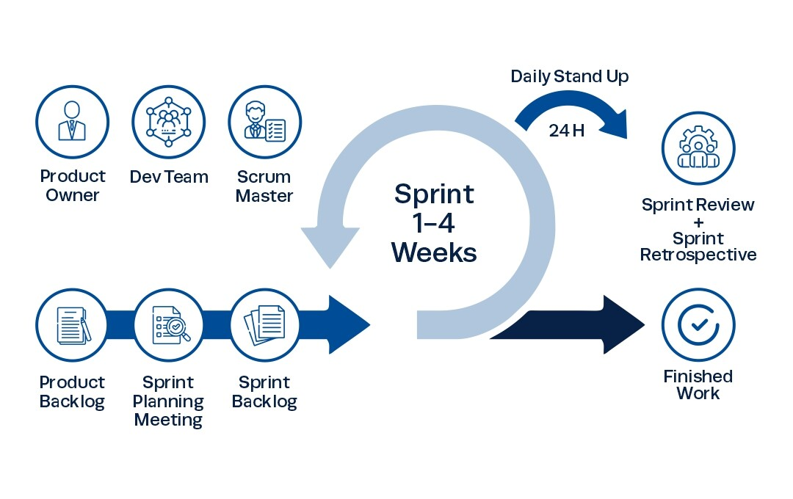
Scrum
Scrum is an empirical process, where decisions are based on observation, experience and experimentation. Scrum has three pillars: transparency, inspection and adaptation.
Scrum is based on an iterative and incremental approach, which means that development takes place in smaller, short cycles called sprints.

Slide 12
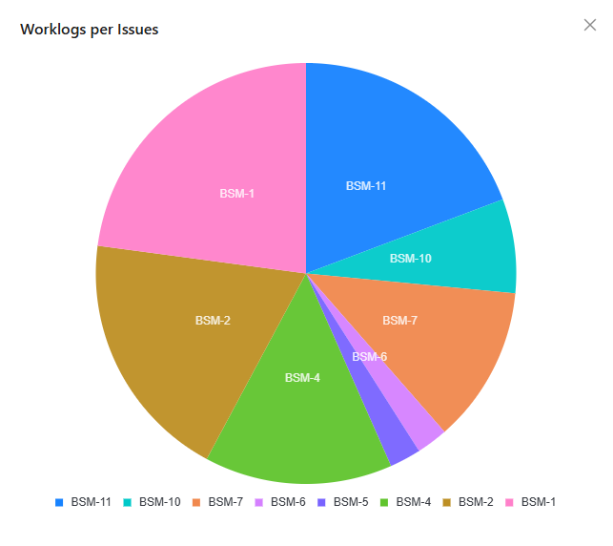
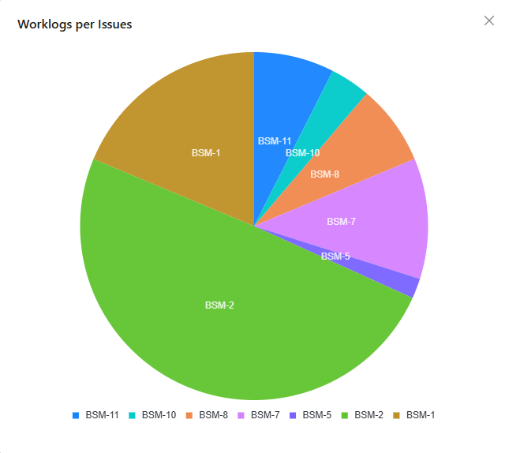
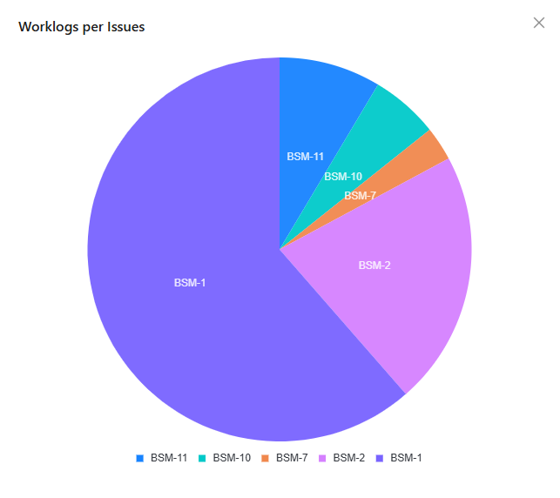
Jira
Jira was the website we used to keep track of our work, worktime, and to plan the parts of our network for the future
In Jira we made tasks, which were helpful in keeping track of the different things we put into the network

Slide 13
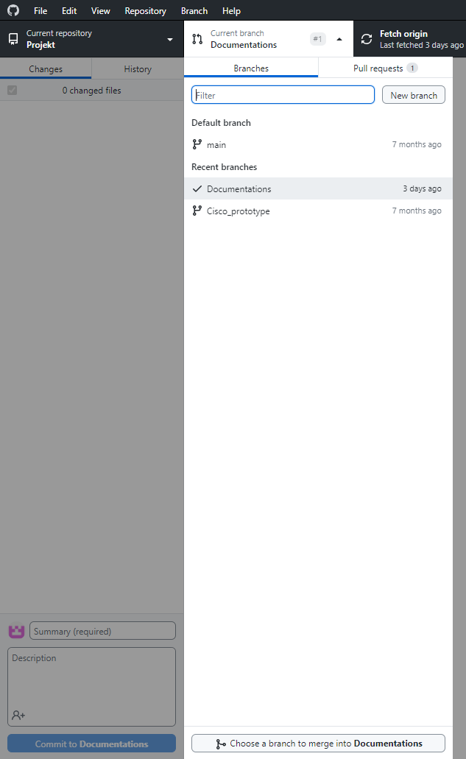
GIT
This is the software we used to upload different versions of our prototype
This was useful, because we could use any version of our project, and this meant that mistakes could be corrected much more efficently

Slide 14
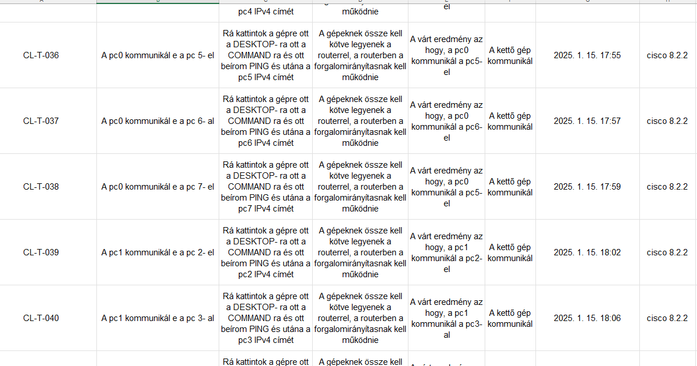
Testing
We used microsoft excel to keep track of our progress with the testing
We tested the devices in the network a little more than hundred times.

Slide 15
Our Future PLANS
Expanding the list of devices that has a IPV6 Address
If possible, expanding it with more devices
The integration of artificial intelligence into the network, which automatically detects and resolves performance issues.
The implementation of 5G and Wi-Fi 6E technologies for faster and more reliable wireless connections.

Slide 16
THANKS FOR your atteniton!!

