Slide 1
Going Serverless with Azure Functions
Milan Nankov

Slide 2





Milan Nankov
Co-founder at New Venture Software
/milannankov
/milannankov
newventuresoftware.com/blog
milan@newventuresoftware.com

Slide 3
Agenda
Evolution of the Cloud
Azure Functions
Demos
Q & A

Slide 4
Serverless

Slide 5
Evolution of the Cloud
On-Premises
IaaS
PaaS
Serverless
Application
Data
Infrastructure
OS
Updates
Networking
Storage
Application
Data
Infrastructure
OS
Updates
Application
Data
Infrastructure
Application
Data

Slide 6
“It is serverless because you think about servers less.”
Chris Anderson
Senior Program Manager

Slide 7
What is “serverless”
Abstraction of servers
Event-driven scale
Sub-second billing
source: https://techcommunity.microsoft.com/t5/Tech-Summit-All-Sessions/BRK2250-Build-serverless-applications-with-Azure-Functions/td-p/18249

Slide 8
Benefits of Serverless?
Focus on the Business
Faster time to market
Reduced DevOps
source: https://techcommunity.microsoft.com/t5/Tech-Summit-All-Sessions/BRK2250-Build-serverless-applications-with-Azure-Functions/td-p/18249

Slide 9
Building blocks of serverless
App Components
Messaging
Data
Loosely coupled, collaborating services
Components must communicate
Components use data

Slide 10
Monolith
Serverless
App 1
App 1

Slide 11
App Components
App 1

Slide 12
App Components
App 1
Messages Events

Slide 13
Messaging in Azure
Azure Storage Queue
Azure Service Bus Queues
Event Grid

Slide 14







Serverless application platform components
Platform
Event Grid
Logic Apps
Functions
Manage all events that can trigger code or logic
Design workflows and orchestrate processes
Execute your code based on events you specify
Database
Storage
Security
IoT
Analytics
Intelligence

Slide 15
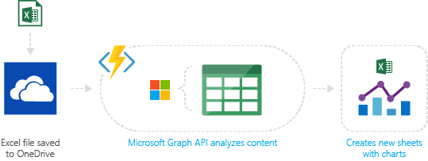
Timer-based processing
Real-time stream processing
Every 15 minutes
Find and clean invalid data
Clean table
Millions of devices feed into Stream Analytics
Transform to structured data
Store data in SQL DB
Backends (Mobile/IoT/Web)
Integrate external systems
...
Photo taken and WebHook called
Stores in blob storage
Produces scaled images
image source - https://azure.microsoft.com/en-us/services/functions/

Slide 16
Summary
Less infrastructure
Event-driven approach
Pay per use
Azure serverless platform

Slide 17
Azure Functions

Slide 18

Azure Functions
“Solution for easily running small pieces of code, or functions, in the cloud.”

Slide 19
Azure Functions
Features
Choice of language
Flexible development
Automatic scale based on demand
Pay-per-use pricing model
Built on Azure App Service
Open source

Slide 20
Azure Functions architecture
Code
Config
Language Runtime C#, Node.js, F#, PHP, etc.
WebJobs Script Runtime Azure Functions Host – Dynamic Compilation, Language abstractions, etc.
WebJobs Core
Programming model, common abstractions
WebJobs Extensions
Triggers, input and output bindings
App Service Dynamic Runtime Hosting, CI, Deployment Slots, Remote Debugging, etc.
source: https://techcommunity.microsoft.com/t5/Tech-Summit-All-Sessions/BRK2250-Build-serverless-applications-with-Azure-Functions/td-p/18249

Slide 21
Demo: First Azure Function

Slide 22
Output
Trigger
Input
public static async Task<HttpResponseMessage> Run(HttpRequestMessage req, TraceWriter log)
{
log.Info("C# HTTP trigger function processed a request.");
// parse query parameter
string name = req.GetQueryNameValuePairs()
.FirstOrDefault(q => string.Compare(q.Key, "name", true) == 0)
.Value;
// Get request body
dynamic data = await req.Content.ReadAsAsync<object>();
// Set name to query string or body data
name = name ?? data?.name;
return name == null
? req.CreateResponse(HttpStatusCode.BadRequest, "Please pass a value for 'name'")
: req.CreateResponse(HttpStatusCode.OK, "Hello " + name);
}
Output

Slide 23
Output
Trigger
Input
public static async Task<HttpResponseMessage> Run(HttpRequestMessage req, TraceWriter log)
{
}
{
"bindings": [
{
"authLevel": "anonymous",
"name": "req",
"type": "httpTrigger",
"direction": "in"
},
{
"name": "$return",
"type": "http",
"direction": "out"
}
],
"disabled": false
}

Slide 24
Trigger
module.exports = function (context, req) {
context.log('JavaScript HTTP trigger function processed a request.');
if (req.query.name || (req.body && req.body.name)) {
context.res = {
// status: 200, /* Defaults to 200 */
body: "Hello " + (req.query.name || req.body.name)
};
}
else {
context.res = {
status: 400,
body: "Please pass a name on the query string or in the request body"
};
}
context.done();
};
Output

Slide 25
Trigger
module.exports = function (context, req) {
context.log('JavaScript HTTP trigger function processed a request.');
context.res = {
status: 200,
body: “Thank you for using our function."
};
}
context.done();
};
Output

Slide 26
Trigger
module.exports = function (context, req) {
context.log('JavaScript HTTP trigger function processed a request.');
context.res = {
status: 200,
body: “Thank you for using our function."
};
}
context.done();
};
{
"bindings": [
{
"authLevel": "function",
"type": "httpTrigger",
"direction": "in",
"name": "req"
},
{
"type": "http",
"direction": "out",
"name": "res"
}
],
"disabled": false
}
Output

Slide 27
Bindings & Triggers

Slide 28
Triggers
Define how a function is invoked
One trigger per function
Triggers have associated data

Slide 29
Bindings
Declarative way to connect to data
Bindings are optional
Multiple bindings per function

Slide 30
Type | Service | Trigger | Input | Output
Schedule | Azure Functions | ✔
HTTP (REST or webhook) | Azure Functions | ✔ |  | ✔
Blob Storage | Azure Storage | ✔ | ✔ | ✔
Events | Azure Event Hubs | ✔ |  | ✔
Queues | Azure Storage | ✔ |  | ✔
Queues and topics | Azure Service Bus | ✔ |  | ✔
Storage tables | Azure Storage |  | ✔ | ✔
SQL tables | Azure Mobile Apps |  | ✔ | ✔
NoSQL DB | Azure Cosmos DB | ✔ | ✔ | ✔
Push Notifications | Azure Notification Hubs |  |  | ✔
Twilio SMS Text | Twilio |  |  | ✔
SendGrid email | SendGrid |  |  | ✔
Excel tables | Microsoft Graph |  | ✔ | ✔
OneDrive files | Microsoft Graph |  | ✔ | ✔
Outlook email | Microsoft Graph |  |  | ✔
Microsoft Graph events | Microsoft Graph | ✔ | ✔ | ✔
Auth tokens | Microsoft Graph |  | ✔

Slide 31
Demo: Conference Management System

Slide 32
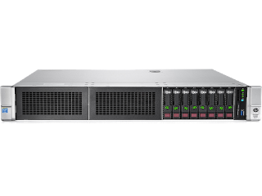
Conference Management System
web app reporting

Slide 33
Conference Management System
Reporting
web app

Slide 34
Summary
Conference Management System
Reporting
web app
Independent
Auto-scale
JavaScript
Not affected by reporting
C#

Slide 35
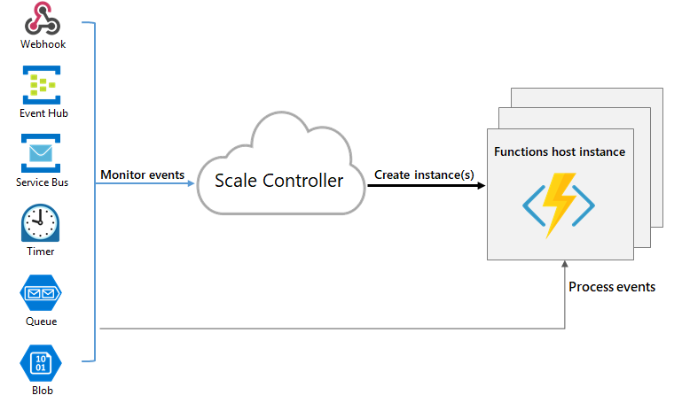
Scaling
https://docs.microsoft.com/en-us/azure/azure-functions/functions-scale

Slide 36

Billing Model

Slide 37
Per second resource consumption
X
Number of executions
https://azure.microsoft.com/en-us/pricing/details/functions/

Slide 38
3 million executions for 1 second with 512 MB memory consumption = $17.60

Slide 39
DEMO: Logic Apps

Slide 40
Tooling

Slide 41
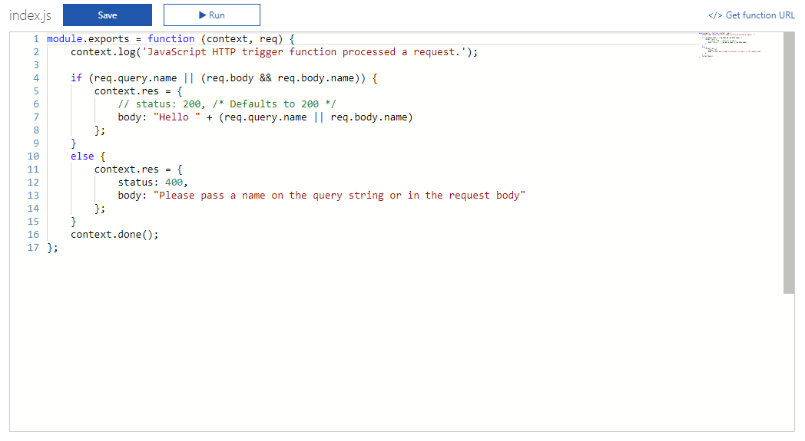

Slide 42
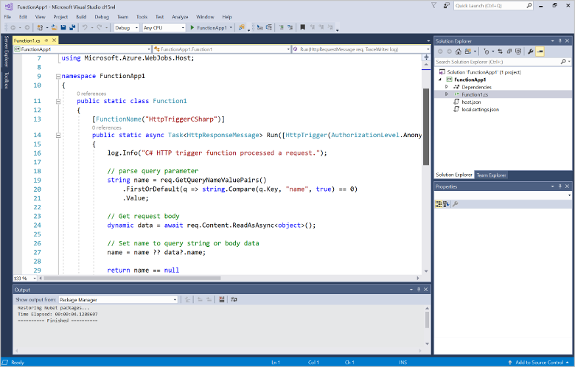

Slide 43
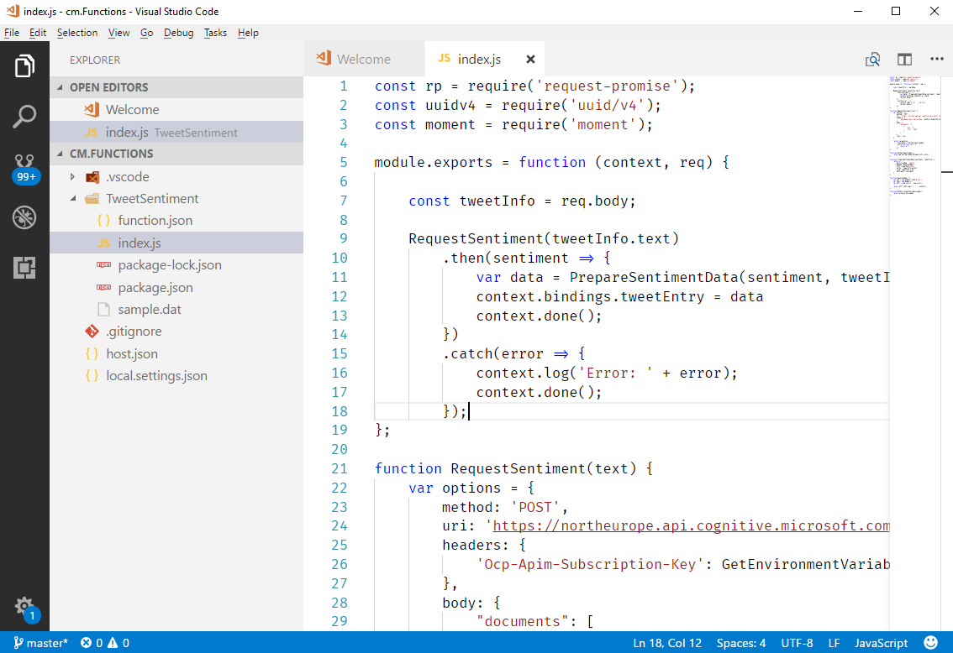

Slide 44
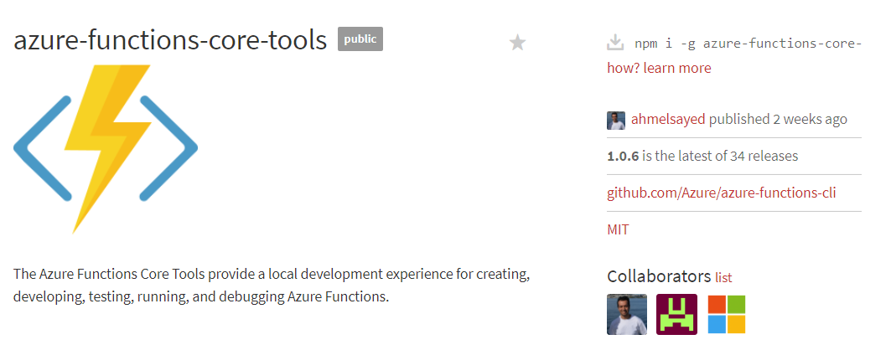
https://www.npmjs.com/package/azure-functions-core-tools
https://docs.microsoft.com/en-us/azure/azure-functions/functions-run-local

Slide 45
Get started and reach out!
Try Functions – https://functions.azure.com/try
Try App Service – https://tryappservice.azure.com

Slide 46

https://www.facebook.com/AzureUserGroupBulgaria/

Slide 47
Thank you!

Slide 48
Questions?

