Slide 1
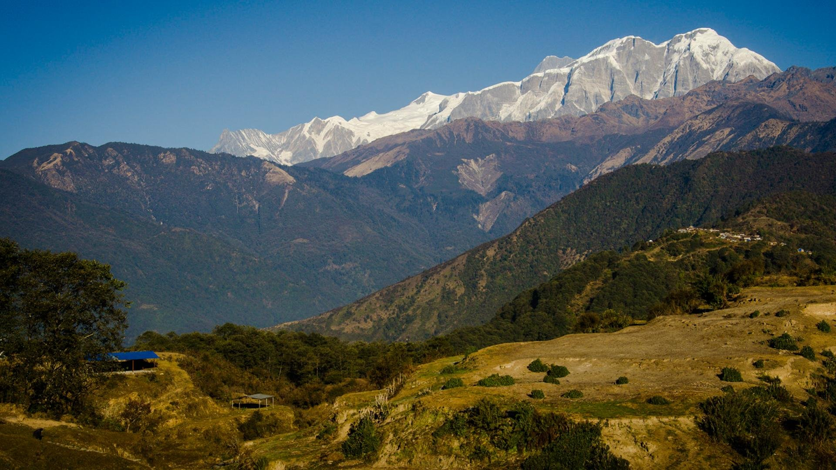


Retreat or Revitalize?
The Unsettled Futures of Agropastoralism in Lamjung, Nepal
Gurung herders, high pastures and the choices ahead
Milan Shrestha, PhD
School of Sustainability, Arizona State University
Scan to open the deck
milanshrestha.net/research/agropastoralism
Notes:
Welcome. Today we look at agropastoralism — farming combined with herding — among Gurung (Tamu) communities in Lamjung, central Nepal. The question in the title is real and unresolved: will mobile herding retreat, or can it be revitalized as a climate adaptation? We will end with two class exercises.

Slide 2






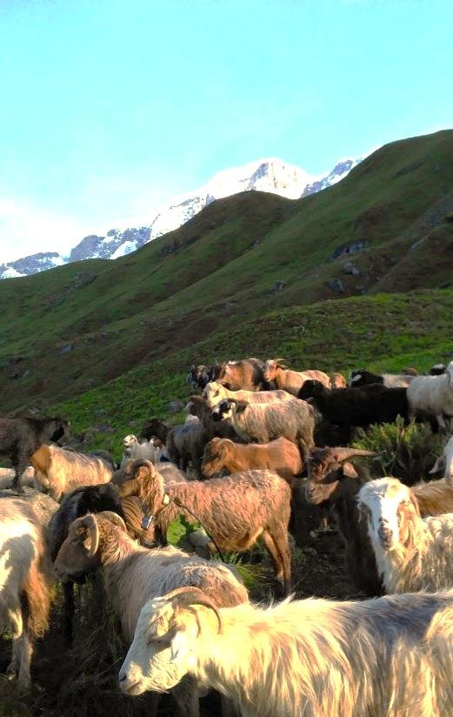





Big ideas for today
Uncertainty is a harsh reality in mountains. Systems thinking helps us frame the social, ecological and technical systems of mountain agriculture in a climate-challenged world.
Decline of transhumance
Markets, schooling and out-migration are pulling labour away from farming and herding (Aryal et al. 2014; Childs et al. 2014).
Seeking climate resilience
Agropastoralism can be an adaptation in marginal lands, spreading risk across altitudes and seasons (FAO 2013; IPCC 2014).
Food security and sovereignty
Who grows, herds and decides what mountain households eat, and on whose terms?
Notes:
Three threads run through the lecture: transhumance (seasonal movement of herds) is declining; yet it may be exactly the kind of flexible, risk-spreading practice that helps mountain people adapt to climate change; and underneath both is the question of food security and food sovereignty.

Slide 3


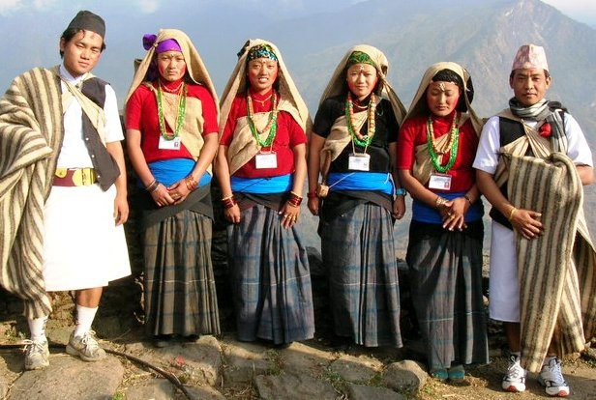




Who are the Gurungs (Tamu)?
People and language
Homeland
Gurung is the Nepali name; the people call themselves Tamu. Their language, Tamu Kyi, is Tibeto-Burman.
The southern slopes of the Annapurna and Lamjung Himal, especially Lamjung and Kaski districts. In Lamjung, about 28% of residents speak Gurung as a first language (2021 census).
Ritual life
Livelihoods
A blend of Bon, Buddhist and Hindu practice. Pachyu and ghyabri (klehpri) priests guide souls and recite pye (oral texts); lamas lead Buddhist rites.
Terraced farming plus sheep, goats and cattle on high pastures; Gurkha service since 1816; and today remittances and tourism.
Gurung (Tamu) men and women in traditional dress
Notes:
Key points: 'Gurung' is an exonym; 'Tamu' is the self-name. Tamu Kyi belongs to the Tibeto-Burman family. Heartland is Lamjung and Kaski on the south side of the Annapurna/Lamjung Himal. Lamjung district: 2021 census shows ~28% speak Gurung as mother tongue. Religion blends Bon (pachyu, ghyabri/klehpri shamanic priests) with Buddhism (lamas) and Hinduism. Main festival: Tamu Lhosar (15 Poush, late December). Military service in British/Indian Gurkha regiments since the Treaty of Sugauli (1816) shaped the economy; today remittances and tourism matter a great deal. Sources: Wikipedia 'Gurung people' and 'Lamjung District' (accessed Nov 2026); Pignède 1993; Macfarlane & Gurung 1990.

Slide 4

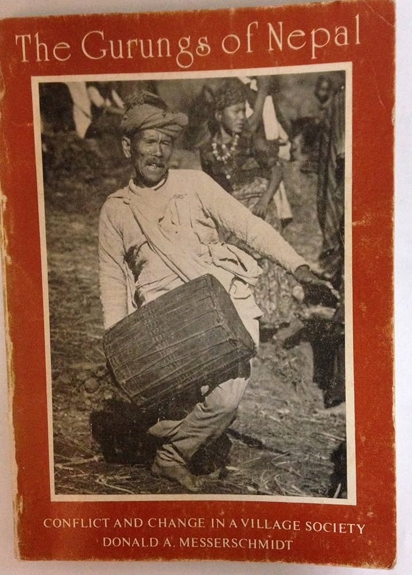
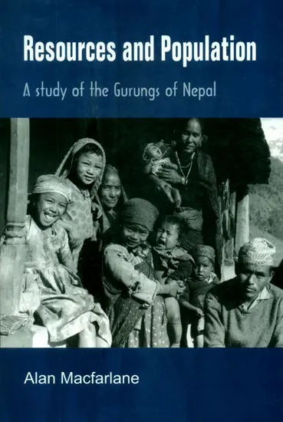
Anthropologists who studied the Gurungs
Bernard Pignède
Don Messerschmidt
Alan Macfarlane
1932–1961 · French
American · fieldwork early 1970s
b. 1941 · Cambridge
Seven months in Mohoriya (Kaski), 1958
Gurung villages of Lamjung District
Thak village, north of Pokhara, from 1968
First full ethnography of the Gurungs: clans, kinship, the rodhi, village politics and ritual. He died at 29; Louis Dumont saw the book into print.
Looked at conflict, change and ecology: how Gurung villages adapted pastoral and farming practice as forests, trade and politics changed. First anthropologist to visit Kohla, the ancestral Tamu site (1972).
Studied how population growth pressed on land, forest and labour. He has returned to Thak almost every year since 1986, so the work is a rare long-term record of change.
Les Gurungs (Mouton, 1966); English ed. The Gurungs (1993), trans. & ed. Macfarlane and Harrison
The Gurungs of Nepal: Conflict and Change in a Village Society (1976); Human Ecology 4: 167–185 (1976)
Resources and Population (Cambridge UP, 1976); A Guide to the Gurungs (with Indra Bahadur Gurung, 1990)
Gurung voices too: Tamu scholars and the Tamu Pye Lhu Sangh now co-produce this history, e.g. the Kohla Project (Pettigrew & Tamu 1999). Who gets to tell the story of a people?
Notes:
Spellings: Bernard Pignède (not 'Pingede'); Alan Macfarlane (not 'McFarlane'). Pignède (1932–1961) spent seven months in 1958 in Mohoriya, Kaski; his thesis was published posthumously in 1966 (ed. Louis Dumont) and translated into English in 1993 by Sarah Harrison and Alan Macfarlane (Ratna Pustak Bhandar, Kathmandu). Messerschmidt worked in Lamjung in the early 1970s; his 1976 Human Ecology article 'Ecological change and adaptation among the Gurungs of the Nepal Himalaya' is directly relevant to today's topic; he also wrote on Gurung shamanism in Lamjung (in Hitchcock & Jones, eds., Spirit Possession in the Nepal Himalayas, 1976). Macfarlane arrived in Thak in December 1968 and stayed 15 months; Resources and Population (1976) asks whether population growth was outrunning resources. Discussion prompt: what does it mean that the classic accounts are by outsiders, and how have Gurung organisations such as the Tamu Pye Lhu Sangh reshaped that?

Slide 5

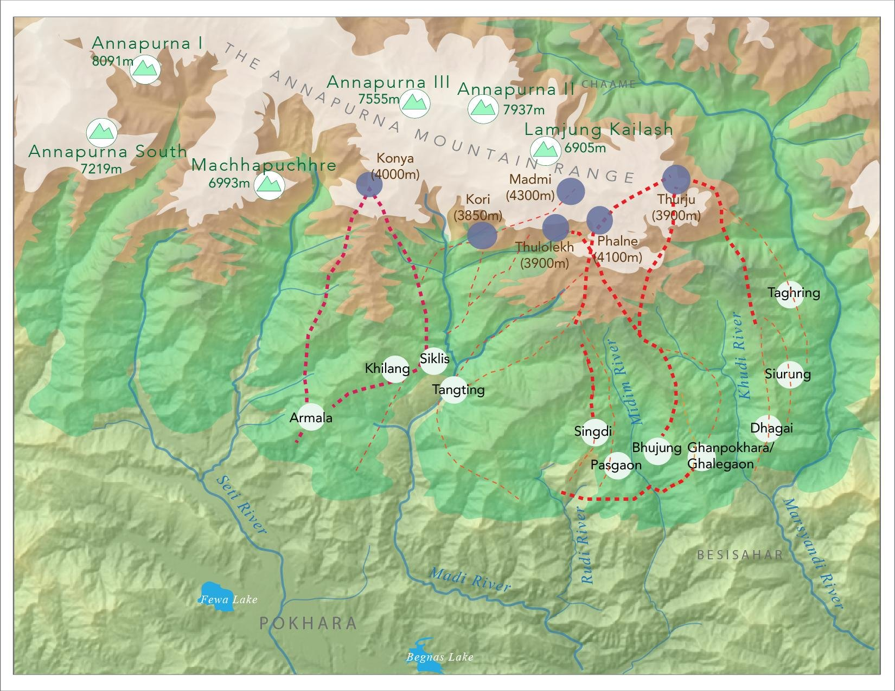
The upper Madi river basin
1
Two villages, one basin
Bhujung (Lamjung) and Siklis (Kaski) send flocks up the Madi valley toward Lamjung Himal.
2
Migration tracks
Red dotted lines trace herders' routes between village, forest and alpine camps (goth), up to about 3,900 m.
3
Vertical zones
Terraced fields, mid-hill forest and alpine meadows are linked by the moving flock.
4
Ecosystem services
Regulating services, wildlife corridors and biodiversity all depend on how pastures are used.
5
Food security in mountains
a) Adaptation to extreme environments
b) Diversification of livelihood & risks
c) Prioritizing stability in food systems
Notes:
Map from the project's PlanetScope imagery (3.7 m resolution). Bhujung lies in Lamjung; Siklis lies just across the district line in Kaski; both use the upper Madi basin below Lamjung Himal and Annapurna IV/II. Camp sites (goth) are marked along the tracks. Ask students: what would change for the ecosystem if no flocks came up anymore?

Slide 6
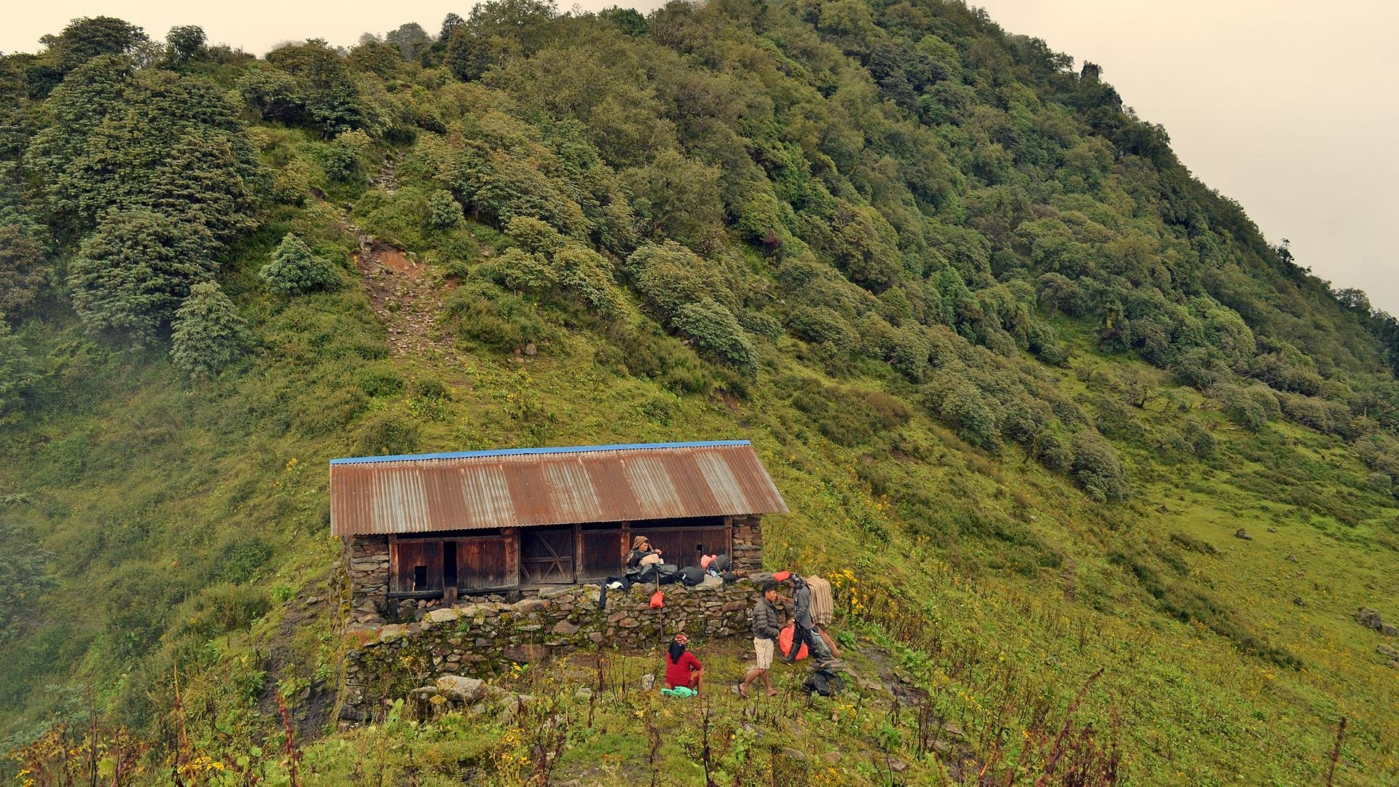




Agropastoralism as adaptation
Meadows
Meat
Alpine grass that crops cannot use becomes food.
Sheep and goats sold for Dashain and local feasts.
A herders' camp (goth) on the way to the high pastures
Milk
Manure
Animals supplement crops across a vertical landscape:
Milk, ghee and cheese from cattle and buffalo.
Flocks folded on terraces fertilise the next crop.
verticality and production zones, interdependence norms, opportunistic seasonal migration and robust rules in use.
Notes:
The 'four Ms': meadows, meat, milk and manure. The key idea is complementarity: herding turns land unsuitable for crops into food and fertiliser, and it spreads risk across altitudes and seasons. That flexibility is why researchers (FAO 2013; IPCC 2014) describe agropastoralism as an adaptation in marginal lands.

Slide 7
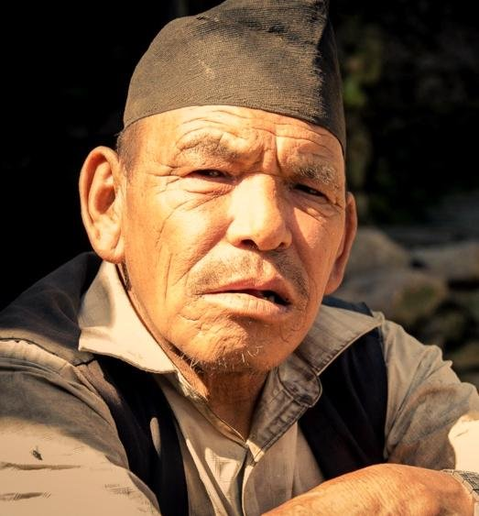
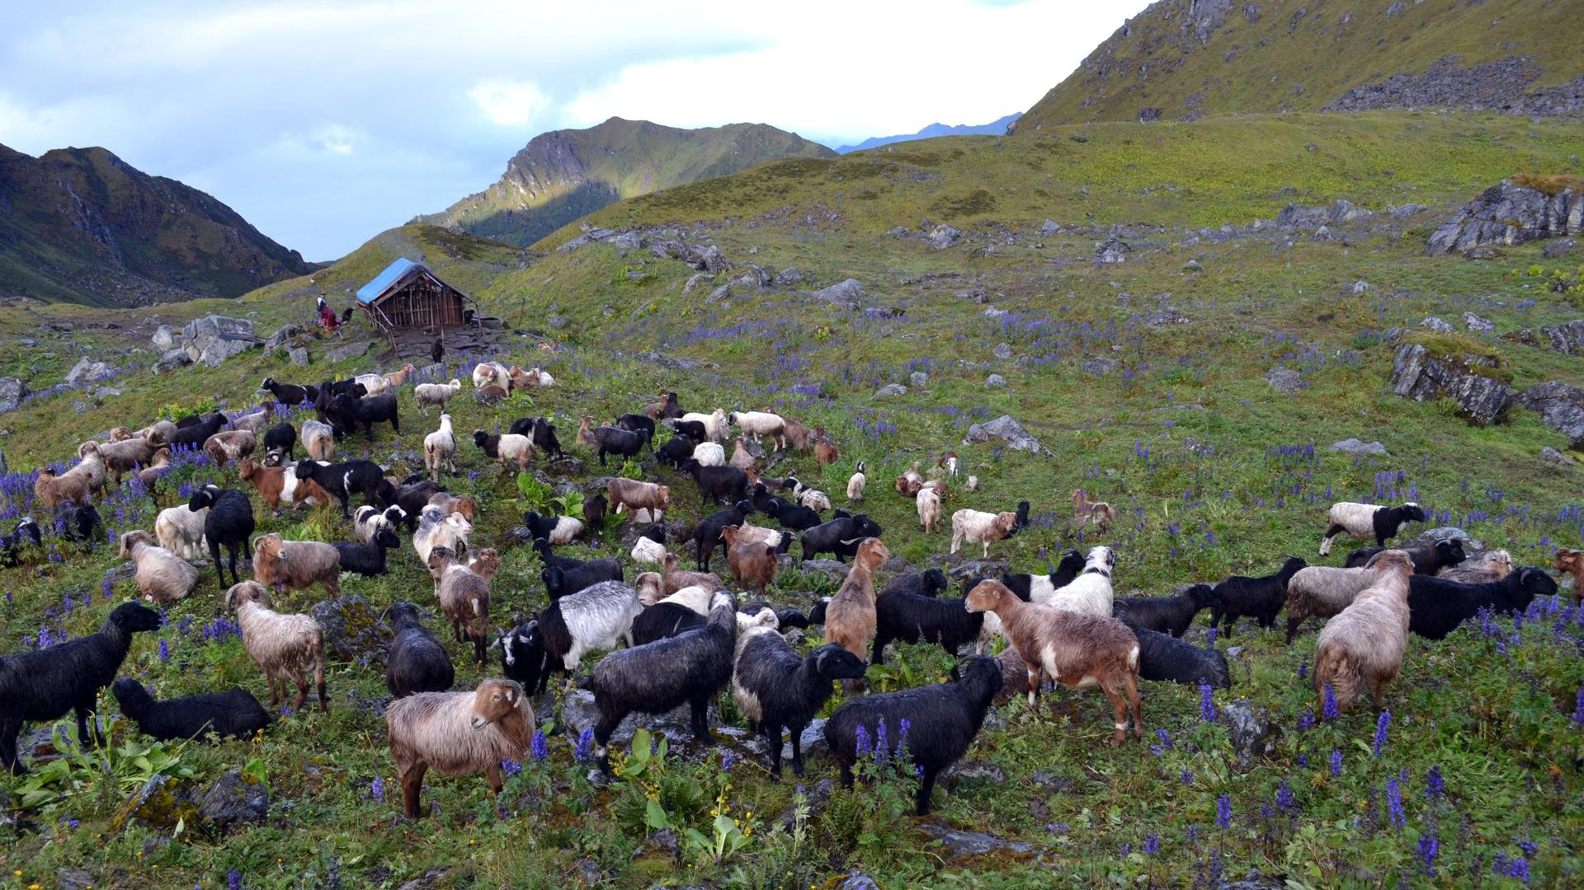

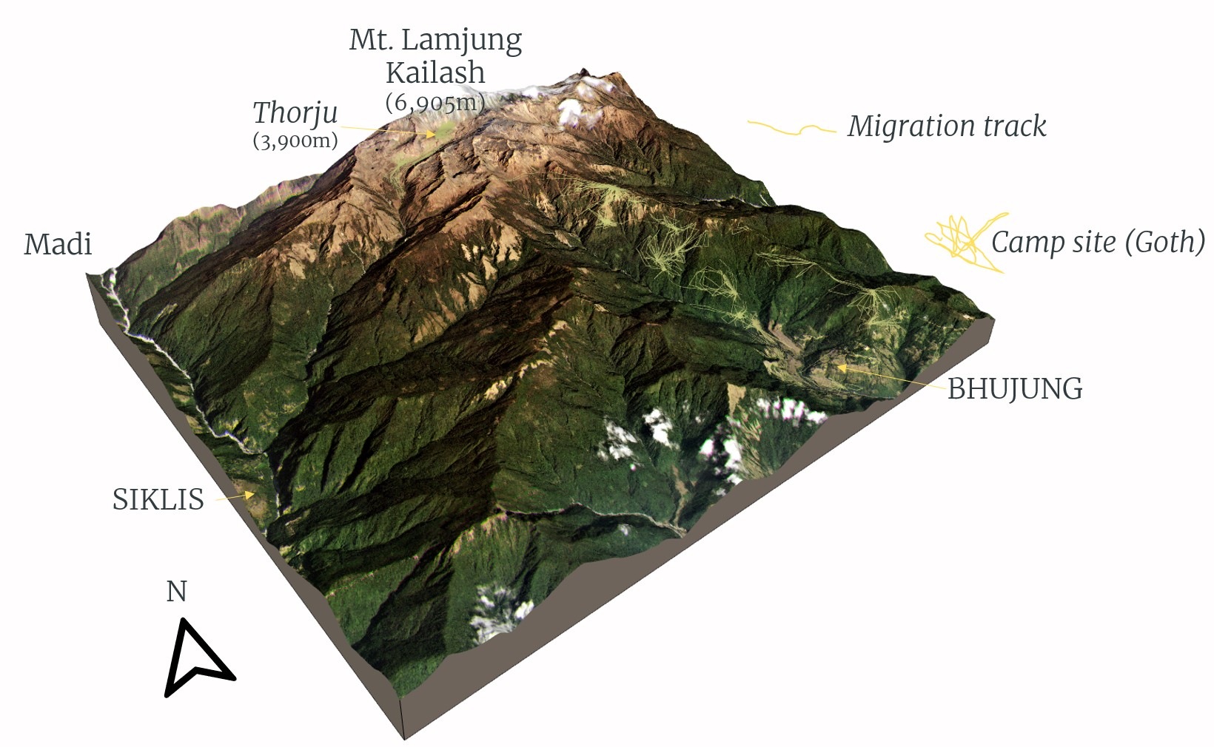
A year on the move
Spring
Mar–May
Flocks climb through forest camps as snow melts; fields are ploughed and planted below.
Monsoon
Jun–Aug
Highest alpine pastures (kharka) at about 3,500–4,000 m, away from growing crops.
Khamba Gurung, herder
Flock on an alpine meadow
Autumn
Sep–Nov
Flocks descend; animals are sold for the Dashain festival.
Winter
Dec–Feb
Lower forests and fallow terraces; flocks are folded on fields, leaving manure.
GPS collars track the flocks
Migration tracks and goths
General pattern only; timing varies by flock, village and year.
Notes:
Transhumance = regular seasonal movement of herds between altitudes. This is a generalised cycle for sheep and goat flocks in the Madi basin; specific dates and altitudes vary. Ask: which step depends on the most labour? (Answer: all of them — which is why youth migration bites so hard.)

Slide 8
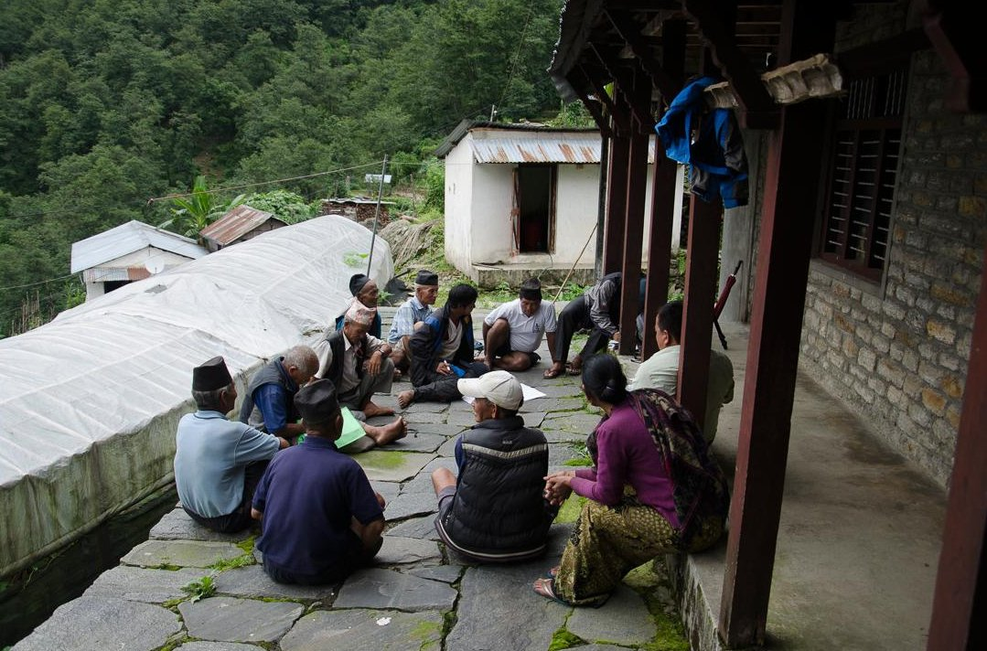
Governance of transhumance
1
STAKEHOLDERS
Coproduction
Municipality, shepherds, government agencies, ACAP, youth groups and mothers' groups share decisions.
2
MAINTAINING DHARMA
Enforcing norms
Customary rules (thiti) carry moral weight that can match or exceed state law (riti).
Villagers and herders meet to set grazing rules
3
RULES IN USE
Formal rules
“Gurung thiti is equally powerful, if not more, than the Raja's riti.”
Boundaries, planning, monitoring, sanctions and conflict resolution.
Notes:
Three layers of institutions. Coproduction: many actors share governance, including the Annapurna Conservation Area Project (ACAP). Enforcing norms: Gurung customary law (thiti) versus the state's law (riti) — the local saying captures how much legitimacy custom still holds. Formal rules: Ostrom-style design principles — boundaries, monitoring, graduated sanctions, conflict resolution.

Slide 9

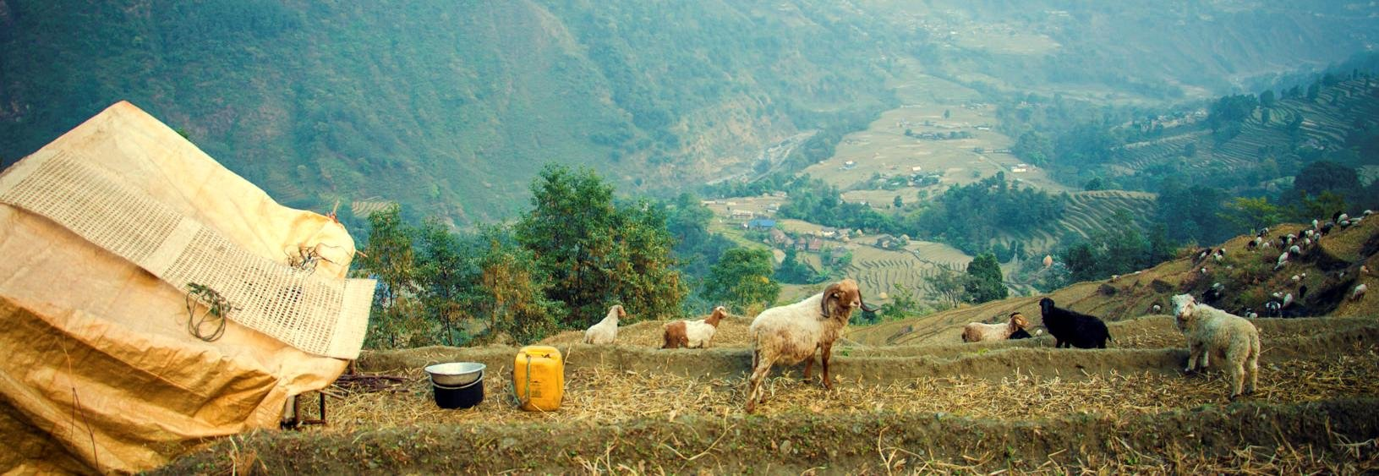


What is unsettling the system?
Market economy
Institutions
Migration
The global economy has made small-scale farming look impractical
Growing pull toward off-farm jobs
Customary grazing rights abolished or weakened
New bodies (VDCs, ACAP) with their own rules
Rules in use depend on norms and trust
First waves of labour migration in the 1960s–80s
Youth migration abroad today
Labour shortages for herding and farming
Notes:
Three intertwined drivers. Note the order of causation is debated: does migration cause the decline of herding, or does unprofitable herding push people to migrate? Childs et al. (2014) describe a similar depopulation in ethnically Tibetan villages of Nepal driven by education and out-migration.

Slide 10





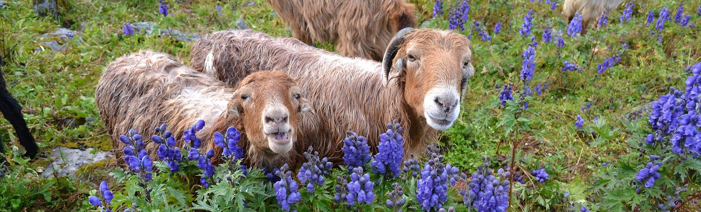





Challenges ahead
Adaptive practices
Local economy and livelihood
Climate change
Retreat or revitalize? Who will continue herding?
Agricultural change, labour shortage, tourism and remittances.
Extreme events, droughts and declining access to water.
Ethnoecological knowledge and institutional analysis are key to understanding risk perceptions and adaptive measures.
Notes:
Pause here and ask the class: which of the three challenges is hardest to solve from inside the village?

Slide 11
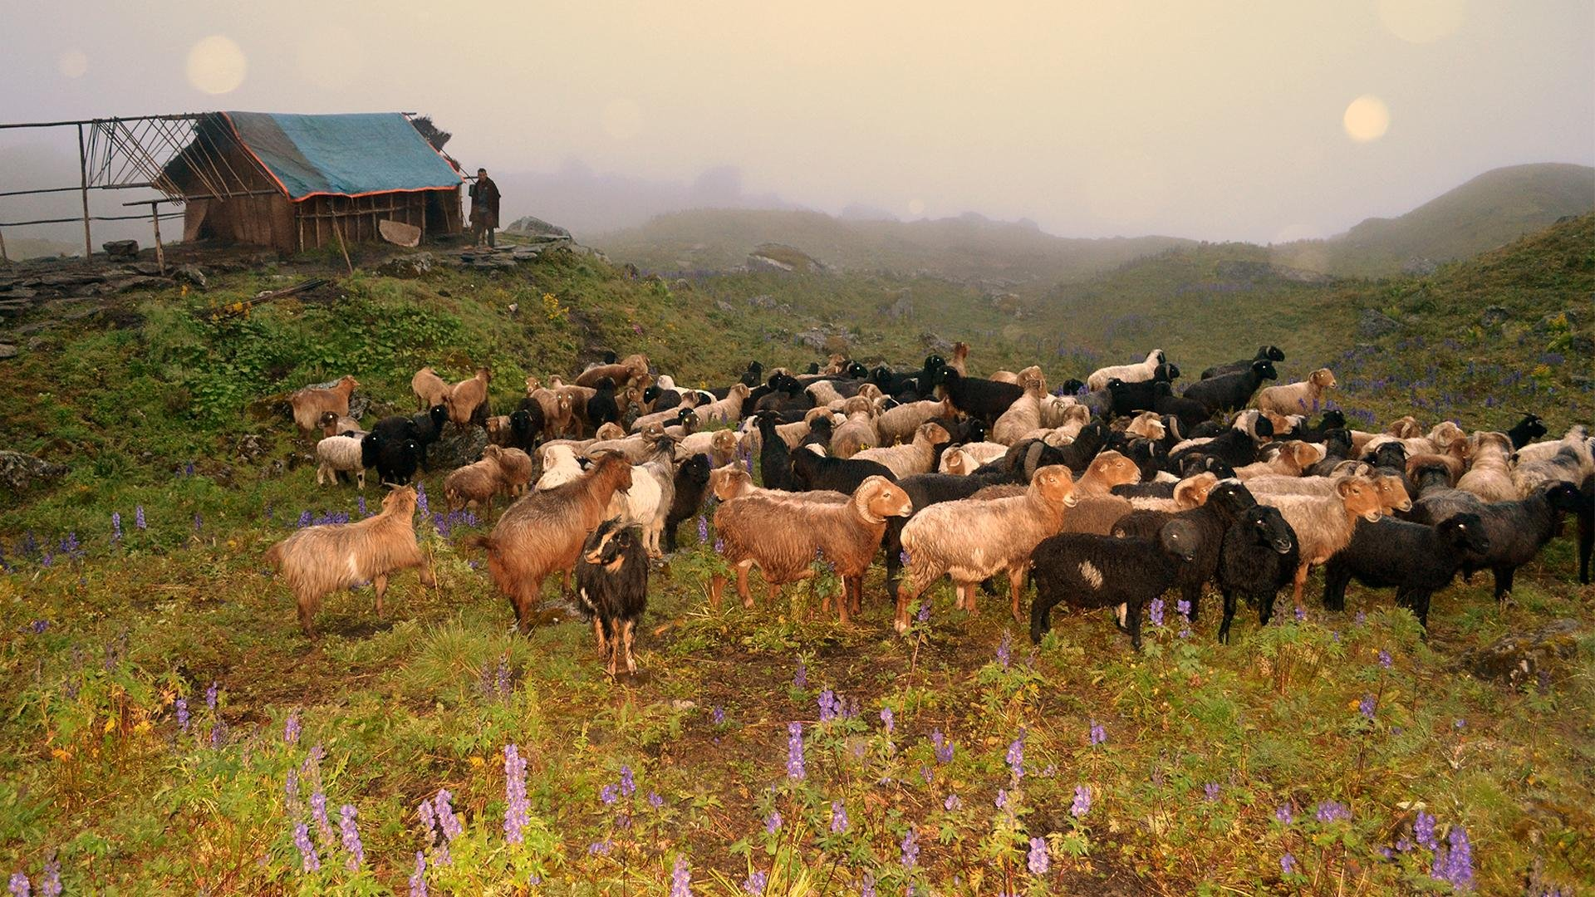





How herders adapt: five strategies
Mobility
Move animals across space to where grass and water are.
Storage
Hold fodder, grain and seed across time.
Diversification
Spread income and assets across many activities.
Communal pooling
Share labour, animals and risk across households.
Exchange
Trade with markets and other villages to fill gaps.
Adapted from Agrawal (2008). Each works through adaptive learning: reactive real-time adjustments, anticipatory adjustments, scheduling and opportunistic extraction.
Notes:
Agrawal's (2008) World Bank paper classifies local adaptation into mobility, storage, diversification, communal pooling and market exchange, and stresses that local institutions make each one work. This framework sets up Exercise 1.

Slide 12

Exercise 1 · Sort the strategy
In pairs, match each practice to one of the five strategies. Be ready to defend any card you think fits two. (10 min)
A
B
C
D
Herders move to a higher goth earlier after a dry spring
Families dry and stack maize stalks and leaf fodder for winter
A household opens a trekkers' homestay but keeps a small flock
Several families combine their sheep under one hired shepherd
E
F
G
H
Herders sell wool and animals, then buy rice and salt in Besisahar
Grain is kept in the household granary as a buffer for a bad year
Shepherds share one camp and take turns guarding against leopards
A son's remittances from the Gulf pay for a hired herder
Mobility
Storage
Diversification
Communal pooling
Exchange
Notes:
ANSWER KEY. A Mobility. B Storage. C Diversification. D Communal pooling. E Exchange (market). F Storage. G Communal pooling. H Diversification (income), though students may argue Exchange or that it actually replaces family labour — a good debate about whether remittances sustain or hollow out herding. Debrief: which strategies need the most labour, and which are weakened by out-migration? (Mobility and pooling.) Which are strengthened by markets and remittances? (Exchange, diversification.) The interactive HTML version scores this automatically.

Slide 13


Kwholasothar Rural Municipality 2030
Exercise 2 · A role-play experiment. Groups of five: three household heads, one Tiyale and one village leader. Read only your own role, then negotiate a grazing pact for the next ten years.
How the experiment runs
Household head A
Household head B
Household head C
1
Read your role (3 min). Keep your pressures to yourself.
Largest mixed herd: 6 cattle, 40 sheep. Terraces far from the village.
Wants the flock folded on your fields for more nights; manure is your fertiliser.
Small herd: 2 cattle, 15 sheep. Your son works in Kathmandu.
Short of labour; you want to pool animals and share the cost of herding.
4 cattle, 25 sheep. Fields beside the trail near the village.
Worried about overgrazing near home; you want a strict rotation so pastures recover.
2
Set the five drivers as you expect Kwholasothar in 2030 (5 min).
3
Negotiate the pact: rotation, manure, the Tiyale's pay, youth, culture (12 min).
Tiyale (shepherd)
Village leader
Manages everyone's flocks and herds through the year for grain, clothes, a share of lambs and a little cash.
The work is hard and lonely, and young people refuse it. Without better pay and a helper you may quit.
Champions Tamu cultural renewal: Lhosar, pye, pride in herding heritage.
Must also secure the village economy, keep benefits fair across households, and weigh the road, school and water projects.
4
Report your pact and who gained or gave up most.
Notes:
Setting: Kwholasothar Rural Municipality, Lamjung, in 2030. Print or read out one role per student; each sees only their own. Household heads keep cattle and sheep in the transhumant flock and want rotational grazing plus manure folding on their own terraces (who gets which nights is the core conflict between A, B and C). The Tiyale is the hired shepherd who moves with the animals and is paid in grain, clothes, a share of lambs and some cash; the work is hard and young people avoid it, so their threat to quit is real. The village leader balances Tamu cultural renewal against economic security, fairness between households, and other development priorities. Then move to the next slide to set the drivers and record the pact.

Slide 14
Negotiate the grazing pact
Five drivers in 2030 (circle one level each)
What did your pact agree? Rank 1 to 5
1 = top priority; leave unranked if not agreed
Youth out-migration
to Besisahar, Pokhara, Kathmandu, London and cities abroad
Low
Med
High
−
Rotational grazing calendar
Blocks rest in turn so pastures recover
1
2
3
4
5
Climate stress
drought, extreme rain, shrinking water sources
Low
Med
High
−
Manure folding shared fairly
Every household gets folding nights on its terraces
1
2
3
4
5
Market and tourism demand
local meat, wool, cheese, homestays
Low
Med
High
+
Better pay for the Tiyale
More grain, cash or lambs, set by the group
1
2
3
4
5
Institutional support
municipality, ACAP, cooperatives, customary rights
Low
Med
High
+
A young helper for the Tiyale
Apprentice paid by the households or ward
1
2
3
4
5
Renewed cultural identity
Tamu Lhosar, pye, pride in herding heritage
Herding honoured in cultural life
e.g. herders recognised at Tamu Lhosar
1
2
3
4
5
Low
Med
High
+
Retreat
Hybrid
Revitalize
Flocks sold off, high pastures abandoned. The Tiyale quits and herding knowledge leaves with the elders.
A smaller flock survives under one hard-pressed Tiyale. Some terraces get manure, others go without.
Rotation restores pastures, manure is shared, the Tiyale has fair pay and a helper, herding is part of Tamu identity.
Scoring. Low 0, Med 1, High 2. Add the + drivers, subtract the − drivers, add 1 per ranked pact item. ≤ −1 Retreat · 0 to 3 Hybrid · 4 or more Revitalize.
Notes:
Groups set each driver Low/Medium/High (or use the sliders and checkboxes in the HTML deck, which score live). Score = market + institutional support + cultural identity − out-migration − climate stress, plus 1 for each pact item the group ranks (unranked = not agreed). Groups circle 1 to 5 to show priority, 1 = top. ≤ −1 → Retreat; 0 to 3 → Hybrid; 4 or more → Revitalize. Debrief: Compare groups' number 1 priorities: did households put manure first while the Tiyale and leader put pay and a helper first? Who gave up most to keep the Tiyale? Did the three household heads agree a fair manure rotation, or did the largest herd win? Can the village leader fund the Tiyale's pay and a young helper while also meeting road, school and water demands? Which drivers can Kwholasothar control, and which are set in Besisahar, Pokhara, Kathmandu, London or the atmosphere? Can renewed Tamu identity make herding work young people want?

Slide 15
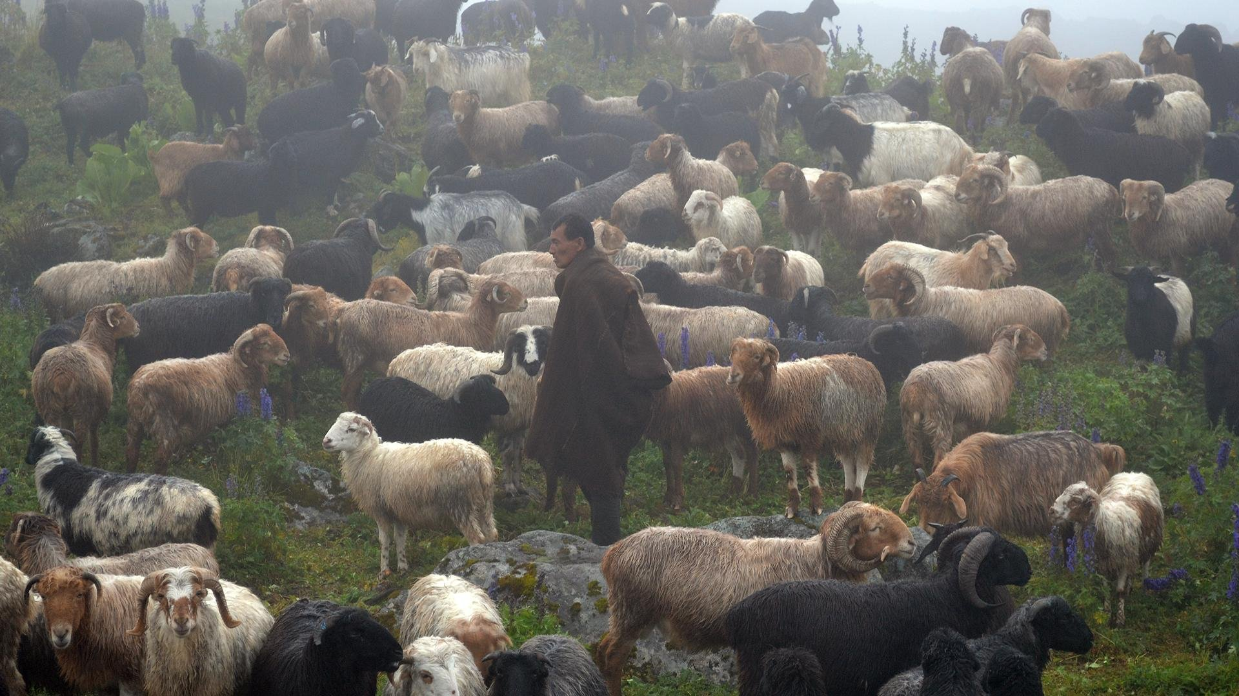

Retreat or revitalize?
1
Who should decide the future of the high pastures: herders, the municipality, ACAP, or the youth who left?
2
Pignède, Messerschmidt and Macfarlane each saw a different 'problem'. Which lens fits Lamjung in 2026?
3
If herding retreats, what is lost that a market price would never show?
Notes:
Closing discussion. Use a think-pair-share: one minute alone, two in pairs, then a few groups report out.

Slide 16

References
Agrawal, A. (2008). The Role of Local Institutions in Adaptation to Climate Change. Washington, DC: World Bank.
Aryal, S., Maraseni, T. N., & Cockfield, G. (2014). Sustainability of transhumance grazing systems under socio-economic threats in Langtang, Nepal. Journal of Mountain Science, 11(4), 1023–1034.
Childs, G., Craig, S., Beall, C. M., & Basnyat, B. (2014). Depopulating the Himalayan highlands: Education and outmigration from ethnically Tibetan communities of Nepal. Mountain Research and Development, 34(2), 85–94.
Macfarlane, A. (1976). Resources and Population: A Study of the Gurungs of Nepal. Cambridge: Cambridge University Press.
Macfarlane, A., & Gurung, I. B. (1990). Gurungs of Nepal: A Guide to the Gurungs. Kathmandu: Ratna Pustak Bhandar.
Messerschmidt, D. A. (1976a). The Gurungs of Nepal: Conflict and Change in a Village Society. Warminster: Aris & Phillips.
Messerschmidt, D. A. (1976b). Ecological change and adaptation among the Gurungs of the Nepal Himalaya. Human Ecology, 4(2), 167–185.
Pettigrew, J., & Tamu, Y. (1999). The Kohla Project: Studying the past with the Tamu-mai. Studies in Nepali History and Society, 4, 327–364.
Pignède, B. (1966). Les Gurungs: Une population himalayenne du Népal. Paris: Mouton. English ed. (1993), The Gurungs, trans. S. Harrison & A. Macfarlane. Kathmandu: Ratna Pustak Bhandar.
Notes:
FAO (2013) and IPCC (2014) are cited on slide 2 as in the original talk. Census figure for Lamjung (27.7% Gurung mother tongue) is from the 2021 National Population and Housing Census, Nepal.

Slide 17
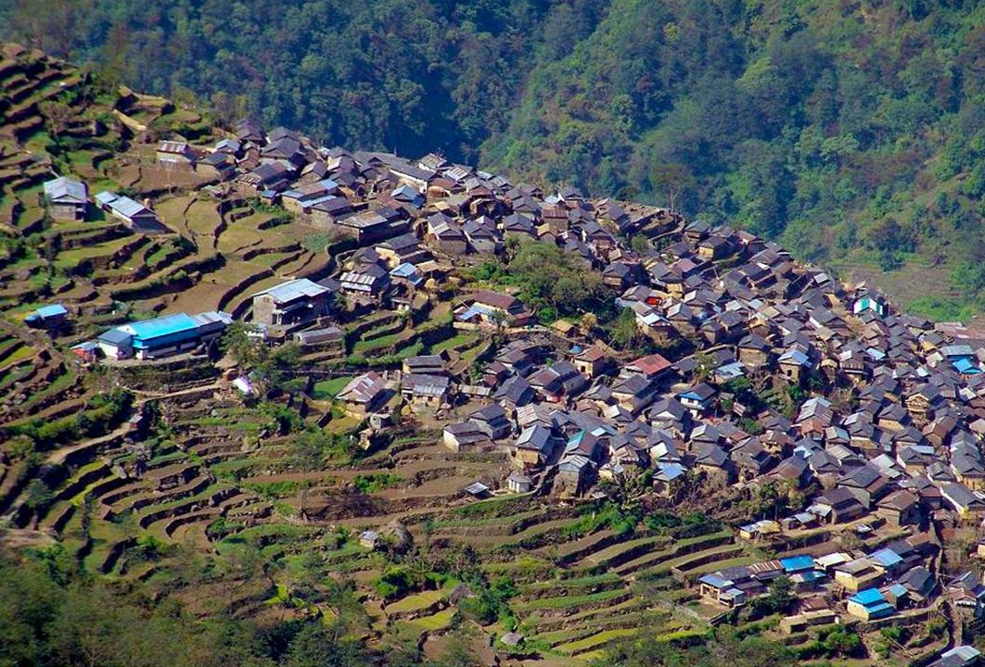
Acknowledgements
Feed the Future Innovation Lab for Collaborative Research on Adapting Livestock Systems to Climate Change, Colorado State University (Grant No. COEUS#12092246)
Dr. Netra Chhetri, Lead PI of APaCC; Dr. Pashupati Chaudhary, Bishnu Dhakal and other staff of LI-BIRD Nepal; Khamba Gurung, Lal B. Gurung, Prem J. Ghale, Kashi Jung Ghale and other villagers
The National Science Foundation's Dynamics of Coupled Natural and Human Systems program
Milan Shrestha, PhD
Teaching Professor, School of Sustainability, Arizona State University
milanshrestha@asu.edu · milanshrestha.com
Notes:
Thank the funders and especially the herders and villagers of the upper Madi basin.

