Slide 1
RCB Performance Analysis using SQL
--By Milan Thakral

Slide 2
Introduction
Indian Premier League (IPL) is a data-rich T20 tournament.
Royal Challengers Bangalore (RCB) has strong fanbase but no IPL title.
This project analyses RCB performance using SQL.

Slide 3
Project Objectives
Analyse RCB performance across seasons.
Identify strengths and weaknesses.
Understand home vs away dependency.
Provide data-driven strategic recommendations.

Slide 4
Data Overview
IPL relational database with match and ball-level data.
Key tables: Matches, Ball_by_Ball, Player, Team, Season, Venue, Wicket_Taken.
Normalized schema ensured clean analysis.

Slide 5
Methodology
SQL used for querying and analysis.
Joins, CTEs, CASE statements, Window functions.
KPIs calculated for batting, bowling, and team performance.
Visualized results using charts.

Slide 6
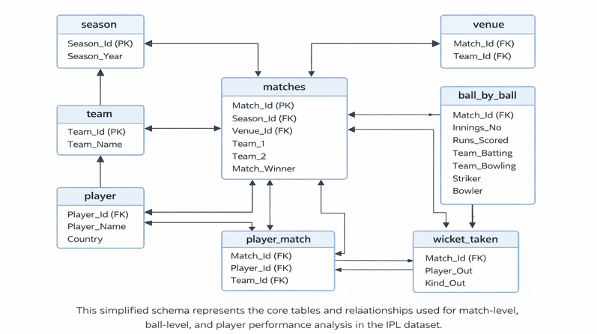
Database Schema Overview

Slide 7
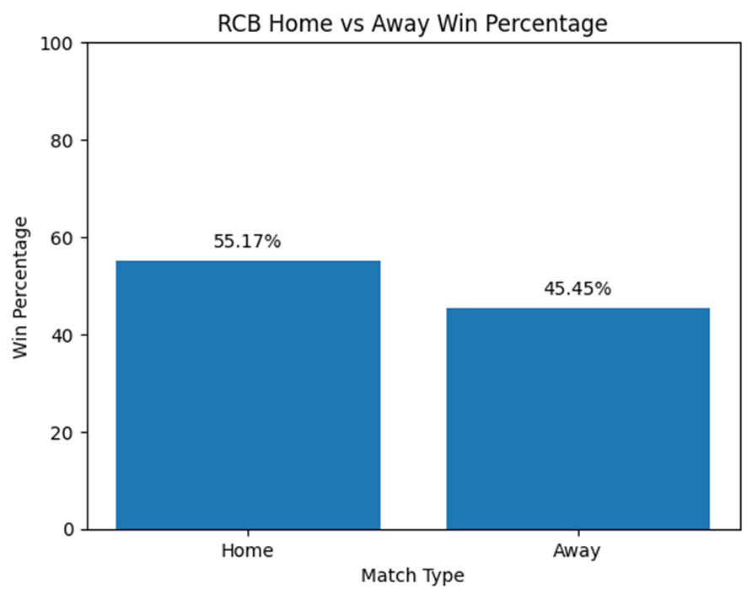
RCB Home vs Away Performance
Home Win Percentage: 55.17%.
Away Win Percentage: 45.45%.
RCB performs significantly better at home venue.

Slide 8
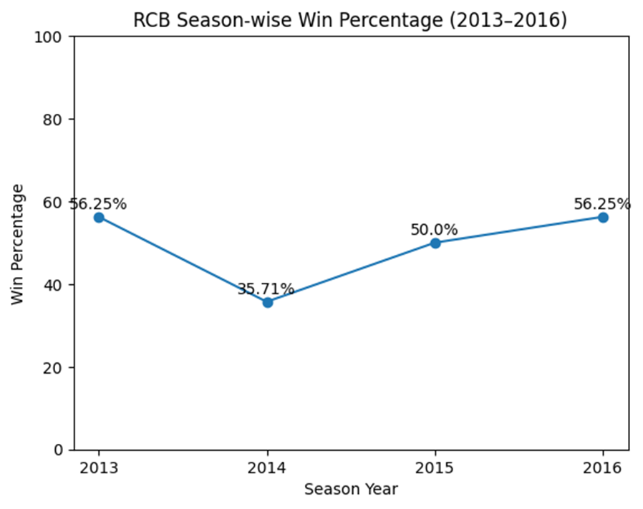
Season-wise Performance Trend
RCB performance fluctuates across seasons.
Sharp dip observed in 2014.
Lack of consistency affects title chances.

Slide 9
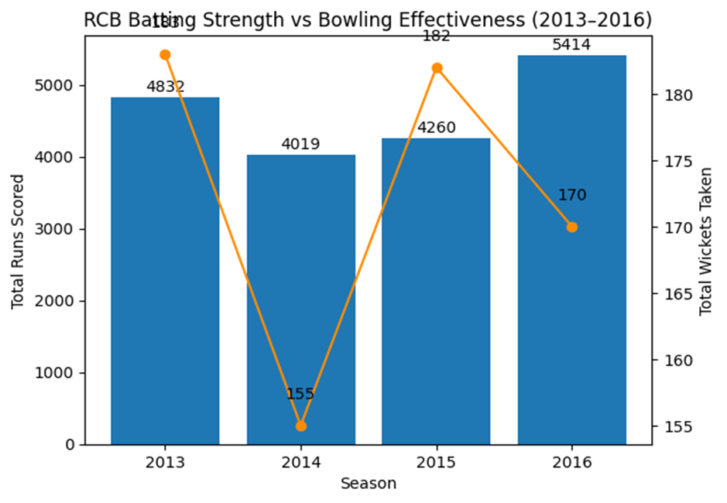
Batting vs Bowling Imbalance
RCB consistently scores high runs.
Wickets taken do not scale with runs.
Bowling weakness impacts knockout matches.

Slide 10
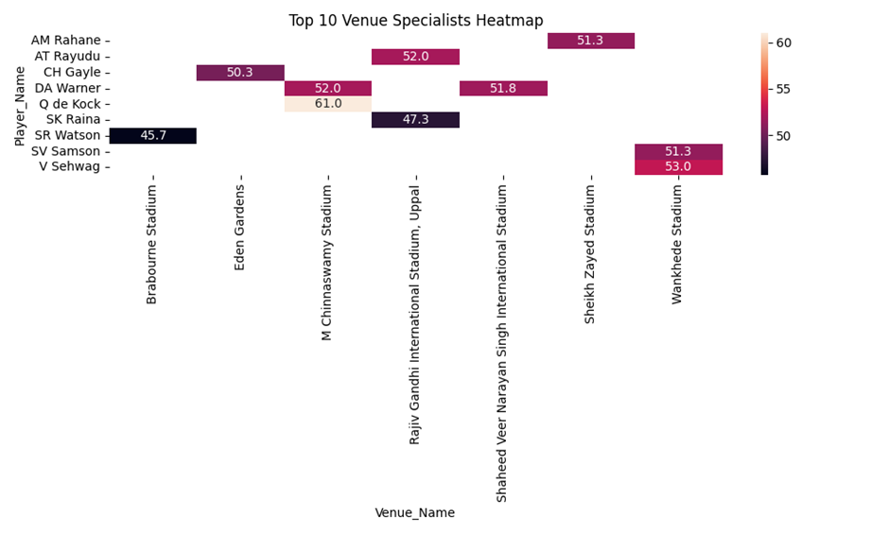
Venue-wise Player Performance
Certain players perform better at specific venues.
Heatmap analysis identifies venue specialists.
Strategy can be optimized using this insight.

Slide 11
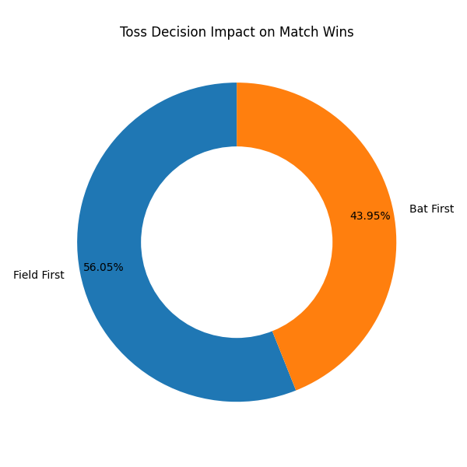
Impact of Toss Decision
Teams fielding first win more matches.
Toss impact varies by venue.
Strategic toss decisions are crucial.

Slide 12
Key Problems Identified
Inconsistent season performance.
Weak bowling attack.
Over-reliance on few star batters.
Poor away match adaptability.

Slide 13
RCB Mega Auction Strategy
Invest in wicket-taking bowlers.
Add reliable middle-order batters.
Prioritize all-rounders.
Strengthen domestic core.

Slide 14
Expected Impact
Improved bowling balance.
Better away match results.
Higher playoff and title chances.

Slide 15
Conclusion
RCB has strong batting but structural weaknesses.
Data-driven insights highlight gaps clearly.
Balanced squad and strategy can lead to success.

