Slide 1

AEROLYTICS: The Pilot's Weather Co-Pilot
Team members:
Milan Tony AKSHAY R VASIST
Dhruv SRIJIT SYED SHOBAN IMAM

Slide 2

The Problem
Flight Planning is Drowning in Complex Data
Pilots face significant challenges when planning flights:
Information Overload: Meteorological data (METAR, TAF, SIGMET) is often cryptic, dense, and scattered across multiple sources.
Time-Consuming Analysis: Manually interpreting raw weather reports to assess risk for a specific route is slow and prone to error.
Lack of Actionable Insight: Standard reports tell you what the weather is, not what it means for your flight.
The result? Increased workload, potential for misinterpretation, and added stress during critical flight planning.

Slide 3

Our Solution
Introducing Aerolytics 🛩️
A comprehensive aviation weather intelligence platform that transforms complex meteorological data into simple, actionable insights.
Aerolytics aggregates, analyzes, and presents real-time weather information from official aviation sources, enhanced with a powerful AI assistant to simplify decision-making.
From raw data to flight-ready intelligence in seconds.

Slide 4
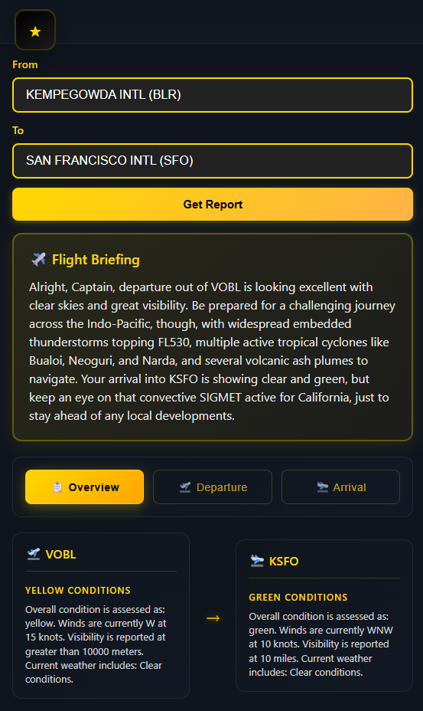
Core Features: Real-Time & Comprehensive Data
Aerolytics integrates multiple critical data streams to provide a complete picture of flight conditions:
• METAR Reports: Current, real-time weather observations, intelligently parsed.
• TAF Forecasts: Terminal aerodrome forecasts for up to 30 hours ahead.
• SIGMET Alerts: Official warnings for significant meteorological events.
• PIREP Integration: Real-world conditions reported by other pilots.
• Multi-Airport Support: Seamlessly use ICAO (KLAX) or IATA (LAX) codes.

Slide 5
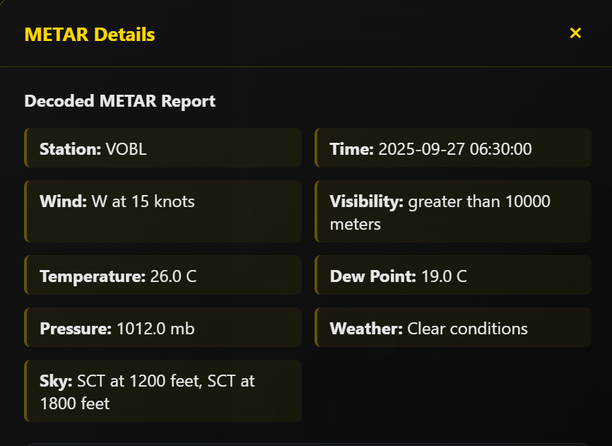
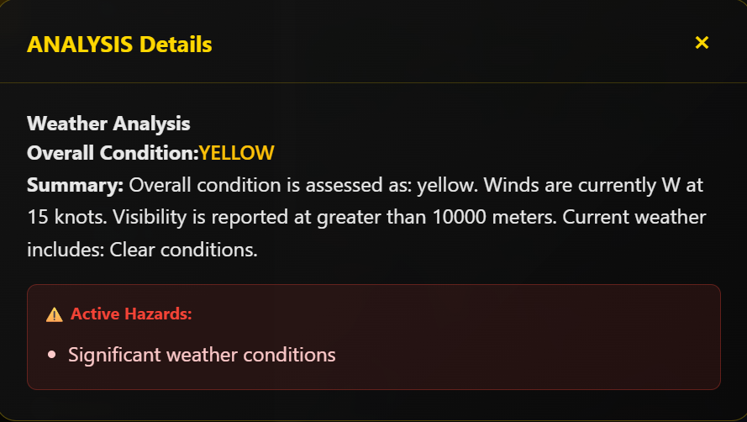
Core Features: Intelligent Risk Analysis
Our system doesn't just show you data; it analyzes it for you with a sophisticated 3-tier risk assessment system.
🟢 GREEN (Favorable): Wind < 15 knots, Visibility > 5 miles, no significant weather.
🟡 YELLOW (Caution): Moderate wind (15-25 kts), reduced visibility, or light precipitation.
🔴 RED (Severe): High wind (> 25 kts), low visibility (< 3 miles), or hazardous conditions like thunderstorms.
Instantly understand the weather risk for your entire route, from departure to arrival.

Slide 6
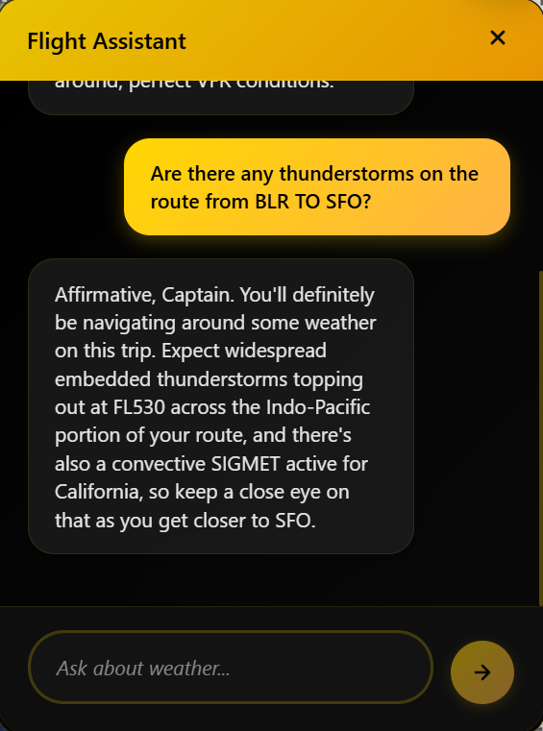
The AI Co-Pilot
Your Personal Weather Assistant, powered by Gemini. Ask complex weather questions in plain English and get instant, context-aware answers.
• Natural Language Queries: Instead of parsing codes, just ask: "What's the weather like at LAX?" or "Are there any thunderstorms on the route from JFK to ORD?"
• Context-Aware Responses: The AI understands aviation weather and maintains conversation history for relevant follow-up questions.
• Reduces Cognitive Load: Get the exact information you need without sifting through reports.

Slide 7

Interactive Visualization
See Your Route, See the Weather 🌍 Aerolytics brings data to life with an intuitive and interactive map interface.
• Visual Route Planning: Plot your departure and arrival airports on a dynamic map.
• Weather Overlays: Visualize significant weather events (SIGMETs, severe conditions) directly on your flight path.
• Intelligent Airport Search: Quickly find any of the major airports worldwide.
• Responsive Design: Plan your flight on desktop or on the go with your mobile device.

Slide 8

The Technology Stack
Backend:
• FastAPI (Python): For a high-performance, modern API.
• Google Generative AI: Powers the Gemini 2.5 Flash chat assistant.
• Python-METAR & NumPy: For reliable weather data parsing and analysis.
Frontend:
• React 18.2+: For a fast, modern, and interactive user interface.
• Google Maps API: To deliver the interactive mapping experience.
• Axios: For seamless communication with the backend API.
Data Sources:
• AviationWeather.gov (FAA/NOAA): The official source for reliable, real-time weather data.

Slide 9
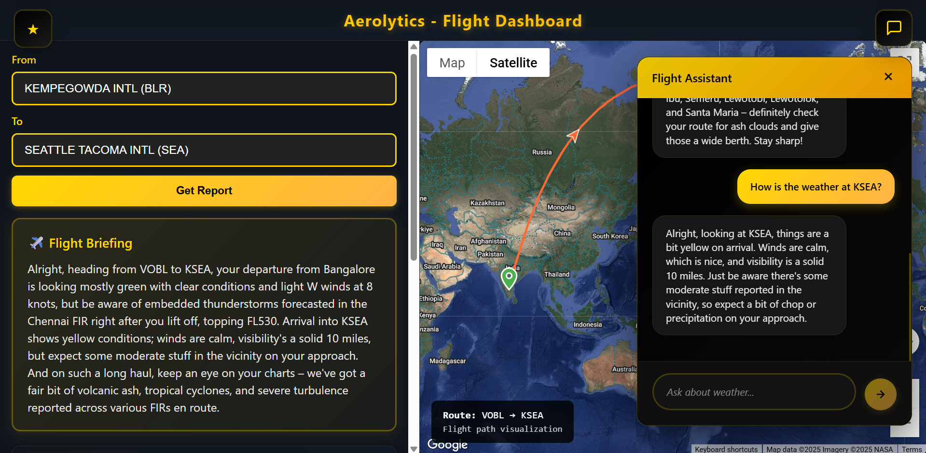
Dashboard

Slide 10
THANK YOU!
GitHub: https://github.com/milantony05/aerolytics.git

