Slide 1
Political Bias Transfer in LLM-Generated Training Data
Milan Varghese (mv644@drexel.edu) · DSCI 690 · Spring 2026

Slide 2
Research Questions
Why this matters?
LLMs are increasingly used for synthetic training data when labels are scarce
Wagner et al. (ICLR 2025) demonstrated synthetic data improves stance detection on X-Stance (German policy). They flagged bias propagation as a concern but did not measure it.
This work tests propagation: generator → synthetic data → classifier predictions
RQ1: Does training on LLM-synthetic tweets shift classifier predictions on real tweets?
RQ2: Does the shift hold across classifier architectures?
RQ3: How to fix this Bias Shift?

Slide 3
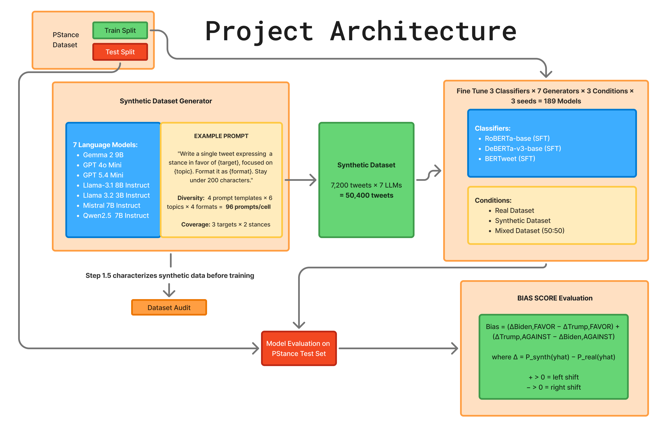

Slide 4
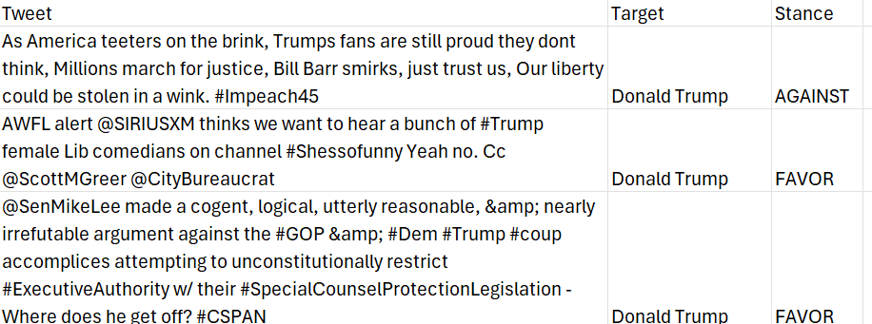
Real data: P-Stance
21,574 real tweets
3 targets: Trump / Biden / Sanders
Binary stance: Favor / Against
80/10/10: train/val/test stratified per target
Krippendorff alpha of 0.81 (3 random Annotator Agreement)
Mild Imbalance in dataset
Target | Train | Val | Test | %FAVOR (train)
Trump | 6,362 | 814 | 777 | 46%
Biden | 5,806 | 745 | 745 | 44%
Bernie | 5,056 | 634 | 635 | 56%
Target | Train | Val | Test
Bernie Sanders | 56.5% | 55.2% | 54.0%
Donald Trump | 46.2% | 45.9% | 45.3%
Joe Biden | 44.0% | 44.0% | 45.2%

Slide 5
Synthetic dataset 7 generators × 7,200 tweets each = 50,400 total
Provider | Model | Alignment regime
OpenAI | gpt-4o-mini | Heavy RLHF (practitioner default)
OpenAI | gpt-5.4-mini | Heavy RLHF (newer generation)
Mistral AI | Mistral-7B-v0.3 | Lighter alignment (Wagner et al. 2025 réplications)
Google | Gemma-2-9B | Heavy RLHF (different family)
Alibaba | Qwen-2.5-7B | Different RLHF philosophy
Meta | Llama-3.1-8B | Open RLHF
Meta | Llama-3.2-3B | Open RLHF (size scaling)
Generation method:
Neutral, label-only prompts: no political framing
4×6×4 prompt grid = 96 unique prompts per (target, stance)
Diversity from surface scaffolding (templates × topics × formats), not content steering

Slide 6
Synthetic Dataset Sample
Tweet | Target | Stance | model | prompt_idx | seed | refused
I've been impressed by Trump's bold leadership and strong stance on the economy. His policies created jobs and boosted our pride as a nation. We need that kind of energy back in office! #MAGA | Donald Trump | FAVOR | gpt-4o-mini-2024-07-18 | 0 | 42 | FALSE
How can anyone support a leader who prioritizes tax cuts for the rich while neglecting healthcare and education for our children? Is this really the future we want? #NotMyPresident #ChooseWisely | Donald Trump | AGAINST | gpt-4o-mini-2024-07-18 | 149 | 100191 | FALSE
Isn’t it time we rally behind a leader like Biden who actually cares about unity and progress? Can we really afford to go back to divisive politics? #Biden2024 #PrimaryRace | Joe Biden | FAVOR | gpt-4o-mini-2024-07-18 | 737 | 200779 | FALSE
How can we trust Joe Biden to lead when he keeps dodging questions about the economy? Isnâ€™t it time for a president who actually addresses the issues? #BidenFailure #Accountability | Joe Biden | AGAINST | gpt-4o-mini-2024-07-18 | 158 | 300200 | FALSE
Isn't it time we prioritize universal healthcare for all? Bernie Sanders has the vision to make it a reality. Why should anyone in this country go without basic medical care? #FeelTheBern | Bernie Sanders | FAVOR | gpt-4o-mini-2024-07-18 | 534 | 400576 | FALSE
Bernieâ€™s campaign trail is just a rerun of old promises; he needs to come up with fresh ideas instead of recycling the same slogans. #NotImpressed | Bernie Sanders | AGAINST | gpt-4o-mini-2024-07-18 | 899 | 500941 | FALSE

Slide 7
Synthetic Dataset Audit
Generator | char_len | n_hashtags | distinct_2 (Higher = Vocab Diversity) | Self-BLEU (lower = more diverse) | mean_cos (higher = closer to real distribution) | FAVOR↑ asym (writes more templated)
Real (ref) | 170 | 1.9 | — | — | — | —
gpt-4o-mini | 172 | 1.67 | 0.21 | 0.39 | 0.67 | +31%
gpt-5.4-mini | 125 | 0.17 | 0.26 | 0.28 | 0.62 | +31%
mistral-7b | 144 | 1.53 | 0.38 | 0.19 | 0.66 | +34%
gemma-2-9b | 91 | 0.72 | 0.33 | 0.26 | 0.65 | +50%
qwen-2.5-7b | 105 | 0.90 | 0.37 | 0.26 | 0.64 | +3%
llama-3.1-8b | 112 | 0.23 | 0.41 | 0.13 | 0.62 | +20%
llama-3.2-3b | 120 | 0.38 | 0.44 | 0.11 | 0.62 | +22%
Open-weight models are more diverse than closed APIs.
GPT-5.4-mini is more out-of-distribution than GPT-4o-mini

Slide 8
Training & Eval
Conditions:
Synthetic
Real Dataset
Mixed Dataset
Evaluation:
Macro F1 Score Disagreements between synthetic and Real Classifier
Classifier | Hub ID | Params | FT method
RoBERTa-base | FacebookAI/roberta-base | 125M | Full fine-tuning
DeBERTa-v3-base | microsoft/deberta-v3-base | 184M | Full fine-tuning
BERTweet | vinai/bertweet-base | 134M | Full fine-tuning
Llama-3-8B | meta-llama/Meta-Llama-3-8B | 8B | LoRA (r=16)
Condition | LR | Weight decay | Max epochs
Real | 2e-5 | 0.01 | 5
Synth | 1e-5 | 0.10 | 3
Mixed | 2e-5 | 0.05 | 4

Slide 9

Results:
overall F1 + Bias Score Trump Vs Biden:
Classifier | Real F1 | Synth F1 | Mixed F1 | Synth−Real | Bias Score (full / balanced) | Bias (mixed)
RoBERTa-base (125M, full FT) | 0.822 | 0.704 | 0.811 | −11.8 pp | +0.280 / +0.297 | +0.050
DeBERTa-v3-base (184M, full FT) | 0.847 | 0.717 | 0.836 | −13.0 pp | +0.166 / +0.195 | −0.003
BERTweet (134M, full FT, tweet-pretrained) | 0.817 | 0.704 | 0.804 | −11.3 pp | +0.068 / +0.098 | −0.049
Per-target macro-F1: RoBERTa | DeBERTa-v3 | BERTweet:
Quick Summary
Bias Scores +ve
Trump's drop is 2.7× Biden's; Bernie's is 1.7× Biden’s
Mixed Dataset eliminates Bias
Tweet-pretrained BERTweet shows lowest bias
Target | Real | Synth | Mixed | Synth ΔF1 | Avg. ΔF1
Donald Trump | 0.845 / 0.875 / 0.844 | 0.664 / 0.685 / 0.674 | 0.829 / 0.862 / 0.823 | −18.1 / −19.0 / −17.0 pp | −18.0
Joe Biden | 0.835 / 0.854 / 0.820 | 0.765 / 0.786 / 0.760 | 0.822 / 0.850 / 0.814 | −7.0 / −6.8 / −6.0 pp | −6.6
Bernie Sanders | 0.774 / 0.800 / 0.777 | 0.672 / 0.672 / 0.671 | 0.769 / 0.782 / 0.760 | −10.2 / −12.8 / −10.6 pp | −11.2
pp = percentage points (absoute Δ)

Slide 10
Generator Political Profile
Heavy-RLHF commercial models lean anti-Trump; only llama-3.2-3b leans pro-Trump
llama-3.2-3b is the most architecturally consistent generator (0.738)
Generator | Mean BvT Bias | Lean
gpt-4o-mini | +0.178 | left
gemma-2-9b | +0.143 | left
gpt-5.4-mini | +0.129 | left
mistral-7b | +0.126 | left
qwen-2.5-7b | +0.029 | neutral
llama-3.1-8b | −0.072 | neutral
llama-3.2-3b | −0.147 | right

Slide 11
Z-Score Word Analysis: Where Each Generator's Vocabulary Diverges from Real Tweets
Two-proportion Z-test on document frequency (tweet-level binary) for FAVOR vs AGAINST per target
Same test on real P-Stance training tweets
Spearman ρ = rank-agreement between synthetic and real word associations. Lower ρ = more divergence.
Target | gpt-4o-mini (anti-Trump) | qwen-2.5-7b (neutral on BvT) | llama-3.2-3b (pro-Trump)
Trump | 0.258 ← lowest | 0.298 | 0.332
Biden | 0.355 | 0.313 | 0.317 ← lowest
Sanders | 0.44 | 0.362 ← lowest | 0.413

Slide 12
Three Distinct Bias Mechanisms
gpt-4o-mini (anti-Trump) | qwen-2.5-7b (neutral on BvT) | llama-3.2-3b (pro-Trump)
Scrubbed real MAGA vocab: buildthewall, deepstate, bestpresidentever, bluewave, demexit Injected sanitized terms: bold, chaos, commitment, brighter, progress Top sign-flip: wakeupamerica — real FAVOR (+3.51) → synth AGAINST (−8.49) | Pro-Sanders vocab inverted (synth AGAINST, real FAVOR): trust, campaign, policies, win, save, america, issues, i’m Invented hashtags absent from real: bernieforpresident, berniestrong, bidengaffe, bidenblunders Top sign-flip: trust (Sanders) — synth AGAINST (−6.81) → real FAVOR (+1.76) | Preserves MAGA concepts: wall, swamp, fake, news, outsider, unapologetic Pro-Biden vocab inverted (synth AGAINST, real FAVOR): campaign, trust, presidency, team, waiting Top sign-flip: biden — synth FAVOR (+13.97) → real AGAINST (−7.09)

Slide 13
Findings & Next Steps
 | Takeaway
RQ1 | Synth training shifts classifier predictions in 21/21 combos (paired t-test, p < 0.05 for all)
RQ2 | Bias direction tracks generator alignment: gpt-4o-mini = +0.178 (most anti-Trump), llama-3.2-3b = −0.147 (most pro-Trump)
RQ3 | Mixing 50% real data reduces |bias| by ~41% on average and recovers ~88% of lost F1
Mechanism | Word-level Z-score analysis exposes 3 distinct bias mechanisms — sanitization, hidden axis inversion, polarity inversion
Hidden bias | Single-axis BvT metric misses qwen's anti-Bernie signal — word-level analysis catches it
Architecture | RoBERTa amplifies bias ~2.5× more than BERTweet — tweet-pretraining acts as partial shock absorber

Slide 14
Findings & Next Steps
RQ1 & RQ2: Bias transfer is real and architecture-independent. Direction (anti-Trump)
Trump suffers disproportionately: 2.7× the F1 drop of Biden.
Tweet-pretrained classifiers resist bias better.
BERTweet's lower Bias Score (+0.068)
RQ3: BIAS SHIFT FIX?
Mixing real + synthetic effectively eliminates the bias.
Robustness check: bias is content-driven, not from test-set class imbalance.
Next steps: Replicate on Llama-3-8B-base with LoRA model + Ablation training across all synthetic datasets + Paper Write Up

Slide 15
References
Wagner, Stefan & Behrendt, Maike & Ziegele, Marc & Harmeling, Stefan. (2024). The Power of LLM-Generated Synthetic Data for Stance Detection in Online Political Discussions. 10.48550/arXiv.2406.12480.
Santurkar, Shibani & Durmus, Esin & Ladhak, Faisal & Lee, Cinoo & Liang, Percy & Hashimoto, Tatsunori. (2023). Whose Opinions Do Language Models Reflect?. 10.48550/arXiv.2303.17548.
Feng, Shangbin & Park, Chan & Liu, Yuhan & Tsvetkov, Yulia. (2023). From Pretraining Data to Language Models to Downstream Tasks: Tracking the Trails of Political Biases Leading to Unfair NLP Models. 11737-11762. 10.18653/v1/2023.acl-long.656.

Slide 16
Thank You!

