Slide 1
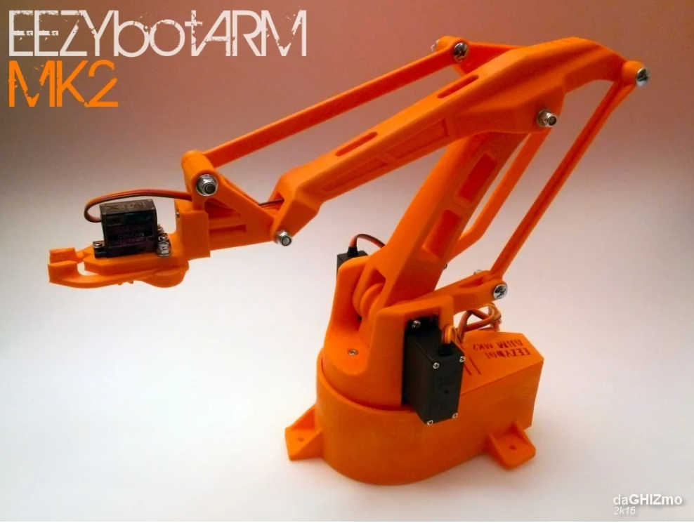




Computer Vision for object learning and retrieval
Team 19
Voice Recognition for user commands
CogniArm
AI Engine for feature extraction
File System for learning
Ziyin Zeng(3113788Z) Shantong Wang(3108877W) Longyi Chen(3169503C) Dingyan Guo(3075250G)
Hang Liu(3075147L)

Slide 2


Real-time system
CogniArm: Evolution from Control to Cognition
Stage 1. Traditional motion
Multithread
C++ Real-time Kernel & IK
Hardware Control
Stage 2. Intelligent Interaction
Vision|Voice
Async Voice Command Processing
SQL | Knowledge
…..
Stage 3. Cognitive Perception
Vision-Voice & Learning

