Slide 1

CPA Recommendations
Miguel Tasende, Data Scientist, MAD

Slide 2
Problem Statement
Solution Proposals
Initial exploration
First Implementation
Simulator Model (in progress)
Open problems
Next steps

Slide 3
1.
Problem Statement

Slide 4
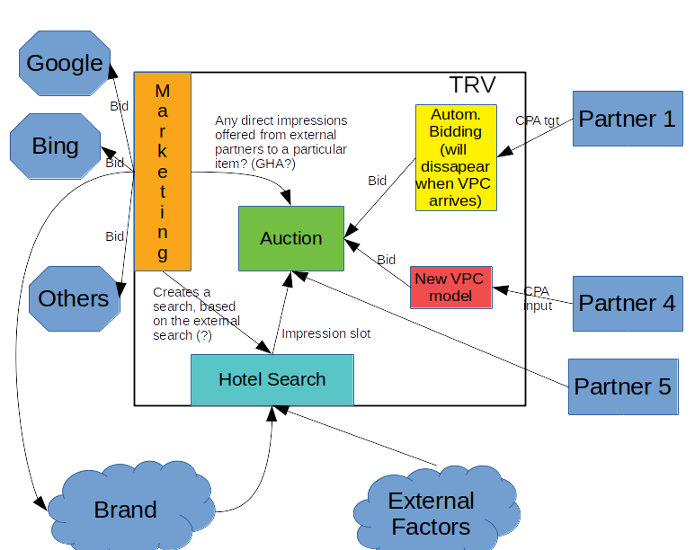
We want to find the best input for this...
...on the next month

Slide 5
Problem Statement
For a partner:
The Booking Value depends on the CPA input, so the problem is:
Find the CPA input value that maximizes the partner’s Profit.
(Almost solved if we had “Booking Value” as a function of “CPA Input”)

Slide 6
Why “we can’t solve this problem”?
Biggest problems with the Data
We don’t have real data from the process!!
Possible “solutions”:
Use the “measured CPA” as a proxy for the “CPA input”. Very rough approximation.
Simulate the process. Expensive.
Wait for data to arrive. Not acceptable. We need a solution now.

Slide 7
Other issues that make us narrow the goal:
Narrowing the Problem...
We don’t have the partner’s margins, most of the time => Leave the final optimization out.
We don’t want to make predictions about the next month’s market level => Work with “shares”.
We want to start “simple” => Start with a Linear Model.

Slide 8
2.
Solution Proposals

Slide 9
Approaches:
Proposed Solutions
Try to approximate BV_share = F(CPA | locale, partner)
Linear Model
Other ML models
Simulate different CPA levels and assume the VPC model as “correct”, to estimate the Booking Value
Estimate the amount of booked nights at item level

Slide 10


Approach 1a: Linear Model
Fast, Easy, and theoretically well known.
The range of “fitness” of this model to the problem, with the available data goes from “rough approximation” to “totally wrong”.
Can be used as a very rough Benchmark.
We need to determine the validity range of the hypothesis:
- Errors from the regression
- Errors from the linear approximation
What to do when the slope is negative?
Uses data from a different process (until we have enough data from the partners bidding on CPA).

Slide 11
Approach 1b (ML):
Faster and easier than the following approaches
Requires some experimentation, and no good results are certain.
Likely better than the Linear Model
May require more “quality tests” due to less interpretability.
The range of validity is likely larger than in the Linear Model
Uses data from a different process (until we have enough data from the partners bidding on CPA).

Slide 12
Approach 2 (Simulator):
It simulates the process that we want to model.
It may be expensive to simulate.
The deterministic part of the Simulator is a very good source of information.
The non-deterministic part of the model depends on the assumption that the VPC model is “correct” (beyond its original scope of application).
- That may be improved with a more realistic model when more data is available.
There is previous work in the company to reuse (Exposim).

Slide 13
Approach 3 (Estimate by item / item group):
Focusing on the items makes sense “conceptually”.
Getting the item-level estimations [BookedNights(item, CPA, price)] still doesn’t solve the problem. We still need to report the global CPA input.
Estimating at item level can likely have further applications.
There are a lot of items. May require clustering.
Uses data from a different process (until we have enough data from the partners bidding on CPA).

Slide 14
Initial Roadmap
Simulator Model
Working on it
1
2
3
4
Linear Model
Basically done
Final adjustments to go live
ML Model
TO DO

Slide 15
3.
Initial Exploration

Slide 16
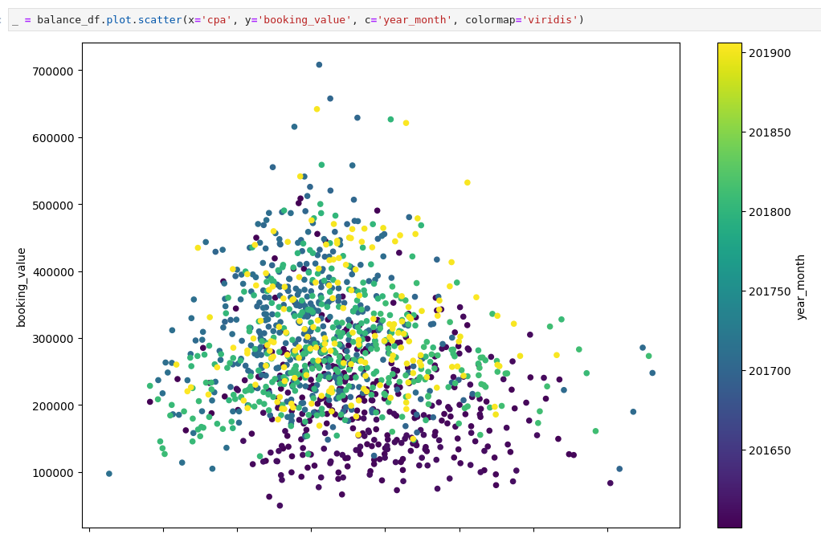
Booking Value = f(CPA) for ExpediaV2 in ‘DE’, (Daily aggregation)
Plot the basic data
There doesn’t seem to be any linear, “sigmoid”, or otherwise “nice” relationship between Booking Value and CPA
CPA
Notes:
<number>

Slide 17
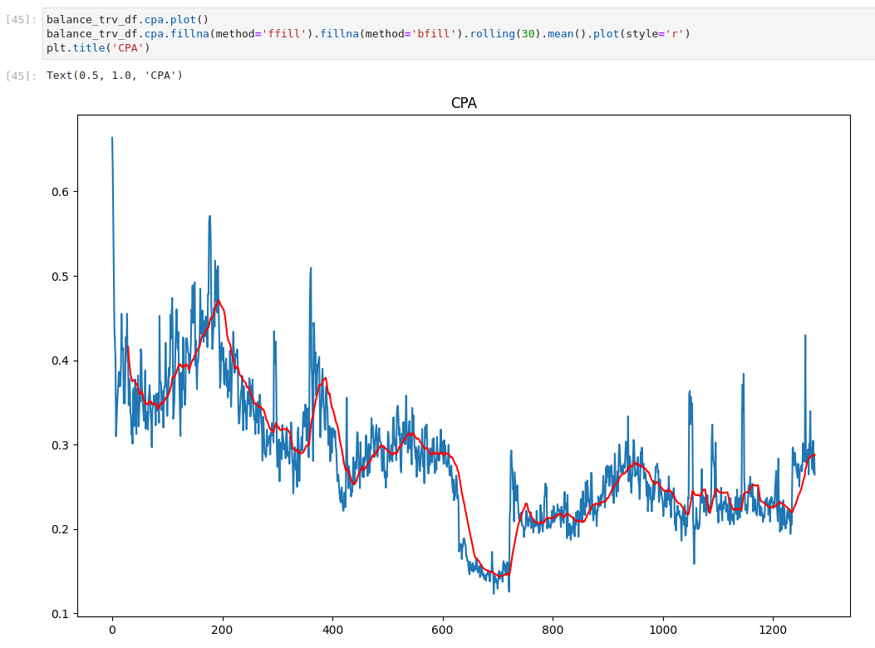
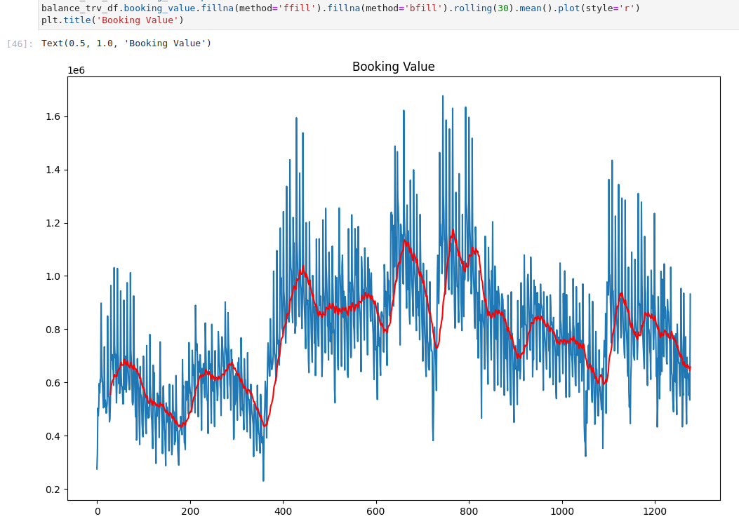
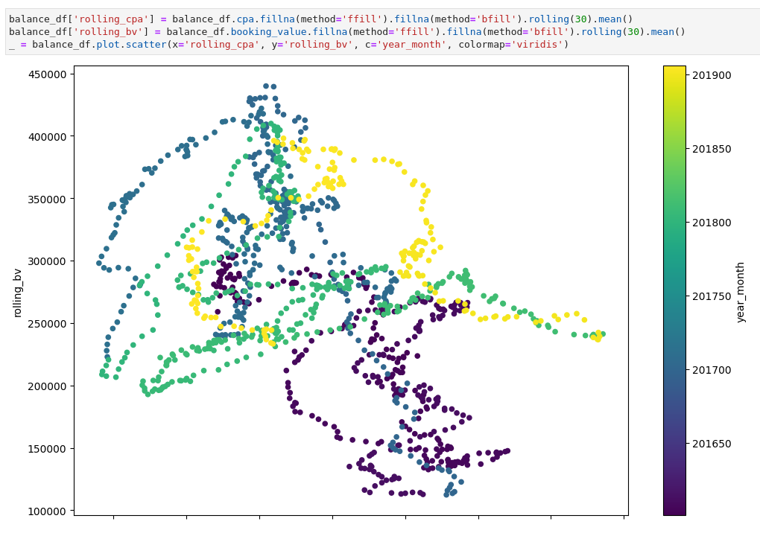
Let’s get some rolling (30 days) means
CPA rolling mean
Booking Value rolling mean
Rolling Booking Value = f(Rolling CPA)
Rolling CPA

Slide 18
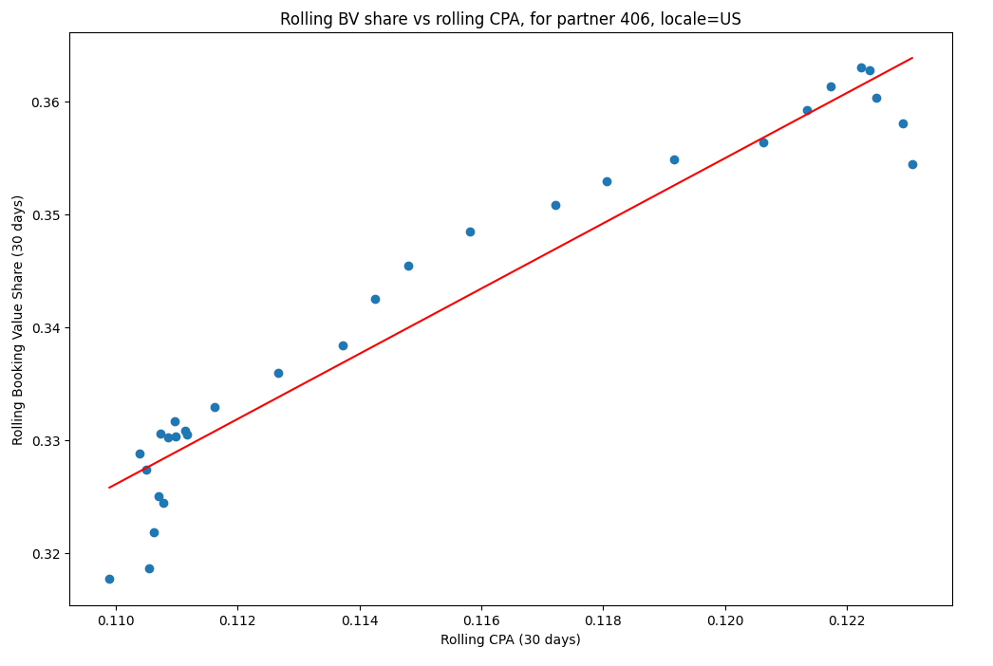
But, restricted to one month...
Fitted Linear Model
When taking only one month of data, sometimes the Linear Model idea doesn’t look so bad...
Notes:
<number>

Slide 19
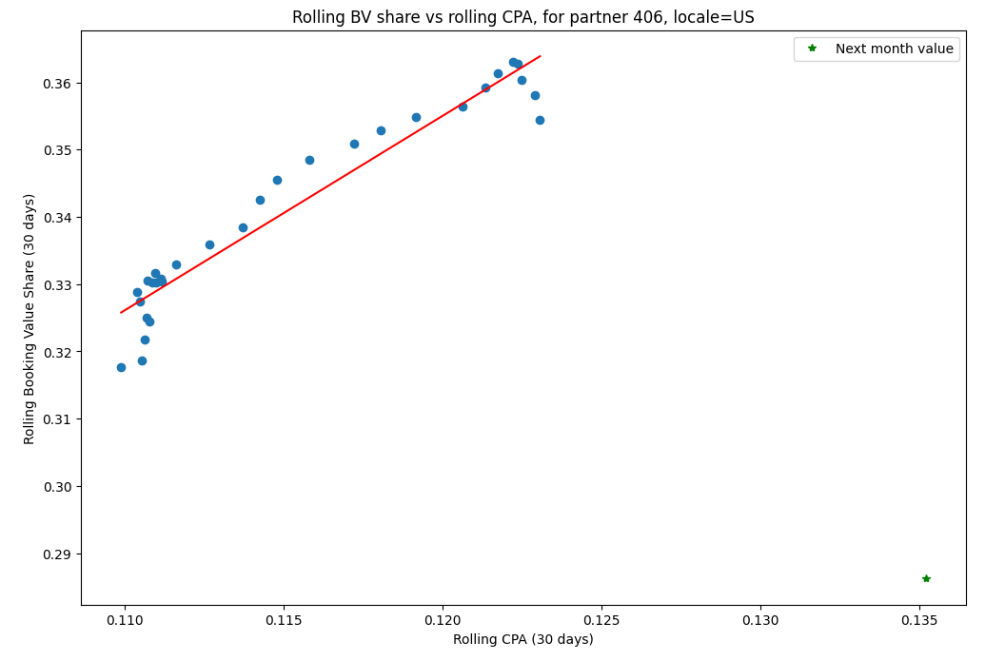
...it is still pretty bad.
Fitted Linear Model
When taking only one month of data, sometimes the Linear Model idea doesn’t look so bad...
Notes:
<number>

Slide 20
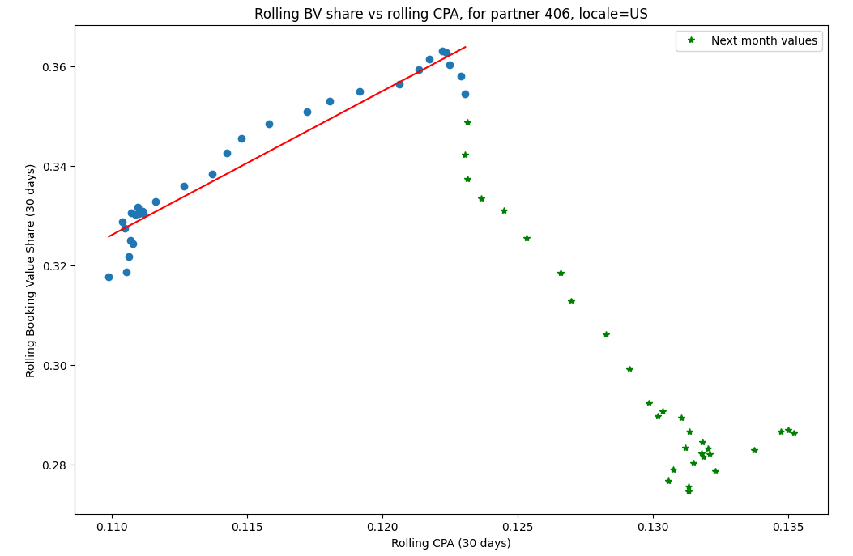
And this is why:
Fitted Linear Model
When taking only one month of data, sometimes the Linear Model idea doesn’t look so bad...
Notes:
<number>

Slide 21
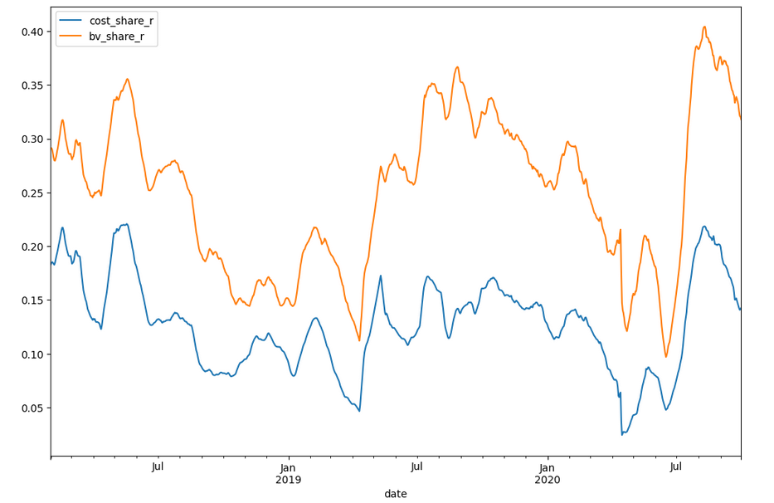
What about using Cost Share?
30-days aggregated “shares”
CPA = Cost / Booking Value.
The inverse dependency on Booking Value may cause some problems.
Let’s use the Cost Share instead (to be defined next).
Notes:
<number>

Slide 22
4.
First Implementation

Slide 23
New Market Definition:
“Share” of what?
The market of the partner is the set of all the items that the partner has in its inventory, in a certain locale.
Market Booking Value = The Booking Value of all those items
Market Cost = The Cost of all those items
Market CPA = The CPA of all those items
Booking Value Share = Partner’s BV / Market BV
Cost Share = Partner’s Cost / Market Cost

Slide 24
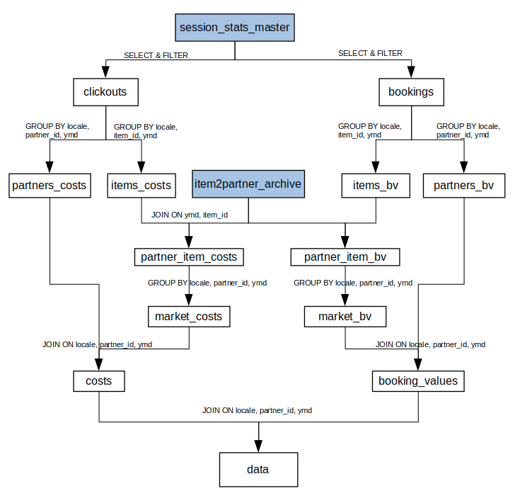
Data Aggregation
Calculate the “Shares”
This Spark (SQL) workflow calculates the shares.
Notes:
<number>

Slide 25
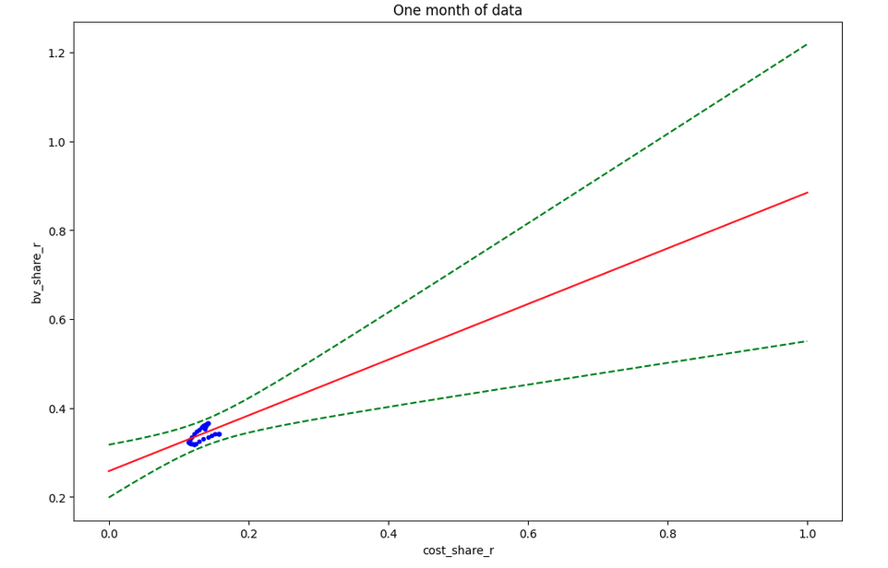
Partner = 452, locale= US, one month (2019-08)
Fitted Linear Model
With one month of data.
Notes:
<number>

Slide 26
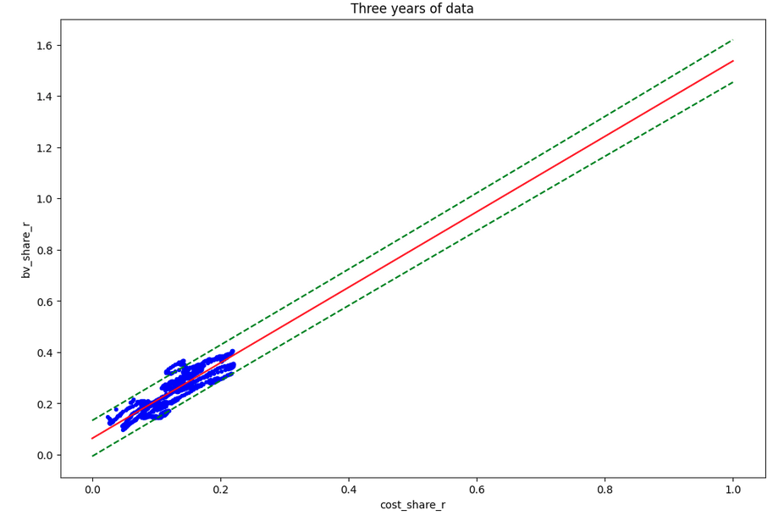
Partner = 452, locale= US, 3 years
Fitted Linear Model
With 3 years of data, it doesn’t look so bad.
Notes:
<number>

Slide 27
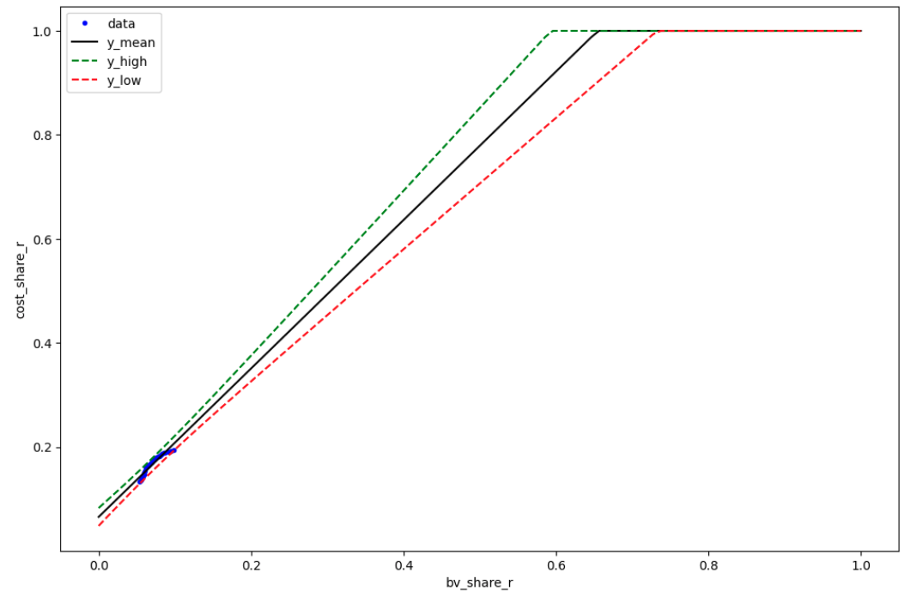
Flip the axis!
Cost Share = F (BV Share)
To make it easier to go back to CPA values.
Notes:
<number>

Slide 28
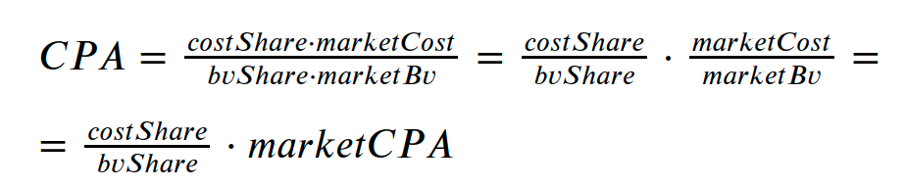
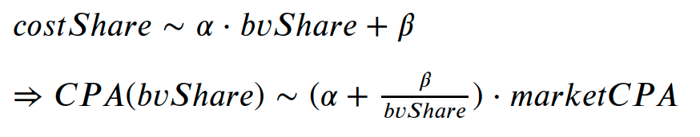
And retrieve the CPA values
Notes:
<number>

Slide 29
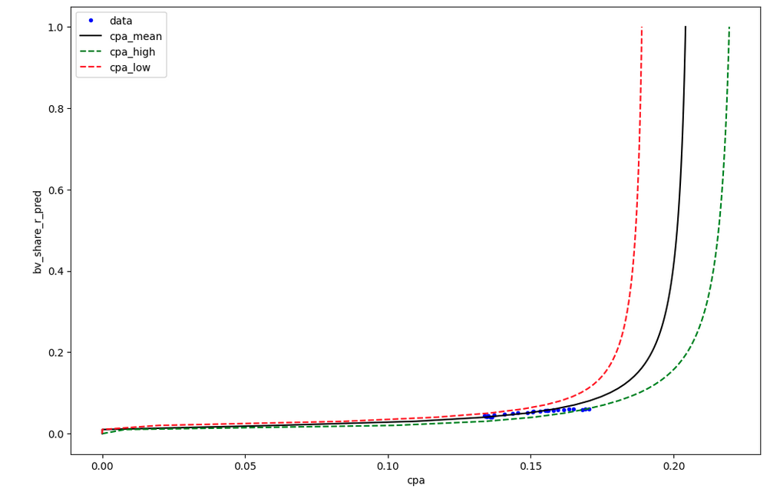
Result example
BV share = F(CPA)
The CPA values beyond the graph limits are to be filled with a BV share value of 1.
Notes:
<number>

Slide 30
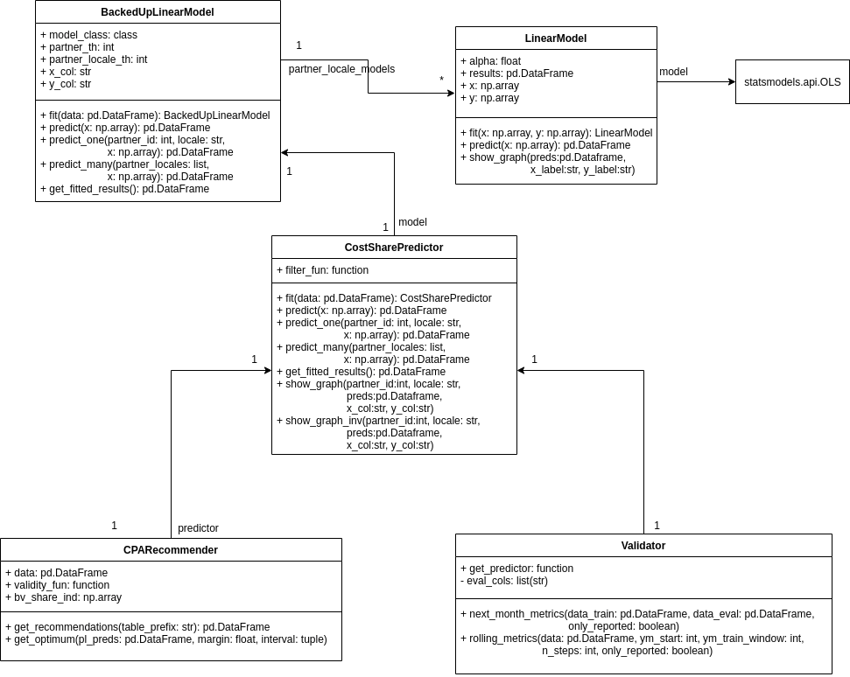
First MVP
It is Backed Up
When a partner-locale doesn’t have enough data the model predicts at partner level, and if it still doesn’t have enough data it predicts a locale level.
We produce Recommendations (not used until we get a source of “margin” data).
The Validator can evaluate on the next month, or do a Rolling Validation for several months.
Notes:
<number>

Slide 31
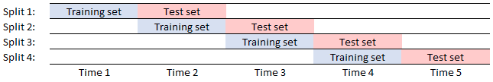
Validation
Things we validate
- "How well" the predictor fits the (bv_share, cpa) pairs for the next month: RMSE, R^2
- The "Confidence/Validity" intervals: % of samples inside the interval for the next month.
Notes:
<number>

Slide 32
Short-term filters:
Filtering
If the CPA of the market < 0, don’t predict (bad data)
If the slope of the cost_share = f(bv_share) fitted line outside [0, 3.0], don’t predict (outlier)
If the r^2 value of the fitting < 0, don’t predict (bad fitting)

Slide 33
Long-term filters:
Filtering
“Good partner-locales”: After a 6 months rolling validation, the partner-locales that got RMSE < 0.05 and more than 30% of their predictions in the Confidence Interval, are selected and we don’t make predictions for the others.
Validity Range: At the moment, only values in the range of previously seen ones are accepted.

Slide 34
Different Windows were validated:
Training Window Variations
1, 2, 3, and 6 months, 1, 1.5, and 2 years.
The best results were for 2 months.

Slide 35
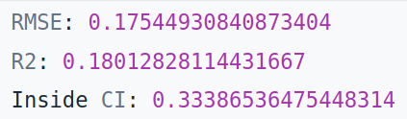
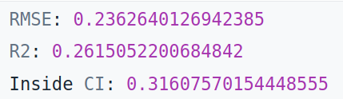
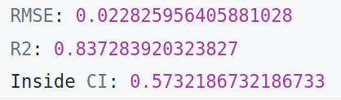
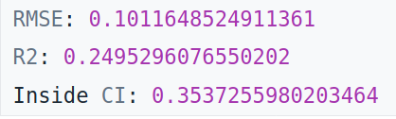
1 year Rolling Validation (BV_share vs CPA):
Results for 2018:
Results for 2019:
Initial Results
Results for 2018 (only “good partner-locales” from 2018):
Results for 2019 (only “good partner-locales” from 2018):

Slide 36
2 possible ideas:
Validity Interval
(for the Linearity Hypothesis)
Don’t predict outside the range of previously seen values (in use).
Determine the maximum CPA difference such that the models error (in a rolling validation) is still acceptable.
Proved difficult to implement (the error vs CPA diff graph didn’t look as expected).

Slide 37
5.
Simulator Model (in progress)

Slide 38
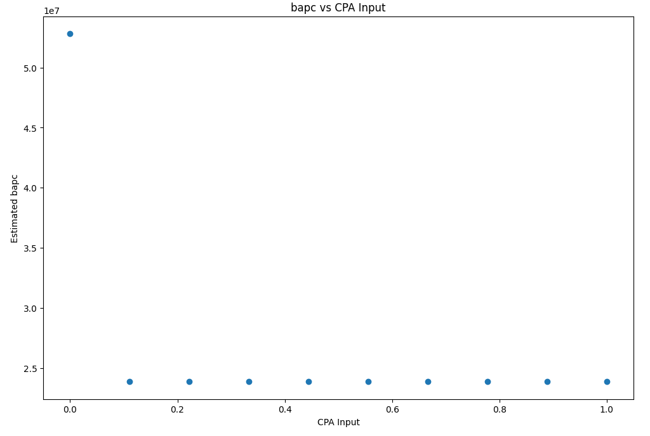
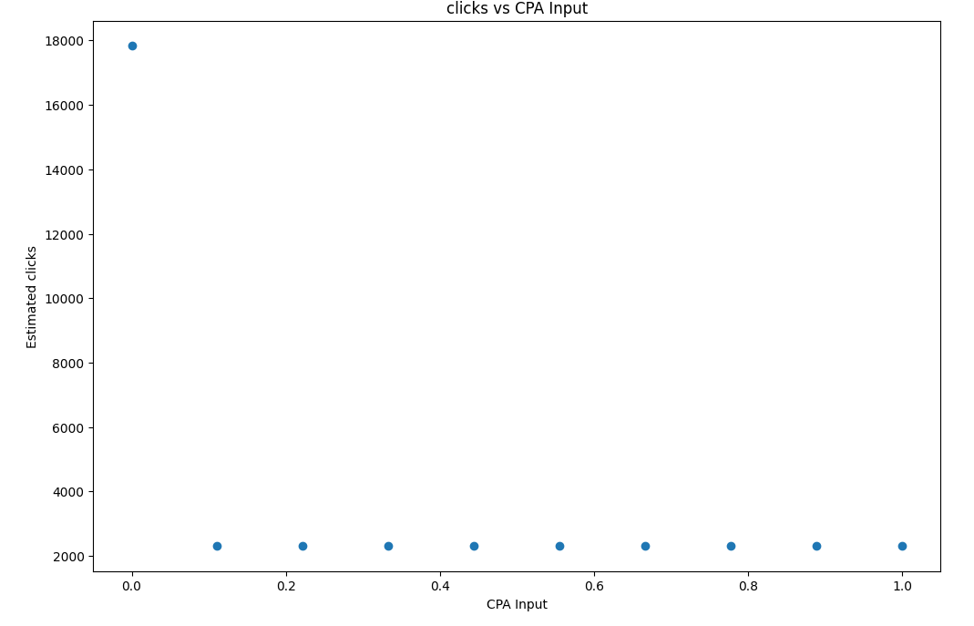
First attempt
Booking Value vs CPA input
Clicks vs CPA input

Slide 39
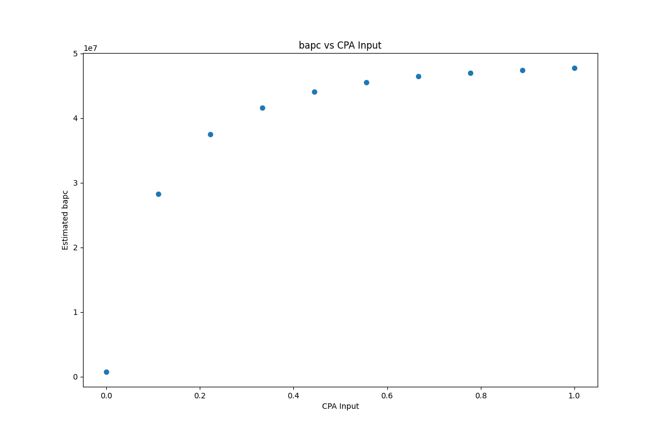
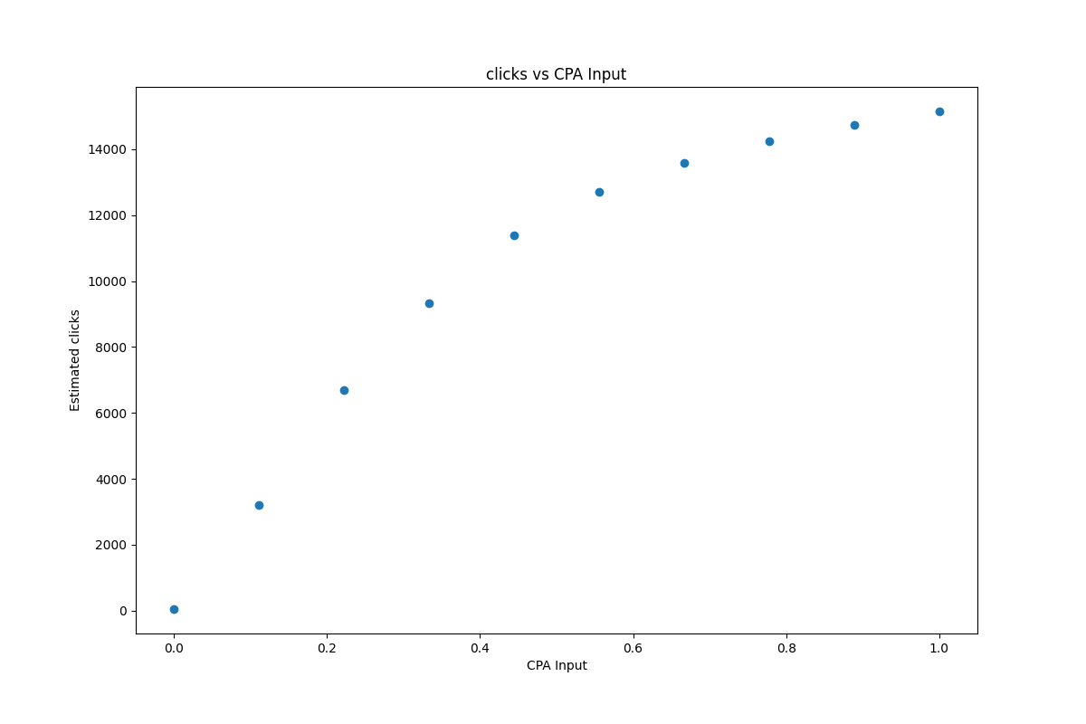
After a minor fix in Exposim
Booking Value vs CPA input
Clicks vs CPA input

Slide 40
We can make daily Booking Value predictions, for 10 CPA input levels, for a few partners (10 – 20 partners).
Those daily predictions can be aggregated (weekly, monthly, etc.)
The challenge now is scaling it to all the partners (needs to be computationally efficient).

Slide 41
6.
Open Problems

Slide 42
Open Problems:
Validating a model that can say “I don’t know” (there is some work in the literature, but…).
Predicting the markets sizes for the next month.
Validating the optimality condition, if / when recommendations are given.
Determining a wider Validity Interval (only for the Linear Model).
Right way to manage the “negative slopes” (only for the Linear Model).
Ideas for the ML model, can also be useful: features that can be useful, different ways to approach the problem, etc.
Open Problems.

Slide 43
7.
Next Steps

Slide 44
Roadmap
Simulator Model
Working on it
1
2
3
4
Linear Model
Basically done
Final adjustments to go live
ML Model
TO DO

Slide 45
Q&A

