Slide 1

CPA Recommendations
Miguel Tasende, Data Scientist, MAD

Slide 2
Use real CPA Inputs
Simulator Exploration

Slide 3
1.
Use real CPA Inputs

Slide 4
Use real CPA Inputs
Why?
When the model was created there weren’t any real values of CPA inputs available, but those are the values we want to model as our inputs.
Before we were using the CPA empirical data, measured “a posteriori”.
How are we using the inputs now?
We use them to calculate the CPA increments. That way the increments that we propose correspond to the real CPA Inputs.
How are we not using them yet?
We are not considering the CPA inputs in the models yet. We should start doing it, but we may still need more data.

Slide 5
2 CPA Groups
How do we solve the fact that there are 2 CPA groups?
We select the group with the most clickouts, and use the partner-locale model to predict.
Why?
Because creating models for each group, considering they may have very few data points, could require some more work (a new “backup” level in the model).
We don’t want to change the user interface at the moment.
To be able to put the first version into production as soon as possible.

Slide 6
2.
Simulator Exploration

Slide 7
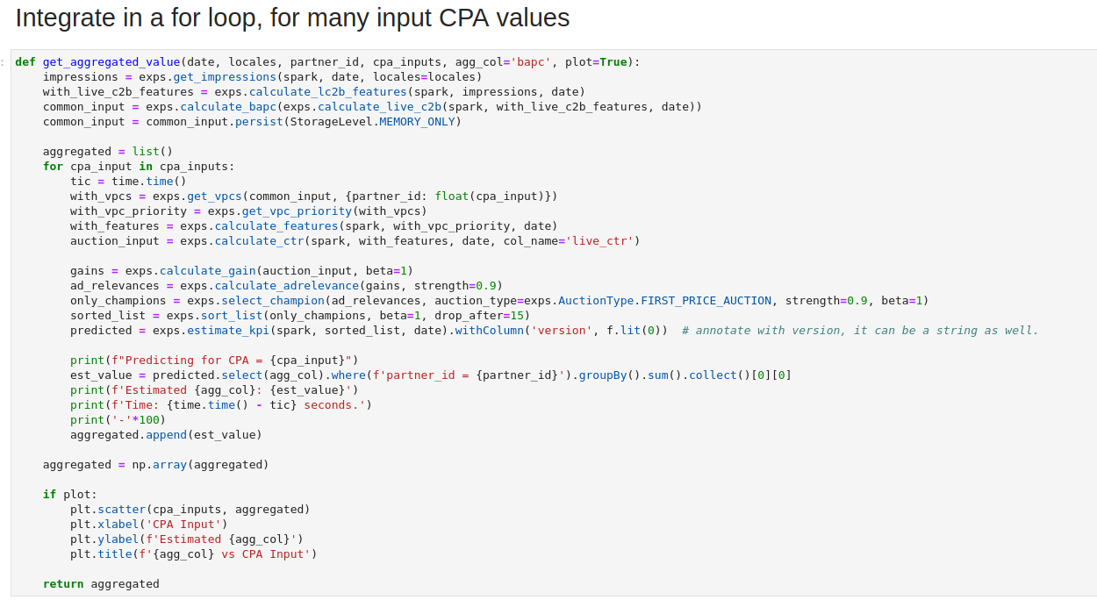
Function to get Booking Value (or other aggregated values) for different CPA Inputs

Slide 8
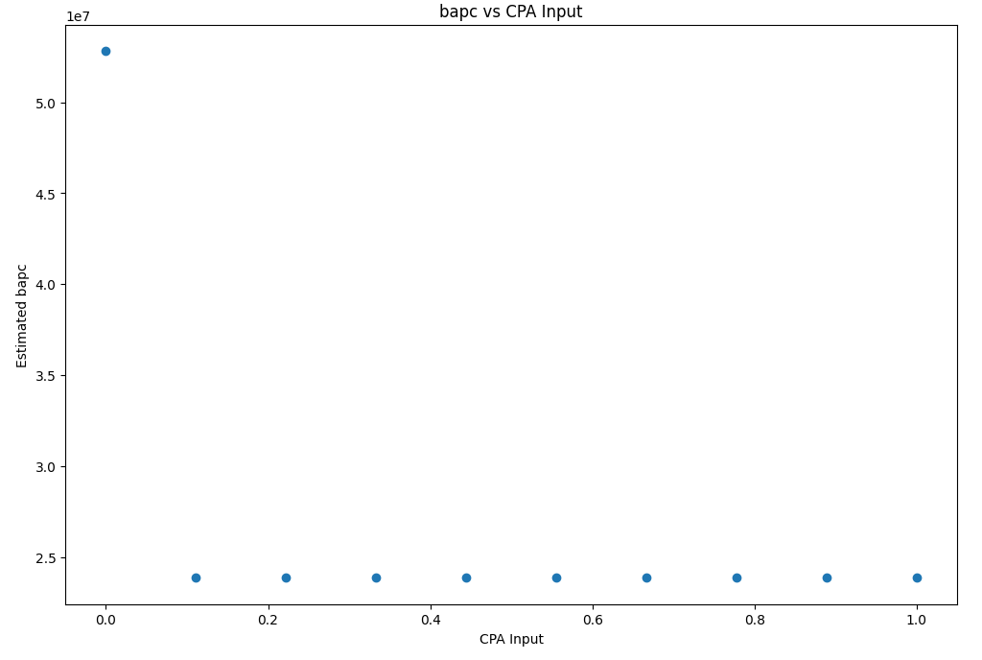
Aggregated Booking Amount per Click:
i.e.: Booking Value

Slide 9
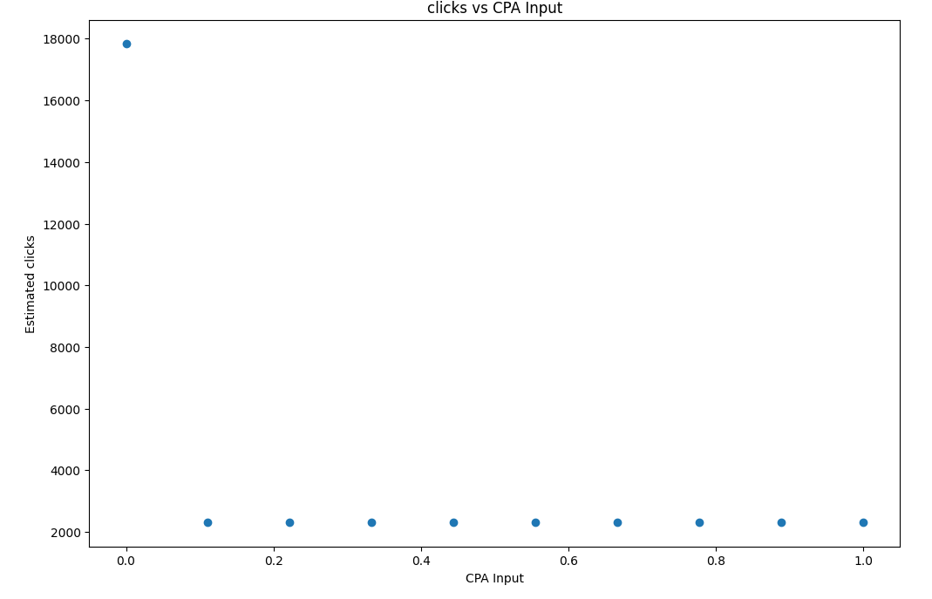
Aggregated clicks: i.e.: Total Estimated Clickouts

Slide 10
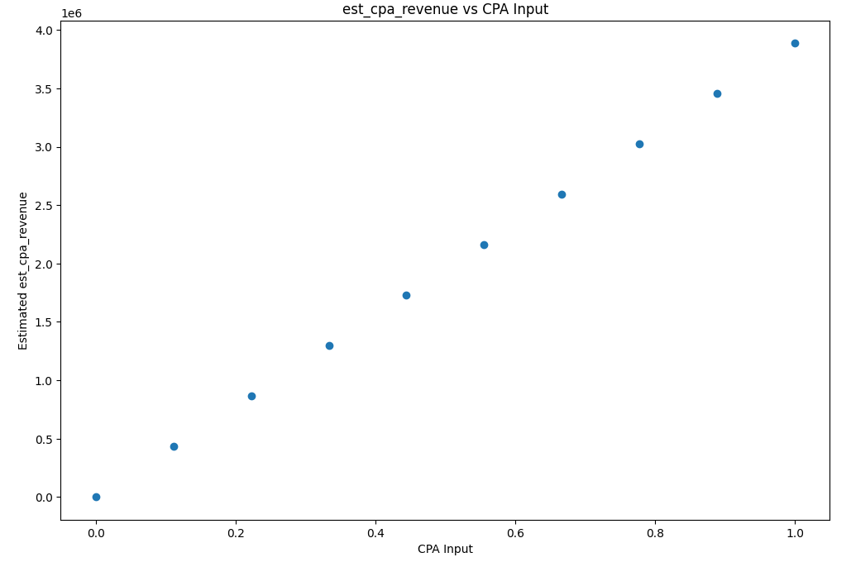
Aggregated CPA Revenue

Slide 11
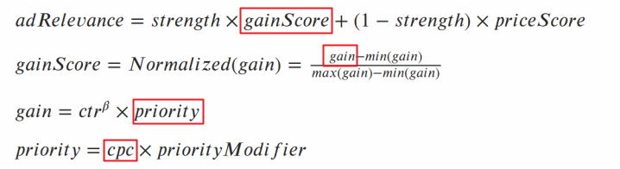
Formulas

Slide 12
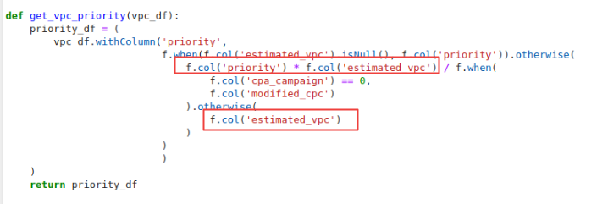
Is the problem here?

Slide 13
Q&A

