Slide 1

CPA Recommendations
Miguel Tasende, Data Scientist, MAD

Slide 2
Small fix to exposim-vpc
Next steps

Slide 3
1.
Small fix to exposim-vpc

Slide 4
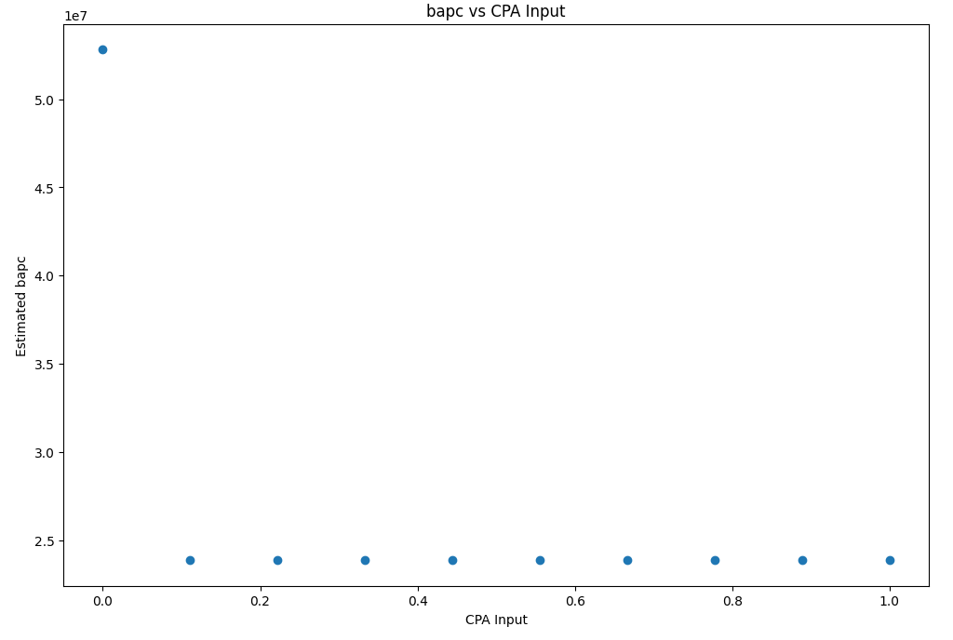
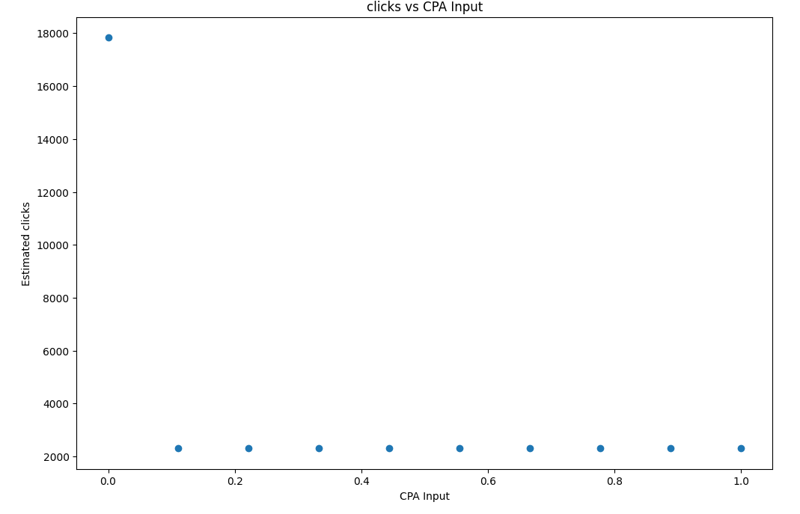
Previous situation

Slide 5
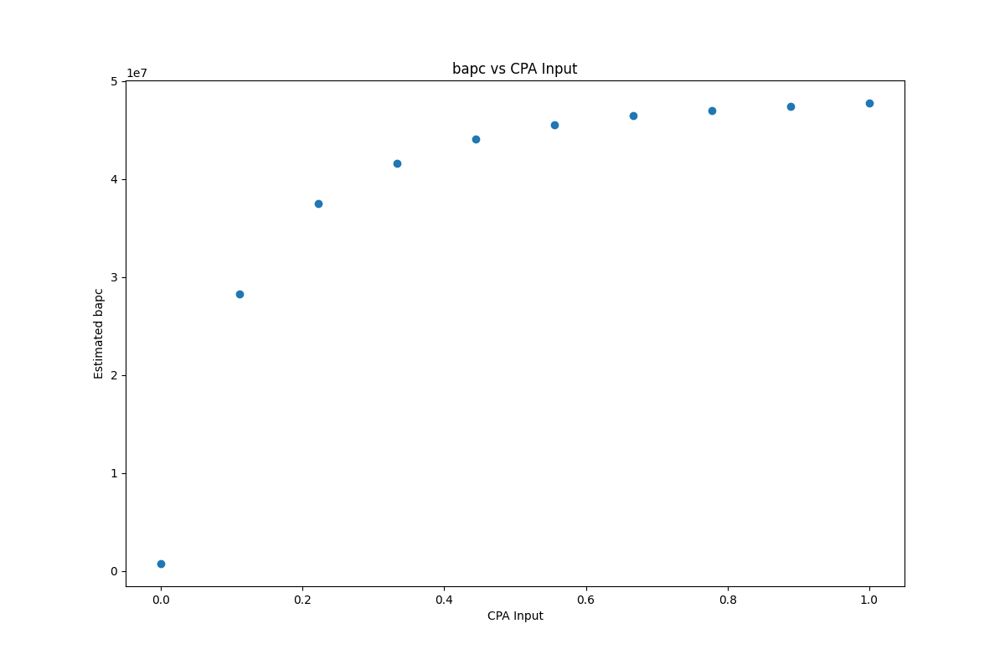
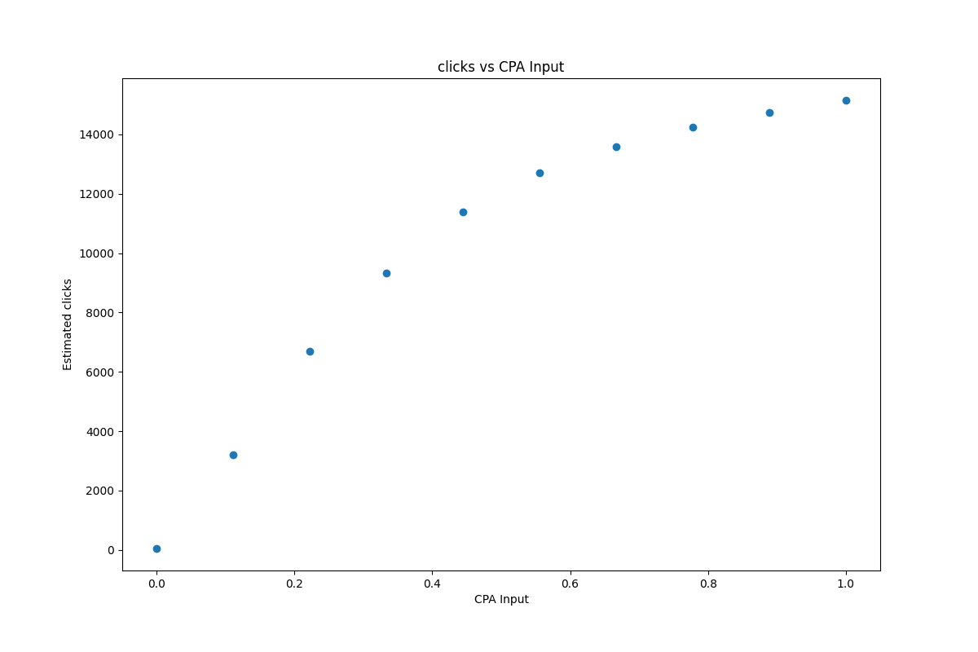
After the fix

Slide 6
2.
Next Steps

Slide 7
It’s a lot of data
For 2020-12-15 (only 1 day):
7364 partner-locales
10 cpa_input points
>361 million rows of data
That is: 2,66 x 10^13 rows in total
Considering a float with 4 bytes, that would use:
96.84 TB of memory
And… each row contains more than 4 bytes in reality.

Slide 8
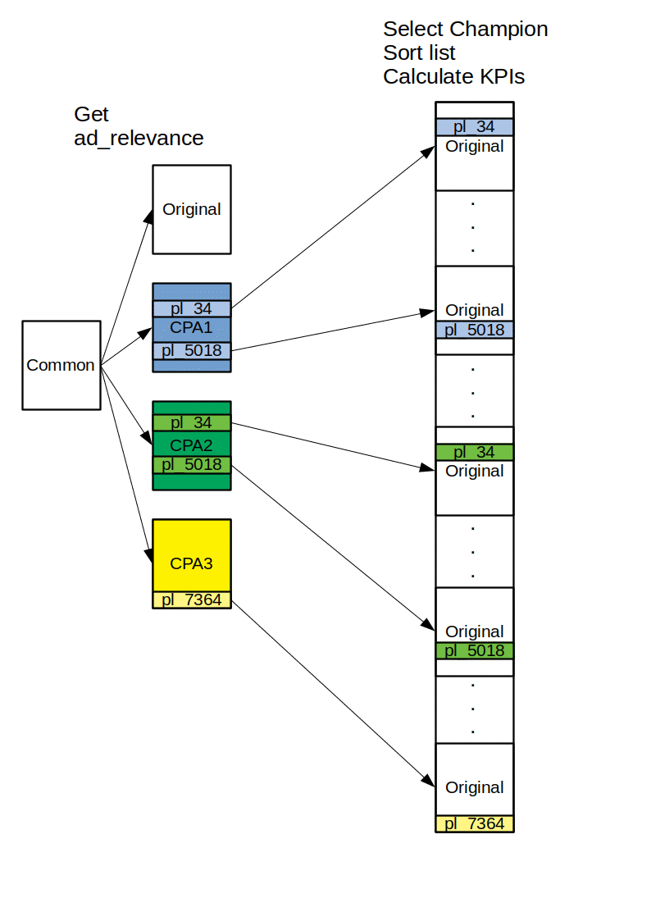
Why it could get so big?

Slide 9
Solution
If the redundancy can be correctly managed, it may be possible to work with only:
3.6 x 10^9 rows, instead of 2.66 x 10^13 (4 orders of magnitude of improvement)
Work in progress

Slide 10
Q&A

