Slide 1

CPA Recommendations
Miguel Tasende, Data Scientist, MAD

Slide 2
Data Checks for CPA Recommendations V1
Daily Simulated values for CPA Recommendations V2

Slide 3
1.
Data Checks for CPA Recommendations V1

Slide 4
Created Data Checks
Number of rows
avg, min, max, std, histogram of cpa_pred_mean
avg, min, max, std, histogram of bv_share_pred
avg, min, max, std, histogram of bv_share_inc_pct
avg, min, max, std, histogram of cpa_inc_pct
Scatter plots to show the predictions and last values
Amount of partner locales
Amount of partners
Amount of locales
Mean, min, max, std, barplot of the number of datapoints per partner-locale
Mean, min, max, std, barplot of the number of datapoints per partner
Mean, min, max, std, barplot of the number of datapoints per locale
Number of partner-locales, partners, locales with more than 2 data points
Position of the last cpa value:
Number inside the interval
Number outside the interval
Number at the left of the interval
Number at the right of the interval
Ratio inside the interval
Ratio outside the interval
Ratio at the left of the interval
Ratio at the right of the interval

Slide 5
Main Changes to the V1 predictions
Some ti_export filters removed
Sample mechanism improved
Good partner locales filter removed
ti_export filters on inc values removed
Change in the calculation for inc values
Refactor of the calculation of the last month values for the predictions
Use only measured CPA values
Drop NaNs in preprocessing instead of filling with 0
Add a monotonically increasing filter

Slide 6
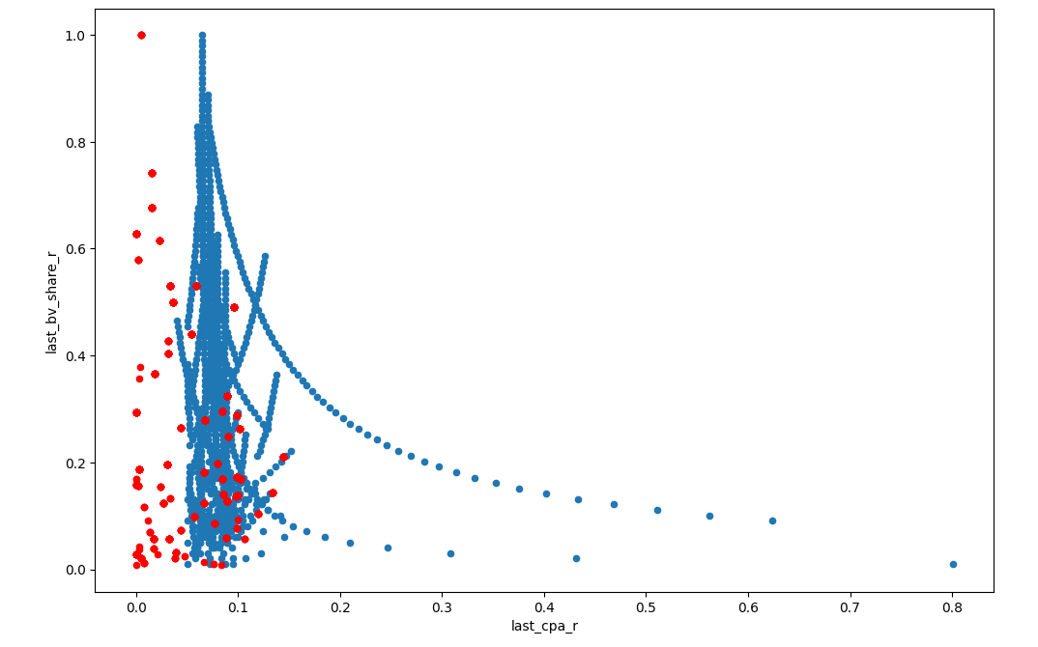
Improvements Output Sequence

Slide 7
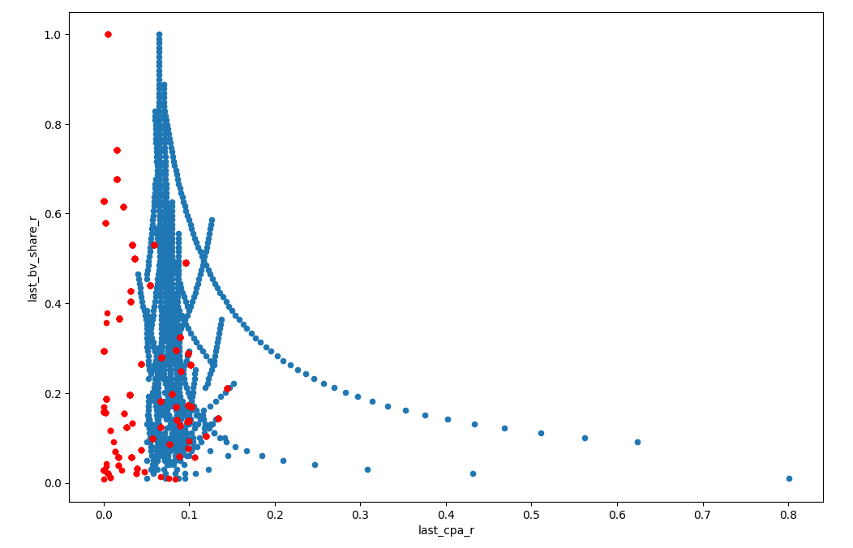
Improvements Output Sequence

Slide 8
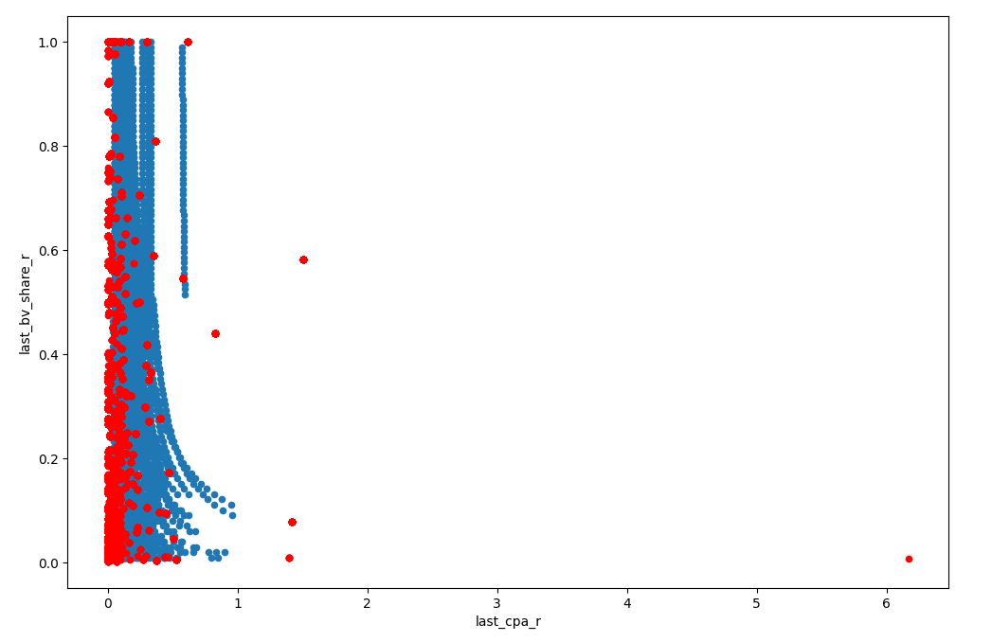
Improvements Output Sequence

Slide 9
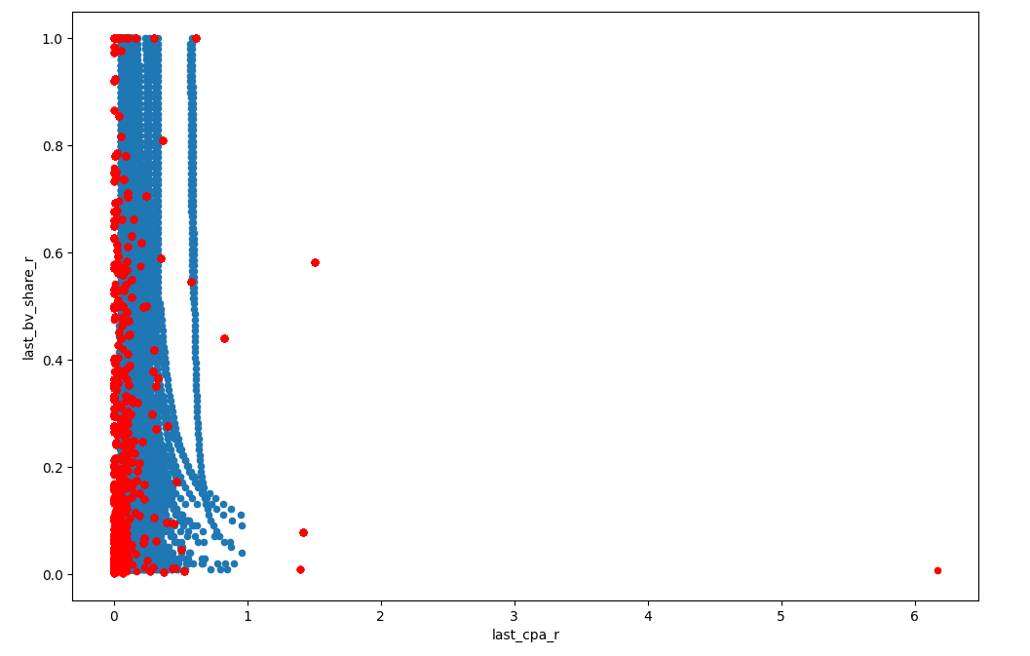
Improvements Output Sequence

Slide 10
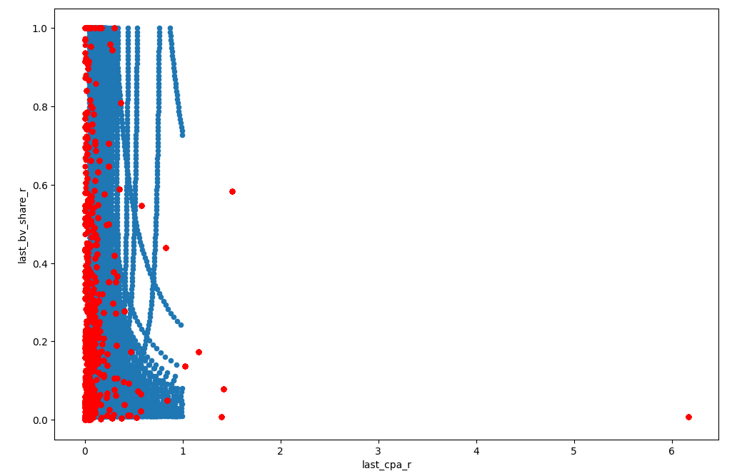
Improvements Output Sequence

Slide 11
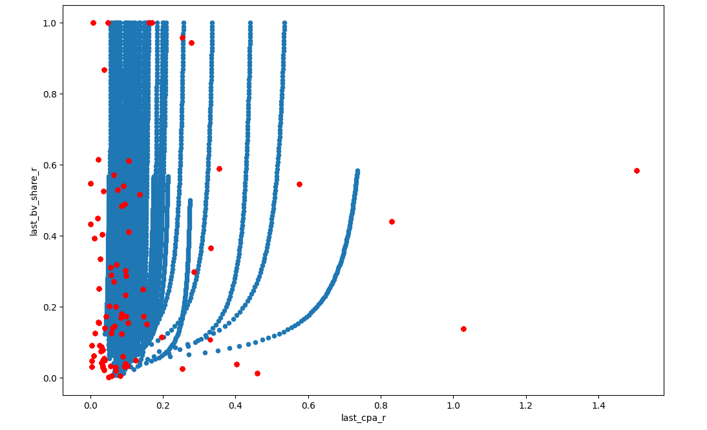
Improvements Output Sequence

Slide 12
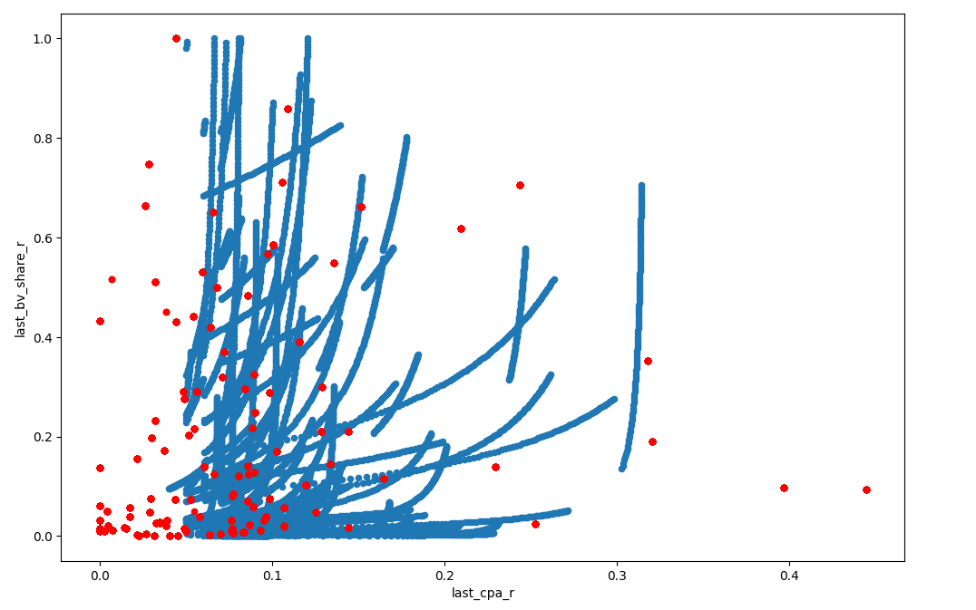
Improvements Output Sequence

Slide 13
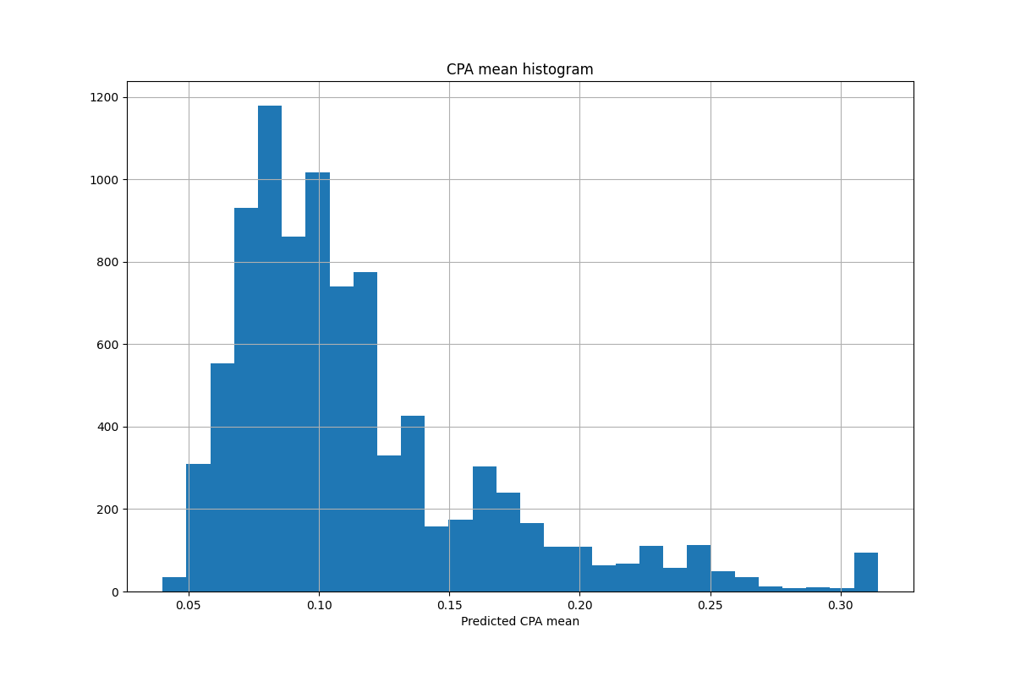
Some charts from the Data Checks (final version, running in Oozie)

Slide 14
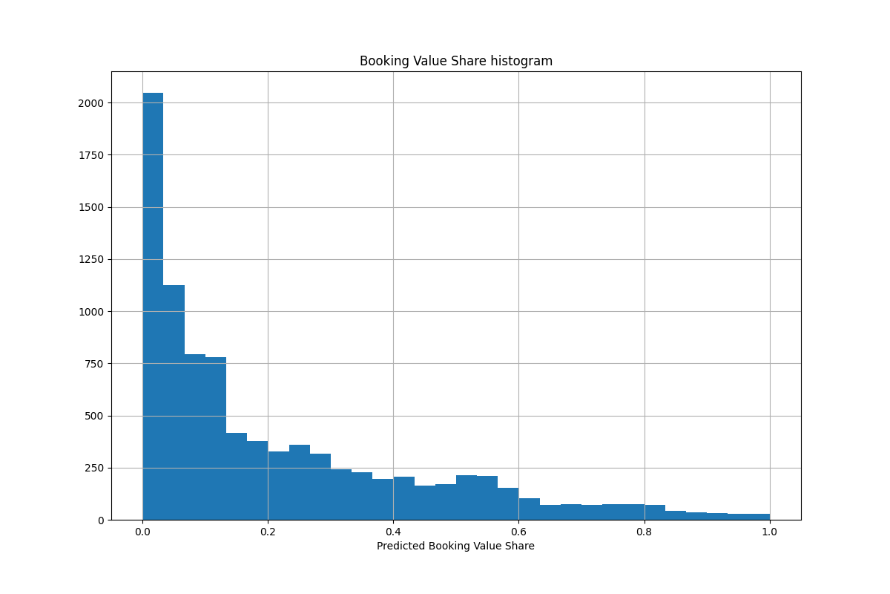
Some charts from the Data Checks (final version, running in Oozie)

Slide 15
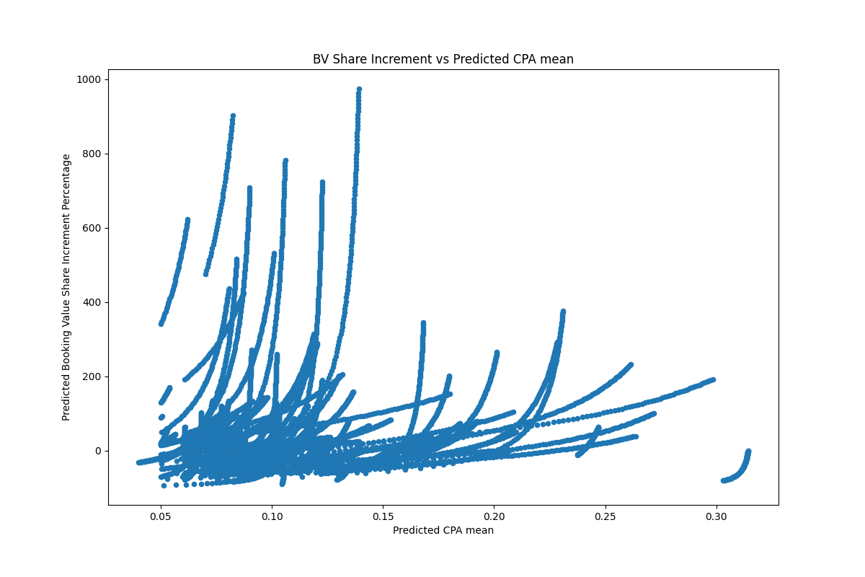
Some charts from the Data Checks (final version, running in Oozie)

Slide 16
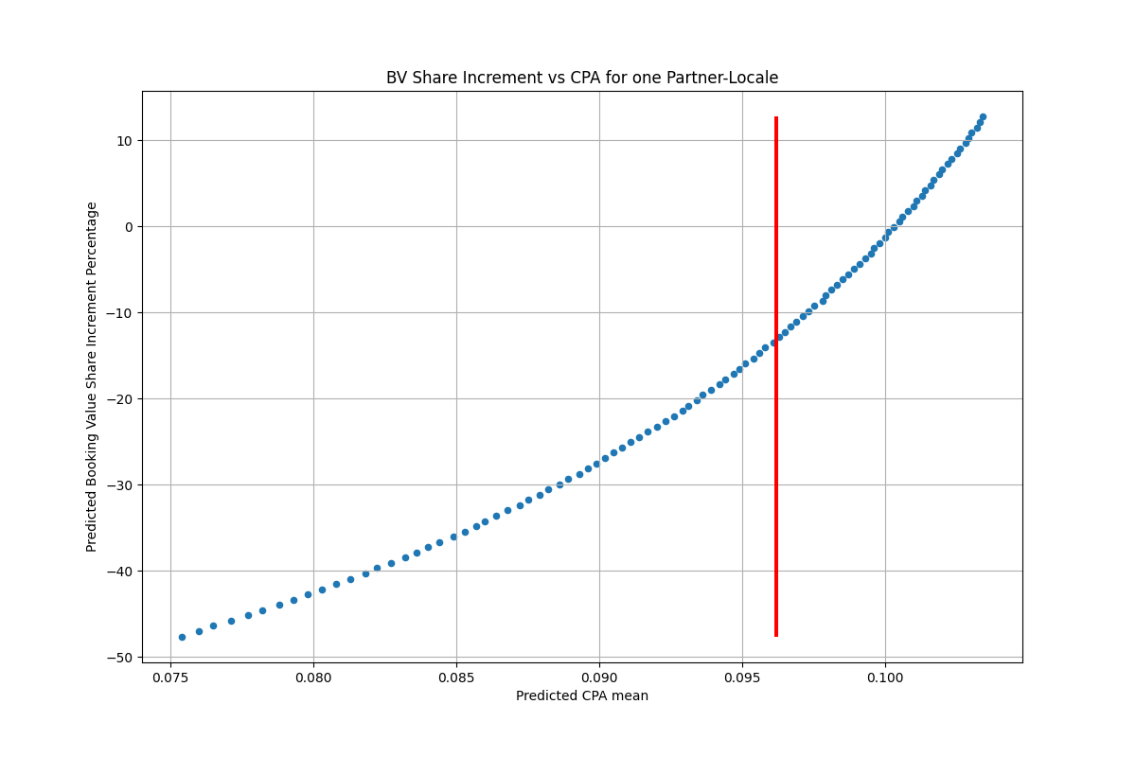
Some charts from the Data Checks (final version, running in Oozie)

Slide 17
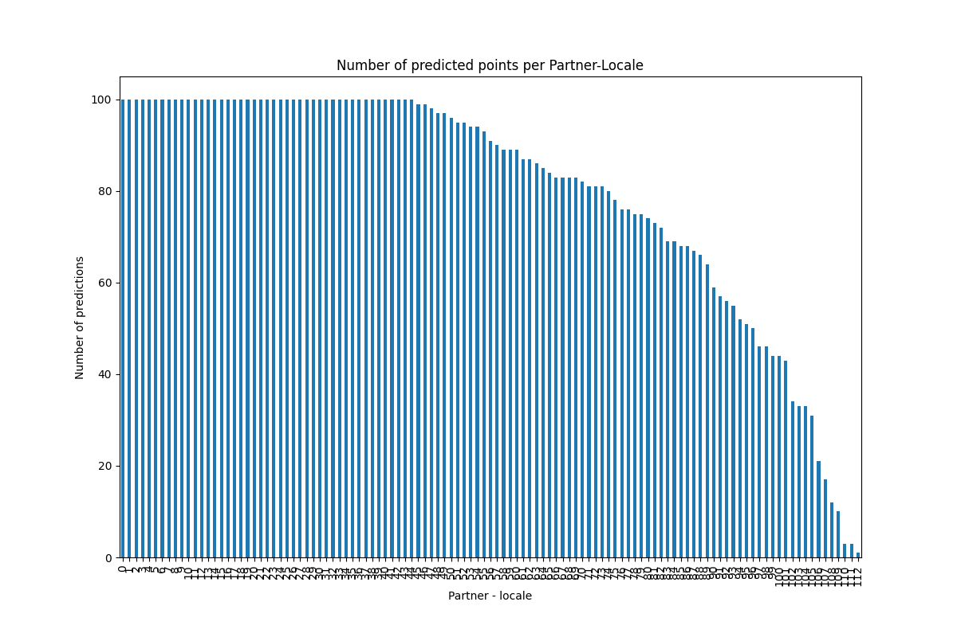
Some charts from the Data Checks (final version, running in Oozie)

Slide 18
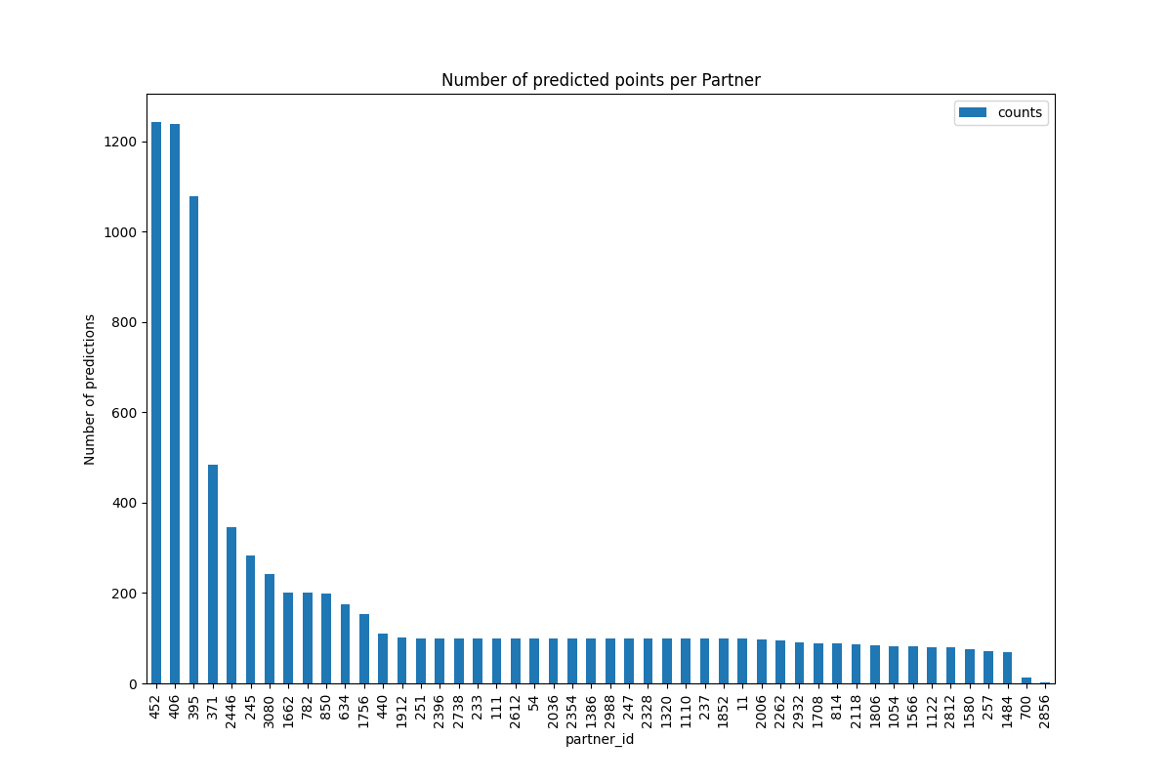
Some charts from the Data Checks (final version, running in Oozie)

Slide 19
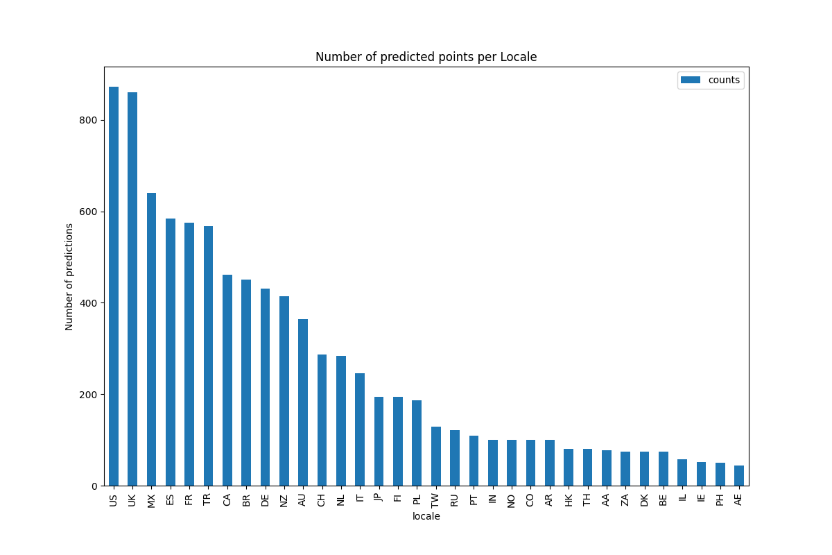
Some charts from the Data Checks (final version, running in Oozie)

Slide 20
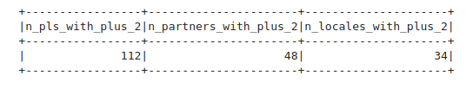
Partner-locales with more than 2 data points predicted
Position of the last recorded CPA value

Slide 21
2.
Daily Simulated Values for CPA Recommendations V2

Slide 22
Goal for this sprint:
Test if we can implement a workflow that reliably produces daily predictions, based on the Exposim simulator, for a few partners, in all the locales.
Next:
Aggregate monthly, fit a curve, validate.
Scale the system to more partners.

Slide 23
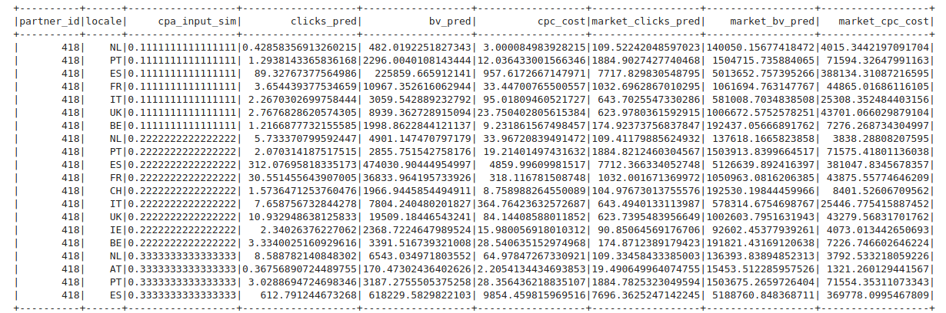
What is being predicted
(for each partner-locale-10 cpa input points)

Slide 24
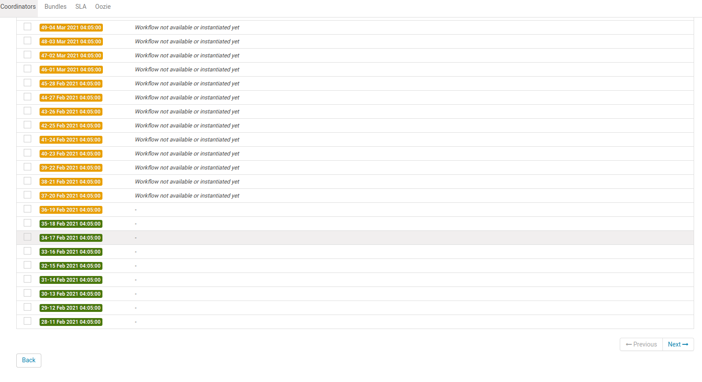
Coordinator from 2021-01-15 (now running)
4 partners (418, 2688, 2864, 1976)
All the locales

Slide 25
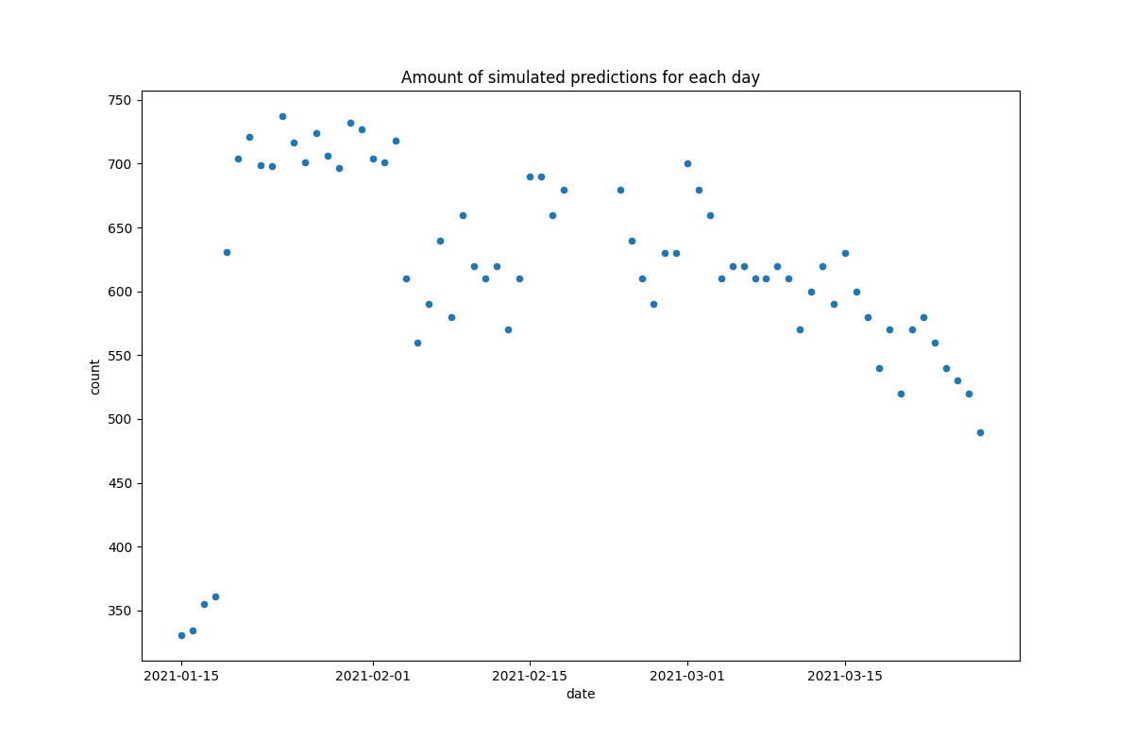
Number of predicted datapoints
per ymd (points after 2021-02-18 not valid)

Slide 26
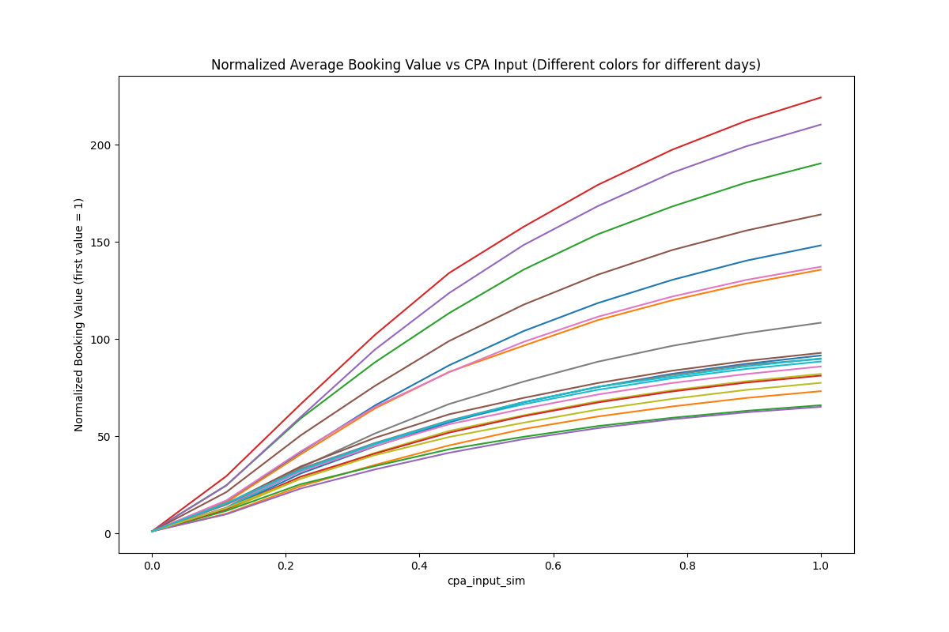
“Shape” of the mean BV vs CPA Input

Slide 27
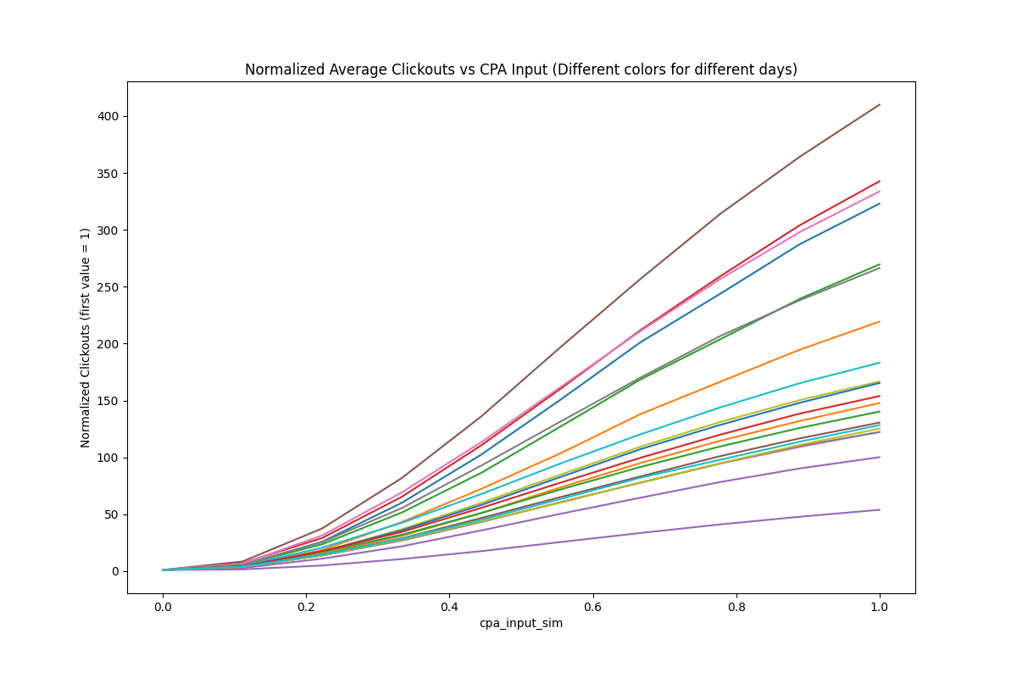
“Shape” of the mean amount of
Clicks vs CPA Input

Slide 28
Conclusions:
The system consistently produces daily predictions for 4 partners in all the locales, that “look good” in some basic checks.
We still need to aggregate, fit and validate the results for monthly predictions.
The VPC model in the simulator is currently outdated, but there is planned work to update it soon.
We still need to scale the system to predict for more partners

Slide 29
Q&A

