Slide 1

CPA Recommendations
Miguel Tasende, Data Scientist, MAD

Slide 2
General Evaluation System for CPA Recommendations
Non-linear Model

Slide 3
1.
General Evaluation System for CPA Recommendations

Slide 4
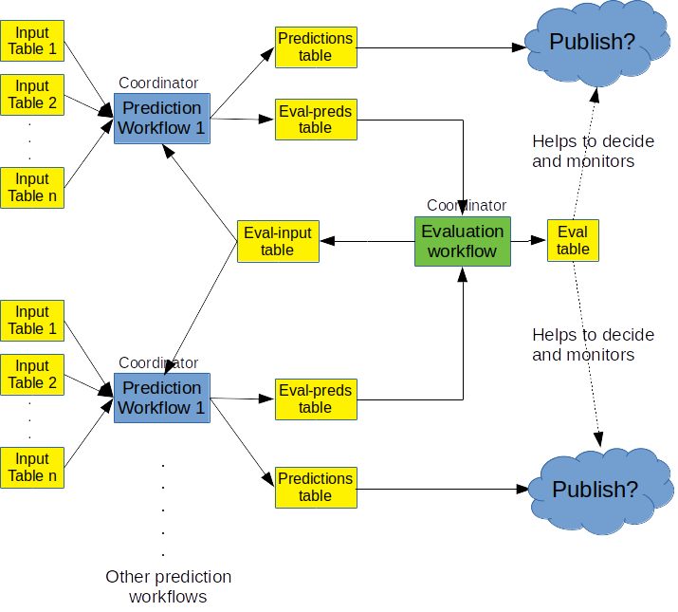
Evaluation
System
Diagram

Slide 5
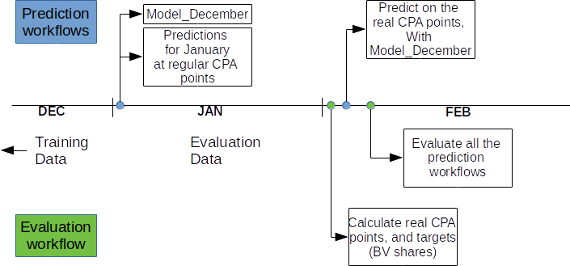
Evaluation timeline

Slide 6
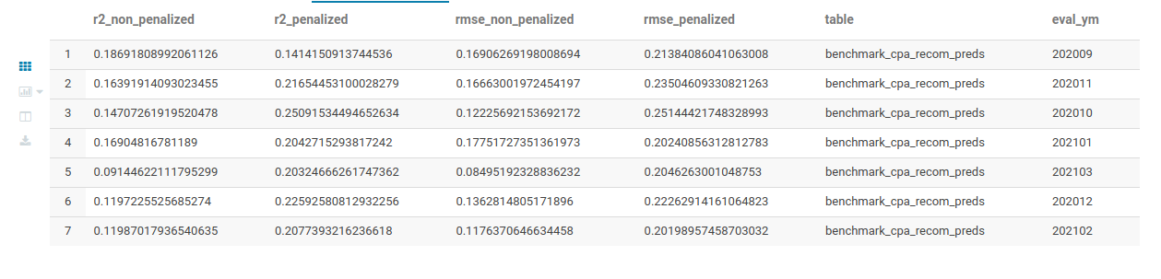
Benchmark Results
(predict last value)

Slide 7
2.
Non-linear Model

Slide 8
Goals
Goals
Modify the model so that we have more partner-locales included.
Make the model compatible with the General Evaluation System.

Slide 9
Hypothesis
Hypothesis
CPA = 0 => Booking Value Share = 0
CPA → Infinity => Booking Value Share → 1
The curve is monotonically increasing

Slide 10
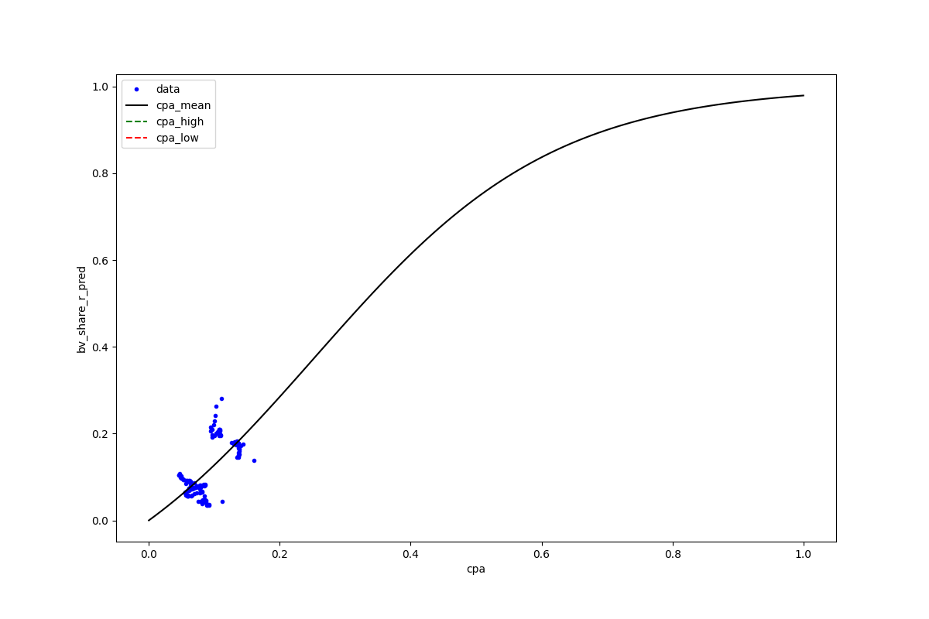
Initial model fitting example (“DE”, 406)

Slide 11
Integration
Integration with the existing System
Getting a prediction workflow with the new model was very fast, due to the modular design.
The model is “backed-up”: Partner/locale - Partner – locale.
Has all the (general) filters, and the right output format.

Slide 12
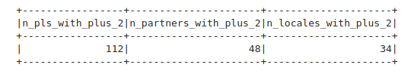
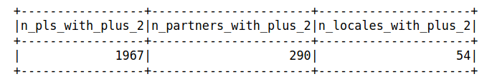
Partner-locales with more than 2 data points
Linear Model
Non-linear Model

Slide 13
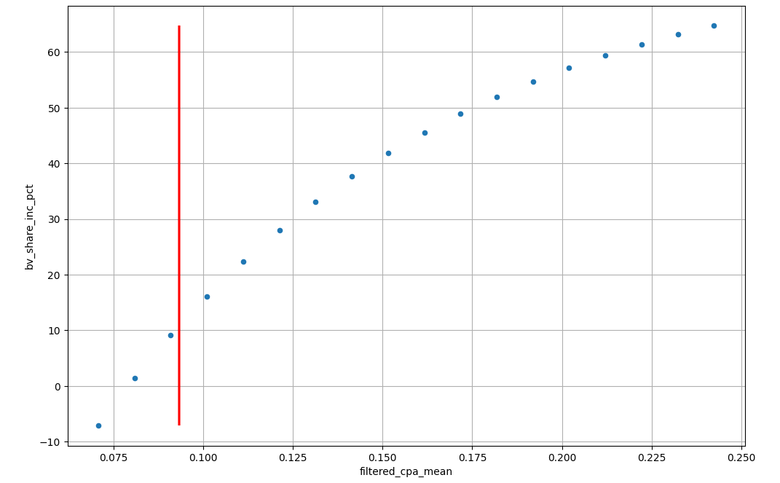
Final chart example

Slide 14
Q&A

