Slide 1
A Concurrent Implementation of MapReduce
CS5600 Final Project
December 16, 2021
By: Mitchell Lawson

Slide 2
Motivation
Redemption for the dreaded File Systems assignment
Redemption from the concurrent Hash Table assignment
Learn more about concurrency
Attempt something hard and very interesting
Prepare for Scalable Distributed Systems → MapReduce, created by engineers at Google for large scale parallel data processing
It makes programming on large-scale clusters easier for developers by alleviating the worries of managing parallelism, crashes and other issues associated with clusters of machines.

Slide 3
Project Details
Project is defined in the OSTEP repository:
https://github.com/remzi-arpacidusseau/ostep-projects/tree/master/concurrency-mapreduce.
A simplification that is made for this project as suggested by the outline given is creating MapReduce for a single machine. There are 3 learning objectives for this personal end of term project.
Learn about and understand the nature of the MapReduce paradigm.
Implement a correct and efficient version of MapReduce that utilizes threads.
Gain more experience and familiarity creating concurrent code.
Will be used/implemented in the context of word counts

Slide 4
Well… what actually is MapReduce?
MapReduce can perform distributed and parallel computations using large datasets across a large number of nodes
A MapReduce job usually splits the input datasets and then process each of them independently by the Map tasks in a completely parallel manner… BUT in my implementation this is done in a concurrent manner

Slide 5
Think of the Following components
Mapper
Some logic is applied to ”n” data blocks spread across different node.
The data blocks in my implementation are words and the nodes are files.
Shuffle and Sort
The output of the mapper then gets sorted
Repeated values get removed and the values get grouped together based on keys
This was done using quick sort and a concurrent hash table/ map
Reducer
The output from the previous step is used in this phase.
“Consolidates” the outputs and creates the finalized product.
Counts the words in my case.
Combiner (Optional)
Provides performance increase by combining inputs from the same node.

Slide 6
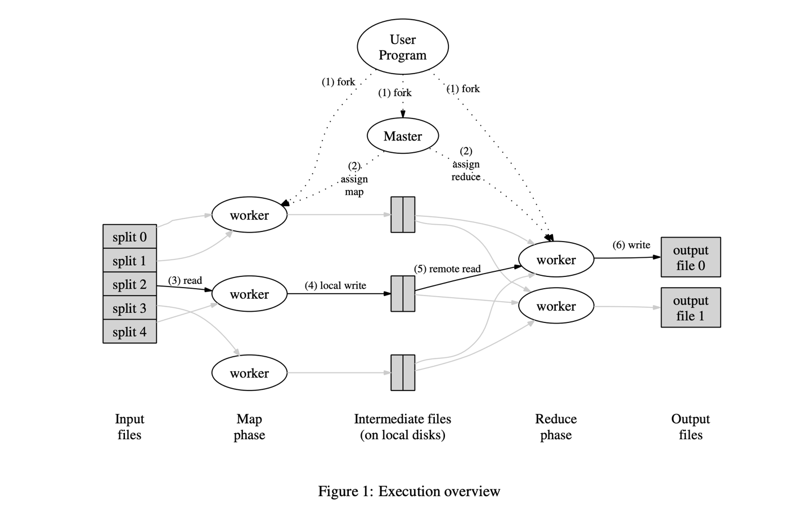

Slide 7
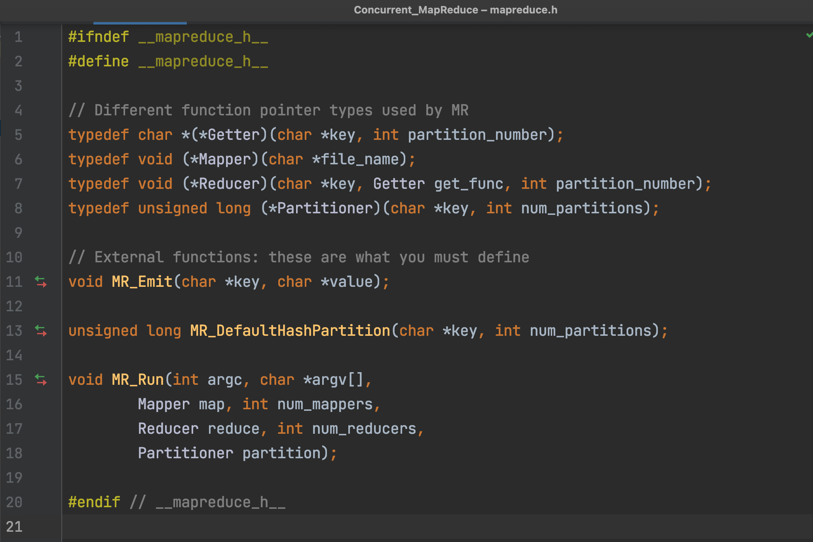
The Provided interface

Slide 8
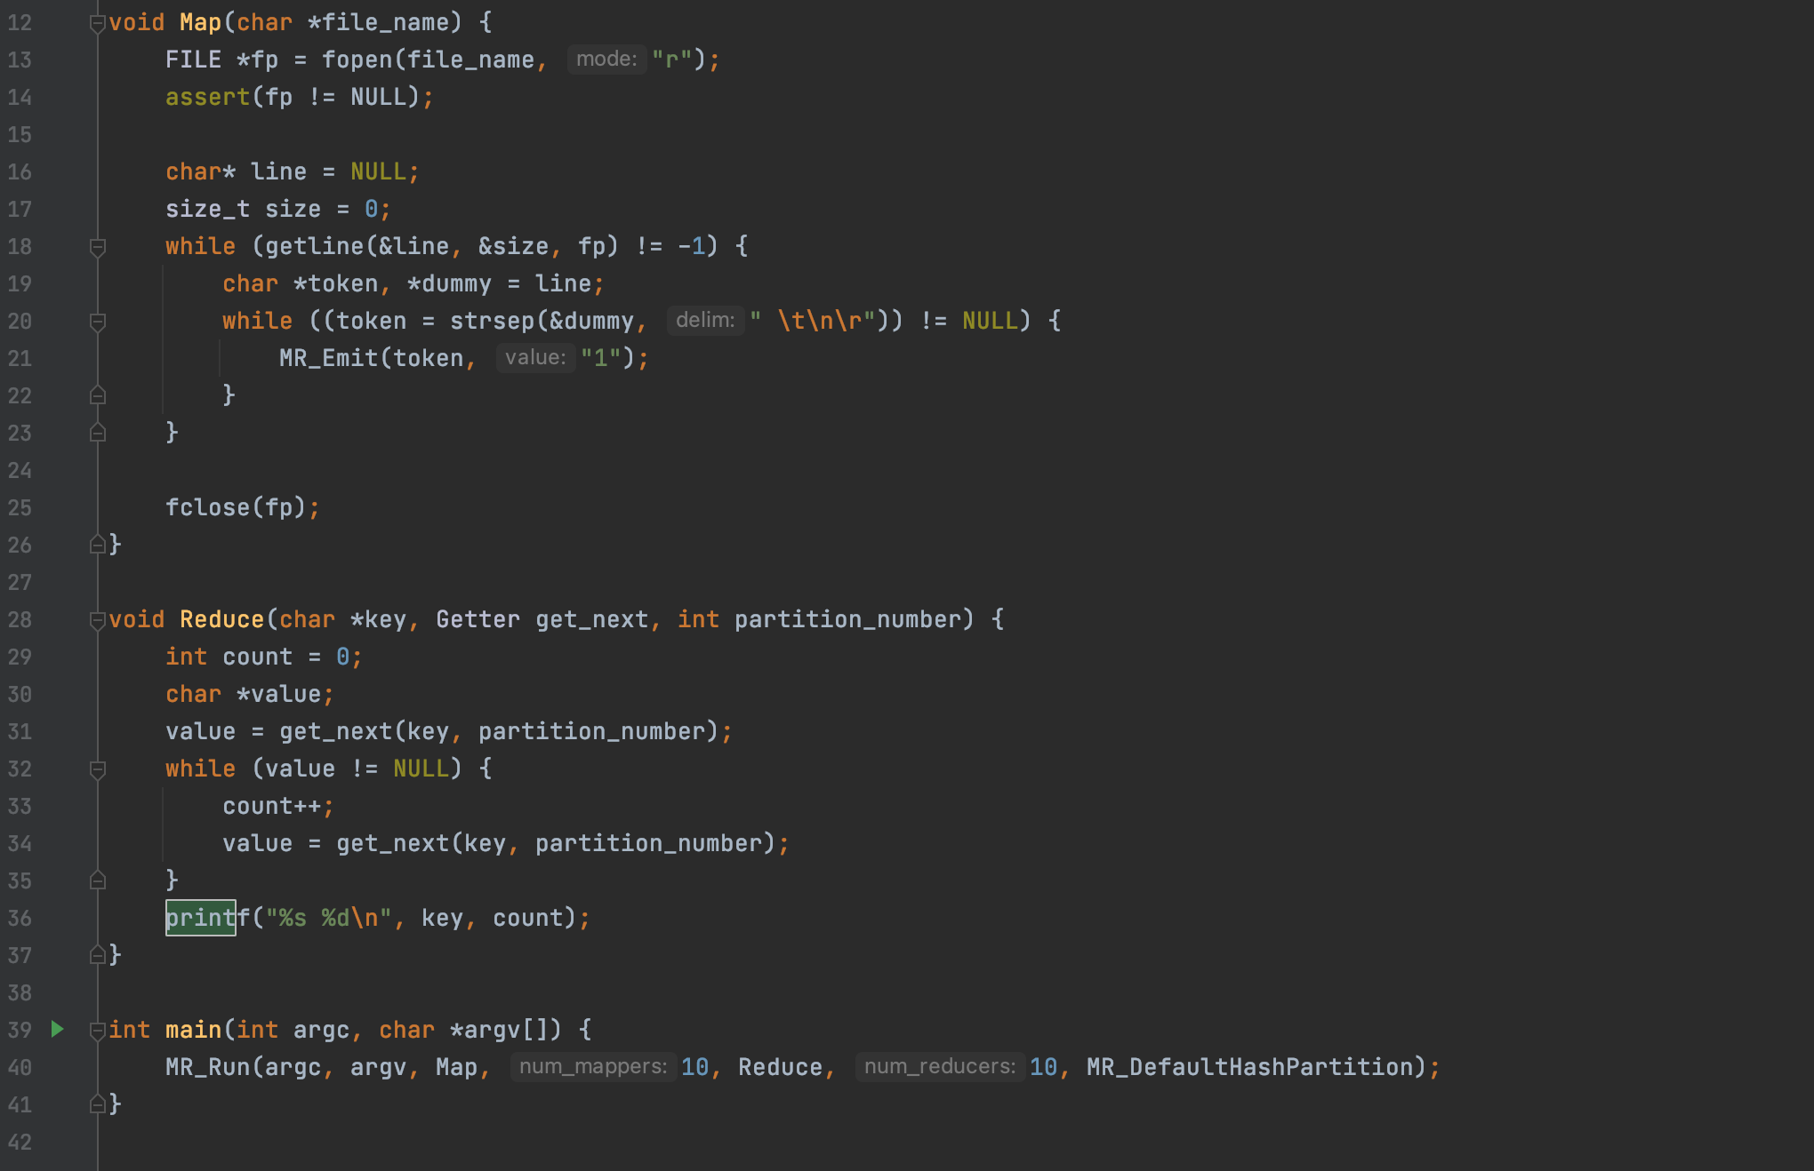
Word Counting

Slide 9
Tests
There are many different areas of my implementation that I wanted to test, however due to time constraints I had to narrow it down to two sets of testing involving…
Ensuring the correct output
1 file containing non-repeating words.
1 file containing repeating and non-repeating words.
Multiple files containing repeating, non-repeating words and overlapping words.
The timing of different file contents with my Reducer
Best Case: 1 file all the same word
Average Case: 1 file with a real-world example from free published text.
Worst Case: All different words.

Slide 10
Results & Analysis
Timing tests:
Best Case: 1 file all the same word.
Average Case: 1 file with a real-world example from free published text.
Worst Case: All different words.
Test | Time (s)
1 (Best) | 0.025456, 0.026044, 0.024939
2 (Average) | 0.223773, 0.199620, 0.192057
3 (Worst) | 1.093060, 0.953125, 0.912240

Slide 11
The timing of different file contents with my Reducer
Best Case: 3 files, 10 mapping threads
Average Case: 3 files, 3 mapping threads
Worst Case: 3 files, 2 mapping threads
The timing of different file contents with my Reducer
Best Case: 3 files, 2 reducing threads
Average Case: 3 files, 3 reducing threads
Worst Case: 3 files, 10 reducing threads
Test | Time (s)
1 (Best) | 1.005772
2 (Average) | 1.018589
3 (Worst) | 1.031590
Test | Time (s)
1 (Best) | 0.530489
2 (Average) | 0.878015
3 (Worst) | 1.047338

Slide 12
Benefits
Fault Tolerance
Resilience
Fast
Parallel Processing
Availability
Scalability
Cost Effective

