Slide 1
NSGA-II
Miljan Čavić and Božidar Vladislav

Slide 2
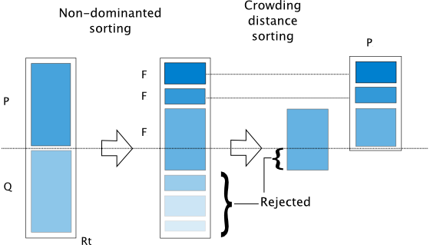
Non-dominated Sorting Genetic Algorithm II(NSGA-II)
Multi-objective evolutionary algorithm
Non-dominated sorting
Crowding distance sorting
Survival of the fittest
Tournament selection, crossover and mutation

Slide 3
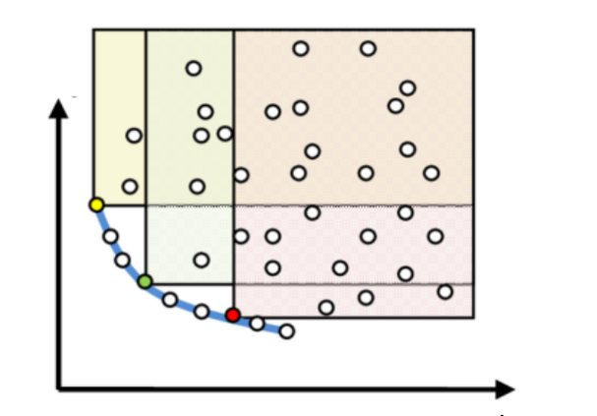
Non-dominated Sorting
Comparing each point with the rest of population
Dividing population into fronts
Points from the same fronts do not dominate eachother

Slide 4
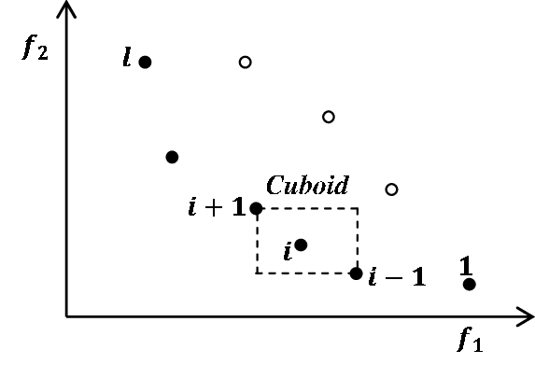
Crowding Distance Sorting
Measuring crowding distance for each point in the front
Distance of the points from the edge of the fronts are set to infinity
Sorting in descending way

Slide 5
Survival of the Fittest

Slide 6
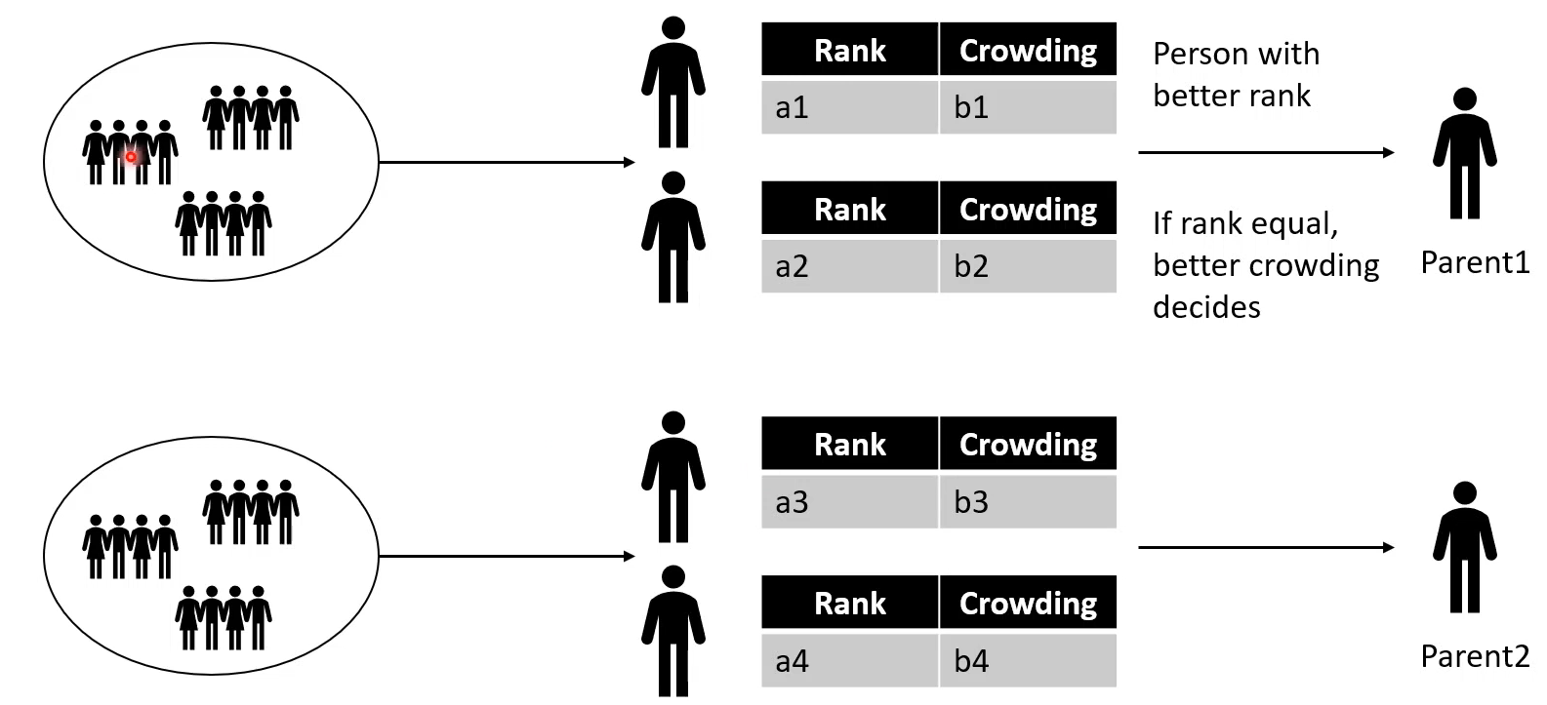
Tournament Selection

Slide 7
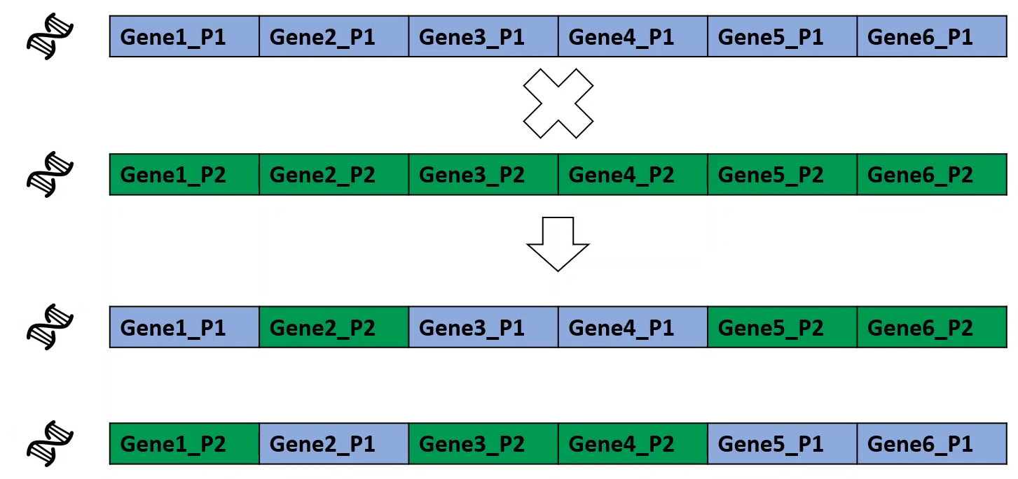
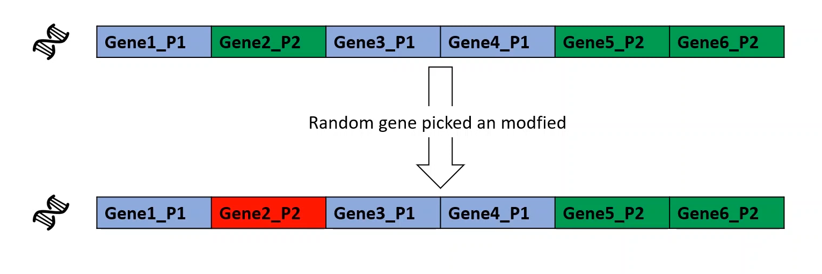
Crossover and Mutation
Crossover
Mutation

Slide 8
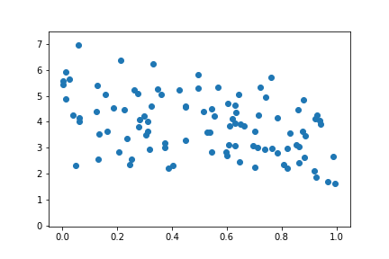
First Generation

Slide 9
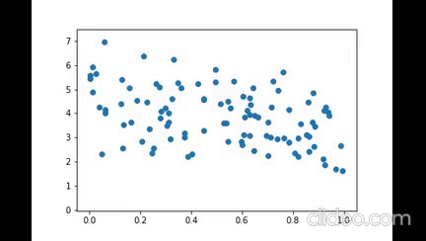
Convergence

Slide 10
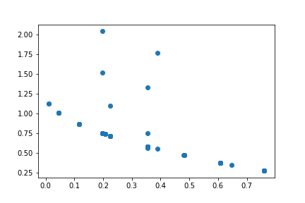
Last Generation (Pareto Front)

Slide 11
Thanks for listening

