Slide 1
5100 Final Project
Recruitment System
Group High Cold qaq~
Renzi Meng
Xiaowei Jiang
2019.04

Slide 2
Problem Statement
Previous recruitment methods has problems include :
01. opaque recruitment information
02. unreasonable recruitment process
03. cumbersome procedures which lack standardization
04. small companies are unable to connect with suitable job seekers

Slide 3
Approach
01
02
03
Fairness
Standardization
Efficiency
Small companies can have more exposure.
Employees from different places and universities have the same opportunity.
Cheating is avoided.
The way to evaluate employee and the format of resume is standardized.
The designed function and process can let both employee and employers concentrate on their own part and save the time

Slide 4
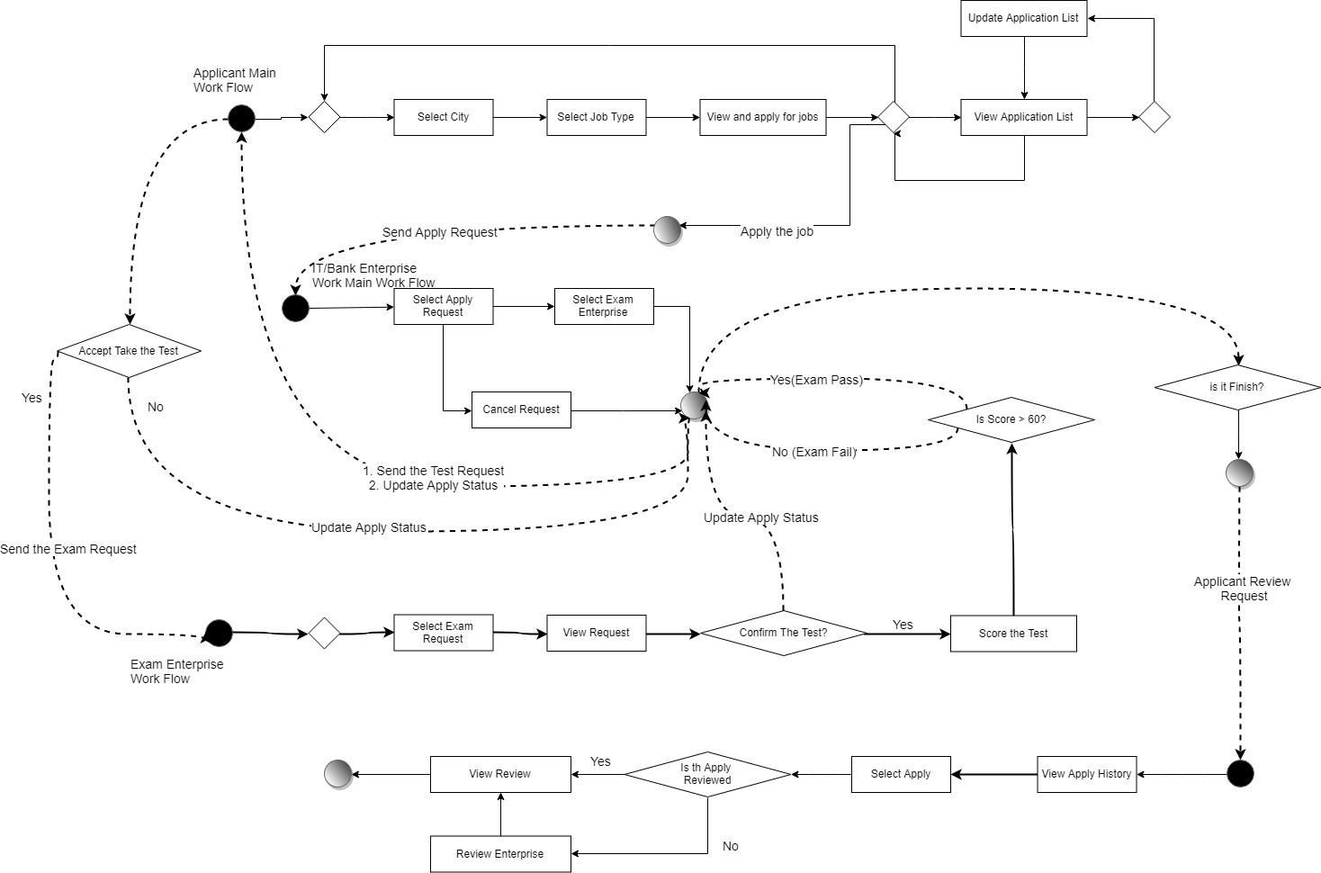

W o r k
F l o w

Slide 5
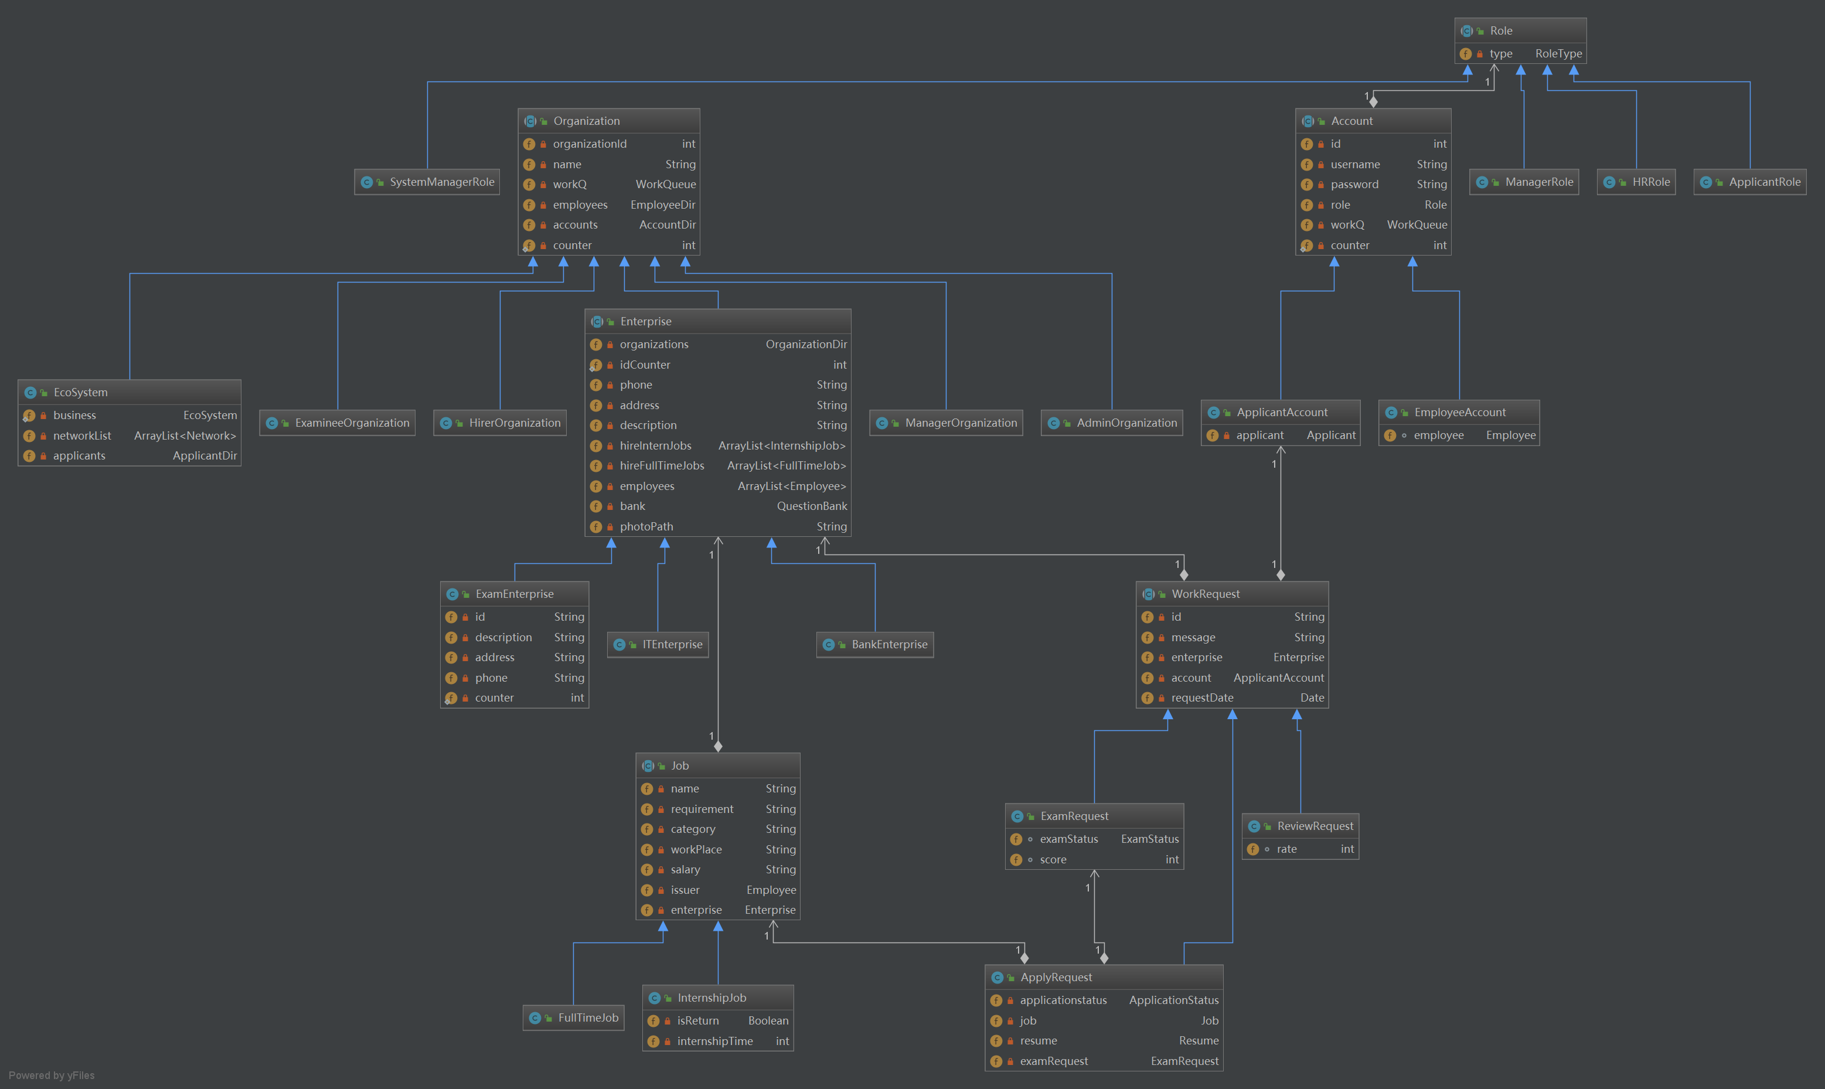
O
b
j
e
c
t
M
o
d
e
l

Slide 6
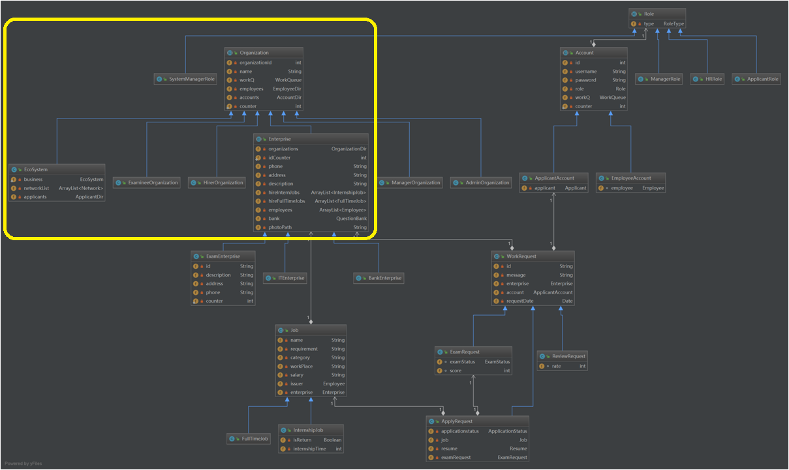
O
b
j
e
c
t
M
o
d
e
l
System – Network – Enterprise – Organization Level

Slide 7
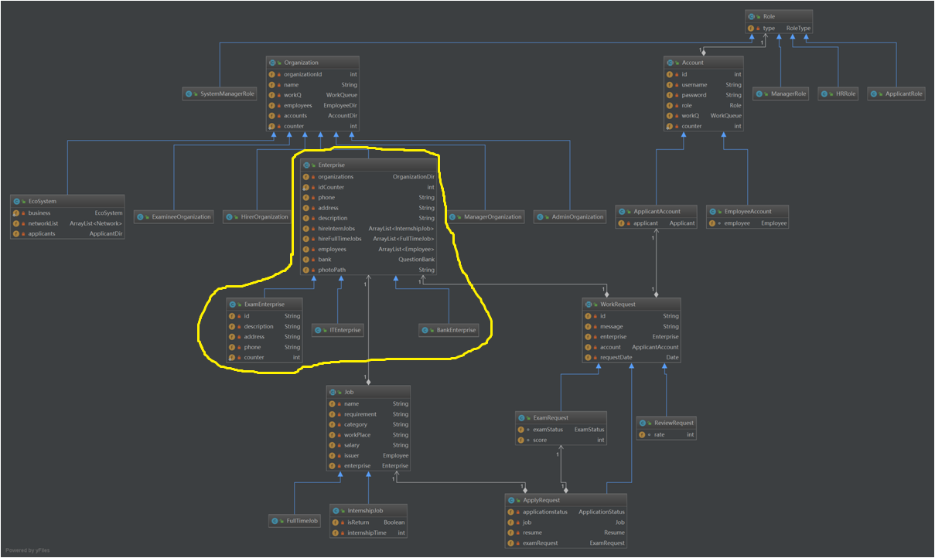
O
b
j
e
c
t
M
o
d
e
l
Enterprise category:
IT Enterprise
Bank Enterprise
Exam Enterprise

Slide 8
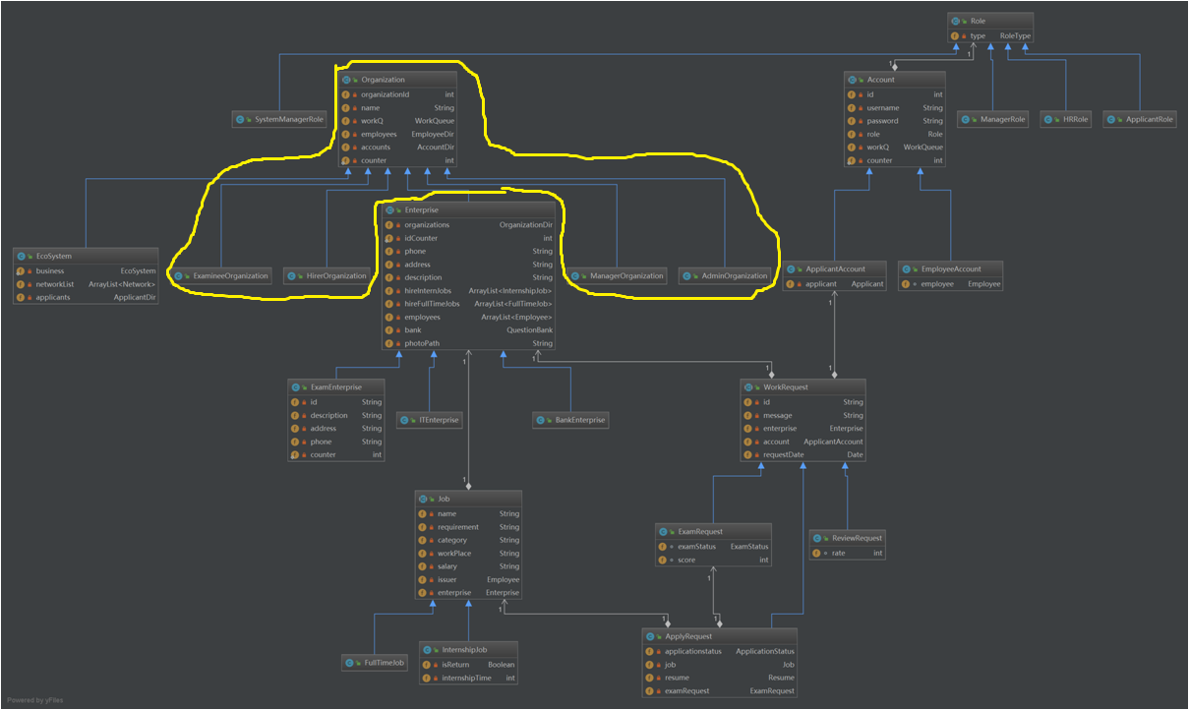
O
b
j
e
c
t
M
o
d
e
l
Organization Category:
Examinee Organization
Hirer Organization
Manager Organization
Admin Organization

Slide 9
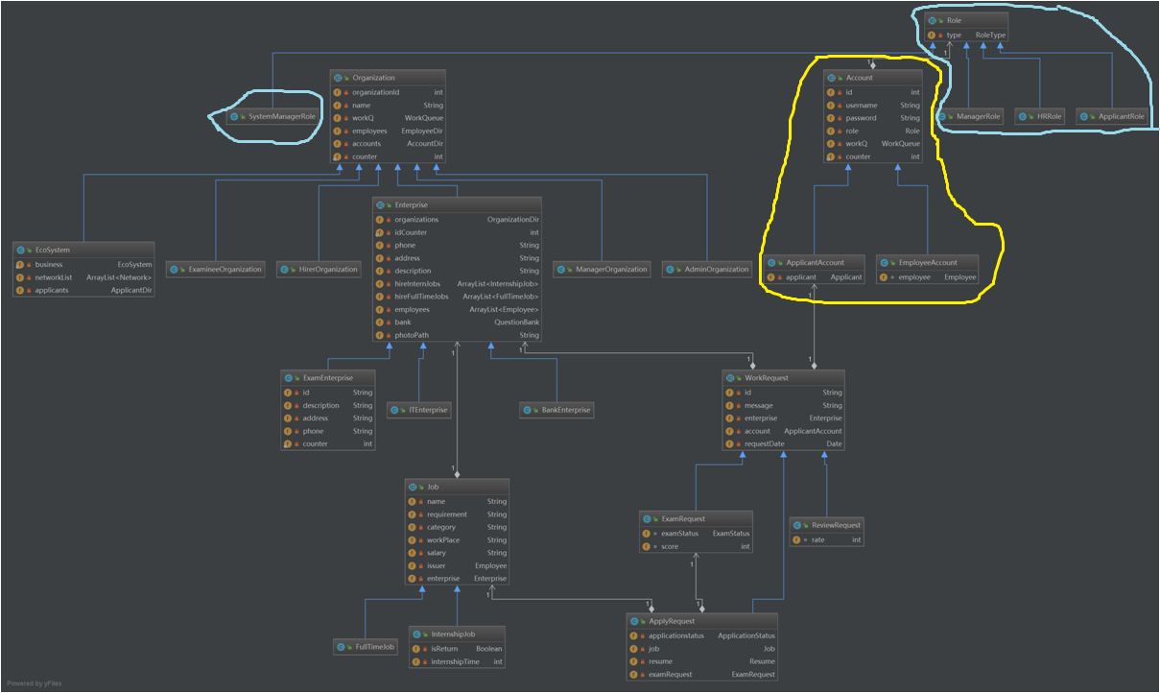
O
b
j
e
c
t
M
o
d
e
l
Account Category:
Applicant Account
Employee Account
Role Category:
Applicant
HR
Manager
System Administrator

Slide 10
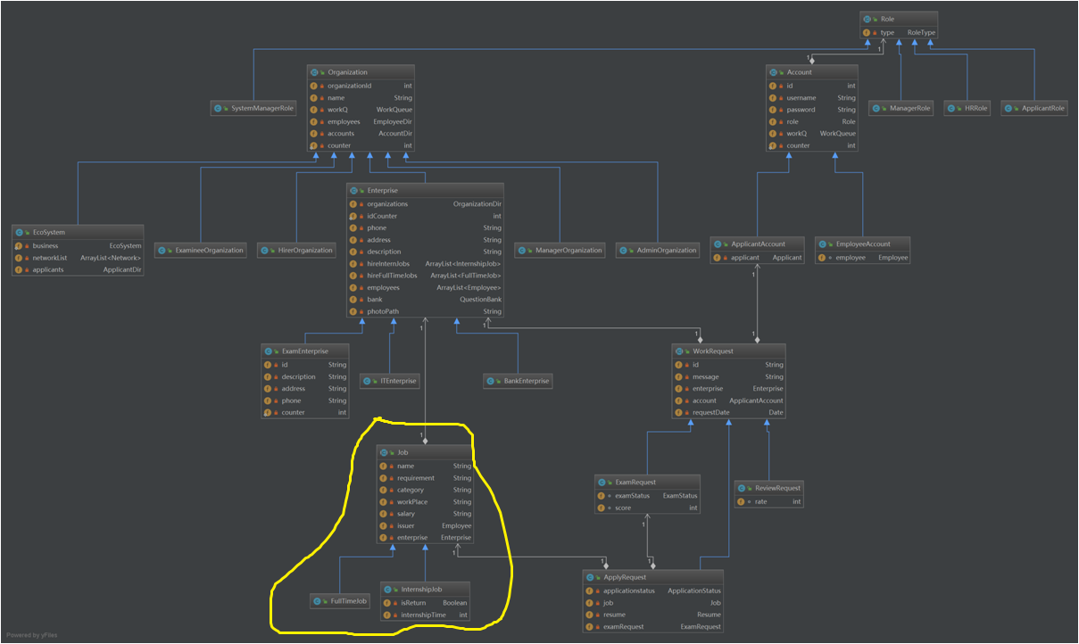
O
b
j
e
c
t
M
o
d
e
l
Job Category:
Full-Time
Internship

Slide 11
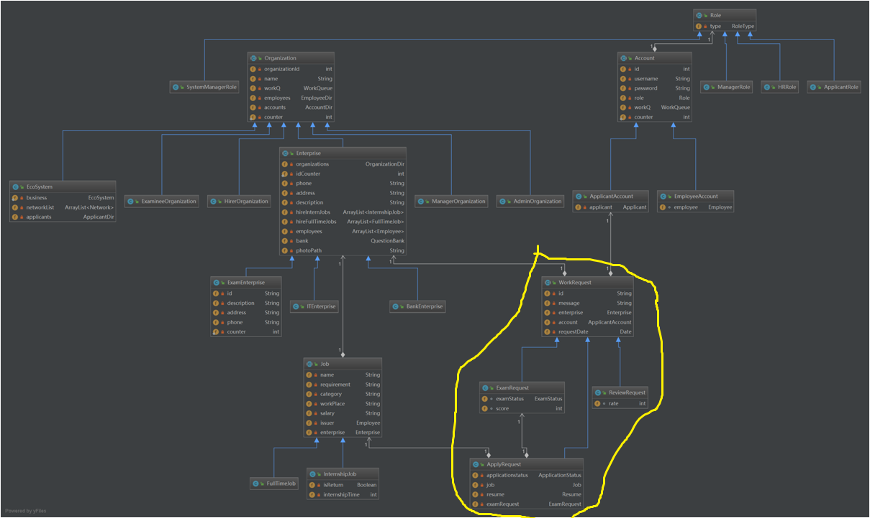
O
b
j
e
c
t
M
o
d
e
l
Work Request Category:
Apply Request
Exam Request
Review Request

Slide 12
User Case
01.Applicant
02. HR&Manager
01
02
Add Position
View Resume.
Give Applicant Test Authority
Send Admission/Rejection
See Review
** Manager can add/delete hr, edit company information.
Sign up
View Position
Make/Cancel Application
Accept Test Request
View Test Info (Pass/Fail, Score)
Review Company
03.Exam Enterprise
03
04
04.System Administrator
View Test Status
Edit Test Score
Create Network
Add enterprise
All authorities of employers and exam enterprise
Edit applicant profile and resume.
All roles can :
edit account profile
change password

Slide 13
Thanks
Group High cold qaq~

