Slide 1
Predicting drug-pathway relationships using the Correlated Topic Model

Slide 2
Topic Models
Document
To generate a document:
  Draw a distribution of topics the document is about
  To generate each word:
    Draw the topic this word is from
    Draw a word from this topic's word distribution
Can explore the topic structure of a corpus:
  Document similarities, summarizing documents (what topic is a document about?)
Genes are organised into pathways, drugs “perturb” multiple pathways
Can topic models be used?
  Drug similarities, pathways affected by a drug
Topic
Topic
Topic
Word
Word
Word
Word
Drug
Pathway
Pathway
Pathway
Gene
Gene
Gene
Gene

Slide 3
Topic Models – Latent Dirichlet Allocation
Applied to gene expression data by N. Pratanwanich and P. Lio (2014) to predict drug-pathway perturbations
Better performance for drugs that affect large amount of pathways
Topic membership priors: we know what genes each pathway has
But LDA assumes all topics/pathways are independent!
  Pathway crosstalk
  Disease comorbidities
Can we do better by assuming dependence?

Slide 4
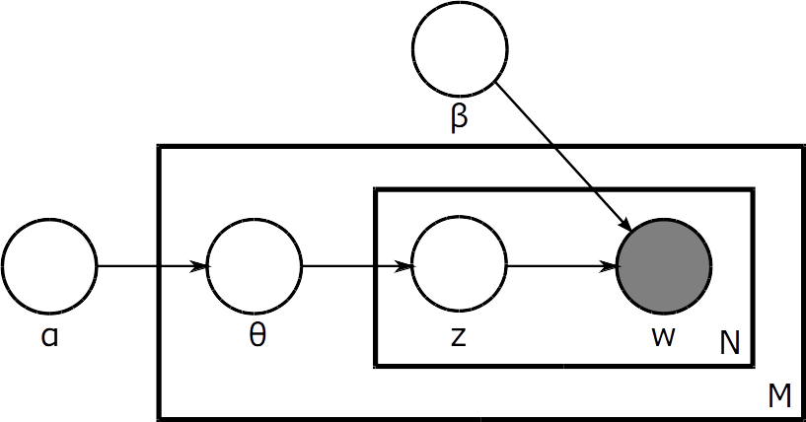
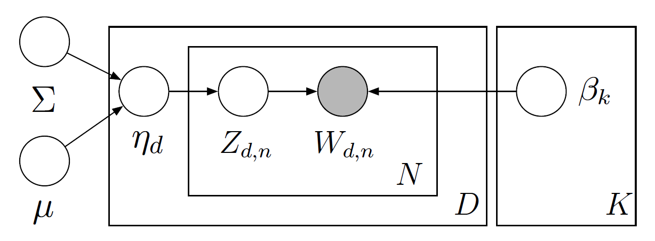
Topic Models – Correlated Topic Model
Draw topics from a multivariate normal with a covariance matrix instead
Allows to model correlations between pathways...
But requires a different approach to training

Slide 5
Correlated Topic Model – Inference
Bayesian inference: maximize P(data|model) by tweaking the parameters of the model
Find an expression for the likelihood bound
Maximize it with respect to every parameter
Repeat until convergence
Document
Variational parameters
Document
Variational parameters
Model parameters
Document
Variational parameters

Slide 6
Progress
Understood the Correlated Topic Model and incorporated priors into it
Wrote an implementation in Python (training + topic inference)
Currently testing and debugging on toy generated datasets, developing methods for validation against LDA
Ran on KEGG/CMap data

Slide 7
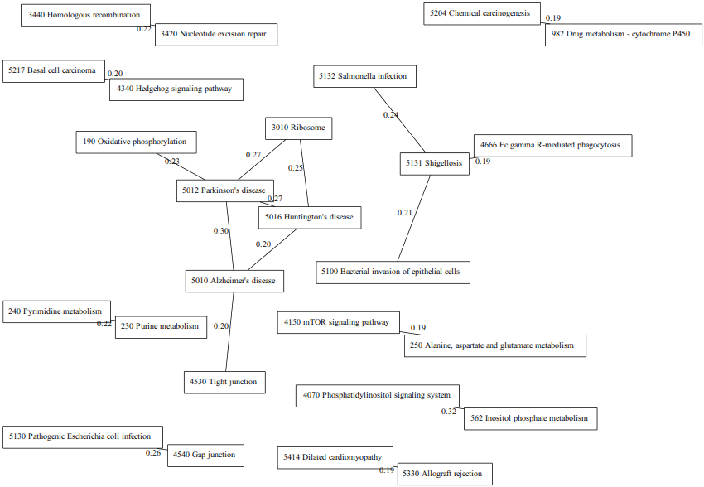

Slide 8
