Slide 1
Gastrointestinal system
MOUTH

Slide 2
Lesson outline
Describe the structure of mouth/buccal of the mouth
State the function of the mouth

Slide 3
MOUTH
The mouth is also called oral or buccal cavity
It is formed by;
Cheeks – that form the lateral walls
Hard and soft palate -
Tongue
The lips or labia – the fleshy folds that surround the mouth made of orbicularis oris muscle. Labial frenulum is a midline fold of mucous membrane that attaches the inner surface of each lip to the gum
Oral vestibule – pocket-like space formed on the inside by gum and the teeth and on the outside by the cheeks
Faucet – is the opening between the oral cavity and oropharynx
Oral cavity – the main open area of the mouth or oral cavity runs from the gums and the teeth to the faucet

Slide 4
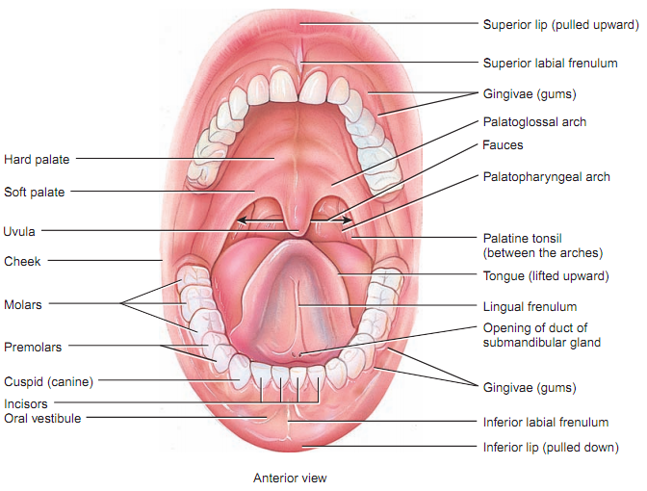

Slide 5
Mouth continue…….
The palate – is a septum that separate the oral cavity from the nasal cavity. The palate is divided into
Hard palate - anterior roof of the mouth formed by maxillae and palatine bone
Soft palate – forms posterior portion of the mouth
Uvula – is a conical muscle hanging from the free border of soft palate. During swallowing, uvula and soft palate close off nasopharynx preventing swallowed food from entering nasal cavity

Slide 6
There are two muscular folds that runs along the soft palate
Anteriorly is palatoglossal arch - that extends to the base of the tongu
Posteriorly is palatopharyngeal arch – extends to the side of pharynx
Palatine tonsils are located between the two arches
Lingual tonsil is at the base of the tongues
The tonsils contain lymphoid tissue and its inflammation is called tonsillitis

Slide 7
Function of the mouth
Ingestions of the food materials
Chewing of food and mixing it with saliva
Food tasting
Transfer of food (bolus) to the esophagus by swallowing
Mouth plays a role in speech
Social functions such as smiling and other expression

Slide 8
Salivary glands
Salivary glands are divided into two; major and minor glands
The major glands form three pairs
Parotid glands
Submandibular glands
Sublingual glands
Minor glands are
Labial gland found in the lips
Buccal gland found in the cheeks
Palatal gland found in the palate
Lingual gland found in the tongues and are two
Lingual mucus glands – found in the posterior one third of the tongue behind circumvallate papillae
Lingual serous glands – found near circumvallate papillae and filiform papillae

Slide 9
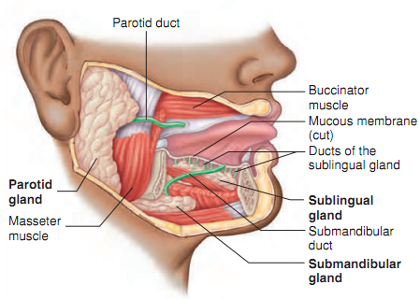
Salivary glands

Slide 10
Parotid glands
The largest glands of all the salivary glands located on both side of the face
It weights about 20 to 30g in adult
The duct that empties its secretion into oral cavity is called Stensen duct (35 to 40mm long)
The ducts open inside the cheeks against upper second molar tooth

Slide 11
Submandibular glands
The glands are located at the submaxillary triangle medial to mandible
It weights about 8 to 10g
It is connected to the buccal by a duct Wharton ducts ( 40mm long)
The ducts opens near the frenulum of the tongue by summit of papillae called caruncula sublingualis

Slide 12
Sublingual glands
Sublingual glands are the smallest salivary glands located at the base of the tongue
It weights about 2 – 3 g
Its secretion is poured into the oral cavity by ducts called ducts of Rivinus.
These ducts open in small papillae beneath the tongues . One of the ducts is larger and is called Bartholin duct

Slide 13
Ducts of major salivary glands
Gland | Duct
Parotid | Stensen duct or parotid duct
Submandibular/submaxillary | Wharton duct or submandibular duct
Sublingual | Duct of Rivinus/ Bartholin or lesser sublingual ducts

Slide 14
Compositions of saliva
Saliva is 95% water and 5% solute
Among the solutes are ions that include
Sodium
Potassium
Chloride
Bicarbonate
Phosphate
Other organic substances are
Urea
Uric acid
Mucus
Immunoglobulin A
Lysozyme
Enzyme salivary amylase

Slide 15
Functions of saliva
Water provide medium for dissolving food
Chloride activates salivary amylase
Bicarbonate and phosphate provides buffer for acidic food entering the mouth (saliva is acidic 6.35-6.85 pH)
saliva helps to remove waste like urea and uric acid
Mucus lubricate food into a ball for easy swallowing
Immunoglobulin A(IgA) and lysozyme neutralize bacteria

Slide 16
Salivation
Salivation is the process of secreting saliva
It is control by autonomic nervous system
Parasympathetic stimulation promotes continuous secretions of saliva that keeps the mouth moist, and lubricate the tongue and help in speech
Sympathetic stimulation occur during stress resulting in the drying of the mouth
Chemicals in the food stimulate receptors in the taste bud, impulse generated are sent to salivary nuclei in the brain stem (superior and inferior salivatory nuclei).
Returning Parasympathetic impulse are sent to salivary glands through facial nerve(vii) and glossopharyngeal nerve (ix) stimulating secretion of saliva
Saliva is secreted heavily even after swallowing which washes the mouth

Slide 17
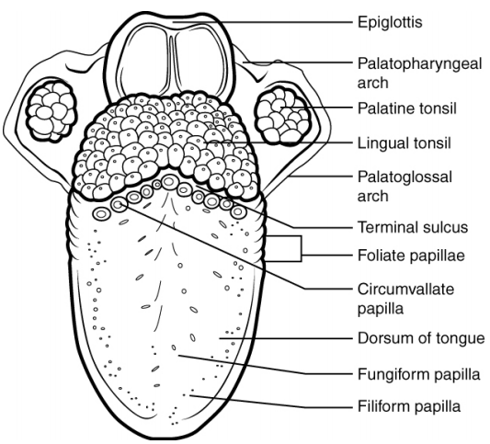
The Tongue

Slide 18
The tongue
The tongue is an accessory of digestion
It is located at the floor of the mouth and divided by a septum into symmetrical lateral halves
The extrinsic muscles that move the tongue are hyoglossus, genioglossus and styloglossus
The intrinsic muscle that form the tissues of the tongues are longitudinalis superior, longitudinalis inferior, transversus linguae and verticalis linguae
The dorsum and lateral surface of the tongues contain papillae that contains taste buds which are gustatory receptors
The taste buds on the tongue are
Circumvallate papillae
Fungiform papillae
Filiform papillae
Foliate papillae

Slide 19
Blood supply to the tongue
Arterial supply is by lingual artery from external carotid artery
Venous drainage is by lingual vein to internal jugular vein
Nerve supply
Hypoglossal nerve (12th cranial nerve) supplying voluntary muscle
Lingual nerve from the mandibular nerve
The facial and glossopharyngeal nerves (7th and 9th cranial nerves)

